Slide 1


Strategy to Fund Regional Infrastructure
Local Income Tax Increment Allocation Concept

Slide 2
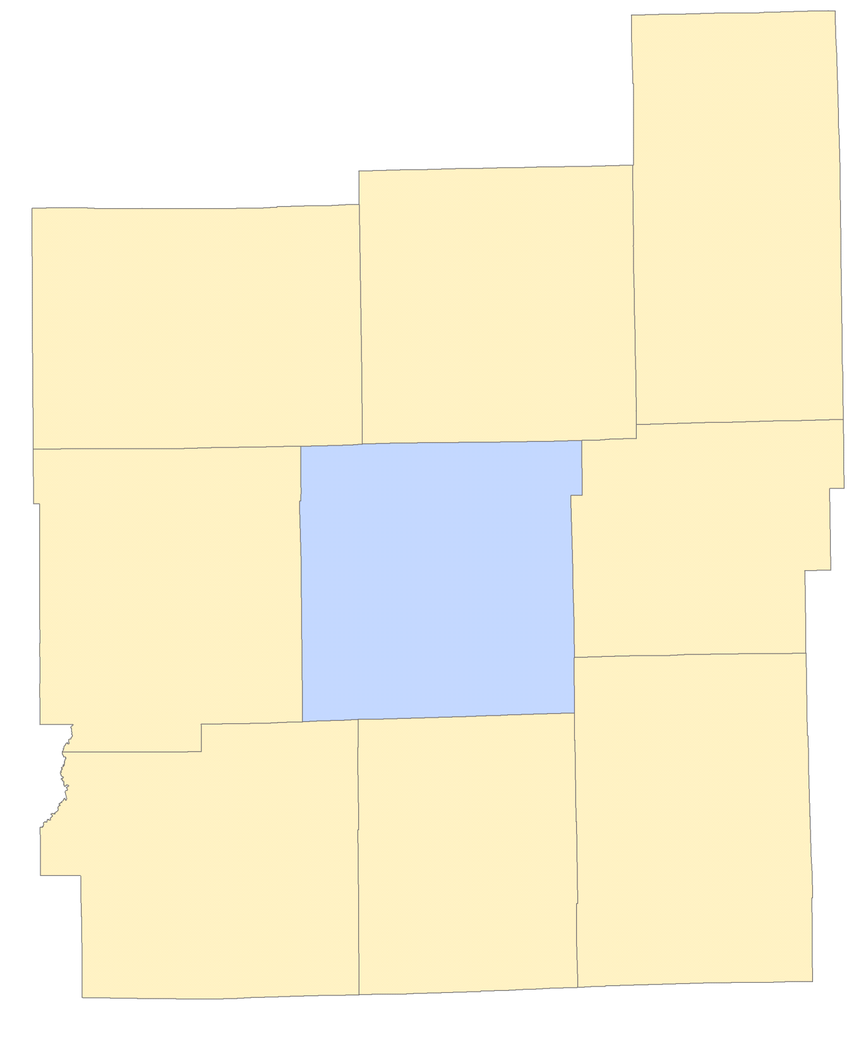

REGIONAL COMMUTING PATTERNS
MADISON
In total, 161,500 workers (23%) who work in Marion County every day commute from surrounding counties.
Wages taxed via the local income tax, are taxed by the county of residence.
HAMILTON
BOONE
6,000 to Marion
11,000 to Marion
55,000 to Marion
900 to Madison
2,900 to Boone
15,000 to Hamilton
HENDRICKS
HANCOCK
15,000 to Marion
Source: IT-40 data compiled by the Indiana Business Research Center
33,000 to Marion
MARION
2,900 to Hancock
10,00 to Hendricks
11,000 to Marion
27,000 to Marion
4,000 to Marion
1,200 to Morgan
7,000 to Johnson
900 to Shelby
MORGAN
JOHNSON
SHELBY

Slide 3
VEHICLE MILES TRAVELED
Distribution of Vehicle Miles Traveled among Central Indiana Counties (2016)
Includes Non-Interstate Freeway, Major Arterial, Minor Arterial Roads
Vehicle miles traveled (VMT) data is published by INDOT for all counties.
VMT is a proxy for the use of infrastructure and the costs required to sustain the transportation network.
Only non-interstate freeways, principal arterials and minor arterials (major thoroughfares) are included because of their role in intra-regional transportation.
Source: INDOT

Slide 4
INFRASTRUCTURE FUNDING
Annual Indianapolis Infrastructure Funding by Source
Includes revenues dedicated to:
DPW Transportation Improvement Program
Transportation Maintenance and Operations
Transportation Engineering
Source: Indianapolis Office of Finance and Management

Slide 5
FOUR YEAR CAPITAL FUNDING PROJECTIONS

Slide 6
CIRCUIT BREAKER IMPACT
Property Tax Revenue
Net Levy and Circuit Breaker

Slide 7
CURRENT INCOME TAX DISTRIBUTION
Comparison of Wages Earned vs. Income Taxes Collected
in the 9-County Region
Approximately $130 million in taxes from Marion County wages are distributed outside the County
Source:
Wages: Woods and Poole estimate of wages earned
Collections: Indiana State Budget Agency; normalized to an equal tax rate

Slide 8
LOCAL INCOME TAX RATES
Local Income Tax Rates in Central Indiana
Local income tax rates range from 1.00% in Hamilton and Johnson Counties to 2.72% in Morgan County.
Marion County’s current income tax rate is 2.02%
In some counties, a portion of the income tax rate is dedicated to special uses, such as public transit, jails, or property tax relief [sometimes via bonding].
Each county in the 9-county region already imposes an “Expenditure Rate” for spendable income tax revenue of at least 1.00%.

Slide 9
POLICY FACTORS
Transportation infrastructure is a critical component to the growth of a regional economy.
The cost burden of critical infrastructure is shared unevenly across the region.
Vehicle miles travelled (VMT) or alternative metrics demonstrate the usage of infrastructure assets between and among Central Indiana residents.
A basic policy premise is: the users of infrastructure assets should bear the costs in relation to their usage.

Slide 10
FRAMEWORK
A “TIF-Like” Income Tax Concept
A portion of the “incremental” increase will be allocated to the Regional Infrastructure Fund
Historical Regional
Tax Base Growth
“Base” Established in first year

Slide 11
FRAMEWORK
Illustrative Incremental “Set Aside” – How much to Allocate?
Portion Allocated to Regional Infrastructure
Historical Tax Base Growth
“Base” Established in first year
Portion of increment distributed in “normal” fashion to Counties

Slide 12
CAPITAL FINANCING – MARION COUNTY SEPARATED
Approximate Annual Bonding Capacity – Bond Proceeds
20 Year Term; 3.5% Rate (dollars in millions)
Potential annual bond proceeds

Slide 13
INFRASTRUCTURE FUNDING
Annual Indianapolis Transportation Funding –
with Regional Infrastructure Proceeds

Slide 14
VMT BASED ALLOCATION
Funding Contribution from Income Tax vs. VMT Based Distribution

