Slide 1
Information Management

Slide 2
Learning Objectives
At the end of this activity, you will be able to:
Describe important elements of an information management system.
Explain things to consider when developing a manual, paper-based information system.
Describe the advantages and disadvantages of a computerized information management system.

Slide 3
Scenario
“You manage a laboratory for a 300 bed hospital and the administrator has just notified you that funds are available for the purchase of a computerized laboratory information system.”
  How do you assess the relevancy of such a system for your laboratory?

Slide 4
The Quality Management System
Organization
Personnel
Equipment
Process Control
Purchasing
&
Inventory
Information Management
Assessment
Documents
&
Records
Occurrence Management
Process Improvement
Customer Service
Facilities
&
Safety

Slide 5


Role in Quality Management System
The test result is the final product of the laboratory.
Quality Lab Report

Slide 6


Information Management
Establish processes for managing data
Paper-based
Quality Lab Report
ID 0905120047
Patient information
  accessible
  accurate
  timely
  secure
  confidential
  private
Electronic

Slide 7

Unique
identifiers
samples,
patients
Effective
communication
Standardized
request forms
Important elements
Effective
reporting
systems
Logs,
worksheets
Confidential
Checking
processes
Data
protection

Slide 8
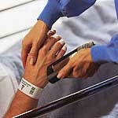
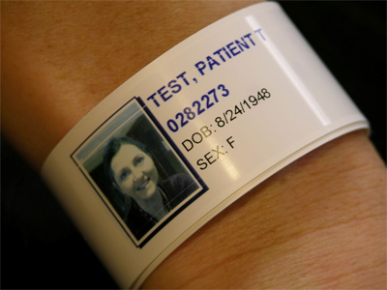
Unique Identifiers
Patient identifiers
Laboratories need to assign unique sample identifiers:
  Code: YYMMDDXXXX - 0905120047 means sample #47
  received on May 12, 2009

Slide 9
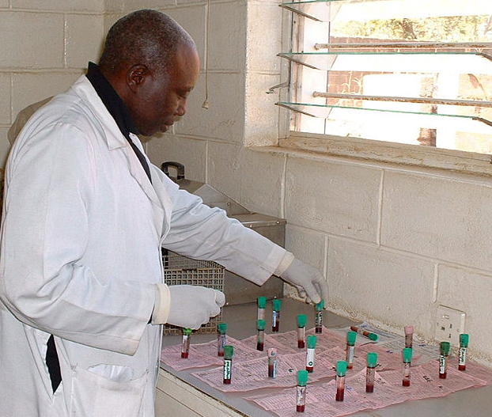
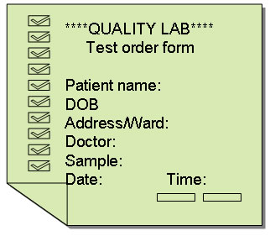

Test request form
Laboratory
ISO
requirement
ISO 15189

Slide 10
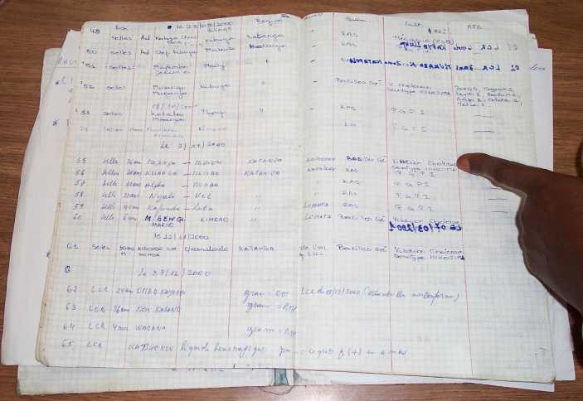
Logs/worksheets and checking processes
Laboratory

Slide 11
Data Protection
Paper-based systems
use durable materials for recording
store records properly
Computerized systems
schedule regular backup of data

Slide 12



Protect confidentiality / security
The laboratory director is responsible for establishing policies and procedures to:
safeguard a patient’s privacy
assure laboratory data confidentiality

Slide 13

Test results reporting systems
Patient: Mary J Johnston DOB: 28 Mar 1949
Address: 1234 Littletown Road, Bergly Bay
Patient ID No.: ab907823_001
Quality
Lab
Report
  timely
  accurate
  legible
  easily understood
ID 0905120047
Sample: MSU
Test: C&S
Report to:
Dr RB Brown
Date:09.06.27

Slide 14


Communication
Develop a good system for communication:
  within the laboratory
  with clients
  other health care providers
  reference laboratories
  with official agencies
Different shifts

Slide 15

Data
incomplete
Computer
systems
incompatible
ID
insufficient
Common problems
Transmission
errors
Forms
inadequate
Data
organized
poorly
Archiving
poor

Slide 16

Manual paper-based system
Requires registers and logs with good design that are:
practical to use and easy
to complete
make it easy to find data
make summarizing data
and writing reports easier

Slide 17
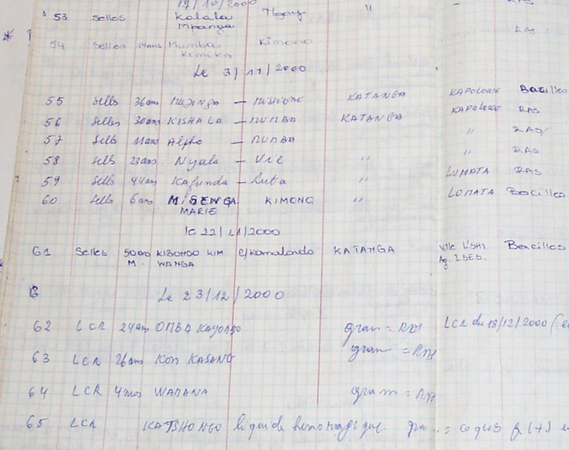
Data entry
Age not recorded
Results recorded
in village column
Village name not recorded

Slide 18
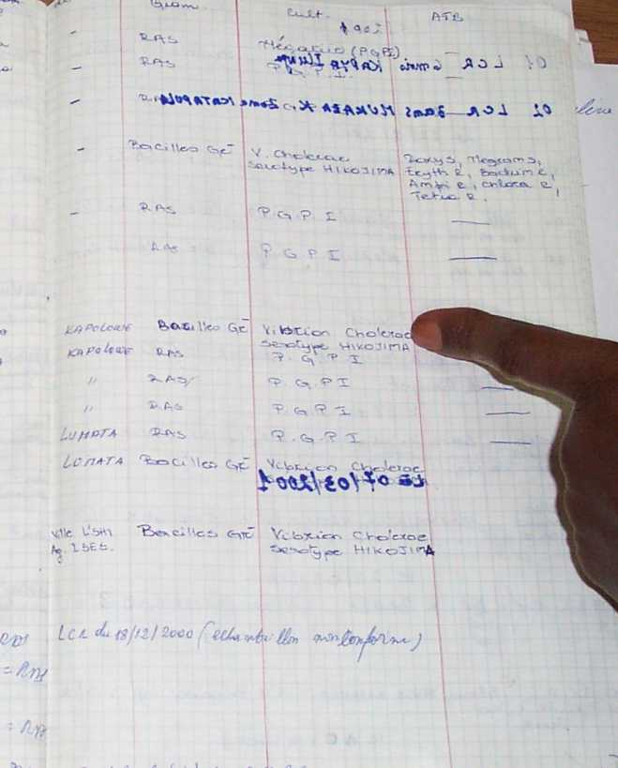
Unreadable-thick felt-tip pen used on other side
Writing illegible

Slide 19
Manual paper-based system
final report is primary product – make it professional
need a system for obtaining duplicates or copies of reports for archiving
assure safe storage of paper records

Slide 20

Manual paper-based system-storage
Goals:
find results
trace samples
evaluate occurrences
Useful rules:
keep everything for a designated time
ensure easy access
use a logical system for filing
number in chronological order
01-04-2009
30-04-2009

Slide 21
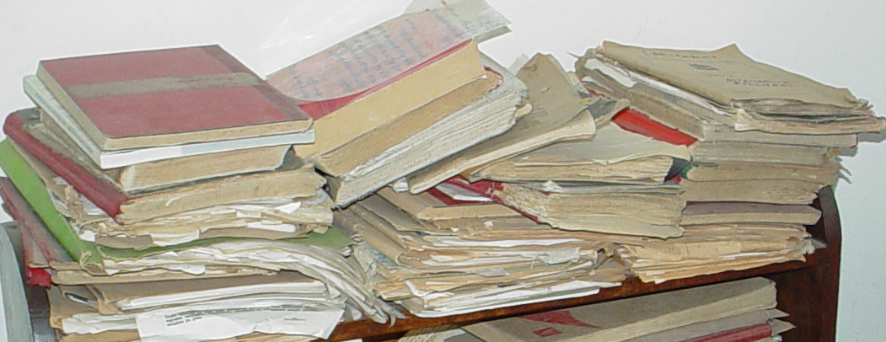
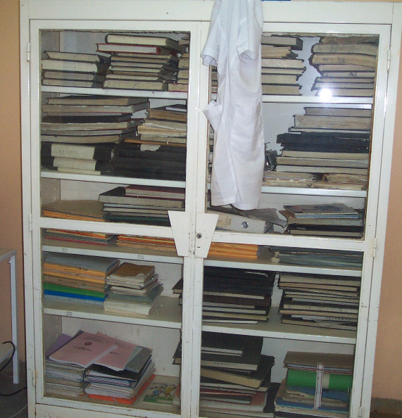


Slide 22



Computerized LIMS
Software options
in-house developed systems using commercial database software
fully developed commercial systems
Look for:
permanence
  computer system maintenance, backups
security
  access
  confidentiality
traceability
system speed, flexibility

Slide 23


Advantages
Error
reduction
Integrate
with other
sites
QC
Financial
management
Data
retrieval
options
Access
control
Detailed,
legible
reports
Track,
analyze
trends
Track
reports

Slide 24


Disadvantages
Training:
time
and money
Back-up
requirements
Adapting
to a new
system
Costs:
purchase
and
maintenance

Slide 25
Summary
System for managing both incoming and outgoing data.
May be paper-based or computer-based
Both require a similar framework, including unique identifiers, forms, logs and worksheets.
Cost is a major factor in using a computer-based system.

Slide 26
Key Messages
A good information management system will:
ensure all data—the final product of the laboratory—is well managed
consider all the ways laboratory data will be used when planning a system
assure the accessibility, accuracy, timeliness, and security of data
ensure confidentiality and privacy of patient information

Slide 27
Questions?
Comments?
Organization
Personnel
Equipment
Process Control
Purchasing
&
Inventory
Information Management
Assessment
Documents
&
Records
Occurrence Management
Process Improvement
Customer Service
Facilities
&
Safety

