Slide 1

Virtualization
By
Tim Ausburn
&
James Cantrell

Slide 2
Virtualization: Why?
Reduce IT Costs
Server consolidation
Application Isolation
Increase Server Utilization
Software migration (Mobility)
Testing/Quality Assurance
Debugging
Simpler Disaster Recovery

Slide 3
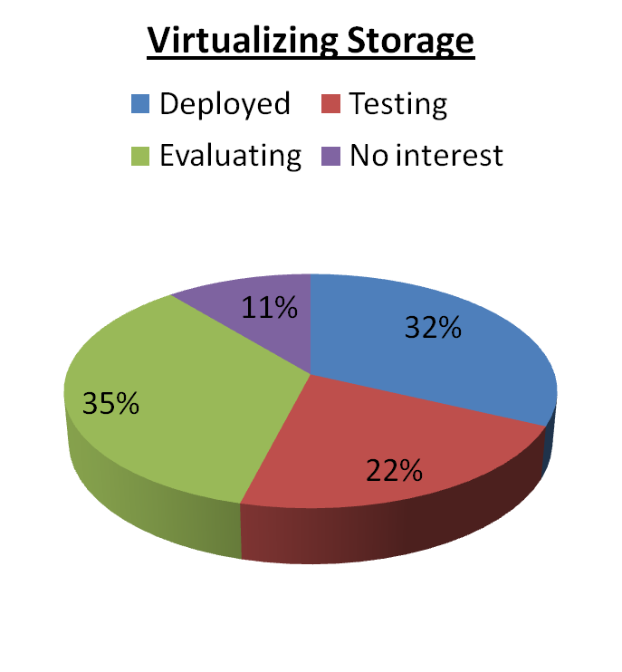
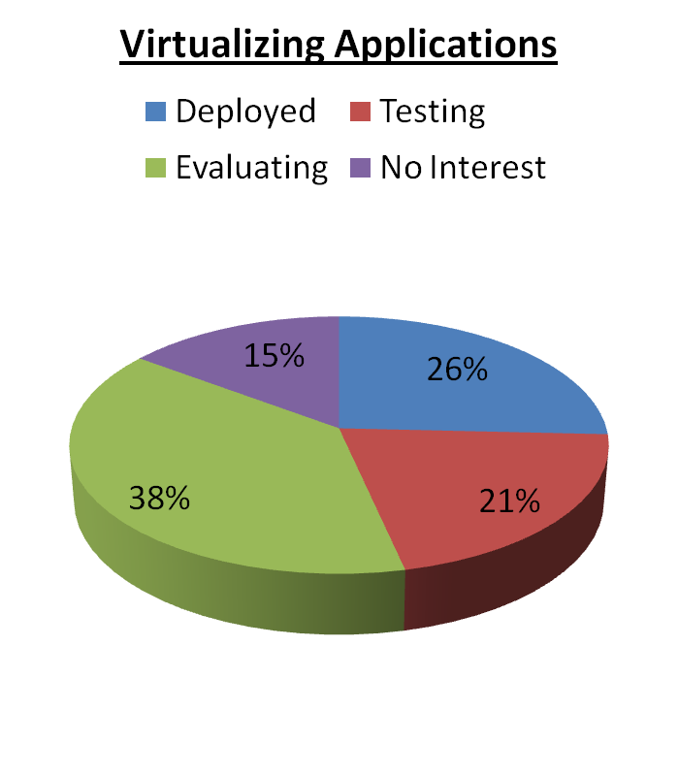
Recent National Statistics*
* From CIO Insight Research, Emerging Technologies 2008

Slide 4
Reduce IT Costs
Reduce hardware and operating costs by as much as 50%
Reduce energy costs by 80%
Reduce the time it takes to provision new servers by up to 70%
Save more than $3,000 per year for every server workload virtualized

Slide 5
Increase Server Utilization
Increase utilization of existing hardware from 10-15% up to 80%
Reduce hardware requirements by a 10:1 ratio or better
Notes:
Increase server hardware utilization; in other words get more usage from hardware in place. Don’t have to purchase & build, maintain yet another box

Slide 6
Manage Your Virtual Infrastructure
Accelerate provisioning time by 50-70%
Manage virtual machines from a central location
Monitor the performance of virtual machines and their hosts
Notes:
Accelerate roll-outs of server environments
Manage all “virtual servers” centrally
Greater ability to monitor performance and adjust resources. “use what’s needed”

Slide 7
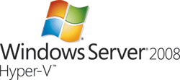


Supported # of guest operating systems
VMware ESX 3.5/ESXi | Microsoft Hyper-V | Citrix XenServer 4.1
30 | 11 | 18
Notes:
Vmware = starting @ $1500
Citrix XenServer = starting @ $2000

Slide 8
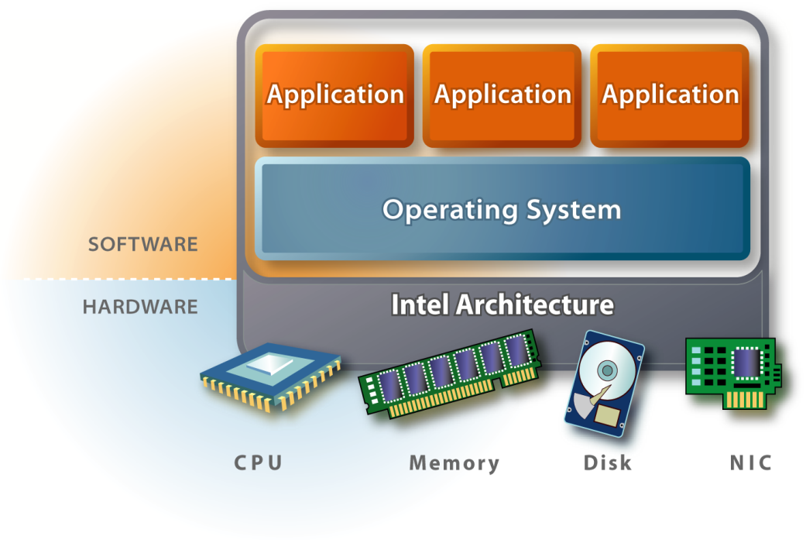
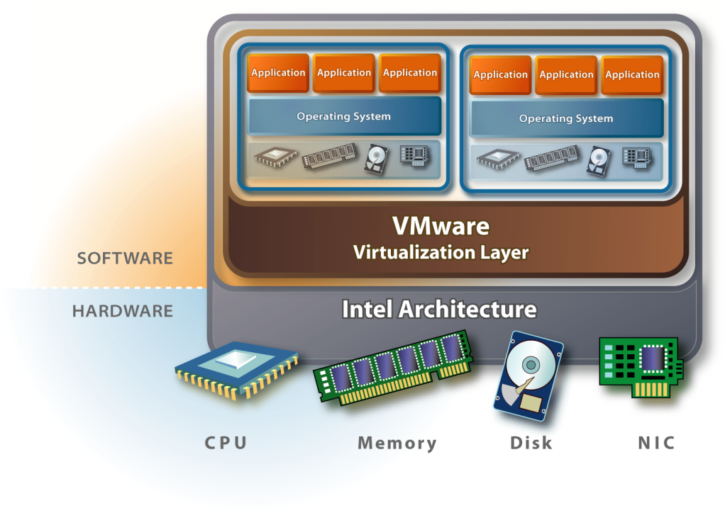
Virtualization Basics
System without VMware Software
System with VMware Software
  Separates BIOS, operating system, and applications from physical hardware
  Allows many virtual systems to share same physical hardware
  Standardizes multiple generations of multi-vendor hardware
Notes:
Example w/o virtualization
Example w/virtualization (explain)
Each virt machine has own virt cpu, mem, disk, etc utilizing real hardware
Each server is a file or small set of files that can be transported digitally

Slide 9
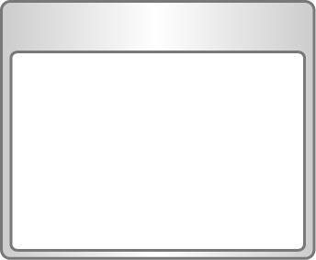
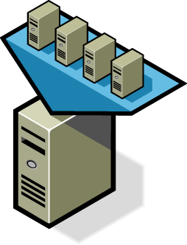
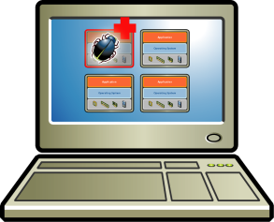
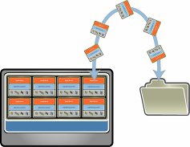
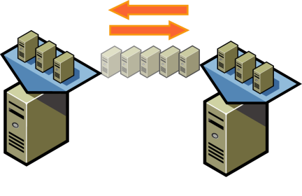
Key Features of Virtualization
Partitioning
Isolation
Run multiple virtual machines simultaneously on a single physical server
Each virtual machine is isolated from other virtual machines on the same server
Encapsulation
Hardware Independence
Entire virtual machine is saved in files and can be moved and copied by moving and copying files
Run a virtual machine on any server without modification
Notes:
Partitioning – multiple machines on single server
Isolation
Encapsulation – server is a file or files
Hardware Independence – run on any server

Slide 10
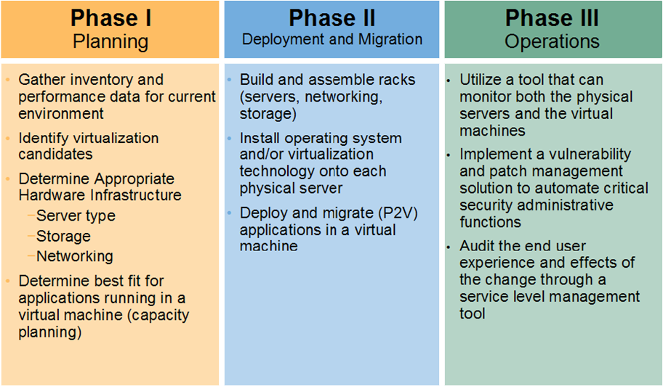
Phases in implementing a virtualized infrastructure
Notes:
Planning
Identify and record specs on each potential virtual server (mem, disk, apps, net)
Indentify candidates (single use systems, end of life systems, apps needing isolation)
Indentify needed hardware capacity
Capacity planning (determine best fit for apps on servers)
Deployment & Migration
Build server hardware
Install OS and hypervisor (virtual technology application)
Install / migrate applications
Operation
Monitor both physical and virtual server
Implement a patching solution / schedule (have a development machine to install updates to virtual technology software)
Audit impact on application performance and query users

Slide 11
VM Disaster Recovery
Hardware independence
Virtualization turns everything about a system—hardware configuration, firmware, operating system install, application install—into data stored in just a few files on disk.
Notes:
* Enables quicker and perhaps less painful recovery of system crash
* Move file(s) to replacement machine

Slide 12
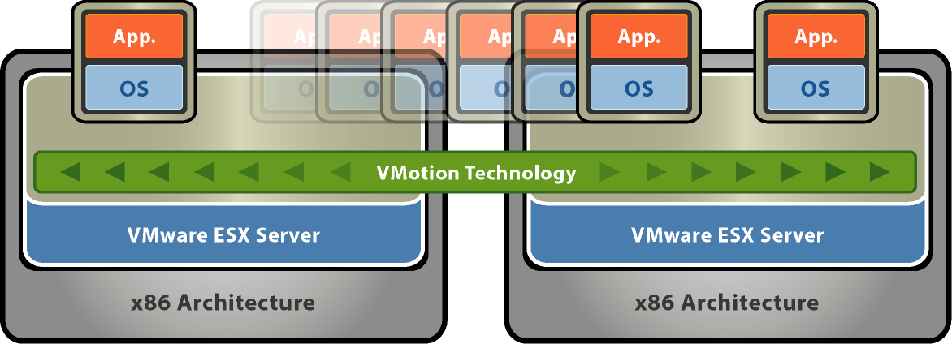
Vmware VMotion™
Migrate running virtual machine from one server to another
Zero downtime
Continuous service availability
Complete transaction integrity.
New – VMotion support on NAS and iSCSI storage

Slide 13
Pros
Fewer physical servers
  Less datacenter space is needed
  Less power (and fewer electrical outlets, power strips, UPSes, etc) (Think Green)
  Fewer KVM heads, network cables, etc
Faster provisioning time

Slide 14
Cons
You still have to patch every VM
Can add complexity
“All your eggs in one basket”
Cost (if usings VMware or Citrix)

Slide 15
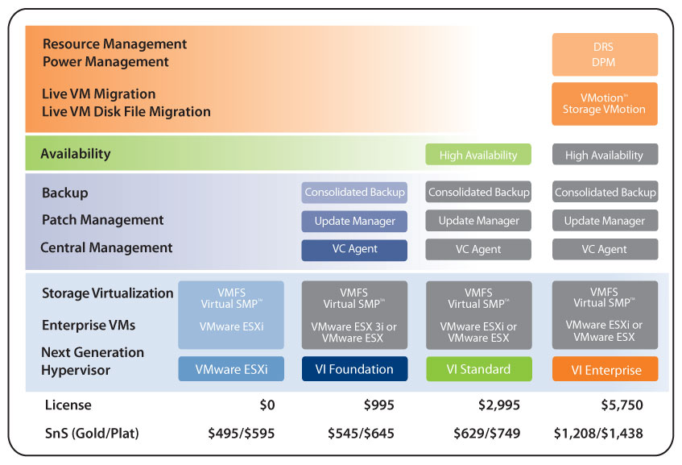

Slide 16
VMware Knowledge Base
# 4309499
http://kb.vmware.com/selfservice/viewContent.do?externalId=4309499

