Slide 1
Diversity and Complementarity in Development Aid：
East Asian Lessons for African Growth
< OECD Global Forum on Development>
December 8, 2008
Izumi Ohno & Kenichi Ohno
GRIPS Development Forum (GDF)
National Graduate Institute for Policy Studies - GRIPS

Slide 2
Background
ODA Policy Report (Feb. 2008), aimed at:
  Serving as the conceptual basis for Japan-UK partnership
  Assisting GoJ in formulating key messages in the 2008 events -- TICAD IV, G8 Summit, Accra HLF, new JICA, etc.
Independent research initiative by GDF, in collaboration with the interested parties in UK
  Authors: researchers, policymakers and practitioners in UK, Japan, Asia (Malaysia) and Africa (Uganda)
While focusing on Japan-UK bilateral aid partnership, this Report intends to serve for the broader donor community.

Slide 3
Topics of Presentation
Key concept
-- Diversity and complementarity as a key principle of aid partnership
What is the East Asian way?
Entry points for East Asian engagement in Africa

Slide 4
1. Key Concept
Donor collaboration based on the principle of “diversity and complementarity”
Arguments for strategic and instrumental diversity
  Comparative advantages of donors
  Non-fungibility of ideas
  Inseparability of content and instruments
➔ We believe that this concept can be extended to the entire donor community.

Slide 5
Comparative Advantages of Donors
Is global convergence to a single idea or approach desirable? (⬅ large swings in development vision in the past decades)
Heterogeneity of partner countries, as well as the donor community
Each donor has different strengths and weaknesses relative to others
Donor diversity likely to increase in the future
Importance to seek an inclusive approach to enhance combined aid effectiveness

Slide 6
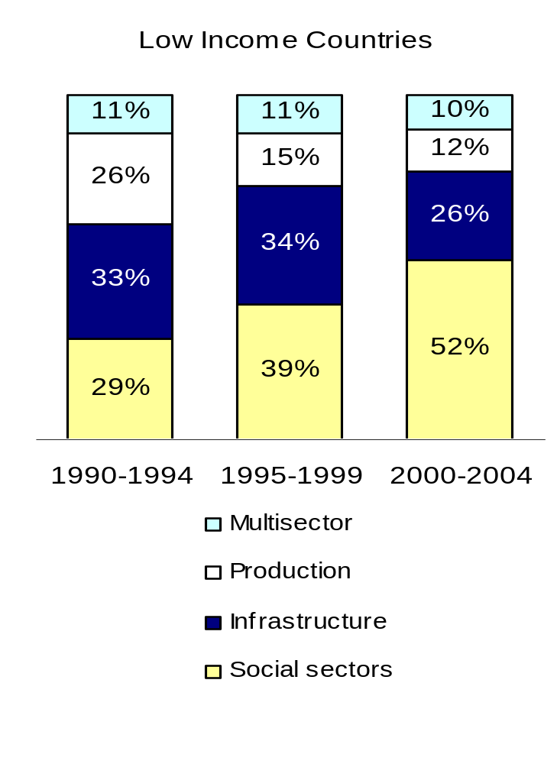
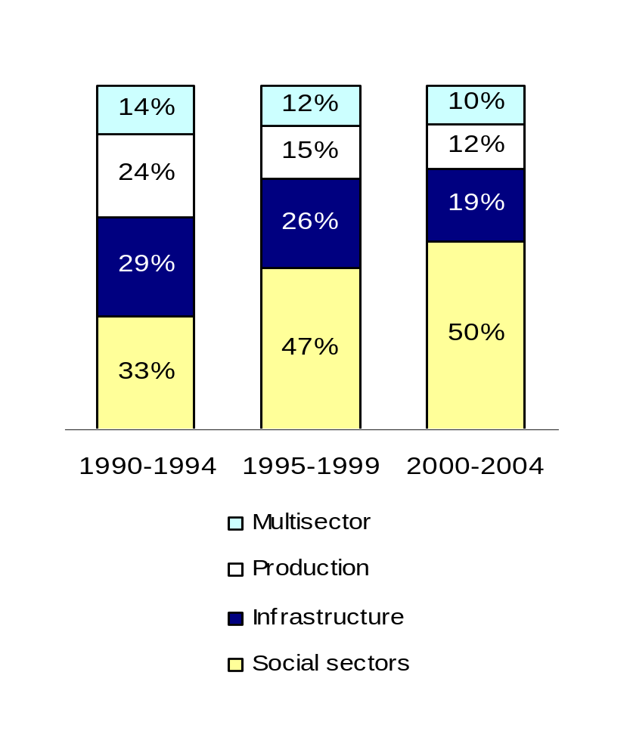
Distribution of Sector Allocable ODA to
Low Income Countries and Sub-Saharan Africa
(commitments, period averages, %, 1990-2004)
Source: IDA (2007) Aid Architecture: An overview of the main trends in official development
assistance flows. p.11, Chart 7.

Slide 7
Non-fungibility of Ideas
Policy ideas are often non-fungible even under harmonized procedures.
In light of diversity of donors and partner countries, we should be open to various possibilities and explore ways most suitable for each case.
Importance of providing alternatives
Country ownership, based on policy multiplicity.
➔If all donors’ advices are the same, how can partner countries choose and combine ideas?

Slide 8
Non-fungibility of Ideas (Examples)
“Infrastructure”
  Innovation in infrastructure financing (UK) -- local currency guarantee, project development facility for privately-financed infrastructure, reaching the poor, etc.
  Building roads & bridges (Japan) -- location, design & technology, etc.
“Industrial promotion”
  Challenge funds (UK) -- matching grants for innovative business models, designing architecture for public-private partnerships, etc.
  Concrete industrial support (Japan) -- Master Plan for specific industries, factory diagnosis, industrial human resource training, etc.

Slide 9
How Different?: Japan’s Bottom-up Approach to Quality Improvement (Eg. Tunisia)
 | JICA Projects | EU Projects
Project Objectives | Strengthening international competitiveness of Tunisian industries
Main Activities | Quality improvement guidance at the production floor of model firms | Assistance for firms to acquire ISO certification (int’l standards)
Features of Assistance | Different approach for each firm (order made) Instructors required to have practical experiences on the production floor Formulation of M/P through the bottom-up approach, deriving from the production floor | Common approach for all firms (ready made) Instructors not required to have practical experiences Focus on quality management & document management systems
Source: T. Kikuchi, Ch.7(GRIPS 2008)

Slide 10
Inseparability of Content and Instruments
Content (= ideas) and instruments (= approaches) are hardly separable
In development aid, different content / ideas call for diverse aid instruments
Need to match aid modalities with development priorities of each country
➔ Conflict with the need for instrumental harmonization?
Cf. Different degree of specificity and transaction intensiveness in public sector activities [Pritchett and Woolcock (2002); Fukuyama (2004)]

Slide 11
Inseparability of Content and Instruments
It is important to match country needs, instruments, and comparative advantages of donors
 | Projects | Budget Support
Instruments | Addressing specific problems, seeking policy innovation, implementing pilot activities (for well- defined objectives) | Providing large resource transfers (incl. recurrent expenditures), generating multiple policy and institutional reforms in a synergic manner
Donors | Preferred by donors who emphasize field-based process support, as an entry point | Preferred by donors who excel in policy dialogue and administrative reform

Slide 12
2. What is the East Asian Way?
No standard “East Asian model” exists
It should be the methodology (in a broad sense) to design and implement policies unique to each country
Japan could complement the current international growth support, by incorporating East Asian perspectives and approaches:
  Continuous policy dialogue for joint strategy formulation
  Goal orientation with concrete thinking, building on your strengths
Notes:
Now, let us discuss “popular” Growth Diagnostics (so called, Harvard professors--HRV model, based on their 2005 paper).
HRV says.
Discover a small number of most binding constraints to growth in each country--rather than attempting a long list of comprehensive reforms, previously suggested by the Washington Consensus. So, prioritization is important.
To do so, they invented a tree approach (based on indigenous growth theory). The tree starts with the assumption that low levels of private investment is the only, key to growth constraints; and begins inquiry – is this due to low appropriability (low return) or high costs of finance…. And search goes on….
Now, this approach is widely used in developing countries, especially by the Harvard researchers, WB, DFID, AsDB, IDB, etc.
This tree looks theoretical, but nothing is new. We also think that this GD approach has limitations.

Slide 13
Policy Design:
Desirability vs. Feasibility
Development is both a political process and an economic process.
What should be done
HRD & technology
Infrastructure
Integration & competition
Systemic transition, etc
What can be done
Leadership
Political constraints
Popular sentiment
Administrative capacity
(mainly economics)
(mainly politics)
Each country is unique in what needs to be done as well as what can actually be done.
Any policy maker must work with economic and political space simultaneously.
Notes:
In designing policy, we argue the need to balance desirability and feasibility.
Desirability is about what should be done—ideally (such as…. investing in….). This is mainly economics—as many people Including the WB argue.
On the other hand, feasibility is about what can be done, given the existing constraints (such as leadership capacity, politics, popular sentiment, administrative capacity, etc.). Are they ready for this? This is mainly politics.
We believe that development is both a political process and an economic process. Since each country is unique in the desirability question (what needs to be done), as well as the feasibility question (what can actually be done), any policy maker must work simultaneously economic and political space.
This common sense was not happening in the past.
Our main argument is that policy advice without feasibility consideration cannot be implemented regardless of whether proposed actions are a few or many, common or tailor-made.
Even if the number of conditionalities /advises is less and diagnosis is country-specific, if they lack feasibility consideration (let’s say, land reform), they cannot be implemented.
So, we need to find a policy sequence which is both desirable and feasible in each country’s context. This Is the ultimately the task of government, to self-discover, such sequence, but we believe that outsiders such as donors can assist in overcoming political problems.

Slide 14
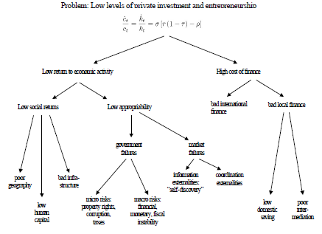
Growth Diagnostics (HRV Model)? Hausmann, Rodrik and Velasco (2005)
Discover a small number of most binding constraints to growth in each country.
HRV Tree—private investment is key to growth; inquiry starts with low return or high cost of finance, and the causes of each.
Harvard, WB, DFID, AsDB,
IDB etc. are conducting
GD in many countries.
Notes:
Contrast the East Asian way and GD.
Now, let us discuss “popular” Growth Diagnostics (so called, Harvard professors--HRV model, based on their 2005 paper).
HRV says.
Discover a small number of most binding constraints to growth in each country--rather than attempting a long list of comprehensive reforms, previously suggested by the Washington Consensus. So, prioritization is important.
To do so, they invented a tree approach (based on indigenous growth theory). The tree starts with the assumption that low levels of private investment is the only, key to growth constraints; and begins inquiry – is this due to low appropriability (low return) or high costs of finance…. And search goes on….
Now, this approach is widely used in developing countries, especially by the Harvard researchers, WB, DFID, AsDB, IDB, etc.
This tree looks theoretical, but nothing is new. We also think that this GD approach has limitations.

Slide 15
Problems with Growth Diagnostics
Search for desirable policies without considering political/administrative feasibility (a few or many, common or unique – secondary issues).
Discovery of general weaknesses relative to global norm instead of enhancing the country’s unique strengths (do you need to be “average” in all aspects before launching a development strategy?)
Diagnostics only—no clear mechanism for prescribing concrete actions (the task is left to policy makers).
Notes:
In Tokyo, we GRIPS, organized discussion meetings on how Japan can effectively support African growth, and we analyzed GD too (with Kuroki, Hanatani, Oiwa, etc).
Although GD is a major progress from the time of single-minded poverty reduction drive, we still see problems.
Here are our observations.
-GD looks for “desirable policies” without considering political/administrative feasibility. Reducing the number of measures is secondary, if they are not feasible, cannot be implemented.
-GD focuses on discovering general weakness, compared to the average of other countries. Do you have to become “average” in all aspects before launching a development strategy?
-This is diagnostics, often prepared in a few months, with limited policy dialogue with recipient countries. So, it is not for prescription that can be taken to policymakers immediately.
-This implies that there is a tendency to be donor-driven If local participation is Insufficient. (South African GD is exception, since they paid to invite Harvard professors to get their advice on the binding constraints of “shared growth” and engaged them for a few years.)

Slide 16
How to Cope with Economics-Politics Nexus
Policy-capability matching (WDR97 WB) :
“Matching the state’s role to its capability”
Improve institutions/governance before attempting difficult policies (such as selective industrial policy)
“The path to a more effective state, although not linear, is likely to be a two-stage process. First, the state must focus what capability it has on those tasks that it can and should undertake. As it does this, it can then focus on building additional capability.” (p.3, Box 1)
➔Too broad without focus; difficult to put into practice or mobilize political support
?

Slide 17
Economic-Politics Nexus (cont.)
Dynamic capacity development: Improve ability
through selective hands-on experience
Goal orientation: long-term vision ➔ phased strategies ➔ concrete action plans.
Direct most effort to perfecting your strengths rather than correcting your general weaknesses.
Stop abstract thinking and start concrete action
No—Is industrial policy useful? What is the role of state?
Yes—Let’s build this port & industrial zone successfully, etc.
Achieve successes one by one, and be proud.

Slide 18

3. Entry Points for East Asian Engagement in Africa
(1) If the country already has valid national vision, strategies and action plans, mobilize aid to realize the existing vision.
(2) If not, engage in continuous policy dialogue for self-discovery and strategy formulation (preferably followed by specific ODA and other assistance).
(3) Build core infrastructure and align aid and investments around it through donor coordination and private-public partnership (e.g., development corridors, OSBP, OVOP).

Slide 19
(1) Mobilize Aid to Realize the Existing National Vision
Ethiopia’s industrial vision (ADLI, Ind. Dev. Strategy) and strategies (Leather M/P, etc) are largely valid and clear.
Donors should support Ethiopia’s vision rather than creating a new one.
Japan has many aid tools for industrial support:
    - Production and technology management
    - Industrial human resource training
    - Efficient logistics and marketing
    - Infrastructure (esp. transport and power)
    - Regional development planning
    - Creating necessary laws, standards, institutions
    - Removing negative impacts of industrialization

Slide 20
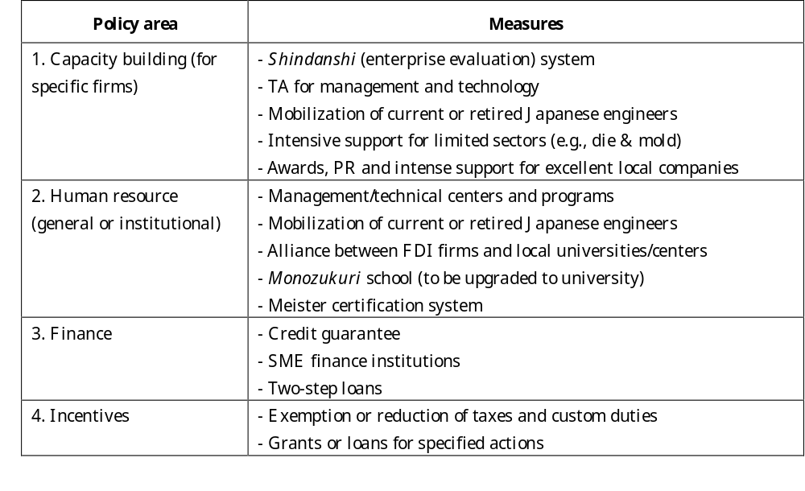
Eg. Japan’s ODA: Standard Policy Menu for Enhancing Industrial Capability in East Asia

Slide 21
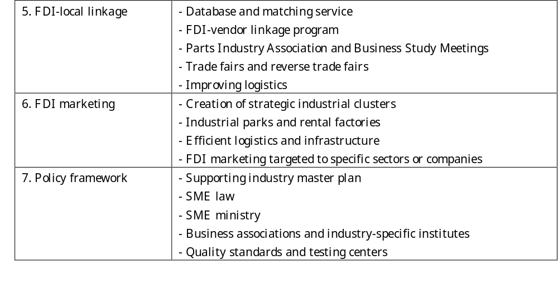
Standard Policy Menu (cont.)
Note: This table summarizes Japan’s assistance measures to East Asian countries contained in the New Aid Plan for ASEAN (late 1980s to early 1990s), the Mizutani Report for Thailand (1999), the Urata Report for Indonesia (2000), and ongoing discussion for strengthening Vietnam’s supporting industries (Ohno, 2008b).

Slide 22
(2) Japan’s Policy Dialogue with Developing Countries
Argentina – Okita Mission 1985-87; 1994-96 (follow up)
Vietnam – Ishikawa Project 1995-2001
Thailand – Mizutani Report for upgrading SMEs and supporting industries, 1999
Indonesia – Continuous Government-Business Policy Dialogue; Urata Report for SMEs, 2000; Prof. Shiraishi & Asanuma, 2002-04 (post-Asian crisis)
Laos – Prof. Hara for overall development strategy, 2000-05
Myanmar – Prof. Odaka,1999-2002 (but failed)
Notes:
Long-term, open-ended policy dialogue.
Japan has been doing it in various countries—mostly in Asia.
But, the origin is Saburo Okita, former Foreign Minister (president of ex-OECF, JBIC). He is the God Father of Japan’s development policy dialogue. He was a key economic technocrat that made Japan’s postwar reconstruction possible, and with this experience, later he led a number of ODA policy missions, representing the government.
-Argentina the first ODA systemic ODA.
-Ishikawa project in Vietnam (which I will explain subsequently).
-Thailand
-Indonesia, Prof. Urata and Prof. Asanuma
-Laos
-Myanmar, failed, but not Prof. Odaka’s fault. Because the government was not seriously engaged in policy dialogue.

Slide 23
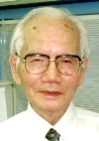
Ishikawa Project in Vietnam
1995-2001
Communist Party General Secretary Do Muoi requested Prof. Shigeru Ishikawa to study the Vietnamese economy. The bilateral project was agreed between two prime ministers.
JICA mobilized a large number of scholars and consultants. Prof. Ishikawa emphasized the spirit of mutual respect and joint work (and a lot of patience).
Topics covered: macro, budget & finance, industry, agriculture, trade, SOE reform, Asian financial crisis.
Continued dialogue—New Miyazawa Plan (1999), Vietnam-Japan Joint Initiative for improving investment climate (2003-).
Now under preparation—Vietnam-Japan Partnership for Supporting Industry Development.

Slide 24
Ishikawa Project in Vietnam
Tasks:
Macroeconomic stabilization
Structural adjustment (systemic transition
to market economy)
Long-term development strategy
Vietnam = Transition economy
+ Underdevelopment
Advice on the implementation issues of the 6th Five-Year Plan, including participation in AFTA/APEC/WTO and industrial policy
Advice on the emerging issues arising from the East Asian crises and the economic integration process
Advice on the formulation of the 7th Five-Year Plan
Advise on the drafting process of the 6th Five-Year Plan
Phase 1 (95.8-96.6)
Macro-economy
Fiscal and monetary
policy
Industrial policy
Agricultural and rural
development
Phase 2 (96.7-98.3)
Fiscal and monetary
policy
Participation in AFTA/
APEC/ WTO and
industrial policy
Agricultural and rural
development
SOE reform
Follow-up Phase
(98.7-99.7)
General commentary
Fiscal and monetary
matters
Industry and trade
Agricultural and rural
development
Phase 3 (99.9-01.3)
General commentary
Fiscal and financial
reform
Trade and industry
Agricultural and rural
development
SOE reform and private
sector development
Follow
up
Joint research (2001- )
Agriculture and rural development (livestock, vegetable,
fruits and industrial crops, etc.)
Monetary policy under partial dollarization
Fiscal policy (introduction of personal income tax)
Trade and industrial policies in the age of integration
(NEU-JICA joint research program ➔GRIPS-VDF)
Source: MPI and JICA, Study on the Economic Development Policy in
the Transition toward a Market-Oriented Economy In the Socialist Republic
of Viet Nam (Phase 3) Final Report Vol. General Commentary, 2001, pp.iii-vi.
JICA Vietnam Office, Executive Summary of “Ishikawa Project” Phase 3,
March 29, 2002.

Slide 25
Continuous Policy Dialogue in the Partnership Context
The case of Zambia (South-South cooperation)
JICA is conducting “Triangle of Hope” Project 2006-09 (improving investment climate), mobilizing a Malaysian expert (ex-MIDA official).
Task forces organized within GoZ, with the involvement of President
Investment promotion initiatives – targeted at Malaysia and India
JICA support to the development of Multi-facility Economic Zone (MFEZ).
As a next step, Zambia wants Japan to help formulate a long-term industrial strategy.

Slide 26
(3) Japanese Assistance for Core Infrastructure
Greater Mekong Subregion – East-West and North-South Corridors for development of Indochina
Thailand – Eastern Seaboard: creation of industrial zones around a port infrastructure
Vietnam – Highway No.5 (Hanoi – Haiphong Port) for FDI attraction (industrial clusters)
Cambodia – Sihanoukville Port, power and telecom networks, special economic zone
El Salvador – La Union Port + regional development
Mozambique (planned) – Nacala Port and Corridor for regional development
Notes:
Our another suggestion is to align assistance around a core infrastructure.
There are a lot of examples of Japanese assistance, especially in East Asia.
-Greater Mekong Subregion: corridors development in Indochina.
-Thailand: Eastern Seaboard
-Vietnam
-Cambodia,….
We have more (on Indonesia, the Philippines…)
But, let me mention the examples outside Asia.
El Salvador, and currently planned Mozambique.

Slide 27
El Salvador: Growth Diagnostics vs. Japan’s ODA
Hausmann-Rodrik Growth Diagnostics 2003: The largest constraint in El Salvador is the lack of self-discovery caused by market failure (low appropriability). Infrastructure is not a binding constraint.
Local Report 2008 (FUSADES): Our infrastructure is best in Central America and we are already a regional hub, but we can do even better by handling trade more efficiently. This will raise our productivity and competitiveness. For this purpose, infrastructure, especially La Union Port, is essential.
Japanese ODA in El Salvador: Upgrade La Union Port as key infrastructure. Additional support for social & HRD, productive sectors, Eastern Region development, and regional integration.

Slide 28
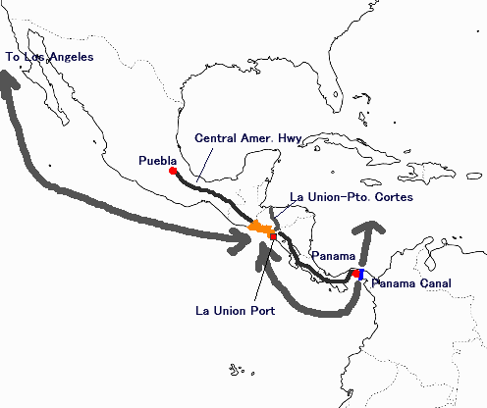
The Vision: Strengthening El Salvador’s Position as a Regional Transport Hub
Airport already a regional hub (built by Japan 28 years ago)
Central American Highway link
Pacific-Atlantic link via Panama Canal – El Salvador as a regional feeder
However, La Union Port is low capacity
➔ Build a new port with sufficient capacity and services

Slide 29
Components of Japan’s ODA in El Salvador (ongoing)
- Construction of La Union Port
Rebuilding an old bridge (Honduras border)
Digital map technology for efficient planning
Urban development planning for La Union City
KEY INFRASTRUCTURE
MEGATEC La Union
(training center)
Primary schools & math
Clean water
Rural electrification
Solid waste control
SME promotion
Aquaculture
Small-scale agriculture
Reservoirs & irrigation
Small-scale livestock
La Union Port
Plan Puebla Panama
CAFTA & other FTAs
Cent. Amer. integration
M/P for Eastern Region
Social & Human RD
Support for
Productive Sectors
Eastern Region Development

Slide 30
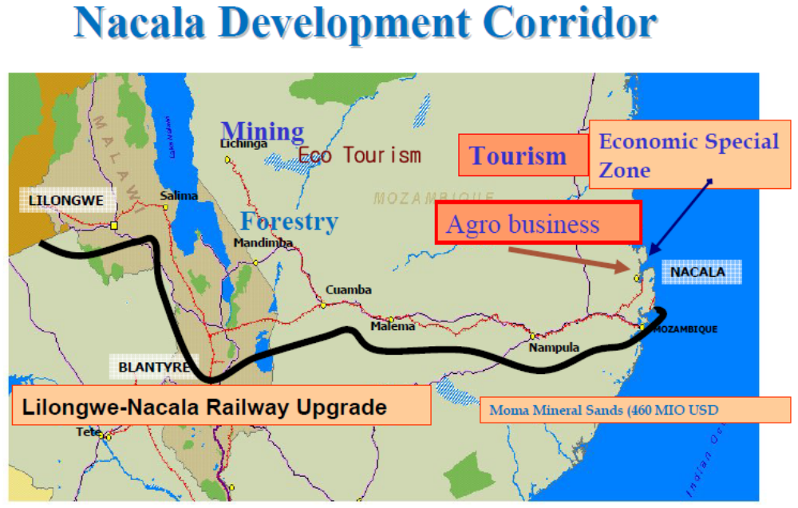
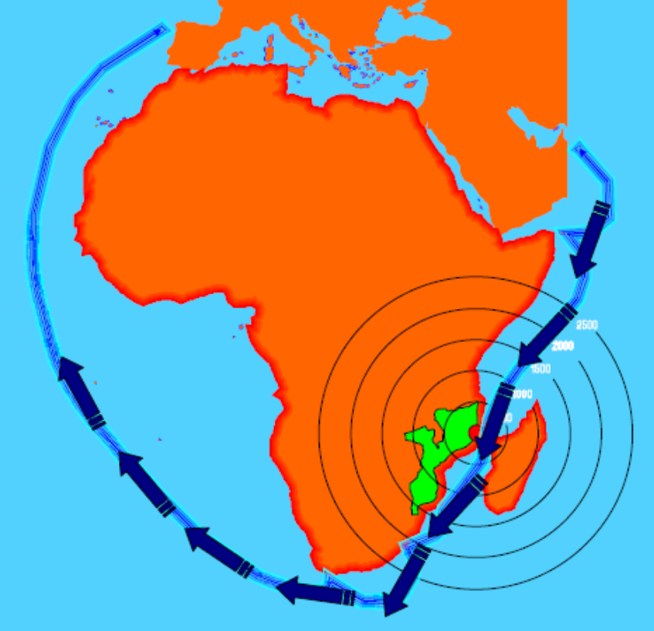
a
Build Core Infrastructure and Align
Development Programs
Nacala Development Corridor➔
(Source: CPI, Govt. of Mozambique)
The Case of Mozambique (planned)
Regional development around Nacala port
and corridor

Slide 31
Conclusion:
East Asian Policy Engagement
Building new competitiveness from the country’s strengths, not correcting general weaknesses.
Goal-oriented approach—vision, phased strategies, concrete action plans.
Focus effort strategically—don’t waste time in general improvement without clear goals.
Donor-recipient policy dialogue for trust, knowledge transfer, and strategy formulation.
Long-term open-ended engagement rather than outcome-based approach with frequent reviews.

Slide 32
More Books from GRIPS http://www.grips.ac.jp/forum-e/index.htm
Ohno, Kenichi, and Izumi Ohno, eds (1998), Japanese Views on Economic Development: Diverse Paths to the Market, Routledge.
Ohno, Izumi and Yumiko Niiya (2004), Good Donorship and Aid Modality: Matching Country Needs with Aid Modality, GRIPS Development Forum.
Ohno, Kenichi, ed (2006), Industrial Policy Formulation in Thailand, Malaysia and Japan: Lessons for Vietnamese Policy Makers, Vietnam Development Forum/Publishing House of Social Labour, Hanoi.
Ohno, Kenichi (2006), The Economic Development of Japan: The Path Traveled by Japan as a Developing Country, GRIPS Development Forum. Also available in Japanese, Chinese, Vietnamese, Arabic.
GRIPS Development Forum (2008), “Proposal for a New African Growth Support Initiative”, Policy Note No.5

