Slide 1

The impact of technology
and its implication
for the future
Hye-Kyung YANG
KERIS, South Korea

Slide 2
Contents
1. Impacts of technology in HE
2. Challenges
3. Policy Implications
4. Conclusions
Notes:
Experimental case of Korea
Teaching and learning -> e-learning concept (including ICT in education)
Administration like ERP, EMIS in Uni
Many report exist about tertiary ed and ICT -> summarize, introduce Korean experience

Slide 3
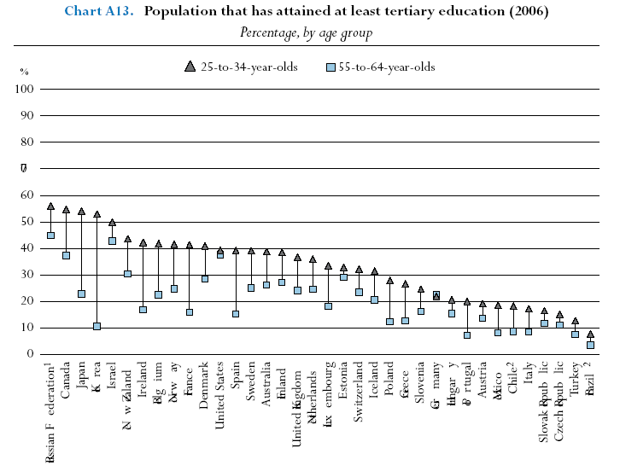
Status
Population that has attained tertiary education(2006)
Source: OECD EAG2008
Notes:
25-34 AGE GROUP 53%(2006)
55-64 AGE GROUP 11%
Trend of attainment rapidly increased
More than 87% of general high school graduates advanced into higher school, GER in tertiary level (KOREA) 91% 2005
405,455 high school graduates

Slide 4
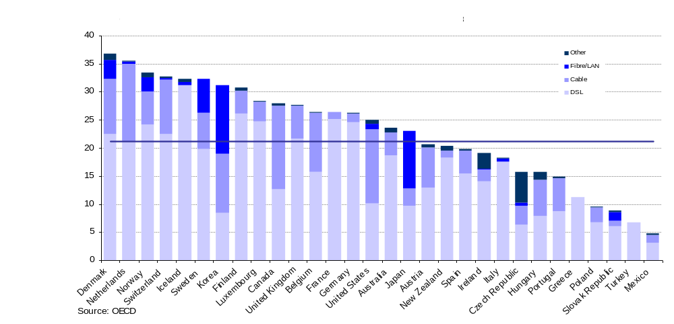
Status
OECD Broadband subscribers per 100 habitants(2008)
Notes:
기술발전
인터넷접속, 랩탑, 휴대용 기기, 이러닝, 디지털라이브러리 등
고등교육에 대한 접근성 강화 및 비용 감소 기대
고등교육에서의 교수학습, 학술연구의 혁신 가능성

Slide 5
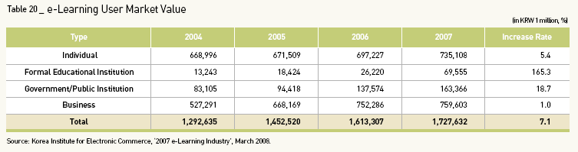
Status
Global e-learning market : 23Billion USD (2006)
Europe : 23.6%, North America:19.8%
Korean e-learning market
Notes:
이러닝 세계시장의 규모는 2006년 말 230억 달러에서 2011년까지 매년 20.6% 성장하여 587억 달러에 이를 것으로 전망
유럽이 전세계 시장의 23.6%, 미주가 19.8% 차지
IT 기술을 기반으로 대기업 및 콘텐츠 제작업체들이 이러닝 산업 발전 주도
The e-Learning user market volume, or e-Learning
expenditure of formal educational institutions,
government, public institutions, businesses, and
individuals in 2007, has increased 7.1% to KRW
1.728 trillion from KRW 1.613 trillion in 2006.
The e-Learning supplier market volume, or e-
Learning sales in each area (solution, contents,
service, etc.), came in at KRW 1.727 trillion in
2007, a 6.8% increase from KRW 1.618 trillion in
2006.

Slide 6
e-Learning in Higher Education (KOREA)
Level of support for an independent e-Learning system(2006)
  National universities : 64% , Private universities : 57%,
Universities of Education : 36%
  Total e-Learning Contents : 2,607 courses
Avg. no. of e-Learning courses at universities : 45.1 (2005) → 187.6 (2006)
E-learning in Virtual Universities : 3,600 courses (2007. 1st semester)
Notes:
In 2007 3.9Million students taking online learning course in USA, 22% of students in USA
The number of students is 2.5 times more than that of 2002.

Slide 7
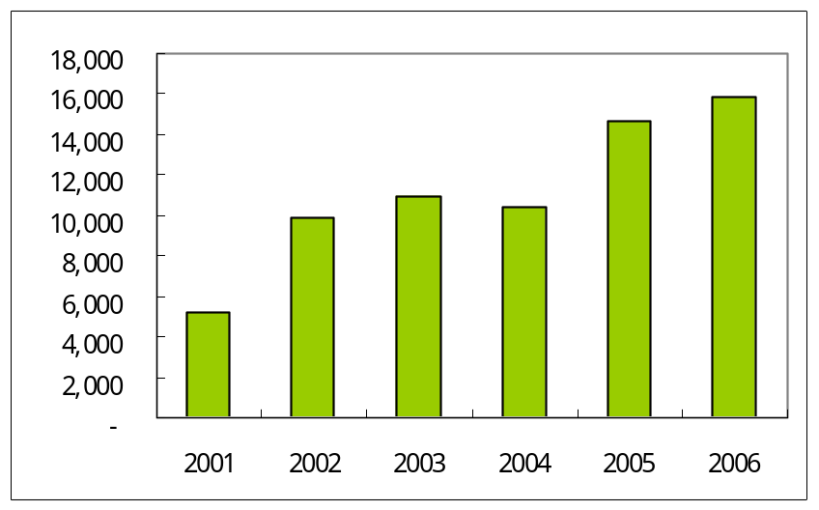
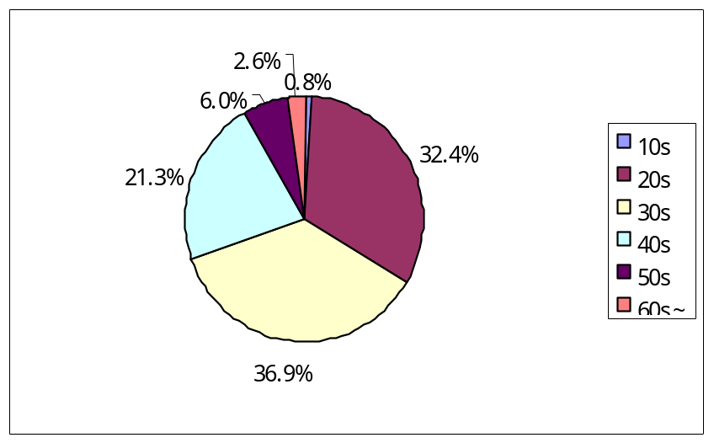
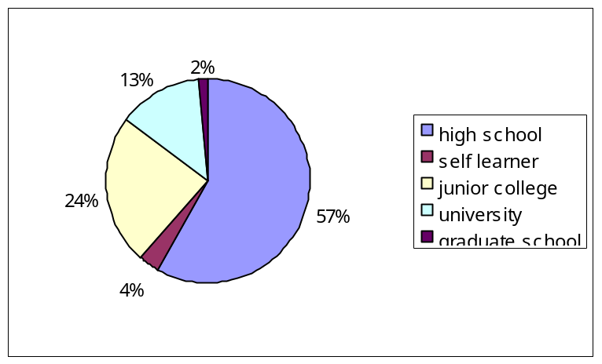
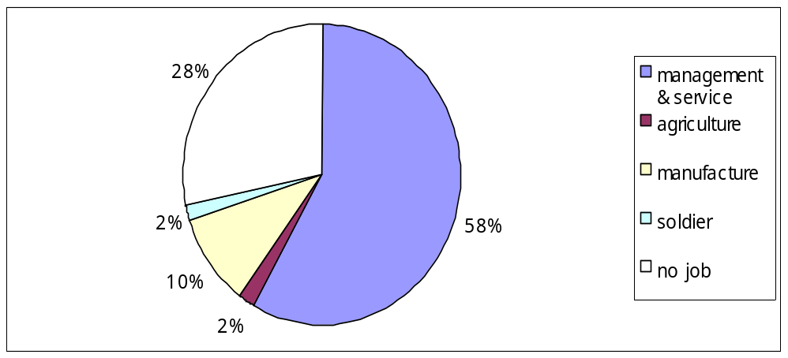
Virtual University (KOREA)
Entrance Enrollment
Distribution of students by age
by academic background
by profession type
Notes:
Background :life long learning society
17,725
More than half of the students : 30~40 age group
Graduate with bachelor degree : 45173(2008)
Monitoring -> evaluation & graduate school
E-learning in Virtual Universities : 3,600 courses (2007. 1st semester)

Slide 8
Knowledge in the world
Rapid knowledge increase in digital form
Total storage amount of knowledge (2003) (unit: terabyte)
 | 1999 | 2002 | 2005 | Growth Ratio(%)
Paper | 1,200 | 1,634 | 2,225 | 36
Film | 431,690 | 420,254 | 409,121 | -3
Magnetic | 2,779,760 | 4,999,230 | 8,990,812 | 80
Optical | 81 | 103 | 130.9753086 | 28
Total amount | 3,212,731 | 5,421,221 | 9,147,867 | 69
Source : Lyman and Hal. 2003
Notes:
Knowledge in digital form increasing rapidly

Slide 9
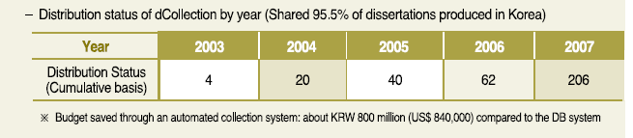
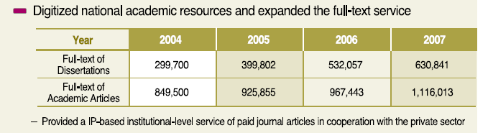
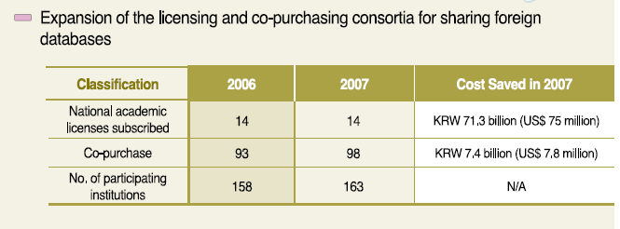
Knowledge in Higher Education
University Library as a resource center

Slide 10
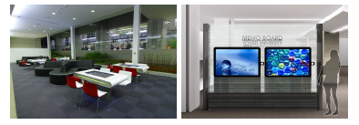
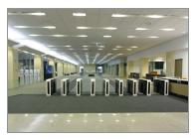
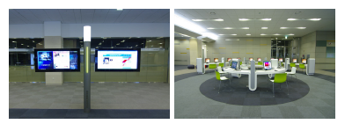
Library as a resource center
u-table
u-memoryboard
u-newspaper
My-e-book
Notes:
Information commons : desktop, laptop for collaborative learning and research
RFID card for personalized service
U-table : electronic whiteboard, small group working,
U-memoyboard : personal message, notices, information sharing
U-newspaper
My e book :

Slide 11
Challenges
Teaching & Learning competitiveness
Quality assurance
Sharing and credit exchange
Copyright infringement
Digital divide
Preference Tendency for Contents Sharing
600
500
400
Frequency
300
200
100
0
Strong
negative
negative
neutral
positive
Strong
positive
degree
Notes:
University competitiveness
Establish a system to manage intellectual property rights
Open source & Creative Common License environment
Nurture e-Learning experts for the e-Learning industry 1. Career path development programs are needed to systematically nurture e-Learning experts 2. Need to continuously nurture experts such as lecturers and consultants to produce e-Learning talents
Vitalize joint use of e-Learning by management of IPR. Systems to protect intellectual property rights are required to uphold the rights of IPR holders and to facilitate R&D activities.
Expand support for ICT to solve digital and cultural divide. System needed to support and promote e-Learning to resolve the “digital divide” between classes, urban-rural areas, conglomerates-SMEs and international communities.

Slide 12
Challenges
  Preference tendency of copyright type for e-elarning contents
Survey Result (2007) |  | percentage
Faculty | Free access, edit, redistribution without permission of authors | 0.0
 | Access, edit, redistribution with permission of authors | 46.2
 | Free access to contents without permission of authors &, edit, redistribution with permission of authors | 50.0
 | Access, edit is free, Redistribution with permission of authors | 0
 | License like CCL | 3.8
 | others | 0

Slide 13
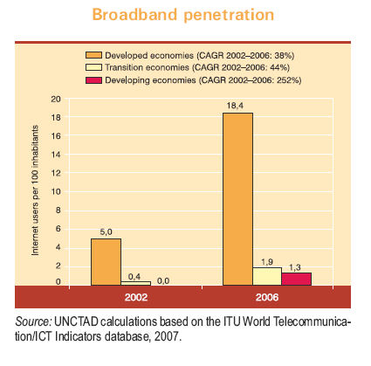
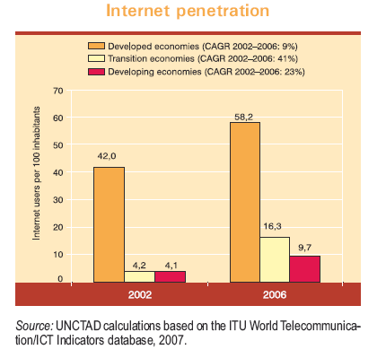
Challenges
Digital divide, disparity in HE
Notes:
Average GER in developed countries 66%
Average GER in Developing countries 17%
E-learning in developing countries (Africa) :
Lack of
supply of electricity
access to infrastructure
sufficient and affordable network bandwidth
Human resource capacity
national strategy, masterplan

Slide 14
Implications
Policy in Korean context
University E-learning Support Center(UESC)
E-learning Contents Sharing
E-learning Quality Assurance

Slide 15

Strategies of the UESC Project

Slide 16


Slide 17


Slide 18
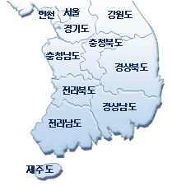
Distribution of UESC
Kyong-Gy
Seoul
South ChungCheong
Kang-Won
North Cholla
North ChungCheong
South Cholla
North KyungSang
South KyungSang
Jeju
InCheon
Notes:
analogy of the map

Slide 19
University E-learning Support Center
10 regional e-learning hub universities
 | 2003 | 2004 | 2005 | 2006 | 2007 | sum
UESCs | 1 | 1 | 3 | 2 | 3 | 10
E-learning contents | 2 | 22 | 90 | 176 | - | 290
Budget ($,M) | 0.8 | 0.8 | 2.1 | 2.1 | 2.8 | 8.6
Notes:
Background of UESC
Spread of the internet & high-speed network
- Drastic changes in the higher education environment
Needs of a user-oriented customized education service
- Learner-centered learning
- Effective self-directed learning support system
Resolution of the imbalance in university education
- Reduce educational quality gap between regional universities
Objective of UESC :
To enhance the competitiveness of universities
- Establishing a web-based self-directed learning support system
- Developing and distributing various quality teaching & learning materials
To resolve the imbalance in university education
- Enabling universities to jointly develop and use educational content
- Training professionals to become specialized
To form and support an e-Learning cluster of businesses, universities and laboratories
- Training of workers needed to develop local strategic industries
- Form partnerships with local businesses and governments
To support lifelong learning through e-Learning
- Developing various human resources
Strategy of UESC
To attract interest in e-Learning in higher education
- Giving full support to university e-Learning support centers
To consolidate cooperation between universities
- Encouraging them to jointly develop specialized e-Learning content and
recycle existing content
To establish a support system for teachers and an e-Learning administrative system for universities
- Differentiating the roles of teachers and universities

Slide 20
QA in Virtual University
Government Support for high quality contents
 | 2003 | 2004 | 2005 | 2006 | sum
E-learning Contents | 15 | 10 | 10 | 10 | 45
Budget (USD) | 400,000 | 500,000 | 500,000 | 650,000 | 2,050,000
Unit of Contents = Semester
Virtual University evaluation
Legal framework
Notes:
Annual eval
11 university into HE act.

Slide 21
E-learning QA center
MEST
K12
Higher/Lifelong/Vocation
consult
E-learning QAC
svc./con.
UESC
Virtual uni
K12 School
verify
MPOE
VET LLL
sol./con./svc.
Public Organizations
supply
supply
Private sector
Notes:
QA : Distance Teacher training center

Slide 22
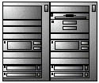

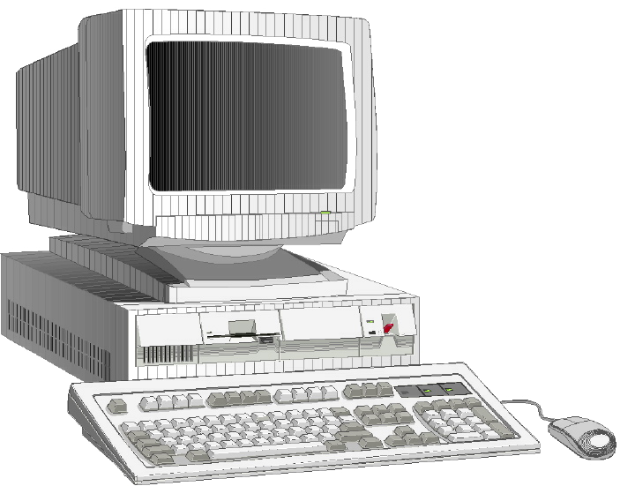
E-learning Sharing
Structure of KOCW
Central e-Learning Content Sharing Center
· e-Learning content & resources
· Research DB (Domestic and Oversea)
Virtual-Universities
Global Partnership
KOCW
Cyber-univ.
OCWC
OAI-PMH
Metadata
Repository
M
GLOBE
S(DP)
C
meta harv.
meta harv.
OAI-PMH
Gateway
SP
OAI-PMH
IMS
meta harv.
OAI-PMH
University CTLs
University E-learning Centers
meta harv.
Cyber-univ.
Univ.
M
C
M
M
Metadata, contents
S(DP)
C
C
OAI-PMH : Open Archive Initiative Protocol for Metadata Harvesting
SP : Service Provider DP : Data Provider
M : Metadata C : Content
CTL : Center for Teaching & Learning
S(DP)
Notes:
the structure of KOCW, as it is laid out in this chart.
KERIS is at the center, and 17 cyber-universities and 10 University e-Learning Centers will be connected to KERIS to form a network. We have selected the OAI-PMH ( open archive initiative protocol for meta harvesting ) method for meta-connection, and the original content will be located at the universities. The center will provide a content Location URL information through KEM metadata. For overseas connection, We have connected to federate Search method for meta harvesting. Currently, We are collaborating with Globe based on the SQI Simple Query Interface method.

Slide 23
Conclusion
Emergence of e-Learning as a new educational paradigm in knowledge-based society
To realize knowledge revolution through timely knowledge acquisition, sharing and creation
Use of ICT as a major driving force for national competitiveness
To build a lifelong education society through national learning ability enhancement
Need for cooperation between the industrial sphere and the academic sphere
To promote active participation of businesses in cooperating with universities, developing high technologies, and training human resources
Quality Promotion in Higher Education
- Recognizing content best practices, content improvement, quality assurance etc.

Slide 24
Thank You!
Merci beaucoup!
감사합니다!
hky@keris.or.kr
Korea Education & Research Information Service
Notes:
Thank you.

