Slide 1
OECD Innovation Strategy
Deliverables, policy implications and next steps
Miriam Koreen
OECD-France workshop
7 December 2009

Slide 2
Outline
Background
Innovation Strategy Deliverables
Policy implications: Moving towards Policy Principles

Slide 3
The OECD Innovation Strategy: a collective policy response
  Ministerial Mandate from May 2007:
  Boosting innovation must be a key objective of government policies to:
    Promote sustainable growth and
    Address global challenges
  The crisis changes the context for innovation, but makes it more urgent.
  Final report for the OECD Ministerial in 2010

Slide 4
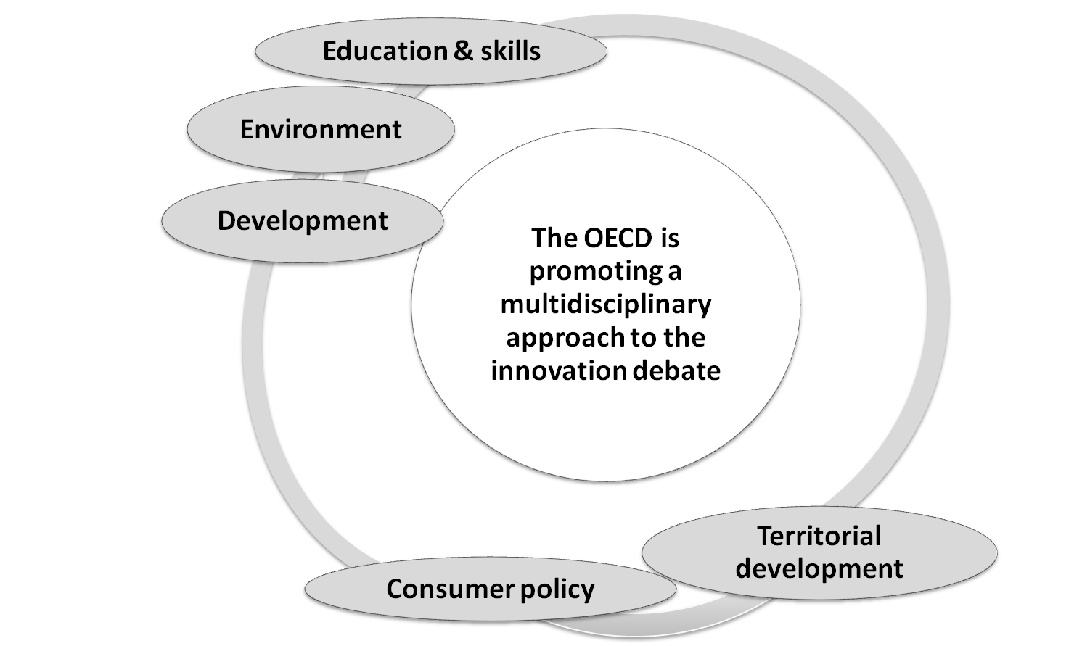








The OECD’s work on innovation:
A multidisciplinary approach
Statistics
Competition
Public governance

Slide 5
OECD Innovation Strategy: Deliverables
A Ministerial policy document presenting the key Policy Principles of the Strategy;
A synthesis report bringing together the OECD state-of-the-art on innovation;
A compendium of indicators which will help position countries in the context of “broader innovation”; track developments in innovation processes; and monitor the implementation of the Strategy;
A toolkit/handbook to help countries operationalise the policy principles (paperback and online); and
A series of detailed individual thematic reports.

Slide 6
Towards Policy Principles
SG/INNOV(2009)4
  Empowering people to innovate
  Anchoring the foundations of innovation
  Investing in innovation and reaping its returns
  Applying innovation to address global challenges
  Improving the governance of policies for innovation
Notes:
A much wider range of policy requirements than just dealing with highly-skilled workers or S&T workers.
Labour markets are important too, e.g. in enabling mobility, as are working arrangements within firms to foster innovation by workers and within organisations.

Slide 7
Towards Policy Principles
  1. Empowering people to innovate
    Providing education and training
    Hard and soft skills
    Tapping into global talent
    Innovative workplaces
    Empowering consumers
    Innovation in the public sector
Notes:
A much wider range of policy requirements than just dealing with highly-skilled workers or S&T workers.
Labour markets are important too, e.g. in enabling mobility, as are working arrangements within firms to foster innovation by workers and within organisations.

Slide 8
Towards Policy Principles
  Anchoring the foundations for innovation: a comprehensive approach that considers linkages
    A dynamic business sector
    Macro-economic stability
    Trade and investment
    Competition policy
    Tax policy
    Markets that encourage innovation

Slide 9
Towards Policy Principles
  3. Investing in innovation and reaping its returns
    Investing in the public research system
    Mobilising private funding for innovation through well-functioning financial markets
    Providing a modern and reliable knowledge infrastructure and platforms for innovation
    Facilitating knowledge flows and fostering the development of knowledge networks and markets

Slide 10
Towards Policy Principles
  4. Applying innovation to address global challenges
    Improving international scientific and technological co-operation and technology transfer
    Developing new mechanisms and platforms
    CC: Providing a stable policy regime which encourages invention and adoption of environmentally friendly technologies
    Development: Strengthen the foundations, foster access to modern technologies, support entrepreneurship

Slide 11
Towards Policy Principles
  5. Improving the governance of policies for innovation
    Innovation as a central component of government policy with strong political leadership
    Ensure policy coherence and adaptability
    Enable innovation at the regional and local levels
    Involve stakeholders in decision-making processes
    New measurements and evaluation frameworks to support policy – a measurement agenda

