Slide 1

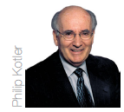


Instructor
Morteza Maleki, PhD

Slide 2

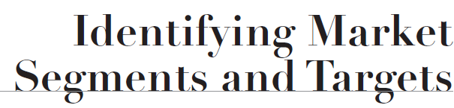

Slide 3
Levels of Market Segmentation
The starting point for discussing segmentation is mass marketing.
In mass marketing, the seller engages in the mass production, mass distribution, & mass promotion of one product for all buyers.
It creates the largest potential market, which leads to the lowest cost, which in turn can lead to lower prices or higher margins.
Yet, critics believe in splintering of the market, & the proliferation of the advertising media & distribution channels, which is making it difficult & increasingly difficult to reach a mass audience.

Slide 4
Levels of Market Segmentation
Segment Marketing
A market segment consists of a group of customers who share a similar set of needs & wants.
Rather than creating the segments, the marketing task is to identify them & decide which one(s) to target.
The company can then better design, price, disclose & deliver the product/service & can fine-tune the marketing program & activities to better reflect competitor’s marketing.

Slide 5
Levels of Market Segmentation
Flexible Market Offering consists of two parts;
A NAKED SOLUTION containing of the product & service elements that all segment members value, &
DISCRETIONARY OPTIONS that some segment members value; each option might carry an additional charge.

Slide 6
Levels of Market Segmentation
One way to characterize market segments is to identify preference segments;
HOMOGENEOUS PREFERENCES exist when all consumers have roughly the same preferences; the market shows no natural segments.
DIFFUSED PREFERECES in which consumers vary greatly in their preferences; if several brands are in the market, they are likely to position themselves throughout the space & show real differences to match differences in consumer preferences.
CLUSTERED PREFERENCES result when natural market segments emerge from groups of consumers with shared preferences.

Slide 7
Levels of Market Segmentation
Niche Marketing
A niche is a more narrowly defined customer group seeking a distinctive mix of benefits; marketers usually identify niches by dividing a segment into sub-segments.
What does an attractive niche look like?
The customers have a distinct set of needs,
They will pay a premium to the firm that best satisfies them,
The niche is fairly small but has size, profit, & growth potential & is unlikely to attract many other competitors, &
The nicher gains certain economies through specialization.

Slide 8
Levels of Market Segmentation
Example of Niche Marketing
Hertz, Avis, Alamo, and others specialize in airport rental cars for business and leisure travelers;
Yet,
Enterprise (http://www.enterprise.com/car_rental/home.do) has attacked the low-budget, insurance-replacement market by primarily renting to customers whose cars have been wrecked or stolen.

Slide 9
Levels of Market Segmentation
Local Marketing
Target marketing is leading to marketing programs tailored to the needs & wants of local customer groups in trading areas, neighborhoods, even individual stores.
Local marketing reflects a growing trend called grassroots marketing.
It is marketing activities that concentrate on getting as close & personally relevant to individual customers as possible.
These activities include sponsorship of local school teams, expert-conducted clinics, etc.
Yet, it drives up manufacturing & marketing costs by reducing economies of scale & magnifying logistical problems.

Slide 10
Levels of Market Segmentation
Individual Marketing
The ultimate level of segmentation—one-to-one marketing
Today, customers are taking more individual initiative in determining what & how to buy,
They log on to the Internet,
They look up info & evaluations of product or service offers,
They conduct dialogue with suppliers, users, & product critics, &
They design the product they want.

Slide 11
Levels of Market Segmentation
Customerization
It combines operationally driven mass customization with customized marketing in a way that empowers consumers to design the product & service offering of their choice.
The firm no longer require prior info about the customer, nor does the firm need to own manufacturing.

Slide 12
Levels of Market Segmentation
Customization …
The firm provides the platform & tools & “rents” out the customers the means to design their own products.
A company is customized when it is able to respond to individual consumers by customizing its products, services, & messages on a one-to-one basis.

Slide 13
Levels of Market Segmentation
Downsides of Customerization
It may be difficult to implement for complex products such as automobiles.
It can raise the cost of goods by more than customer is willing to pay.
Some customers do not know what they want until they see actual products.
Consumers can not cancel the order after the company has started to work of the product.
The product may be hard to repair & have little sales value.

Slide 14
Bases for Segmenting Consumer Markets
There are four broad criteria for segmenting the markets;
GEOGRAPHIC
Region,
City,
Rural & Semi-urban Areas
DEMOGRAPHIC
Age
Family Size
Gender
Income
Occupation
Education

Slide 15
Bases for Segmenting Consumer Markets
PSYCHOGRAPHIC
Socioeconomic Classifications (SEC)
Lifestyle
Personality
BEHAVIORAL
Occasions
Benefits
User Status
Usage Rate
Loyalty Status
Readiness Stage
Attitudes towards Product

Slide 16
Bases for Segmenting Consumer Markets
Geographic Segmentation
Geographic segmentation calls for the division of the market into different geographical units such as nations, states, regions, countries, cities, or neighborhoods.
For instance, rural & urban markets differ on a number of important parameters, like
Literacy levels,
Income,
Spending power,
Availability of infrastructure like electricity, telephone network, & roads, and
Social & cultural orientations of people that affect the market potential, & buying patterns & habits

Slide 17
Bases for Segmenting Consumer Markets
Demographic Segmentation
In demographic segmentation, the market is divided into groups on the basis of variables like age, family size, family life cycle, gender, income, occupation, education, religion, race, generation, nationality & social class.
Reasons of popularity of such variables;
They are often associated with consumer needs & wants.
They are easy to measure.

Slide 18
Bases for Segmenting Consumer Markets
AGE & LIFE CYCLE STAGE
Consumers wants & abilities change with age.
LIFE STAGE
Life stage defines a person’s major concern, such as getting married, deciding to buy a home, sending the child to school, taking care of the older family members, marrying off their children, planning of the retirement, etc.
These life stages present opportunities for marketers who can help people cope with their major concerns.

Slide 19
Bases for Segmenting Consumer Markets
GENDER
Men & women have different attitudes & behave differently, based partly on genetic makeup, & partly on socialization.
For instance, men often need to be invited to touch a product; women are likely to pick it up without prompting.

Slide 20
Bases for Segmenting Consumer Markets
INCOME
Income determines the ability of consumers to participate in the market exchange & hence this is a basic segmentation variable.
Yet, it does not always predict the best consumers for a given product.
Even if two consumers have similar income levels, each may own different types & brands of product based on a host of factors like lifestyle, attitudes, & values.

Slide 21
Bases for Segmenting Consumer Markets
GENERATION
Each generation is profoundly influenced by the times in which it grows up—the music, movies, politics, & defining events of that period.
Demographers call these generational groups cohorts.
Members share the same major cultural, political, & economic experiences & have similar outlooks & values.

Slide 22
Bases for Segmenting Consumer Markets
SOCIAL CLASS
Social class has a strong influence on preferences on cars, clothing, home furnishings, leisure activities, reading habits, & retailers.
Many companies design products & services for specific social class.

Slide 23
Bases for Segmenting Consumer Markets
Psychographic Segmentation
Psychographics is the science of using psychology & demographics to better understand consumers.
In psychographic segmentation, buyers are divided into different groups on the basis of the psychological/personality traits, lifestyle or values.

Slide 24
Bases for Segmenting Consumer Markets
People within the same demographic group can exhibit very different psychographic profiles.
Values & lifestyles significantly affect product & brand choice of the consumers.
Religion has a significant influence on values & lifestyles.
The strict norms that consumers follow with respect to food habits or even dress codes are representative examples in this regard.

Slide 25
Bases for Segmenting Consumer Markets
One of the most popular commercially available classification systems based on psychographic measurements is SRI Consulting Business Intelligence’s VALS.
Signifying values & lifestyles, VALS classifies US adults into eight primary groups based on responses to a questionnaire featuring 5 demographic & 35 attitudinal questions.
(http://www.strategicbusinessinsights.com/vals/presurvey.shtml)

Slide 26
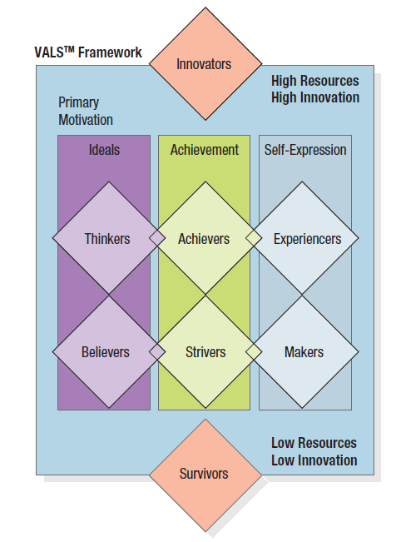
Bases for Segmenting Consumer Markets

Slide 27
Bases for Segmenting Consumer Markets
The four group with higher resources are;
Innovators
Successful, sophisticated, active, “take charge” people with high self-esteem.
Purchases often reflect cultivated tastes for relatively upscale, niche-oriented products & services.
Thinkers
Mature, satisfied, & reflective people who are motivated by ideals & who value order, knowledge, & responsibility.
They seek durability, functionality, & value in products.

Slide 28
Bases for Segmenting Consumer Markets
Achievers
Successful, goal-oriented people who focus on career & family.
They favor premium products that demonstrate success to their peers.
Experiencers
Young, enthusiastic, impulsive people who seek variety & excitement.
They spend a comparatively high proportion of income on fashion, entertainment, & socializing.

Slide 29
Bases for Segmenting Consumer Markets
The four groups with lower resources are;
Believers
Conservative, conventional, & traditional people with concrete beliefs.
They prefer familiar products & are loyal to established brands.
Strivers
Trendy & fun-loving people who are resource-constrained.
They favor stylish products that emulate the purchases of those with greater material wealth.

Slide 30
Bases for Segmenting Consumer Markets
Makers
Practical, down-to-earth, self-sufficient people who like to work with their hands.
They seek products with a practical or functional purpose.
Survivors
Elderly, passive people who are concerned about change.
They are loyal to their favorite brands.

Slide 31
Bases for Segmenting Consumer Markets
Behavioral Segmentation
In behavioral segmentation, marketers divide buyers into groups on the basis of their knowledge of, attitude toward, use of, or response to a product.
DECISION ROLE
People play five roles in a buying decision; initiators, influencer, decider, buyer, & user.
Recognition of different buying roles & specification of the people who play these roles for specific products & services are vital for marketers.
This is especially useful for designing the communication strategy.

Slide 32
Bases for Segmenting Consumer Markets
USER & USAGE
Occasions
Occasion segmentation can help firms expand product usage.
Firms producing greeting cards, chocolates, cars, etc. are using heavy advertisement in special occasions.

Slide 33
Bases for Segmenting Consumer Markets
USER & USAGE
User status
Every product has its non-users, ex-users, potential users, first time users, & regular users.
The key to attracting potential users or even possibly non-users is understanding the reasons they are not using.
Included in the potential user group are consumers who will become users in connection with some life stage or life event.

Slide 34
Bases for Segmenting Consumer Markets
Usage rate
Markets can be segmented into light, medium, & heavy product users.
Heavy users are often a small percentage of the market but account for a high percentage of total consumption.
However, the heavy users are often either extremely loyal to one brand or never loyal to any brand & always looking for the lowest price.

Slide 35
Bases for Segmenting Consumer Markets
Buyer Readiness Stage
Some people are unaware of the product, some are aware, some are informed, some are interested, some desire the product, & some intend to buy.

Slide 36
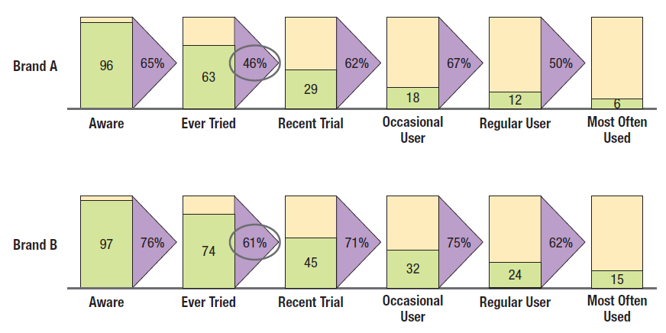
Bases for Segmenting Consumer Markets

Slide 37
Bases for Segmenting Consumer Markets
Loyalty Status
Marketers usually envision four groups based on brand loyalty status;
Hard-core Loyals—consumers who buy only one brand all the time.
Split Loyals—consumers who are loyal to two or three brands.
Shifting Loyals—consumers who shift loyalty from one brand to another.
Switchers—consumers who show no loyalty to any brands.

Slide 38
Bases for Segmenting Consumer Markets
Loyalty Status
What appear to be brand-loyal purchase patterns may reflect habit, indifference, a low price, a high switching costs, or the unavailability of other brands.
Attitude
Five attitudes about products are: enthusiastic, positive, indifferent, negative, & hostile.

Slide 39
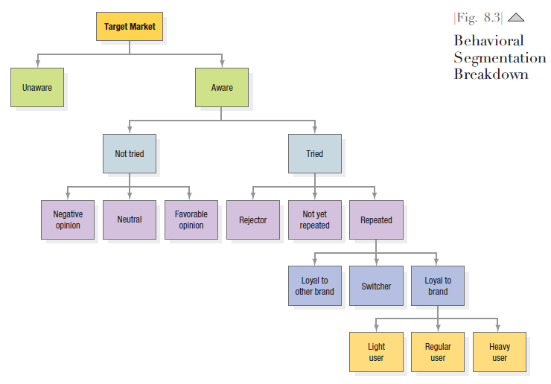
Bases for Segmenting Consumer Markets

Slide 40
Bases for Segmenting Consumer Markets
THE CONVERSION MODEL
The conversion model measures the strength of consumers’ psychological commitment to brands & their openness to change.
To determine how easily a consumer can be converted to another choice, the model assesses commitment based on factors such as consumer attitudes towards, & satisfaction with, current brand choices in a category & the importance of the decision to select a brand in the category.

Slide 41
Bases for Segmenting Consumer Markets
The model segments the users of the brand into four groups based on the strength of commitment from low to high;
Convertible—most likely to defect
Shallow—uncommitted to the brand & could switch—some are actively considering alternatives
Average—also committed to the brand they are using, but not as strongly; they are unlikely to switch brands in the short term.
Entrenched—strongly committed to the brand they are currently using; they are highly unlikely to switch brand in the foreseeable future.

Slide 42
Bases for Segmenting Consumer Markets
The model also classifies nonusers of a brand into four other groups based on their “balance of disposition” & openness to trying the brand, from low to high;
Strongly unavailable—unlikely to switch to the brand; their preference lies strongly with their current brands.
Weakly unavailable—not available to the brand because their preference lies with their current brand, although not strongly.
Ambivalent—as attracted to the brand as they are to their current brands.
Available—most likely to be acquired in the short run.

Slide 43
Bases for Segmenting Business Markets
Demographic
INDUSTRY—which industries should we serve?
COMPANY SIZE—what size companies should we serve?
LOCATION—what geographical areas should we serve?
Operating Variables
TECHNOLOGY—what customer technology should we focus on?
USER OR NONUSER STATUS—should we serve heavy-, medium-, or light- or non-users?
CUSTOMER CAPABILITIES—should we serve customers needing many of few services?

Slide 44
Bases for Segmenting Business Markets
Purchasing approaches
PURCHASINF-FUNCTION ORG—should we serve companies with highly centralized or decentralized purchasing orgs?
POWER STRUCTURE—should we serve companies that are engineering dominated, financially dominated, & so on?
NATURE OF EXISTING RELATIONSHIPS—should we serve companies with which we have strong relationship or simply go after the most desirable companies?
GENERAL PURCHASING POLICIES—should we serve companies that prefer leasing? Service contract? System purchases? Sealed biding?
PURCHASING CRITERIA—should we serve companies that are seeking quality? Service? Price?

Slide 45
Bases for Segmenting Business Markets
Situational Factors
URGENCY—should we serve companies that need quick & sudden delivery or service?
SPECIFIC APPLICATION—should we focus on certain application of our product rather than all applications?
SIZE of ORODER—should we focus on large or small orders?
Personal Characteristics
BUYER-SELLER SIMILARITY—should we serve companies whose people & values are similar to ours?
ATTITUDE TOWARDS RISK—should we serve risk-taking or risk-avoiding customers?
LOYALTY—should we serve companies that show high loyalty to their suppliers?

Slide 46
Target Marketing
Once the firm has identified its market segment opportunities, it must decide how many & which ones to target.
Marketers are increasingly combining several variables in an effort to identify smaller, better-defined target groups.

Slide 47
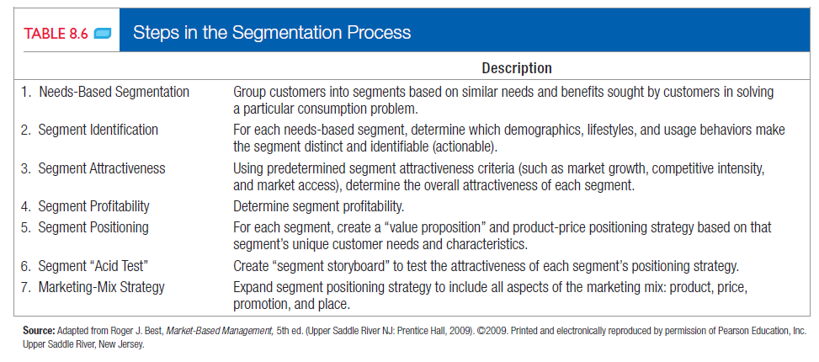
Target Marketing
Needs-based Market Segmentation Approach (Roger Best)

Slide 48
Target Marketing
Effective Segmentation Criteria
To be useful, market segments must rate favorably on five key criteria;
Measurable—the size, purchasing power, & characteristics of the segments can be measured.
Substantial—a segment should be the largest possible homogeneous group worth going after with a tailored marketing program.
Accessible—the segments can be effectively reached & served.
Differentiable—the segments are conceptually distinguishable & respond differently to different marketing-mix elements & programs.
Actionable—effective programs can be formulated for attracting & serving the segments.

Slide 49
Target Marketing
Evaluating & Selecting the Market Segments
In evaluating different market segments, the firm must look at two factors;
The segment's overall attractiveness, &
The company’s objectives & resources

Slide 50
Target Marketing
Evaluating & Selecting the Market Segments
After evaluating different segments, the company can consider five patterns of target market selection;
Single Segment Concentration
Through concentrated marketing, the firm gains a strong knowledge of the segment’s needs & achieve a strong market presence.
The firm enjoys operating economies through specializing in production, distribution, & promotion.
Yet, a particular market segment can turn sour or a competitor may invade the segment.
Supersegment is a set of segments sharing some exploitable similarity.

Slide 51
Target Marketing
Selective Specialization
A firm selects a number of segments, each objectively attractive & appropriate.
There may be little or no synergy among the segments, but each promises to be a moneymaker.
This multi segment strategy has the advantage of diversifying the firm’s risks.

Slide 52
Target Marketing
Product Specialization
The firm makes a certain product that it sells to several different market segments.
The downside risk is that the product may be supplanted by an entirely new technology.
Notes:
REPLACED

Slide 53
Target Marketing
Market Specialization
The firm concentrates on serving many needs of a particular customer group.
The firm gains a strong reputation in serving this customer group & becomes a channel for additional products the customer group can use.
The downside risk is that the customer group may suffer budget cuts or shrink in size.

Slide 54
Target Marketing
Full Market Coverage
The very large firms, like Microsoft, Coca-Cola, etc. attempt to serve all customer groups with all the products they might need.
They can do so by two broad ways;
Undifferentiated Marketing,
Differentiating Marketing

Slide 55
Target Marketing
Undifferentiated Marketing
The firm ignores segment differences & goes after the whole market with one offer.
It designs a product & a marketing program that will endow the product with a superior image & appeal to the broadest number of buyers & it relies on mass distribution & advertising.
Differentiated Marketing
The firm operates in several segments & designs different products for each.
Because it leads to both higher sales & higher costs, nothing general can be said about the profitability of this strategy.

Slide 56
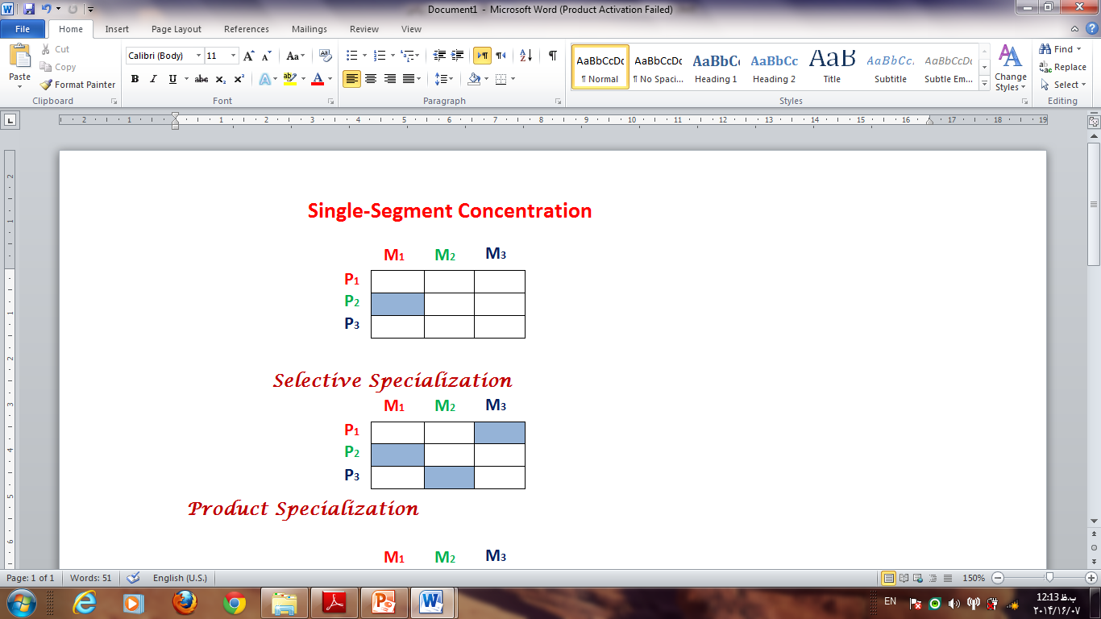
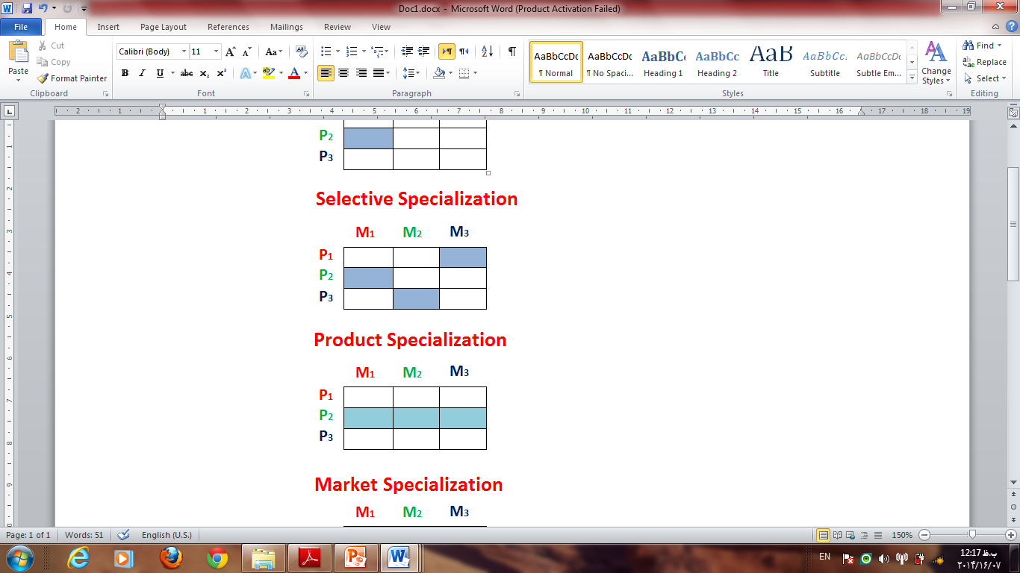
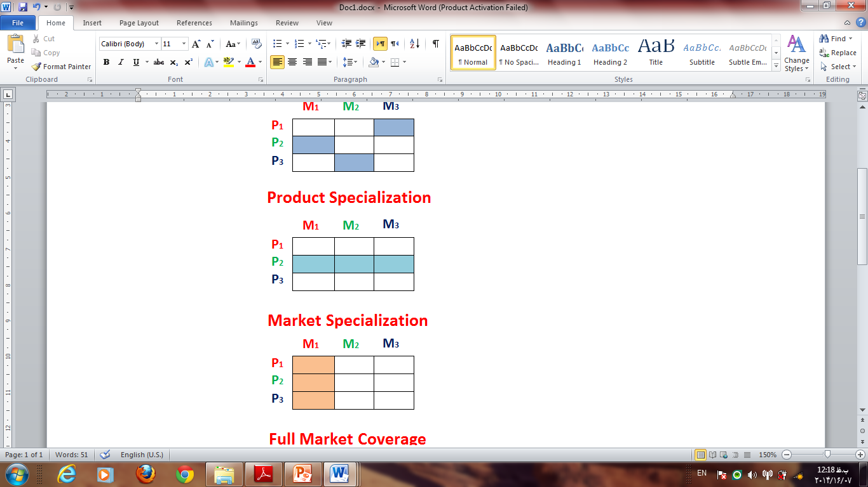
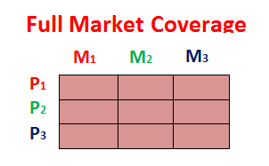
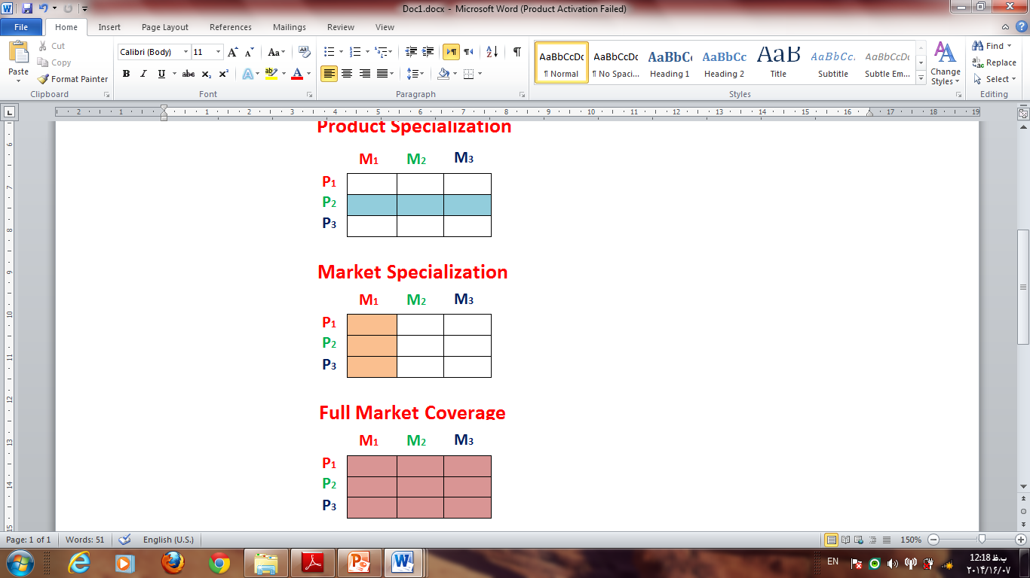
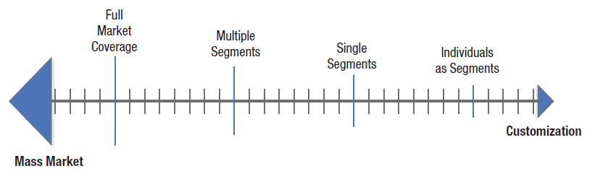
Target Marketing

Slide 57
The End

