Slide 1
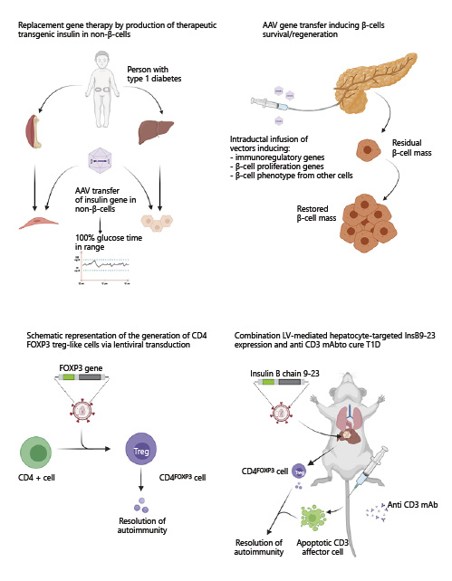

Potentialities of Gene Therapy in Pediatric Endocrinology
Horm Res Paediatr - DOI:10.1159/000520965
© 2021 S. Karger AG, Basel
Notes:
Fig. 1. Gene therapy approaches for cell and hormone replacement in T1D (created with BioRender.com).

Slide 2
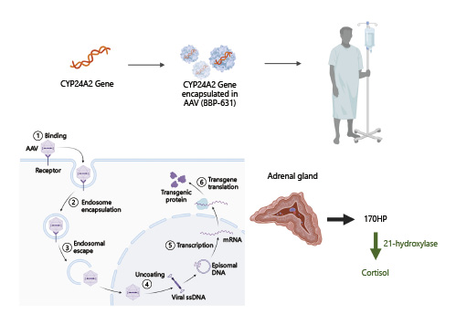
Potentialities of Gene Therapy in Pediatric Endocrinology
Horm Res Paediatr - DOI:10.1159/000520965
© 2021 S. Karger AG, Basel
Notes:
Fig. 2. Phase 1/2 open-label gene therapy in adults with 21OHD-CAH through administration of an AAV5 encoding the human CYP21A2 gene (BBP-631) (NCT04783181) (created with BioRender.com). 17OHP, 17-hydroxyprogesterone.

