Slide 1



TITLE SLIDE: HEADLINE
Securing and managing your Tomcat installations
Presenter name
Title, Red Hat
Date
Mladen Turk
Principal Sotware Engineer/Apache Tomcat PMC Chair
mturk@apache.org
mturk@redhat.com
05 November 2010
Notes:
This deck provides an overview of all of our JBoss Solutions for Java applications, from development tools to production runtime platforms to application management.

Slide 2
Discussion Topics
Understanding Tomcat security
Understanding Operating System security
Understanding Network security
Fitting It All Together
Maintenance and life cycle management
Notes:
This is the agenda

Slide 3
Speaker Introduction
Apache Tomcat PMC Chair
Committer for Apr, Commons, Httpd, Jakarta,
Traffic Server projects
Working at Red Hat Europe
  Native integration, EWS

Slide 4
Understanding Tomcat security
A chain is only strong as its weakest link
  Application security
  Operating system security
  Java Virtual Machine security
Secure vs. Secure Enough
  What is enough ?
  Mandated by the scope
  Mandated by the regulations
  Mandated by the infrastructure

Slide 5
Understanding Tomcat security
Core Apache Tomcat
  http://tomcat.apache.org/security.html
  Maintained by the Apache Tomcat Security team
  Security impact levels
    Critical, Important, Moderate, Low
    Information disclosure
    Cross-site scripting
    Denial of Service
But …
  Tomcat is only one link in the chain

Slide 6
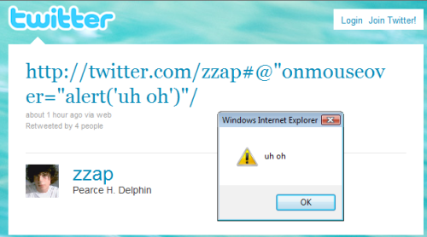
Understanding Tomcat security
Reporting security issues
  security@tomcat.apache.org
  Do not disclose before reporting !!!
  Twitter XSS worm (23 October 2010)
    Less than 2 hours for hackers to exploit this vulnerability
    in a wide scale fashion

Slide 7
Understanding Tomcat security
Security API and implementation
  Mandated by the Servlet Specification
    Verifiable using TCK
  Realms
    User database abstraction
  AAA
    Authentication, Authorization, and Accounting
    Mostly by using Valves
      Switching to Filters with Tomcat 7

Slide 8
Understanding Tomcat Security
Authentication
  BasicAuthentication
  SingleSignOn
Authorization
  Access to resources
  RemoteHost, RemoteAddress
  Integrated with Java security model
Accounting
  AccessLogValve

Slide 9
Understanding OS Security
Physical operating system
  Unix and its derivates
    Well known and tested security model
    Must be used properly
  Windows
    Notorious in the past regarding security
    Hardened with latest versions
    Concepts often change
    Complex using ACL's

Slide 10
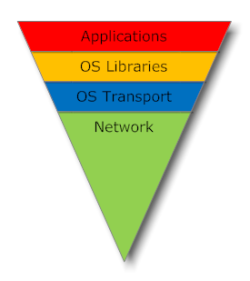
Understanding OS security
What can be defined as Operating System
  Everything you are using
  Disable unused subsytems
Choose your policy
  Rising vs. loosening the security

Slide 11
Understanding OS security
Java Virtual Machine
  Compile once, run everywhere
  Nice in theory, but does it work like that?
  Using Java Security Manager
    Basically an application level security
    Differences between platforms
if (dir != null) {
/* When resolving a directory-relative path that refers to a
drive other than the current drive, insist that the caller
have read permission on the result */
String p = drive + (':' + dir + slashify(path.substring(2)));
SecurityManager security = System.getSecurityManager();
try {
if (security != null) security.checkRead(p);
} catch (SecurityException x) {
/* Don't disclose the drive's directory in the exception */
throw new SecurityException("Cannot resolve path " + path);
}
return p;
}

Slide 12
Java Security Manager cont.
Based on the concept of permissions
  Permissions must be explicitly granted
  Core Java SE permissions
    java.lang.RuntimePermission - System.exit(0)
    java.util.PropertyPermission - getProperty(“java.home”)
  Tomcat policy
    $CATALINA_HOME/conf/catalina.policy
  grant {
  permission java.util.PropertyPermission "java.home", "read";

Slide 13
Java Security Manager cont.
Helps fighting with malicious Web application
  Real malicious applications are rare
  Bugs in applications make application malicious
Doesn't help much if setup incorrectly
  System administrator vs. developer
  Granting unnecessary permissions
    Usually *
    Myriad of permissions that application require
    Hard to maintain

Slide 14
Java Security Manager cont.
Running with Security Manager
  Pretty easy
  $CATALINA_HOME/bin/catalina.sh run -security
  Usually not used during development
    Applied to the entire JVM
    Hard to use with Embedded Tomcat
  Usually not used during automated testing
    Requires additional permissions for test suite
    End result might not be what you have tested

Slide 15
Understanding OS security
Running under special account
  A must for all operating systems
  Limits the number of damage in case of gaining control
  Applications run wild
    Use limits and quotas
  Essential to understand physical OS capabilities
    From IT perspective Tomcat != Tomcat
  Special considerations when switching OS
    Development vs. Deployment platforms

Slide 16
Understanding Network security
Protecting your perimeter
  Firewalls
  Secure Remote Access
Network protection
  Personal firewall
  Address translation
  Encrypting Sensitive Data
Intrusion detection
  On demand and proactive

Slide 17
Firewalls
Restricting network traffic
  Hardware or software based
  Application gateways (layer 7 firewalls)
Screened Subnet
  Simplest and most common
  Small business and home use
  Also known as edge firewall
  Sensitive to flaws in setup and viruses

Slide 18
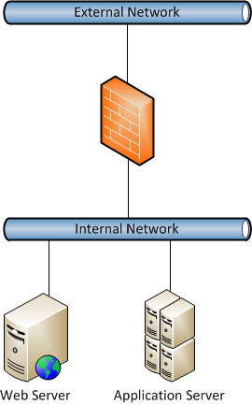
Screened subnet

Slide 19
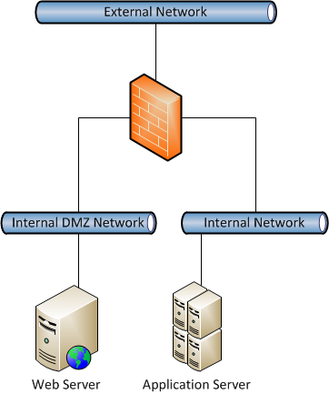
One-Legged DMZ
Uses single firewall
Hacked web server still needs to pass the firewall
Complex configuration

Slide 20
True DMZ
Two or more firewalls
  Internal and external
  Allows multiple firewall technologies
    Hardly to have the same flaw in two different types
  Configuration dependent on system topology
    Clusters require additional opened ports
    Multiple internal firewalls
    No bucks, no Buck Rodgers

Slide 21
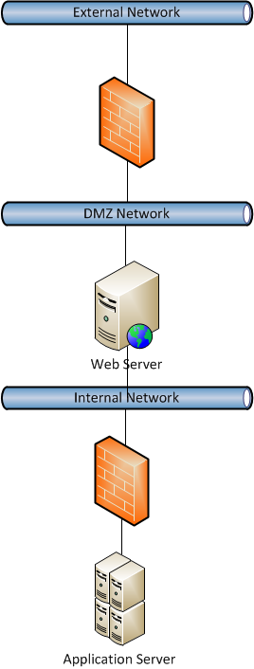
True DMZ

Slide 22
Network Security
Segment your network
  Routers with secure physical access
  Helps fighting the wire tapping
Network traffic encryption
  Using SSL
    Use it consistently
set CATALINA_OPTS=-Dcom.sun.management.jmxremote \
-Dcom.sun.management.jmxremote.port=%my.jmx.port% \
-Dcom.sun.management.jmxremote.ssl=false \
-Dcom.sun.management.jmxremote.authenticate=false

Slide 23
Network traffic encryption
Fronting with Apache Httpd
  AJP protocol is not encrypted
  Special Valve for mod proxy https
  Using SSL tunneling
  Using private VLAN's with virtulalization
  Using separate physical network segments

Slide 24
SSL Configuration
Using JSSE
Using Tomcat Native and OpenSSL
Use 1024 key or better
  Do not reuse keys between certificates
Use TLSv1 or better
Avoid out of the box hazardous configuration
  redirectPort="8443"
  Do not serve any resources that are otherwise
  delivered over SSL!

Slide 25
SSL Configuration
Site Type | Cert | Key size | Client Cert | Cipher | Key ex | Protocol
No authentication and all content public | - | - | - | - | - | -
Implemented authentication | DV | 1024 | - | 128 | - | TLSv1+
E-commerce | EV | 1024 | - | 128 | - | TLSv1+
Internet banking and similar | EV | 2048 | Opt | 256 | - | TLSv1+
Long term security | EV | 4096 | Yes | 256 | Ephemeral Diffie- Hellman only. | TLSv1+
Notes:
Scoring rules
Key Exchange 30%
Cipher strength 40%
Protocol support 30%

Slide 26
SSL Configuration
Sometimes mandated by field of use
  OCSP
    Enables to determine the (revocation) state of an identified certificate (RFC 2560).
    Supported both by JSSE and OpenSSL
  FIPS-140
    NIST specified and required for government use
    Requires special OpenSSL build
  Hardware encryption engines
    Supported with OpenSSL by majority vendors
    Check for JSSE availability

Slide 27
Fitting It All together
Developers and System Admins must work together
  Opposite goals make this hard
We are not an island
  Operating system
  JVM
  Networking
  Applications
  Each sub-system has an overall impact on security

Slide 28
Using Common Daemon
Run Tomcat as part of the System
  Huge difference between unix like and windows OS's
  Running on privileged ports
    Only one aspect
    Allows client initiated restart
  Close to Apache Httpd parent/child concept
    Cannot fork JVM
    Future work as part of Commons Runtime
      Integrating Tomcat Native and Commons Daemon
    Changing capabilities

Slide 29
Using Commons Daemon cont.
Replaces java executable
  Might not support all command line options
  Proper use requires custom DaemonLoader
Procrun or Windows service wrapper
  Big difference between pre and post Windows Vista
  Distinction between user and Session 0
  UAC
    Usually just turned off because of annoyance
Running under special account
  Allow similar behavior across platforms
    Lots of work in the future

Slide 30
Maintenance and Life cycle Management
Essential part of system stability and security
  Tomcat community doesn't produce patches
  Fixed in the next version
    You might get more then you wanted
    Patch your own source, or
  Use professional support
    Red Hat/JBoss
    VMware/SpringSource
    MuleSoft
    http://wiki.apache.org/tomcat/SupportAndTraining
    Tomcat Users List

Slide 31
Questions

Slide 32
TITLE SLIDE: HEADLINE
Securing and managing your Tomcat installations
Presenter name
Title, Red Hat
Date
Mladen Turk
Principal Sotware Engineer/Apache Tomcat PMC Chair
mturk@apache.org
mturk@redhat.com
05 November 2010
Notes:
This deck provides an overview of all of our JBoss Solutions for Java applications, from development tools to production runtime platforms to application management.

