Slide 1
Web Services and e-Business
Vince Kellen
Acting Vice President, Information Services, DePaul University
Instructor, School of CTI, DePaul University

Slide 2
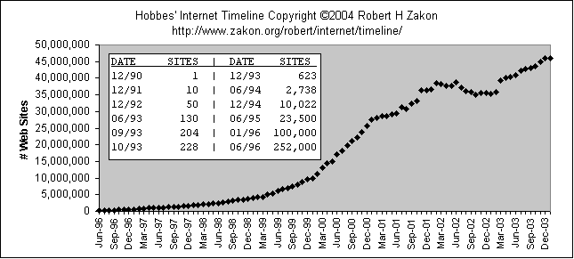
Growth of the Internet
Dot com bust begins

Slide 3
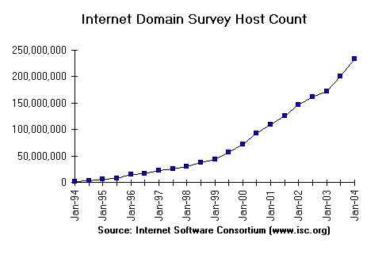
Growth of the Internet
Dot com bust begins

Slide 4
Dimensions of E-Commerce
??
Pure e-commerce
Amazon.com e-books
Digital
Insurance, Amazon.com
Product
E-tailing
Digital
Physical
Traditional commerce
Process
Physical
Physical
Digital
Intermediary

Slide 5
Business models
E-commerce types
Traditional purchase
Name your price
Find the best price
Dynamic brokering
Affiliate marketing
Group purchasing
Electronic tendering systems
Online auctions
E-marketplaces, exchanges
Business to business, B2B
Business to consumer, B2C
Consumer to consumer, C2C
Peer to peer, P2P
Consumer to business, C2B
Intra-business
Business to employee, B2E
Government to citizen, G2C
Exchange to exchange, E2E
Mobile commerce

Slide 6
EC is Interdisciplinary
Marketing
Creative (digital art, design, photography, cinematography)
Computer science
Consumer behavior, psychology
Finance
Economics Accounting, auditing
Management
Strategy, planning
Business law, ethics

Slide 7
E-Business continuum
Pre-Internet
  One-to-one, EDI
EDI over the Internet
  Peer to peer EDI
Net Markets
  Exchanges provide M:M mapping
Cooperative coercion
  Peers to hub, Covisint
Collaborative Community
  Hub and spoke, peer to peer, hub

Slide 8
Trading communities: Information flow
Governments
Professional
Associations
Universities
Researchers
Manufacturers
Dealers
Contractors
An Exchange
Or
A Business
Customers
Suppliers
Retailers
Subsuppliers
Content
Providers
Banks,
Financial
institutions
Logistic
Services
IT
Providers
Other
Exchanges

Slide 9
Supplier aggregation
Small Buyers
SME 1
Supplier 1
Hosting
SME 2
Workflow
Applications
Supplier 2
Aggregation
Of
Catalogs
SME 3
Supplier 3
SME 4
Supplier 4
Large Buyers
Buyer 1
Workflow,
Approvals, budget controls
ERP, SCM
Integration

Slide 10
EC Services
E-Process
E-Markets
Payment
Financial
Services
Logistics
and related
Marketing
Sales
Advertising
Affiliate
programs,
data mining
E-Infrastructure
Consulting
E-Communities
Systems
development
Business partners
B2B Applications
Portals, Buy-side
Sell-side, Auctions
Exchanges
Integration
standards
Government
Hosting,
Security, others
Customers
Suppliers
Networks,
EDI, Extranets
E-Content
E-Services
Other
Services
Content
Directory
Services
CRM
PRM

Slide 11
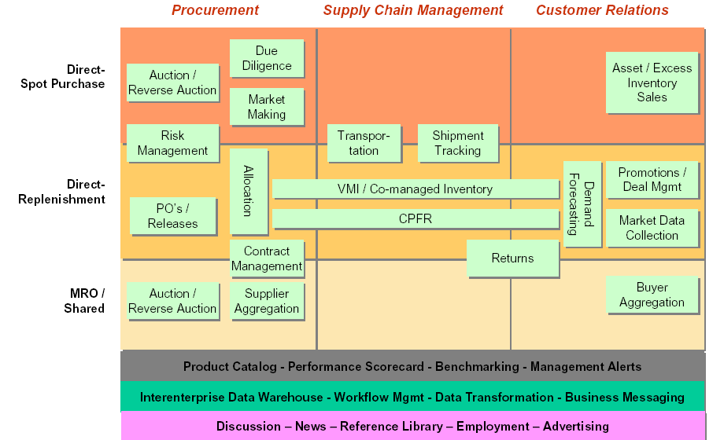
B2B Exchanges and B2B Portals
Source: http://www.cpfr.org

Slide 12
Marketing Type Factor | Transactional Marketing | Relationship Marketing
 | Transaction Marketing (1:Infinity) | Database Marketing (1:N) | Interaction Marketing (1:1) | Network Marketing (M:M)
Purpose of exchange | Economic transaction | Information and economic transaction | Interactive relationships between buyer and seller | Connected relationships between firms
Nature of communication | Firm to mass market | Firm to targeted segments | Individuals with individuals (across organizations) | Firms with firms (involving individuals)
Type of contact | Arm’s-length, impersonal | Personalized (yet distant) | Face-to-face (close, based on commitment, trust and cooperation | Impersonal to interpersonal (ranging from distant to close)
Managerial intent | Customer attraction (to satisfy the customer at a profit) | Customer retention (to satisfy the customer, increase profit, increase loyalty, decrease customer risk) | Interaction (to establish, develop, and facilitate a cooperative relationship for mutual benefit) | Coordination (interaction among sellers, buyers and other parties across multiple firms for mutual benefit, resource exchange, market access)
Managerial focus | Product or brand | Product/brand and customers (in a targeted market) | Relationships between individuals | Connected relationships between firms (in a network)
Managerial level | Functional marketers (sales manager, product development manager) | Specialist marketers (customer services manager, loyalty manager) | Managers from across functions and levels in the firm | General Manager
Source: “How Firms Relate to Their Markets,” Journal of Marketing, Summer 2002.

Slide 13
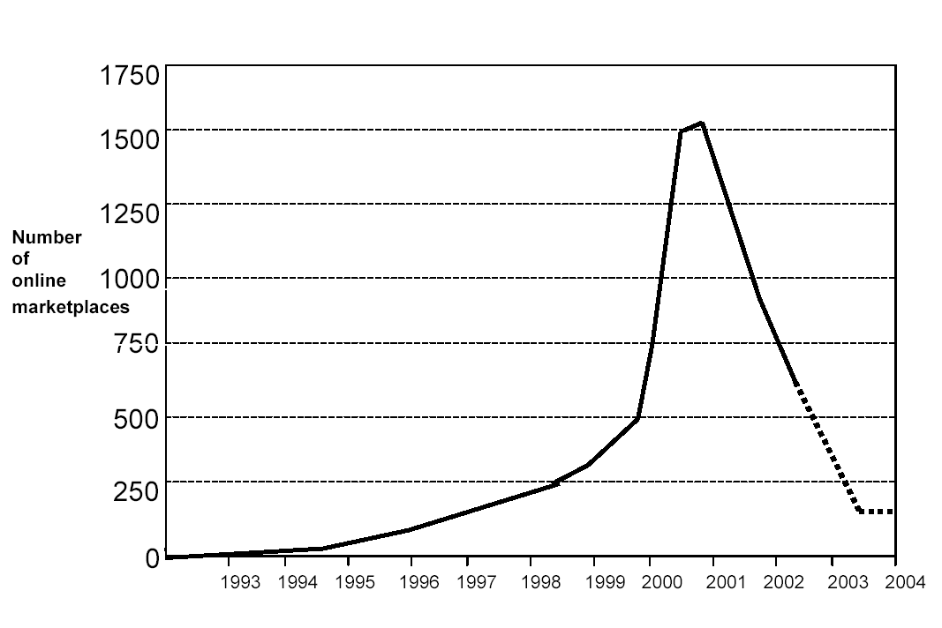
Wither exchanges?
Source: “Shakeouts in Digital Markets: Lessons from B2B Exchanges,” Day, G.S., Fein, A. J. & Ruppersberger, G, Nov. 2002

Slide 14
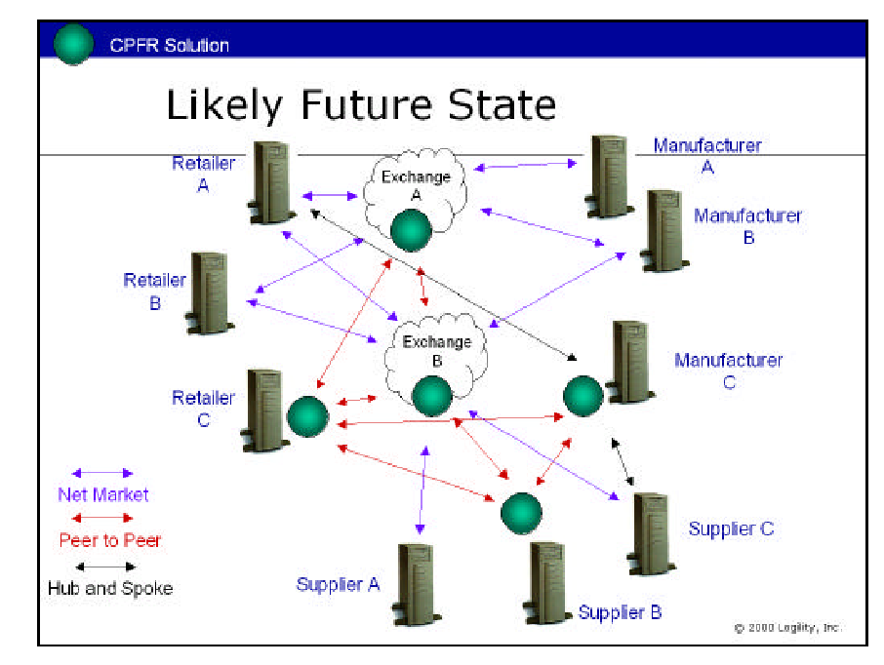

Slide 15
Enterprise application integration
Allow multiple applications to talk to each other so the user finds them easier to use
Various ways of providing integration
  Message oriented middleware (MOM)
  Extraction, transformation and loading (ETL)
  Web services, SOAP, XML, UDDI
  Object interfaces (EJB, RMI, CORBA, COM)
  Direct data access (SQL/ODBC)

Slide 16
Ways to integrate data
Network layer
  TCP/IP, seamless routing of packets across the enterprise
Data architecture layer
  Database system consistency (e.g., all-Oracle, all OLE-DB compliant, all JDBC compliant)
Middleware data layer
  MOM/EAI, ETL, home-brew

Slide 17
Ways to integrate data, more
Logical data layer
  Common relational schema, consistent record unique identifiers, common data models, attribute definitions
Middleware application layer
  Application-Application direct dialog
  COM, DCOM, COM+, EJB, CORBA, RPC, SOAP
Presentation layer
  xHTML, HTML, XML, WML, Windows GUI, Web Services
  Interface ties disparate applications or data stores together

Slide 18
Integration Factors
Heterogeneity
  Networks
  Computer hardware, operating systems
  Programming languages, implementations
Openness
  Published interfaces
Security
Scalability
  Lots of data or small amount of data
Failure handling
Transparency
  Access (local, remote), location, concurrency, replication, failure, mobility of clients & resources
Time
  Real time versus non real time
  Synchronous versus asynchronous

Slide 19
Web Services
The Basics
  Distributed programming via HTTP & XML
  WSDL – Web Services Description Language
  UDDI – Universal Description, Discover and Integration
  SOAP – Simple Object Access Protocol

Slide 20
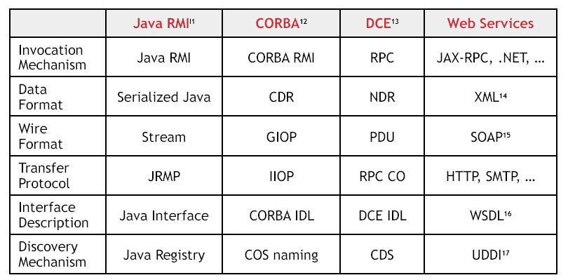
Comparisons

Slide 21
Client/Server Architecture
Binary calls to COM objects
MS
Exchange Server
MS Outlook
Client
POP3 / IMAP / SMTP calls
MS IIS
Data and control exchanged
MS
Exchange Server
2000
Browser
via HTTP
Source: Enrique Castro-Leon, “A Perspective on Web Services.” http://webservices.org

Slide 22
Web Services Architecture
Web services server interface
Web services client interface
MS IIS
MS Outlook
Client
Data and control exchanged
MS
Exchange Server
2000
using XML inside SOAP wrappers
Services
Directory
(UDDI)
Setup, billing
service description
Using WSDL

Slide 23
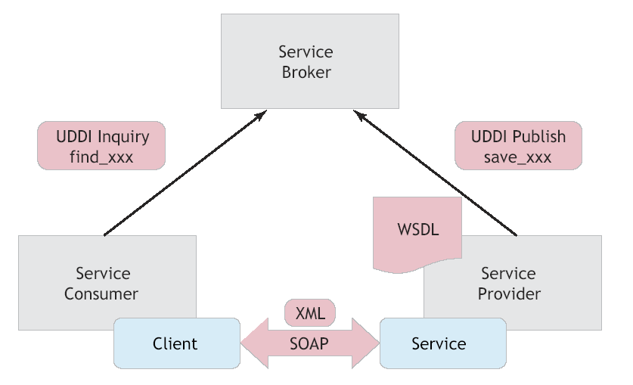
Generic Model

Slide 24
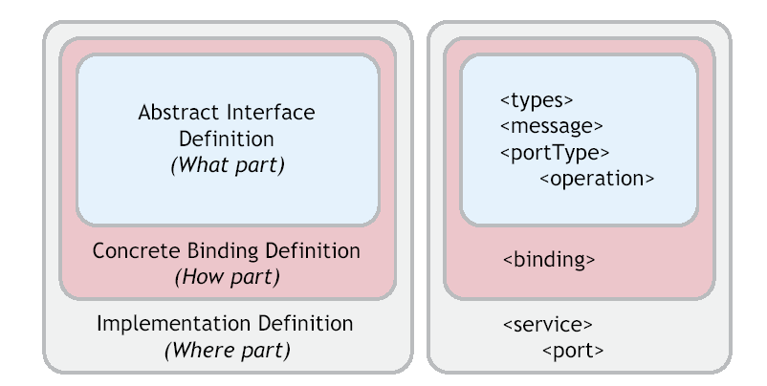
WSDL Structure

Slide 25
Sample WSDL
<?xml version="1.0"?>
<definitions name="StockQuote"
targetNamespace="http://example.com/stockquote/service"
xmlns:tns="http://example.com/stockquote/service"
xmlns:soap="http://schemas.xmlsoap.org/wsdl/soap/"
xmlns:defs="http://example.com/stockquote/definitions"
xmlns="http://schemas.xmlsoap.org/wsdl/">
<import namespace="http://example.com/stockquote/definitions"
location="http://example.com/stockquote/stockquote.wsdl"/>
<binding name="StockQuoteSoapBinding" type="defs:StockQuotePortType">
<soap:binding style="document" transport="http://schemas.xmlsoap.org/soap/http"/>
<operation name="GetLastTradePrice">
<soap:operation soapAction="http://example.com/GetLastTradePrice"/>
<input>
<soap:body use="literal"/>
</input>
<output>
<soap:body use="literal"/>
</output>
</operation>
</binding>
<service name="StockQuoteService">
<documentation>My first service</documentation>
<port name="StockQuotePort" binding="tns:StockQuoteBinding">
<soap:address location="http://example.com/stockquote"/>
</port>
</service>
</definitions>
http://www.w3.org/TR/wsdl#_style

Slide 26
SOAP
SOAP is a simple and lightweight mechanism for exchanging structured and typed information between peers in a decentralized, distributed environment using XML
SOAP does not define implementation specific semantics. It defines a simple mechanism for expressing semantics
SOAP can be used for one-way or two-way (request-reply) protocols
Source: http://www.w3.org/TR/SOAP/

Slide 27
Sample SOAP
HTTP REQUEST
POST /StockQuote HTTP/1.1
Host: www.stockquoteserver.com
Content-Type: text/xml; charset="utf-8"
Content-Length: nnnn
SOAPAction: "Some-URI"
<SOAP-ENV:Envelope
xmlns:SOAP-ENV="http://schemas.xmlsoap.org/soap/envelope/"
SOAP-ENV:encodingStyle="http://schemas.xmlsoap.org/soap/encoding/">
<SOAP-ENV:Body>
<m:GetLastTradePrice xmlns:m="Some-URI">
<symbol>DIS</symbol>
</m:GetLastTradePrice>
</SOAP-ENV:Body>
</SOAP-ENV:Envelope>
HTTP REPLY
HTTP/1.1 200 OK
Content-Type: text/xml; charset="utf-8"
Content-Length: nnnn
<SOAP-ENV:Envelope
xmlns:SOAP-ENV="http://schemas.xmlsoap.org/soap/envelope/"
SOAP-ENV:encodingStyle="http://schemas.xmlsoap.org/soap/encoding/"/>
<SOAP-ENV:Body>
<m:GetLastTradePriceResponse xmlns:m="Some-URI">
<Price>34.5</Price>
</m:GetLastTradePriceResponse>
</SOAP-ENV:Body>
</SOAP-ENV:Envelope>
More examples: http://www.w3.org/TR/soap12-part0/

Slide 28
Corporate Portal:
Plumtree Architecture

Slide 29
Plumtree and Web Services
Plumtree uses HTTP to communicate between key software components, not COBRA, RMI, DCOM/COM/COM+ or other distributed object models
Plumtree uses SOAP (Simple Object Access Protocol) for component communication via HTTP

Slide 30
Plumtree Overview
Servers
  Plumtree Web Server
    Runs within IIS or UNIX application server. Parallel architecture
  Job Server
    Designed to handle asynchronous tasks (such as crawling for new information, synchronizing the Plumtree user directory with an LDAP directory or NT domain)
Crawler Web Services
  Tool that polls all information sources that are integrated to the portal server. Documentum, Interwoven, Lotus Notes, MS Exchange, file systems
  Accessors
    Component that indexes document text and metadata. Metadata is passed to a thesaurus for normalization. MS Exchange, Office, Visio, Lotus Notes, PDF, generic files, databases

Slide 31
Plumtree Overview (more)
Gadget Web Services
  Components that provide integration for 3rd party packaged applications. Similar to accessors or connectors, they include user interface elements. MS Exchange, Lotus Notes (calendar, email, contacts) and Collaboration (threaded discussions, document sharing, task management).
  Gadgets for Documentum, PeopleSoft, SAP and Siebel, Cognos, eRoom, IMAP
  Gadgets can be developed using many languages. XML/XSL, HTML/CSS, JavaScript
  Plumtree has Gadget Frameworks, graphical development tools that simply the process of creating Gadget Web Services
Authentication Web Services
  Synchronizing with enterprise security systems
Search web services
  Integration with 3rd part search engines. Verity. Google Search Appliance, Inktomi, SharePoint Portal Server

Slide 32
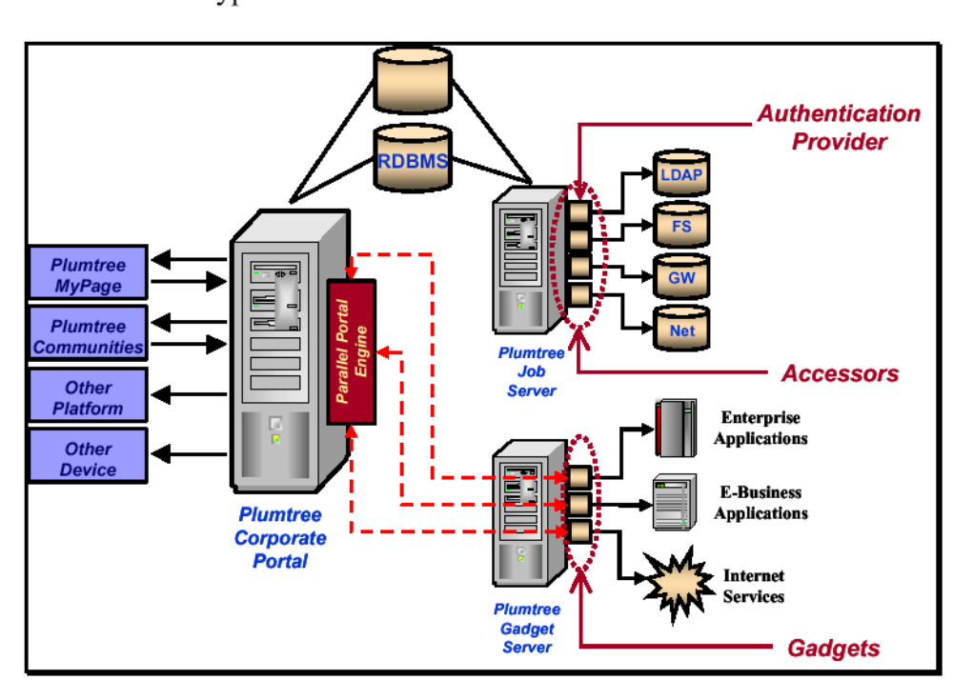
Plumtree Conceptual Architecture
Source: Doculabs

Slide 33
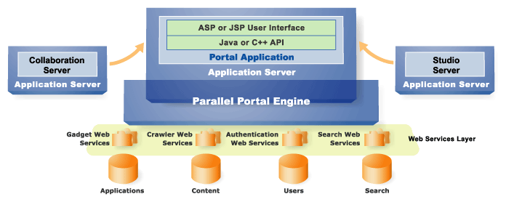
Plumtree conceptual architecture
Source: Plumtree

Slide 34
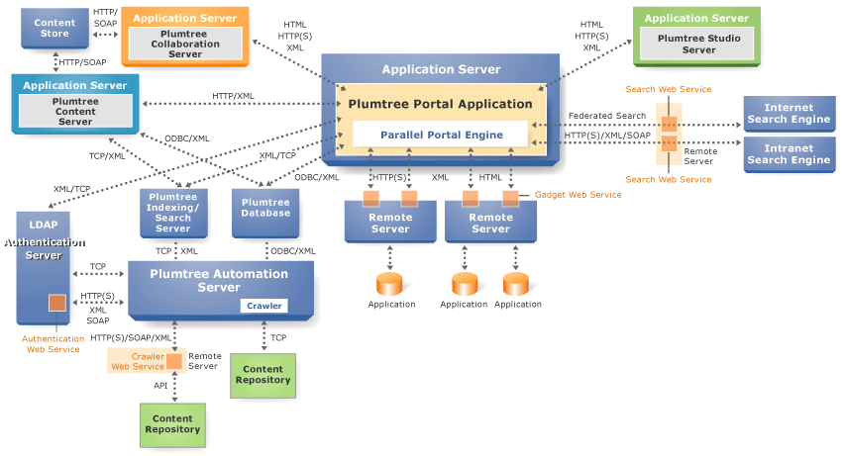
Plumtree Architecture
Source: Plumtree

Slide 35
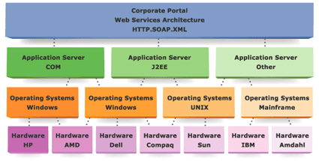
Plumtree Operability
Source: Plumtree

Slide 36
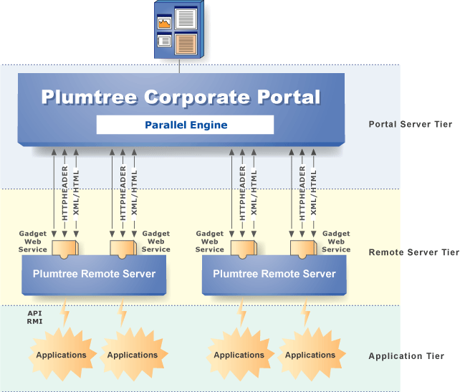
Gadgets
Source: Plumtree

Slide 37
Plumtree Gadget issues
Plumtree is participating in the development of two portlet standards, Java Specification Request (JSR) 168 and Web Services for Remote Portals (WSRP). Other vendors include
  Accenture, Apache Software Foundation, BEA, Boeing, Borland, Bowstreet, Cap Gemini Ernst & Young, Citrix, Computer Associates, CoreMedia, DaimlerChrysler, Documentum, Enformia Ltd, Epicentric, Hewlett-Packard, Interwoven, Macromedia, McDonald Bradley, Oracle, SAP, Silverstream, Sybase, Tarantella, Inc, Vignette
  Specifications to be complete in 2003, both of which are still being specified.
  see http://www.jcp.org/en/jsr/detail?id=168
Plumtree currently supports SAP MiniApps and Microsoft Web Parts as Gadget Web Services.

Slide 38
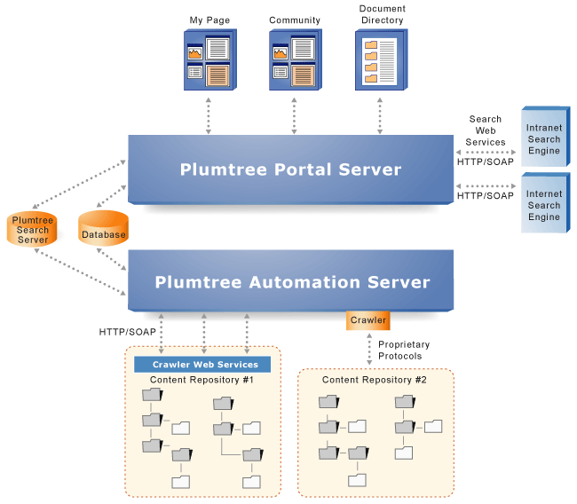
Crawlers
Source: Plumtree

Slide 39
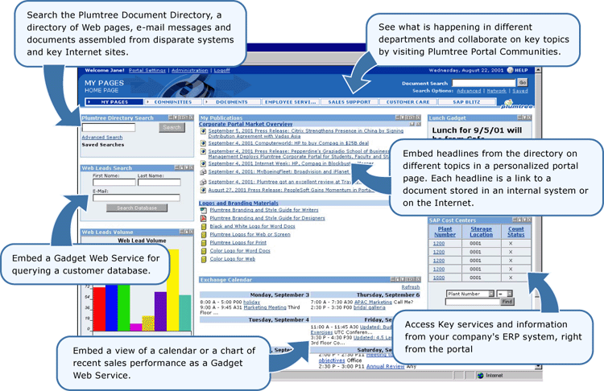
Plumtree Sample
Source: Plumtree

Slide 40
Web Services: What’s coming
Web Services Management Platform
  Basic services: publication, discovery, selection and binding
  Composite services: conformance, monitoring and QoS
  Managed services: market certification, rating, SLA and operations support
Advanced management standards
  WS-Coordination, WS-Security, WS-Transaction, WS-Reliable Messaging WS-Policy, BPELWS
Web Services Networks
  Companies that provide a WS management platform and support for advanced standards. An intermediary that supports digital collaboration between applications using web services standards

Slide 41
Web Services trends
Web services in private exchanges
  Need for agile relationships with partners
  Protect identity of businesses, services or otherwise maintain secrecy
P2P and Web Services converging
  UDDI is a centralized model. Will a distributed model evolve (e.g., DNS)?
Increased complexity
  Hub and spoke with WSN, Hub and spoke without a WSN, P2P with unilateral control, facilitated P2P
Decline of ERP vendors?
  Smaller, focused B2B collaboration possible, avoiding large-scale implementations
Shorter development timeframes?
  Quicker integration cycles at the cost of hardware/network bandwidth
Will web services increase business process integration?
  Power relationships in value chains drive process integration. With a radically decentralized, diffuse web services network, how much will processes integrate? Loosely-coupled? Tightly coupled?

Slide 42
Information
TCP & IP, HTML and its variants, XML, web services, e-mail, directory services (LDAP)
Standards bodies
  UN/CEFACT (UN body for the facilitation of e-commerce. www.ebxml.org
  W3C (www.w3.org) deals with XML, Web Services and other standards
  RosettaNet (www.rosettanet.org) supply chain topics
  OBI consortium (purchasing MROs)
  UDDI (www.uddi.org) standard for registration of products, web services
  OASIS (www.oasis-open.org), web services standards, e-business standards, XML
Portals
  http://www.webservices.org/
  http://www.sys-con.com/webservices/
  http://www.webservicesarchitect.com/

