Slide 1
Chapter 2: Channel Basics

Slide 2
Agenda
Learning Objectives
Introduction
The Key Functions Marketing Channels Perform
Auditing Marketing Channels
Auditing Channel Functions Using the Efficiency Template
Auditing Channels Using Gap Analysis
Auditing Omni-Channels
Take-aways

Slide 3
Learning Objectives
Define the generic channel functions that characterize costly and value-added channel activities.
Understand how the efficiency template helps codify channel function performance according to the channel and channel participant.
Describe the role of channel function allocation in designing a zero-based channel.
Recognize how channel function performance leads to appropriate allocations of channel profits among channel members, using the equity principle.

Slide 4
Learning Objectives
Locate channel function analysis within an overall channel audit process.
Use the efficiency template, even in conditions with little information.
Define service and cost gaps and describe the sources of these gaps.
Perform a gap analysis using both service and cost gaps analysis templates.
Appreciate the challenges of conducting a channel audit in an omni-channel environment.

Slide 5
Agenda
Learning Objectives
Introduction
The Key Functions Marketing Channels Perform
Auditing Marketing Channels
Auditing Channel Functions Using the Efficiency Template
Auditing Channels Using Gap Analysis
Auditing Omni-Channels
Take-aways

Slide 6
The Importance of Marketing Channel Strategies
The central task for marketing is to design and manage a channel structure that can ensure the overall channel system operates efficiently and effectively.
Strong channel systems have a competitive asset and is not easily replicated by other firms, which means it is a source of a sustainable competitive advantage.
If firms adopt less-than-effective channel strategies, products and services will suffer from limited reach and insufficient attractiveness to buyers.

Slide 7
Why Do Marketing Channels Exist?
Channels are essentially sets of interdependent organizations that act as teams and operate on trust.
Marketing Channels exist because they balance the benefits of interacting directly with end-users and its incremental costs.
This balance constantly shifts, which means marketing channels are constantly changes.
It is critical to understand the benefits that intermediaries in the channel provide to both upstream and downstream channel members, service outputs.

Slide 8
Benefits of Downstream Channel Members
Search facilitation- Marketing channels with intermediaries arise partly because they facilitate searches.
Intermediaries help both end-users and sellers because end-users need to find the product, and sellers need to know exactly how to reach their target end-users.
Sorting- Independent intermediaries perform the valuable function of sorting goods and resolving the natural discrepancy between the assortment of goods and services produced by a manufacturer and the assortment demanded by the end-user.
This arises when manufacturers produce a large quantity of a wide variety of goods.
Intermediaries can sort out and break down heterogeneous supply into separate stocks that are relatively homogeneous.

Slide 9
Benefits to Upstream Channel Members
Routinization of transactions- each purchase transaction involves ordering, determining the valuation of, and paying for goods and services.
The buyer and seller must agree on the amount, mode, and timing of payment.
Leads to efficiencies in the execution of channel activities.
Continuous replenishment programs (CRP) remain an important element of efficient channel inventory management.

Slide 10
Example:
Cobweb designs is a high-quality needlework design firm headquartered in Scotland, and licenses needlework kits relating to the royal family, the national trust for Scotland, etc.. Its proprietor, Sally Scott Aiton wanted to reach a larger market in the united states. Aiton sought retail placements in gift shops at major art museums and botanical gardens. Gaining shelf space in a gift shop of a museum like Smithsonian Institution could enhance the company’s sales reach. In short, the intermediary (retail museum shop) becomes the “matchmaker” that brings the buyer and seller together.

Slide 11
Benefits to Upstream Channel Members
Fewer Contacts- Without channel intermediaries, every producer would have to interact with every potential buyer to create all possible market exchanges.
Example: In a small village of only 10 households trading among themselves, 45 transactions would be necessary to conduct decentralized exchanges at each production point (i.e. (10*9)/2)). But if the village added a central market with hone intermediary, it could reduce the complexity of this exchange system and facilitate transactions, such that only 20 transactions would be required to carry out the centralized exchange (10+10).

Slide 12
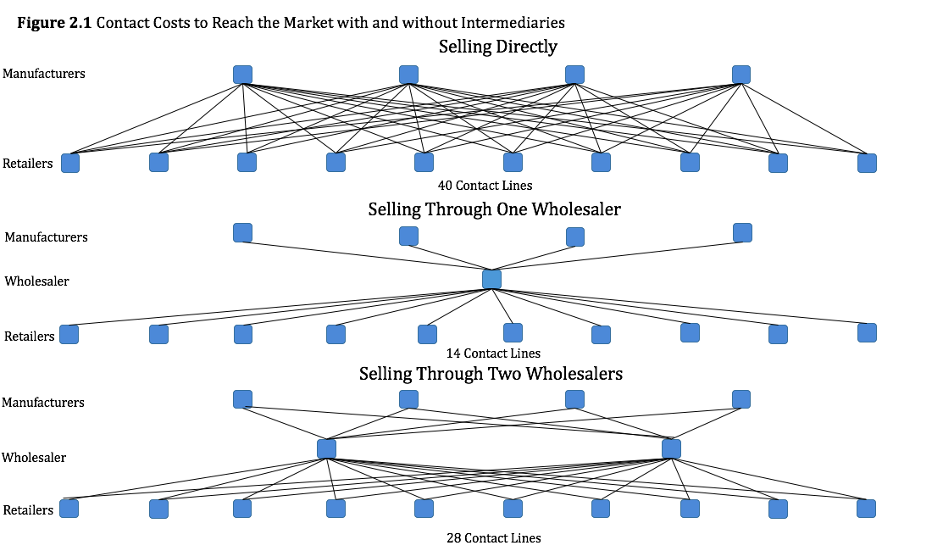

Slide 13
Agenda
Learning Objectives
Introduction
The Key Functions Marketing Channels Perform
Auditing Marketing Channels
Auditing Channel Functions Using the Efficiency Template
Auditing Channels Using Gap Analysis
Auditing Omni-Channels
Take-aways

Slide 14
The Key Functions Marketing Channels Perform
Channel Functions- constitute a process, flowing through a channel, performed at different points in time by different channel members.
Functions include carrying or holding inventory, generating demand through selling activities, distributing products, engaging in after-sales service, and extending credit to other channel members.
Channel Functions take different forms in different points of the channel.

Slide 15
The Key Functions Marketing Channels Perform cont.
Not every channel member needs to participate in every channel function.
The performance of certain channel functions is correlated with that of other functions.
It is possible to eliminate or substitute for members of the channel but not for the functions they perform.
Information sharing is very important to help perform and promote functions better.

Slide 16
Designing Channel Structures and Strategies
A channel manager conducts analyses to determine the degree of channel intensity, mix of channel types/identities, and use of dual distribution, as well as to close any service or cost gaps.
Each segment has a level of intensity, the number of channel partners competing for customers.
More intensive distribution makes the product more readily available to all target end-users, but it also can create conflict among the retailers that compete to sell it.

Slide 17
Designing Channel Structures and Strategies
Example:
Imagine a channel manager seeking to sell a line of fine watches in retail stores. Which types of exact identities of channel partners are optimal: upscale outlets, such as Tiffany’s, or family-owned jewelers? This choice has implications for both channel efficiency and brand image. If the company also seeks to distribute its products in foreign markets, it needs to choose a distributor that can sell overseas, leveraging its good relationships with local channel partners in the target market.

Slide 18
Agenda
Learning Objectives
Introduction
The Key Functions Marketing Channels Perform
Auditing Marketing Channels
Auditing Channel Functions Using the Efficiency Template
Auditing Channels Using Gap Analysis
Auditing Omni-Channels
Take-aways

Slide 19
Auditing Marketing Channels
Auditing is a key step in the marketing channel system. It happens after identifying targeted segments of end-users.
Such audits evaluate each available channel member’s capability to provide service outputs efficiently
Bulk breaking, quick delivery, spatial convenience, assortment, variety, etc.
Must include both the level and the cost of the service outputs provided by each channel member
All members of marketing channel are engaged in productive activity.

Slide 20
Auditing Marketing Channels
Important benefits:
detailed knowledge of the capabilities of each channel member allows them to diagnose and remedy shortcomings in the pricing and provision of service outputs to targeted segments.
An audit may identify gaps in service outputs desired by targeted end-user segments, such that service providers can add necessary new channels or revise currently existing ones to address the shortcomings.
Knowing which channel members have incurred the costs of performing which channel functions helps members allocate channel profits equitably. In turn, channel members can better preserve a sense of fairness and cooperation and avert channel conflicts.

Slide 21
Auditing Marketing Channels
Physical possession- refers to channel activities pertaining to the storage of goods, including transportation between channel members.
For service, such as online bill payment, physical possession costs seemly should be lower, but they still apply to channel members who host data.
Costs of physical possession are distinct from the costs of ownership.
Physical possession and ownership move together in many channel systems. The term commonly used to designate their combined costs is inventory holding costs.

Slide 22
Auditing Marketing Channels
Inventories refer to stocks of goods or components used to make them, and they exist for several reasons.
Demand surges outstrip production capacity. To smooth production, factories anticipate such surges and produce according to the forecast.
Economies of scale exist in production and transportation.
Transportation takes time, especially with greater distances between points of production and points of consumption.
Supply and demand are uncertain.

Slide 23
Auditing Marketing Channels
Promotion functions take many forms: personal selling, media advertising, sales promotions, publicity, etc. These activities seek to increase awareness of the product being sold, educate consumers, and persuade people to purchase the product.
The Negotiation function is present in the channel if the terms of sale or persistence of certain relationships are open for discussion.
Financing costs are inherent to any sale that moves from one level of the channel to the other. Typical financing terms for a B2B purchase requires payment within 30 days and may offer discounts for early payments.

Slide 24
Auditing Marketing Channels
Risk- Long-term contracts between a distributor and end-user may specify price guarantees that lock the distributor to a certain price. If the market price for that product rises while the contract is in force, the distributor loses revenue.
Ordering/Payment costs- are incurred during the actual purchase of and payment for the product.
Information sharing takes place among and between every channel member, in both routine and specialized ways.

Slide 25
Agenda
Learning Objectives
Introduction
The Key Functions Marketing Channels Perform
Auditing Marketing Channels
Auditing Channel Functions Using the Efficiency Template
Auditing Channels Using Gap Analysis
Auditing Omni-Channels
Take-aways

Slide 26
Auditing Channel Functions Using the Efficiency Template
To audit a channel members’ capability to provide each channel function and add value, and at what cost, we can use an efficiency template. This template:
Describes the types and amounts of work done by each channel member to perform the marketing functions
The importance of each channel function to the provision of end-user service outputs
The share of total channel profits that each channel member should reap.

Slide 27
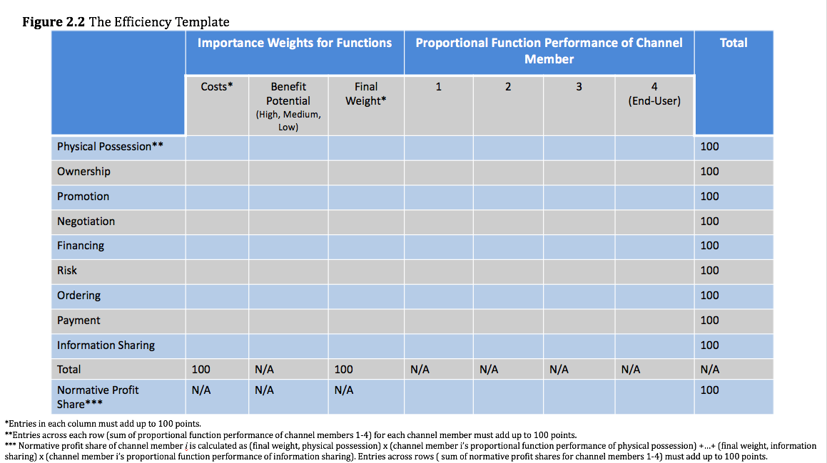

Slide 28
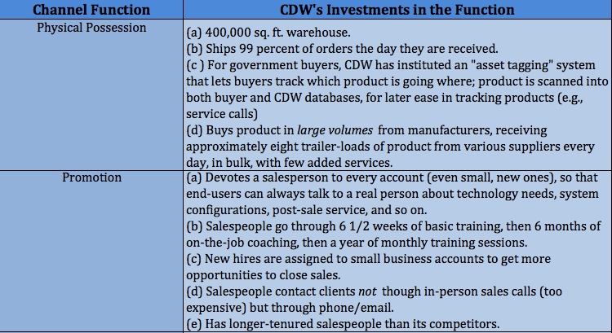
Table 2.1 CDW'S Participation in Various Channel Functions

Slide 29
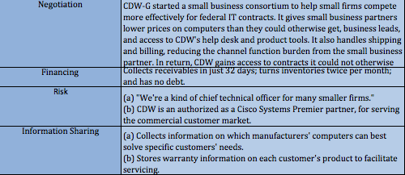
Table 2.1 CDW'S Participation in Various Channel Functions

Slide 30
Auditing Channel Functions Using the Efficiency Template
In summary, the efficiency template is useful for codifying the costs borne, and the value added to the channel by each channel member, including end users.
Can reveal how the costs of particular functions get shared among channel members
Indicates how much each channel member contributes to the overall values creation in the channel
Demonstrates how important each function is to total channel performance.
Can be a powerful tool for justification for current channel performance or changes.

Slide 31
Evaluating Channels: The Equity Principle
The equity principle:
A member’s level of compensation in the channel system should
reflect its degree of participation in the marketing functions and the value created by such participation. That is, compensation should mirror the normative profit shares of each channel member.

Slide 32
The Equity Principle
Is appropriate to reward each channel member in accordance with the value it creates.
Creates strong incentive for channel members to continue generating value.
Channel members must identify the actual costs they incur and develop an acceptable estimate of the value created in the channel.
Actual profit shares do not match the normative shares suggested by the efficiency template.

Slide 33
Evaluating Channels: Zero-Based Channel Concept
Zero-based channels start from scratch and it entails recognizing the level of channel functions that need to be performed to generate appropriate service outputs in the market.

Slide 34
Evaluating Channels: Zero-Based Channel Concept
Sometimes, zero-based channels may not even exist. To know if you need to design a brand new channel system, follow these questions as possible guidelines:
What less or non-valued functions can be eliminated without damaging customer or channel satisfaction.
Are there any redundant activities? Which of them could be eliminated to lower the costs for the entire system?
Is there a way to eliminate, redefine, or combine certain tasks to minimize the steps to a sale or reduce its cycle time?
Is it possible to automate certain activities and thereby reduce the unit costs required to get products to market, even if fixed costs increase?
Are there opportunities to modify information systems to reduce the costs of prospecting, order, entry, quotes generation, or similar activities?

Slide 35
Agenda
Learning Objectives
Introduction
The Key Functions Marketing Channels Perform
Auditing Marketing Channels
Auditing Channel Functions Using the Efficiency Template
Auditing Channels Using Gap Analysis
Auditing Omni-Channels
Take-aways

Slide 36
Auditing Channels Using Gap Analysis
Sources of Channel Gaps:
Gaps in a channel can arise because management has not thought carefully about target end-users’ demands for service outputs or about managing the cost of running their channel.
The solution is simple: Pay attention to both service gaps and cost gaps when designing the channel.
Gaps can arise from limitations placed on even the best intentioned channel managers.

Slide 37
Environmental and Managerial limitations.
Environmental Bounds
Local legal regulations- legal conditions in the marketplace shape which channel partners a company may choose-that is, if they do not simply prevent the company’s access to the market all together.
Sophistication of the physical and retailing infrastructure may prevent certain types of distribution channel structures
They occur outside the boundaries of company directly involved in the channel and prevent channel members from establishing a zero-based channel
Managerial Bounds
Refer to constraints on the distribution structure that arise from the rules imposed by a company-typically, the company that manufactures the product. Sometimes a desire to control the customers, or simply a lack o trust among channel members prevents managers from implementing a less bounded channel design.
May also reflect lack of knowledge about the appropriate levels of investment or activity.

Slide 38
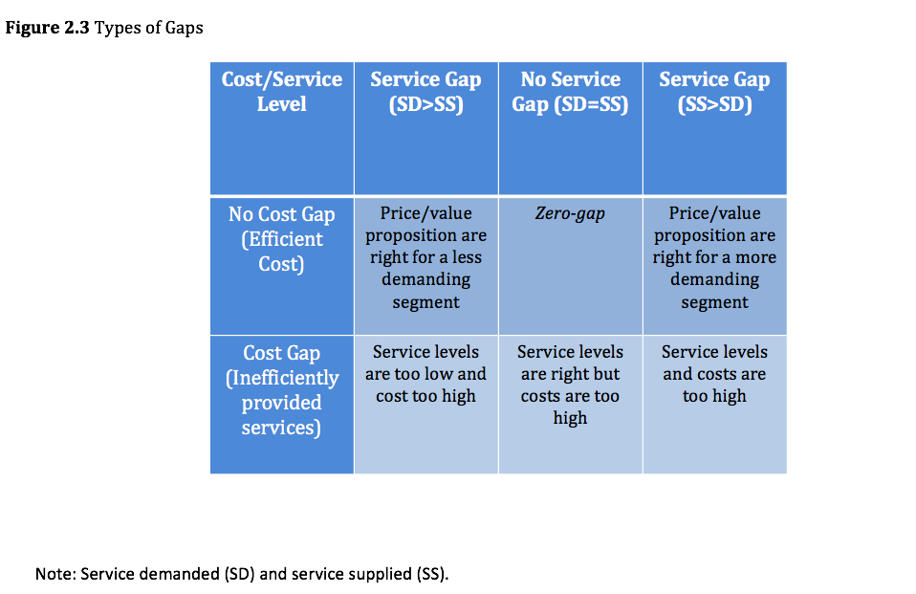

Slide 39
Service Gaps
A service gap exists if the amount of service supplied is less than the service demanded or if the amount of service supplied is greater than the amount demanded.
Businesses have to worry about not just their own service outputs but also the service outputs of other businesses. When one business offers better service, it charges a higher price for the goods it sells; when another business offers poor service, its prices tend to be lower.
It is also possible to find service gaps in more than one service output.
It is critical to perform service gap checks
Segmentation helps identify which service gaps exist for which clusters of potential buyers.

Slide 40
Cost Gaps
A cost gap occurs when the total cost of performing all channel functions is too high, generally because one or more relevant channel functions, from physical possession to information sharing, are too expensive.
If channel functions are to be shifted, a gap will result unless the channel member to whom the functions are shifted agrees to perform them.
High costs are a strong signal of cost gaps, or might exist without any evidence.

Slide 41
Combining Channel Gaps
It is critical to identify the source of the gap.
If a gap arises solely from the cost side, the channel cannot reduce or increase its service output provision in its efforts to reduce costs.
If a service gap, involving too much of a particular service output, and a cost gap, due to inefficiently performed functions, coexist, reducing the level of service outputs offered without also increasing efficiency can never fully close the gap.
If a service gap implies insufficient service outputs, combined with a high cost gap, the temptation may be to cut service provision to reduce channel costs.

Slide 42
Combining Channel Gaps
Cost and service combinations also might arise from the links between cost decisions and the provision of service outputs.
The principals of postponement and speculation offer a good example.
Postponement refers to the desires, by both firms and end-users, to put off incurring costs as long as possible.
Speculation involves producing goods in anticipation of orders, rather than in response to them.

Slide 43
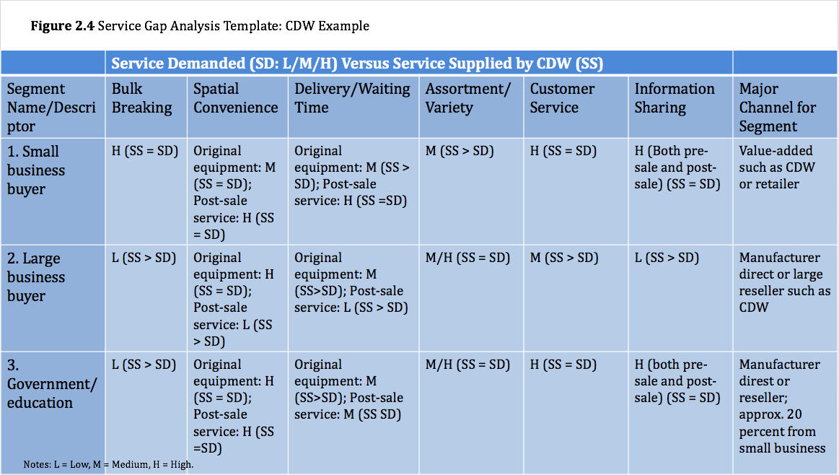

Slide 44
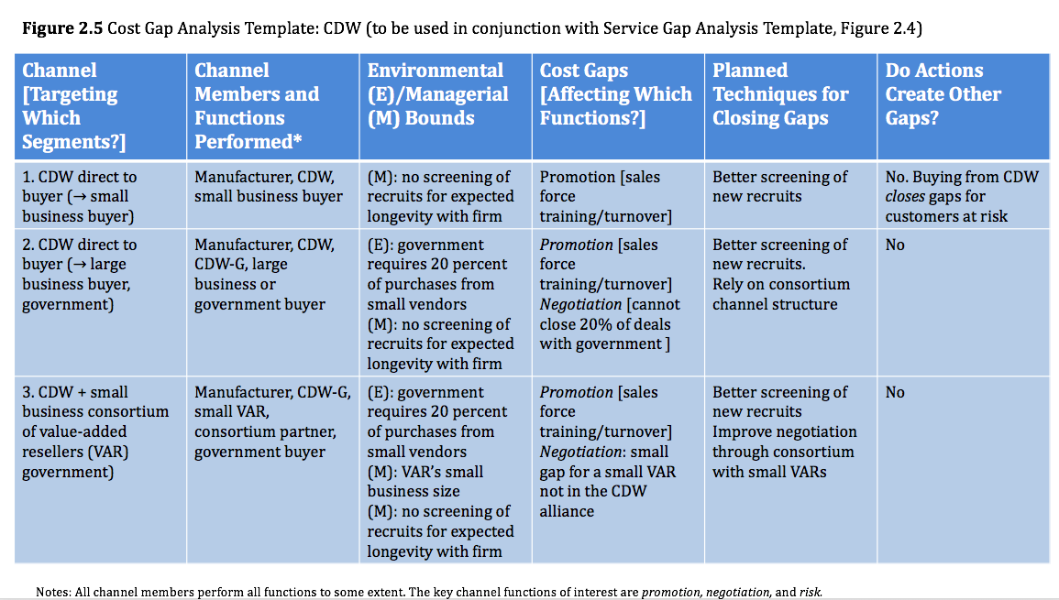

Slide 45
Make-or-Buy Channel Analysis
Offer a structured approach.
In the base case, the manufacturer rarely should vertically integrate a downstream function, because it is typically inefficient to do so. However a manufacturer should take responsibility for a wider set of functions in the channel if it has sufficient resources and could increase its returns on investment over time through integration.

Slide 46
Agenda
Learning Objectives
Introduction
The Key Functions Marketing Channels Perform
Auditing Marketing Channels
Auditing Channel Functions Using the Efficiency Template
Auditing Channels Using Gap Analysis
Auditing Omni-Channels
Take-aways

Slide 47
Auditing Omni-Channels
With an omni-channel audit, the auditor seeks to check and ensure that the myriad channels are functioning seamlessly to deliver a cohesive customer experience.
Consumers generally perceive that they are dealing with a single entity, so they demand consistency among channels.

Slide 48
Example: Disney (USA/Global)
Disney offers a seamless omni-channel experience. They have a user-friendly website, and Disney encourages consumers to use mobile devices to maximize their experiences during actual visits to its theme parks. For example, with the my Disney app, they can purchase fast passes or obtain real-time dining and attraction information, including wait times for rides. Their phones function as hotel keys on Disney's resort hotels too. Disney is extending the omni-channel experience to its retail stores, by integrating its vaunted storytelling experience with technology, livestreaming the famous Disney main street parades in stores, and training store employees to interact with customers similar to the way staff members in the park do, to bring the Disney experience to life.

Slide 49
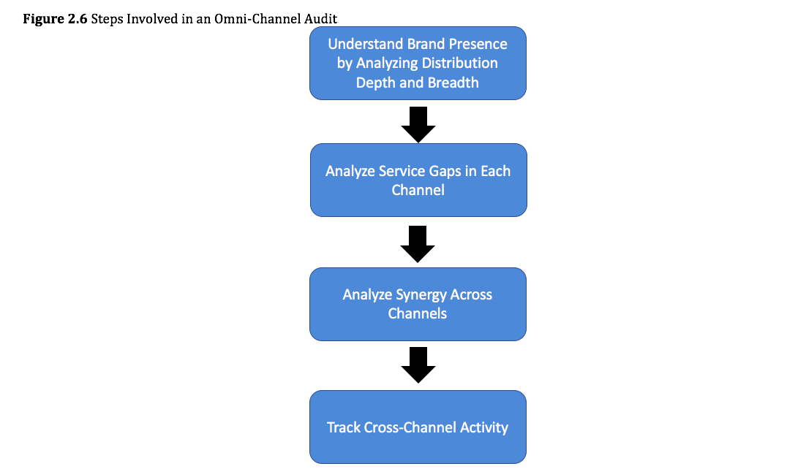

Slide 50
Auditing Omni-Channels
Distribution depth- refers to the ease of finding a brand within a particular channel or outlet.
Distribution breadth- refers to brand coverage, or the ease of finding a source for it, whether online or in store.
To achieve this, the manufacturer needs to make its brand available in multiple venues.

Slide 51
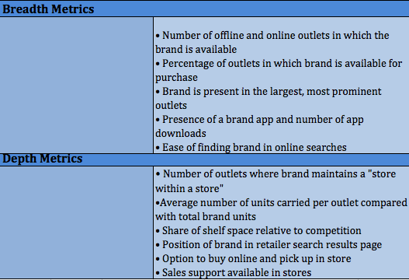
Table 2.2 Metrics for Measuring Omni-Channel Distribution Breadth and Depth

Slide 52
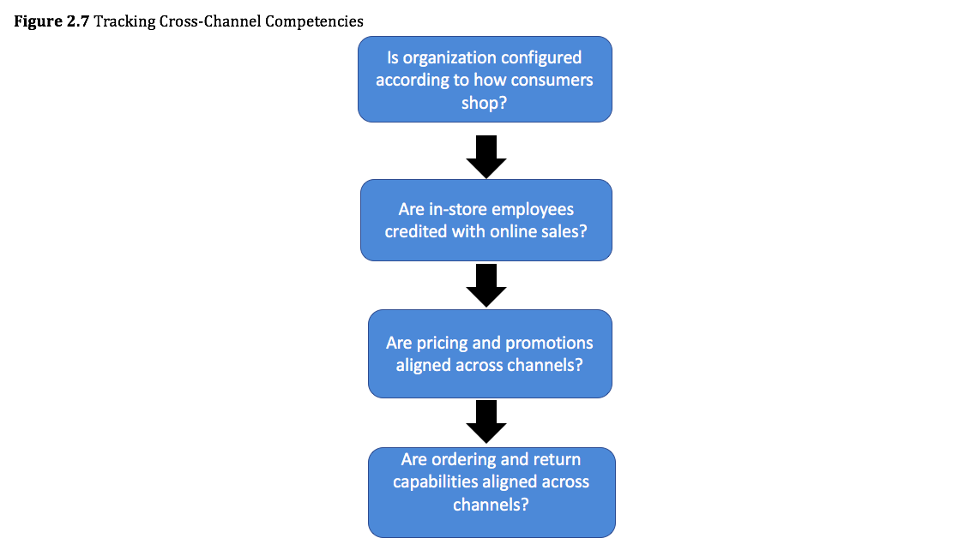

Slide 53
Agenda
Learning Objectives
Introduction
The Key Functions Marketing Channels Perform
Auditing Marketing Channels
Auditing Channel Functions Using the Efficiency Template
Auditing Channels Using Gap Analysis
Auditing Omni-Channels
Take- Aways

Slide 54
Take- Aways
Both upstream and downstream factors affect the development of channels and provide reasons to adjust channels over time.
Downstream factors include:
Search facilitation.
Sorting.
Upstream factors include:
Routinization of transactions.
Reduction in the number of contacts.

Slide 55
Take- Aways
Marketing functions are elements of work, performed by members of the marketing channel. The nine channel functions are:
physical possession, ownership, promotion, negotiation, financing, risk, ordering, payment, information sharing
A channel member can be eliminated from a channel, but the functions performed by that cannot be.
The key members of marketing channels are manufacturers, intermediaries, and end-users.
A framework for analyzing channel design is crucial for creating effective and efficient routes to market.

Slide 56
Take- Aways
Just as a production plants produce physical products, the members of a marketing engage in productive activity.
Detailed knowledge of function performance in the channel improves service output provision, facilitates channel design or redesign, helps determine rewards for channel members, and can mitigate channel conflicts.
Every channel function not only contributes to the production of valued service outputs but is also associated with a cost.

Slide 57
Take- Aways
The drive to minimize channel management costs implies that it is import to avoid performing unnecessarily high levels of any of the functions.
The efficiency template describes the types of work done by each channel member, the importance of each channel function, and the resulting share of total channel profits that each channel member should reap.
A separate efficiency template should be created for each channel used to distribute product.
A zero-based channel design meets the target market segment’s demand for service outputs, at the minimum cost of performing necessary channel functions that produce those service outputs.

Slide 58
Take- Aways
Comparing a zero-based efficiency analysis with the channel’s efficiency analysis can inform the channel analyst of situations in which a channel member may be busy yet not adding commensurate value to the channel’s overall operations.
The equity principle states that compensation in the channel system should reflect the degree of participation in the marketing functions.
Channel gaps arise as a result of environmental and managerial bounds.
Service gaps can arise because a particular service output, provided to a particular target segment of end-users is too low or too high.

Slide 59
Take- Aways
Cost gaps arise when one or more channel functions are performed at high costs.
The Gap Analysis Templates provide tools for codifying knowledge of both the service and cost gaps facing the channel in its channel management tasks.
Omni-channels require extended audits, to determine whether the various channels in the system are seamless and synchronized and whether the incentives of each channel are aligned with that of the whole system.

