Slide 1
Chapter 3 Channel Power

Slide 2
Agenda
Learning objectives
Introduction: The Nature of Marketing Channels
Power
Dependence as the Mirror Image of Power
Power-Based Influence Strategies
Omni-Channel and Power
Take- Aways

Slide 3
Learning Objectives
Appreciate the role of power in managing channel relationships.
Describe the relation between power and dependence and define when dependence exists.
Distinguish five sources of power, as well as the importance and uses of each.
Appreciate the advantages of a mutually dependent relationship.
Distinguish six communication strategies for converting power into influence and their effects in channel relationships.
Appreciate how the omni-channel landscape affects the nature of power in marketing channels.

Slide 4
Agenda
Learning objectives
Introduction: The Nature of Marketing Channels
Power
Dependence as the Mirror Image of Power
Power-Based Influence Strategies
Omni-Channel and Power
Take- Aways

Slide 5
Introduction: The Nature of Marketing Channels
In an effective channel relationship, two or more organizations must function as if they are pursuing a single shared interest.
Every marketing channel is permeated by considerations of power.
Because marketing channels focus on their power, double marginalization can occur.
Inefficiency results from two margins, rather than one in the channel.

Slide 6
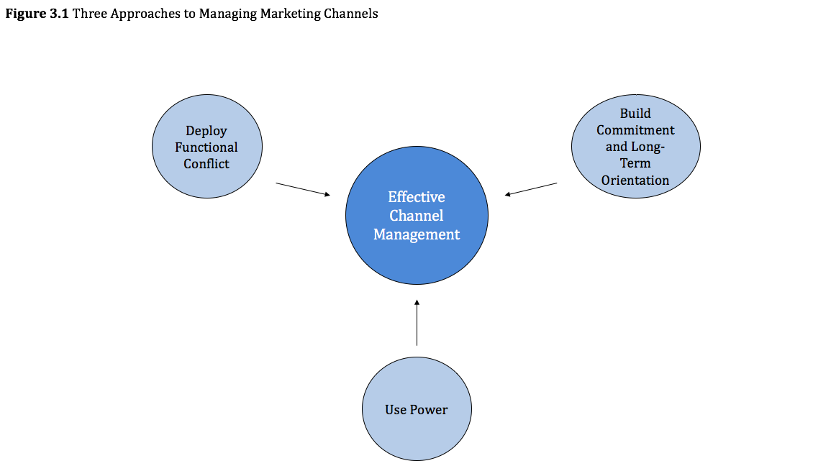

Slide 7
Agenda
Learning objectives
Introduction: The Nature of Marketing Channels
Power
Dependence as the Mirror Image of Power
Power-Based Influence Strategies
Omni-Channel and Power
Take- Aways

Slide 8
Power
Power is the ability of one channel member (A) to get another channel member (B) to do something it otherwise would not have done.
Power is the potential for influence.
It can cause great damage because it can force another channel to generate some value, without granting it equitable compensation for that effort.
But can also represent potential for influence, great benefits can be achieved through its judicious use, to drive a channel toward more efficient, more coordinated operations.

Slide 9
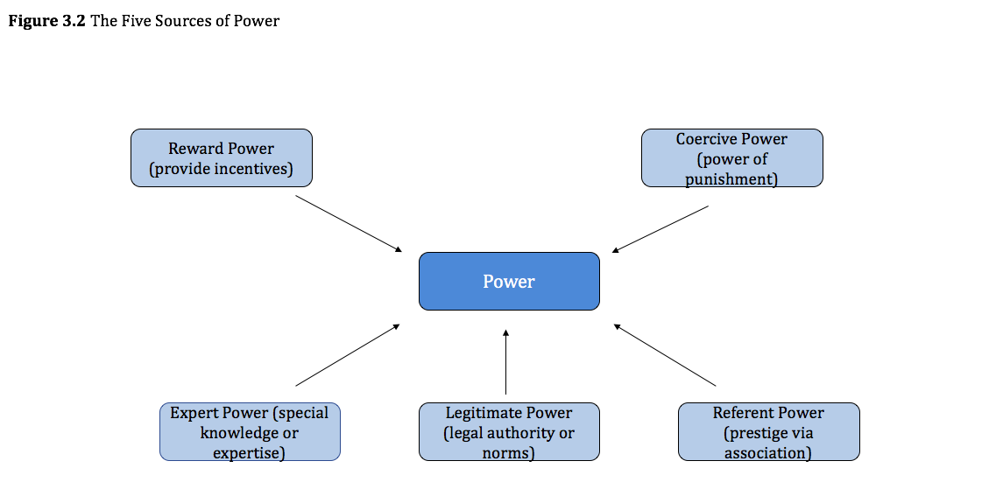

Slide 10
Example: HP Printers
HP made complete printers in a factory, then shipped them into the channel, hoping that end-users would buy them. Because different customers demanded many versions of each printer, this policy resulted in high inventories, often of wrong products. In response, HP pioneered a strategy to achieve mass customization at low prices. Its printer designs featured standardized, independent modules that could be combined and assembled easily to make many variations of the core product. Channel partners could stock the generic modules and assemble them, according to customers’ distinct needs.

Slide 11
The Five Sources of Channel Power
Reward Power
A reward is a benefit, given in return for a channel member’s agreement to alter its behavior. In channels, the emphasis is mainly on financial rewards.
Many channels create reward power in various forms. For example, efforts to boost a reseller’s capabilities enable it to increase its profits.

Slide 12
The Five Sources of Channel Power
Coercive Power
Coercive power stems from B’s expectation of punishment by A if it fails to conform with A’s influence attempt.
Example: In the US, large super market chains extract substantial slotting allowances (fees) from branded producers before they will agree to stock new products.
Other examples: margin reductions, a withdrawal of previously granted rewards, and lower shipments.
Coercion is synonymous with the potential to threaten another organization, whether implicitly or explicitly.

Slide 13
The Five Sources of Channel Power
Expert Power
Based on the target’s perception that the influencer has special knowledge or expertise that is useful and that the target does not possess.
This is the heart of the division of labor, specialization, and comparative advantages in channel functions.
This power can easily dissipate or even disappear in an instant.

Slide 14
The Five Sources of Channel Power
Expert Power
A firm that wishes to retain its expert power over the long run has three options.
It can dole out expertise in small portions, always retaining enough vital data to ensure other channel members’ continued dependence.
The firm can continually invest in learning, to ensure it always has new, important information to offer channel partners.
It might transmit only customized information and encourage channel partners to invest in transaction-specific expertise, which is so specialized that they cannot transfer it easily to other products or services.

Slide 15
The Five Sources of Channel Power
Legitimate Power
Stems from the target company’s sense that it is in some way obligated to comply with requests of the influencer, because such compliance seems right and proper by normal or established standards.
The influencer has legitimate power if the target feels a sense of duty and bound to carry out the influencers request. This comes from two main sources:
The law
Norms or values
Legal legitimate power is conferred by governments, stemming from each nation’s laws of contracts and commerce.
Example: patent and trademark laws gives owners some freedom to supervise the distribution of their products.

Slide 16
The Five Sources of Channel Power
Legitimate Power cont.
Also exists in dealing between organizations.
It comes from norms, values, and beliefs.
One firm may believe that a channel member deserves to be accorded certain deference, because of its successful track record or exemplary management.

Slide 17
Example: Pooniwala v. Wyndham Worldwide Corporation (usa)
Wyndham worldwide assigned Pooniwala to operate various motels under the Travelodge, Super 8, and Days Inn brand names. But Wyndham decided to terminate the agreements, with the claim that the motels operated by this franchisee failed a series of quality assurance tests. In addition to questioning the quality assurance process overall, Pooniwala alleged that Wyndham actually was withdrawing the agreement in retaliation for a separate litigation between the parties, over a different contract. A federal court acknowledged that terminating the franchise agreement would harm Pooniwala, but also could have potential damage to Wyndham. The court sided with Wyndham, noting the detailed documentation it offered of quality assurance violations by Pooniwala.

Slide 18
The Five Sources of Channel Power
Referent power
Exists when B views A as a standard of reference and therefore wishes to identify publicly with A.
One organization might seek to be publicly identified with another in search of prestige. Downstream channel members seek to carry high-status brands to enhance their own image; upstream channel members “rent the reputation” of prestigious downstream firms.
The ability to confer prestige, a key reason manufacturers restrict their distribution coverage to selected outlets, as well as an explanation of why downstream organizations restrict representation to selected brands.

Slide 19
Agenda
Learning objectives
Introduction: The Nature of Marketing Channels
Power
Dependence as the Mirror Image of Power
Power-Based Influence Strategies
Omni-Channel and Power
Take- Aways

Slide 20
Dependence as the Mirror Image of Power
Defining Dependence:
We recognize B depends more heavily on A when it:
Obtains greater utility (value, benefits, satisfaction) from A and
Has access to fewer alternative sources of that utility.
Dependence = utility x alternative scarcity
If B derives value from A, B’s dependence is low.
If A provides greater value but B can readily find other sources to provide the same value, B’s dependence is still low.
Low utility is like multiplying by 0.

Slide 21
Dependence as the Mirror Image of Power
Measuring Dependence
Look at utility and scarcity separately.
Utility- you must recognize your channel partner’s goals and how your offering helps it meet those pursuits.
Scarcity- you must know two things:
Who are your potential competitors?
If alternatives exist, you need to determine how easily the channel member can switch from your organization to a competitor
Combined analysis- reveals the dependence of your channel member on you and thus your level of power.

Slide 22
Dependence as the Mirror Image of Power
Measuring Dependence Cont.
Ways to approximate dependence of utility and scarcity:
Percentage of sales or profits- Estimates the percentage of sales or profits earned by the partner that the focal channel member provides.
Role performance- Dependence approximations can come from assessments of how well the focal actor performs its role compared with competitors.

Slide 23
Balancing Power: A Net Dependence Perspective
Dependence assessments must take both channel partners perspectives.
X depends on P to provide utility, P need X for different types of utility. They are interdependent, they have high mutual dependence.
High, balanced dependence block exploitation, because each side has countervailing power, which it can use for self-protection.

Slide 24
Example: cnh group (usa)
CNH is a construction and farm manufacturer. They own two brands, Case and New Holland. It produces high quality products and devotes considerable resources to marketing and engineering. However, sales had dropped 30%. The group realized it had neglected 1,200 dealers, which were taken over by their competitor, Kubota. The dealers moved the CNH-branded products to the back of their showrooms. To fix this issue, CNH began investing to make itself harder to replace by offering dealers an inimitable benefit: sophisticated market research, conducted by CNH, for dealers, that specified how those dealers compared with competitors in their markets and how they could beat their competition. This investment in expert power offered a route to reinventing CNH as a more responsive, helpful, irreplaceable business partner.

Slide 25
Example: Sabmiller Brewing Vs. EABL
Example: Sabmiller brewing covers the larger market with relative ease. There are 470 wholesalers in the US, but most of those wholesalers carry competitive brands. Each side needs the other (high utility); both sides have alternatives (low scarcity). East African breweries ltd. Also cover a large market in Kenya, but only have 30 wholesalers in the area. Despite this challenge, EABL achieves 98% of market coverage, which enabled it to drive Sabmiller right out of Kenya. The key is high mutual dependence.

Slide 26
Imbalanced Dependence
One channel member may become much more dependent than another. The balance of power factors the less dependent member, whereas the more dependent member suffers exposure to exploitation.
Exposure leads to problems. The more dependent party loses out, in both economic terms and noneconomic benefits.

Slide 27
Imbalanced Dependence
How to balance dependence:
If B depends more on A than A depends on B, then B can:
Develop alternatives to A. This is the most common.
Organize a coalition to attack A. Typically bringing in a third party.
Exit the situation and no longer seek the benefits that A provides. Withdraw from the business and therefore from the relationship.

Slide 28
Imbalanced Dependence
How to tolerate imbalanced dependence:
Most common reaction: no reaction
Weaker parties might rely on internal norms of joint decision making and trust the other party to take its interest into account.
Some imbalanced dependence actually work well.
Both dependence and interdependence complete the picture. They both have their pros and cons. Dependence motivates relationship quality and cooperation; interdependence encourages relationship-specific investments and performance improvements by increasing the stakes for both parties.

Slide 29
Agenda
Learning objectives
Introduction: The Nature of Marketing Channels
Power
Dependence as the Mirror Image of Power
Power-Based Influence Strategies
Omni-Channel and Power
Take- Aways

Slide 30
Power-Based Influence Strategies
There are 6 power-based influence strategies
Promise. If you do what we wish, we will reward you.
Threat. If you don’t do what we wish, we will punish you.
Legalistic. You should do what we wish, because you have agreed to do so.
Request. Please do what we wish.
Information exchange. Let’s pursue a general discussion about the most profitable way for you to run your business, without mentioning exactly what we want.
Recommendation. Similar to an information exchange, let’s discuss profitable methods, but we will provide you with the conclusion, namely, you would be more profitable if you would do what we wish.

Slide 31
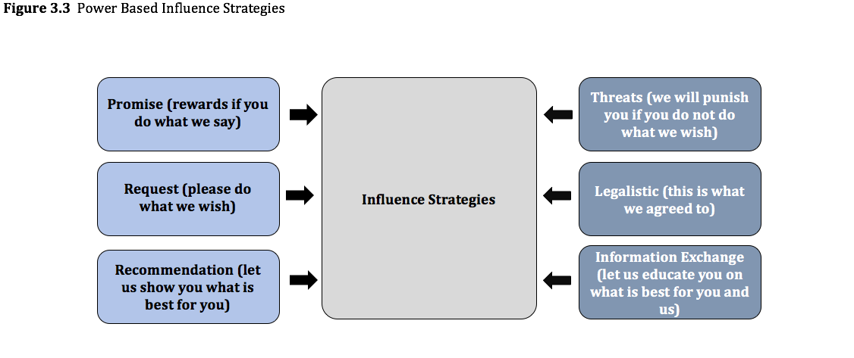

Slide 32
Agenda
Learning objectives
Introduction: The Nature of Marketing Channels
Power
Dependence as the Mirror Image of Power
Power-Based Influence Strategies
Omni-Channel and Power
Take- Aways

Slide 33
Omni-Channel and Power
The use of multiple channels is the visible norm now.
Suppliers like multiple channels because:
Increased market penetration
Gives them a better view of multiple markets
Enjoyment of healthy competition
Customers like multiple channels because:
It gives them the ability to find the channel that works best for them.
They can seek out the lowest prices.

Slide 34
Agenda
Learning objectives
Introduction: The Nature of Marketing Channels
Power
Dependence as the Mirror Image of Power
Power-Based Influence Strategies
Omni-Channel and Power
Take- Aways

Slide 35
Take- Aways
The three ways to manage a relationship are to foster commitment, exercise power, or capitalize and learn from functional conflict.
Channel power is the ability to alter another organization’s behavior. It is a tool, neither good or bad.
Power permeates all aspects of marketing channels. The interdependence of channel members makes power a critical feature of their functioning.
Channel members must invest over time to build power, then assess their power accurately and use it wisely.

Slide 36
Take- Aways
The power of A is equal to the dependence of B. the dependence of B increases when:
B derives great utility from dealing with A.
B cannot find that utility easily among A’s competitors, because there are few competitors or B faces very high switching costs.
Power comes from 5 sources: reward, coercive, expert, legitimate, referent.
Power is a two-sided affair, specific to each relationship at any given time.
Mutually dependent relationships often generate exceptional value added, because each side has sufficient leverage to ensure win-win solutions.

Slide 37
Take- Aways
Imbalanced dependence is very common. In these relationships,
The stronger party can exploit or ignore the weaker one.
The weaker party can take countermeasures, including diversifying, forming a coalition, or exiting the business.
Channel success requires the stronger party to exhibit restraint, act equitably, and appear fair.
Translating power, a latent ability, into influence involves communication. The most common methods are:
Making promises, issuing requests, exchanging information, and making recommendations.

