Slide 1
CS162:
Operating Systems and
Systems Programming
Lecture 6:
Scheduling: Metrics, Ideals, Heuristics
30 June 2015
Charles Reiss
http://cs162.eecs.berkeley.edu/

Slide 2
Recall: Implementing Locks
int value = FREE;
Acquire() {
disable interrupts;
if (value == BUSY) {
put thread on wait queue;
run_new_thread()
// Enable interrupts?
} else {
value = BUSY;
}
enable interrupts;
}
Release() {
disable interrupts;
if (anyone waiting) {
take a thread off queue
} else {
Value = FREE;
}
enable interrupts;
}
Idea: disable interrupts for mutual exclusion on accesses to value

Slide 3
Recall: Implementing Locks
int value = FREE;
Acquire() {
disable interrupts;
if (value == BUSY) {
put thread on wait queue;
run_new_thread()
// Enable interrupts?
} else {
value = BUSY;
}
enable interrupts;
}
Keypress/timer expiration here will trigger interrupt... after interrupts reenabled!
Processor keeps track of pending interrupts.
Idea: disable interrupts for mutual exclusion on accesses to value

Slide 4
Outline
Recall: metrics, priority, FCFS and RR
FCFS versus RR
Optimizing for response time:
  Shortest Job or Remaining Time First
  Heuristics: Mulit-level Feedback
Lottery scheduling
Real schedulers in Linux
Realtime schedulers

Slide 5
Outline
Recall: metrics, priority, FCFS and RR
FCFS versus RR
Optimizing for response time:
  Shortest Job or Remaining Time First
  Heuristics: Mulit-level Feedback
Lottery scheduling
Real schedulers in Linux
Realtime schedulers

Slide 6
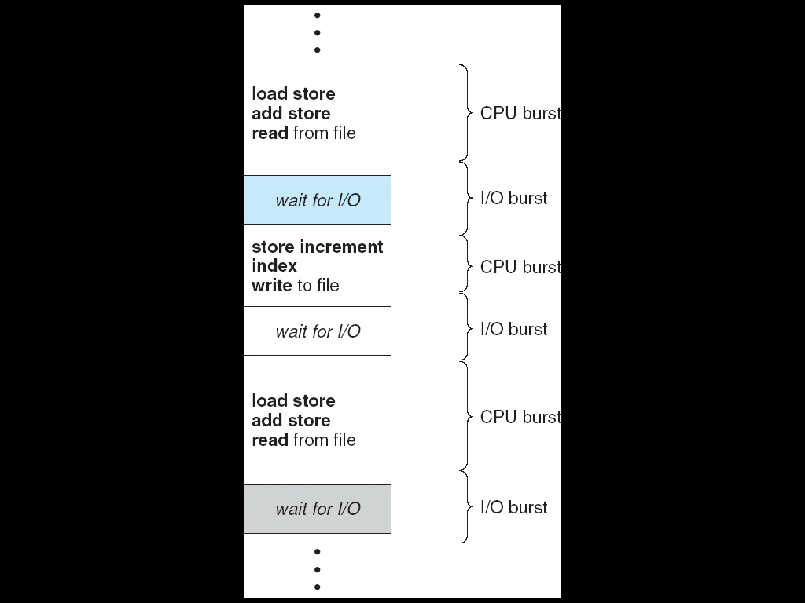
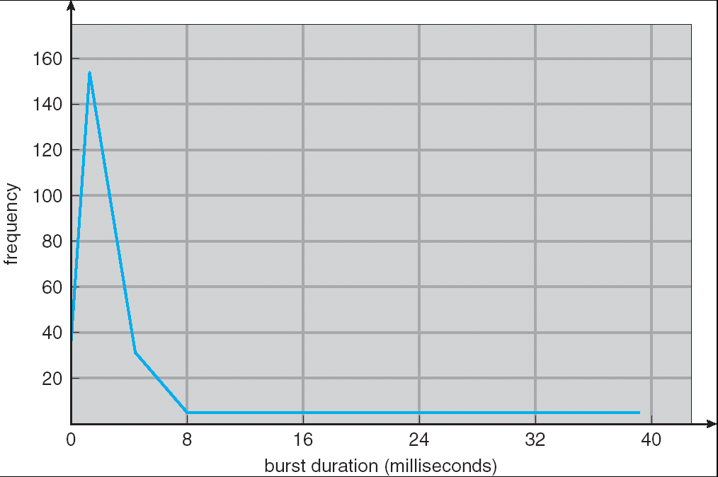
Recall: CPU/IO bursts
Programs alternate between CPU bursts, IO
  Scheduling decision: which CPU burst to run next
Why? Interactive programs!
  Even webserver counts

Slide 7
Recall: Scheduling Metrics
Response time (want low)
  What user sees: from keypress to character on screen
Throughput (want high)
  Total operations per second
  Problem: overhead (e.g. from context switching)
Fairness
  Many definitions
  Conflicts with best average throughput/response time

Slide 8
Recall: Strict Priority Scheduling
Priority 3
Job 1
Job 2
Job 3
Priority 2
Job 4
Priority 1
Priority 0
Job 5
Job 6
Job 7
Always run the job with highest priority
  Best response time/throughput for high priority jobs
  Allows "starvation" of low-priority
Priority inversion: low priority threads holding locks starve high priority threads
  Solution: priority inversion
Mechanism for many scheduling policies (later)

Slide 9
Recall: FCFS/RR
FCFS – First-Come First Served
  In order of arrival
RR – Round-robin
  Time quantum Q
  Preempt threads and put on end of queue when time quantum expires

Slide 10
Recall: RR better than FCFS?
P₂
[8]
P₄
[24]
P₁
[53]
P₃
[68]
Best FCFS:
0
8
32
85
153
Quantum
P₁
P₂
P₃
P₄
Average
Wait
Time
Best FCFS
32
0
85
8
31¼
Q = 1
84
22
85
57
62
Q = 5
82
20
85
58
61¼
Q = 8
80
8
85
56
57¼
Q = 10
82
10
85
68
61¼
Q = 20
72
20
85
88
66¼
Worst FCFS
68
145
0
121
83½
Response
Time
Best FCFS
85
8
153
32
69½
Q = 1
137
30
153
81
100½
Q = 5
135
28
153
82
99½
Q = 8
133
16
153
80
95½
Q = 10
135
18
153
92
99½
Q = 20
125
28
153
112
104½
Worst FCFS
121
153
68
145
121¾
Notes:
RR: larger quantum converges to FCFS with "middle" order
smaller quantum converges to "fair" schedule

Slide 11
Recall: RR better than FCFS?
P₂
[8]
P₄
[24]
P₁
[53]
P₃
[68]
Best FCFS:
0
8
32
85
153
FCFS from
submission order
P₁
[53]
P₂
[8]
P₃
[68]
P₄
[24]
0
53
61
129
153
Worst FCFS:
P₃
[68]
P₁
[53]
P₄
[24]
P₂
[8]
0
68
121
145
153
Notes:
RR: larger quantum converges to FCFS with "middle" order
smaller quantum converges to "fair" schedule

Slide 12
Recall: RR better than FCFS?
P₂
[8]
P₄
[24]
P₁
[53]
P₃
[68]
Best FCFS:
0
8
32
85
153
FCFS from
submission order
P₁
[53]
P₂
[8]
P₃
[68]
P₄
[24]
0
53
61
129
153
P₂ [8]
… P₄ [24]
… P₁[53]
… P₃
[68]
P₄ [24]
… P₁[53]
If we could allocate
1/4th of the CPU
P₁[53]
… P₃ [68]
P₃ [68]
… P₃ [68]
0
32
80
138
153
Worst FCFS:
P₃
[68]
P₁
[53]
P₄
[24]
P₂
[8]
0
68
121
145
153
Notes:
RR: larger quantum converges to FCFS with "middle" order
smaller quantum converges to "fair" schedule

Slide 13
Recall: RR better than FCFS?
P₂
[8]
P₄
[24]
P₁
[53]
P₃
[68]
Best FCFS:
0
8
32
85
153
FCFS from
submission order
P₁
[53]
P₂
[8]
P₃
[68]
P₄
[24]
0
53
61
129
153
Round Robin interpolates between these
P₂ [8]
… P₄ [24]
… P₁[53]
… P₃
[68]
P₄ [24] ...
… P₁[53] ...
If we could allocate
"quarter-CPUs"
P₁[53] ...
… P₃ [68] ...
P₃ [68] ...
… P₃ [68] ...
0
32
80
138
153
Worst FCFS:
P₃
[68]
P₁
[53]
P₄
[24]
P₂
[8]
0
68
121
145
153
Notes:
RR: larger quantum converges to FCFS with "middle" order
smaller quantum converges to "fair" schedule

Slide 14
Outline
Recall: metrics, priority, FCFS and RR
Optimizing for response time:
  Shortest Job or Remaining Time First
  Heuristics: Multi-level Feedback
Lottery scheduling
Real schedulers in Linux
Realtime schedulers

Slide 15
Recall: SRTF/SJF
Goal: best FCFS
No preemption: Shortest Job First (SJF)
  Run whichever job has the least amount of work
Preemption: Shortest Remaining Time First (SRTF)
  New job (completed IO?) with shorter time replaces running one

Slide 16
With a little help from a time machine
SJF/SRTF: provably optimal (at response time)
  SJF among all non-preemptive schedulers
  SRTF among all preemptive schedulers
Key idea: remove convoy effect
  Short jobs ahead of long ones

Slide 17
SRTF Example (1)
A or B
C
C’s
I/O
C’s
I/O
C’s
I/O
Three jobs:
  A, B: one week of computation
  C: loop with 1 ms of CPU, 9 ms of disk I/O
FCFS: Horrible: A or B starve C.
  I/O throughput problem: 0% I/O throughput

Slide 18
SRTF Example (2)
SRTF Example continued:
Disk Utilization:
9/201 ~ 4.5%
C
A
B
C
RR 100ms time slice
Disk Utilization:
~90% but lots of CPU overhead!
C’s
I/O
C’s
I/O
CABAB…
C
RR 1ms time slice
C’s
I/O
C’s
I/O
Disk Utilization:
90%
C
A
A
A
SRTF
C’s
I/O
C’s
I/O

Slide 19
SRTF Problems (1)
Many short jobs → long jobs will never run
Called starvation
Question: But isn't it optimal response time?

Slide 20
SRTF Problems (2)
How do we know remaining time?
Answer: Usually, we can't!

Slide 21
Imitating SRTF/SJF with Priorities
SRTF is a special case of priority scheduling:
  Priority of job ↔ remaining time
Set priorities = 1/(length of CPU burst)
Good if applications knew how long CPU burst was
Problem: They don't
Problem: Lying

Slide 22
Outline
Recall: metrics, priority, FCFS and RR
FCFS versus RR
Optimizing for response time:
  Shortest Job or Remaining Time First
  Heuristics: Multi-level Feedback
Lottery scheduling
Real schedulers in Linux
Realtime schedulers

Slide 23
Predicting CPU bursts
Examine past bursts
Most programs have predictable behavior
  I/O bound in past → I/O bound in future
Scheduling algorithm: SRTF with estimated burst
  Estimate example: exponential-weighted moving avg
  est burst = α (actual burst) + (1-α)(prev est burst)
  Obtaining actual burst: track used time at context switch + is process still ready?

Slide 24
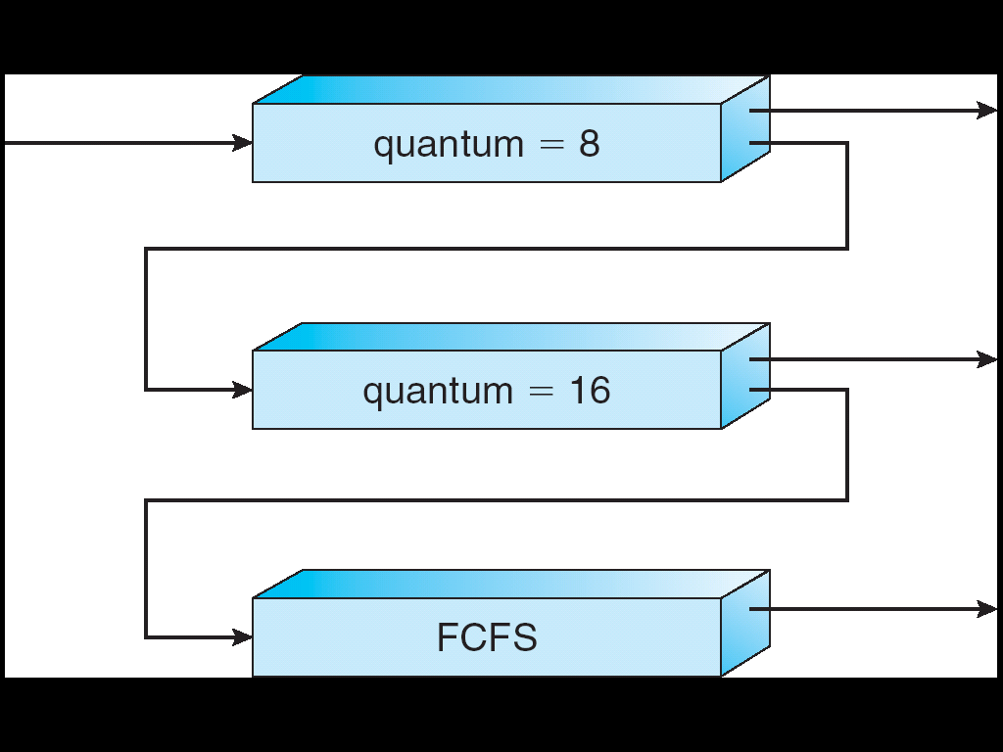
Multi-Level Feedback Scheduling (1)
Highest Priority
Long-Running Compute
Tasks Demoted to
Low Priority
Lowest Priority
Also part of project 1
Similar idea to SRTF with estimated burst
Multiple queues of different priority
  Round robin within each queue
  Different quantum for RR within each queue

Slide 25
Multi-Level Feedback Scheduling (1)
Highest Priority
Long-Running Compute
Tasks Demoted to
Low Priority
Lowest Priority
Intuition: priority level ~ CPU burst length
  Jobs at highest priority have CPU bursts < 8 units
  At second < 16 units
  At last >= 16 units

Slide 26
Recall: Strict Priority Scheduling
Priority 3
Job 1
Job 2
Job 3
Priority 2
Job 4
Priority 1
Priority 0
Job 5
Job 6
Job 7
Need to decide how to run within a priority
Examples: FCFS, RR
Multi-level feedback scheduling – use RR at high priorities
  "Free" information about whether CPU burst is too long
  Prevents starvation

Slide 27
Multi-Level Feedback Scheduling (2)
Highest Priority
Long-Running Compute
Tasks Demoted to
Low Priority
Lowest Priority
Job starts in highest priority queue
Job exceeds quantum: drop to next queue
Job doesn't exceed quantum: raise

Slide 28
Multi-Level Feedback Scheduling (3)
Approximates SRTF
  CPU-bound have lowest priority (run last)
  Short jobs have highest priority (run first)
Low overhead:
  Easy to update task priorities
  Easy to find next runnable task

Slide 29
Multi-Level Feedback Scheduling (4)
Can a program cheat?
How?
Add meaningless I/O (often enough)

Slide 30
MLFS: Fairness
Long running jobs may never get CPU
  Starvation again
  Like SRTF – not because heuristics are wrong
Solutions:
  Time slice queues
    e.g. 70% to highest priority, 20% middle, 10% to lowest
  Increase priority of "starved" jobs
Both hurt response time to improve fairness

Slide 31
Logistics
Project 1 Initial Design – Due Thursday 11:59PM
HW1 due 8 July (week from tomorrow)

Slide 32
Outline
Recall: metrics, priority, FCFS and RR
FCFS versus RR
Optimizing for response time:
  Shortest Job or Remaining Time First
  Heuristics: Mulit-level Feedback
Lottery scheduling
Real schedulers in Linux
Realtime schedulers

Slide 33
Lottery scheduling
Simple mechanism for "fair" scheduling
Like priority, basis for many scheduling policies
Each job gets lottery tickets
Each scheduling decision: choose one ticket
Over time: CPU usage ~ number of tickets
  Tickets represent "CPU share"

Slide 34
Lottery scheduling: Example
A: 3 tickets
B: 2 tickets
C: 1 ticket
PickNextThread():
  roll 6-sided die
  1-3: run A
  4-5: run B
  6: run C

Slide 35
Lottery Scheduling as Building Block
Can approximate many policies – adjust # of tickets per process
Much easier to express "fair" policies than priority scheduling

Slide 36
Lottery scheduling: assigning tickets
Example: approximate priority
Priority 3
Job 1
Job 2
Job 3
Priority 2
Job 4
Priority 1
Priority 0
Job 5
Job 6
Job 7
  priority 3: 1000000 tickets/job
  priority 2: 10000 tickets/job
  priority 1: 100 tickets/job
  priority 0: 1 ticket/job
Adjust ratios: tradeoff: priorities versus starvation

Slide 37
Lottery scheduling: assigning tickets
Example: approximate SRTF
  Short running jobs get more tickets, long running jobs get fewer
    Example: based on last timeslice
  Avoid starvation: every job gets at least one ticket

Slide 38
Outline
Recall: metrics, priority, FCFS and RR
FCFS versus RR
Optimizing for response time:
  Shortest Job or Remaining Time First
  Heuristics: Mulit-level Feedback
Lottery scheduling
Real schedulers in Linux
Realtime schedulers

Slide 39
History: 2.4 Linux Scheduler
p = init_task.next_run;
/* Default process to select.. */
next = idle_task(this_cpu);
c = -1000;
[...]
while (p != &init_task) {
if (can_schedule(p)) {
int weight = goodness(prev, p, this_cpu);
if (weight > c)
c = weight, next = p;
}
p = p->next_run;
}
goodness() function guesses if process "looks" interactive, checks how long since it last ran, etc.,

Slide 40
History: 2.4 Linux Scheduler
p = init_task.next_run;
/* Default process to select.. */
next = idle_task(this_cpu);
c = -1000;
[...]
while (p != &init_task) {
if (can_schedule(p)) {
int weight = goodness(prev, p, this_cpu);
if (weight > c)
c = weight, next = p;
}
p = p->next_run;
}
Loop through entire run queue!

Slide 41
Linux O(1) Scheduler (1)
Kernel/Realtime Tasks
User Tasks
0
100
139
MLF-like scheduler with 140 priorities
  40 for users tasks ("nice"+heuristics); 100 "realtime"
  All algorithms O(1) – low overhead
Active and expired queue at each priority
  Swapped when active empty
  Round-robin within each queue (varying timeslices)

Slide 42
Comment: Unix "nice" levels
Weak priorities – hint to scheduler
… but most systems still try not to starve any process/favor interactive processes regardless of nice level
Why "nice"? Voluntarily lower priority to be nice to other users.

Slide 43
Linux O(1) Scheduler (2)
Lots of heuristics
  Try to boost interactive (IO-bound) tasks
  Try boost priority of starved tasks
"Real-time" threads
  No priority adjustment
  Run ahead of all non-real-time-tasks
  Strict FIFO or strict RR

Slide 44
Linux Completely Fair Scheduler (1)
Linux >= 2.6.23
Based on Fair Queuing in Networks
Idea: Each process gets 1/N of the processor
  As if running on a processor 1/Nth the speed
Refined idea:
  Process i gets get W(i)/(sum of Ws) of the processor
  Similar idea to lottery scheduling tickets

Slide 45
Linux Completely Fair Scheduler (1)
Linux >= 2.6.23
Based on Fair Queuing in Networks
Idea: Each process gets 1/N of the processor
  As if running on a processor 1/Nth the speed
Refined idea:
  Process i gets get W(i)/(sum of Ws) of the processor
  Similar idea to lottery scheduling tickets

Slide 46
CFS: Virtual Time For Throughput
Virtual time = Amount of CPU time given to thread
Fairness → All threads virtual time advances at the same rate
Always run task with lowest virtual time
Make fast with balanced binary tree (O(lg N))

Slide 47
Not Quite RR (1)
Consider:
  A: uses CPU forever
  B: 2 ms CPU burst, followed by 3 ms disk I/O
RR: Q=1
B
A
B
A
B
A
B
A
A has used 8 ms of virtual time
B has used 4 ms of virtual time
Unfair(?)
I/O
I/O

Slide 48
Not Quite RR (2)
RR: Q=1ms
B
A
B
A
B
A
B
A
A has used 8 ms of virtual time
B has used 4 ms of virtual time
Unfair(?)
I/O
I/O
Virtual clocks (with no latency target, etc.), 1ms timeslices
B
A
B
A
B
B
A
B
I/O
I/O
B: virtual clock at 3 ms
A: virtual clock at 4 ms

Slide 49
CFS: Managing Latency
Conflicting goals:
  Fairness (via virtual time)
  No process waits too long – target latency
    Minimum response time
  Don't context switch too often – min granularity
    Minimum throughput
Time quantum = maximum of:
  Min granularity, and
  Target latency * W(i) / (sum of Ws)

Slide 50
Resetting Virtual Time
Don't start threads with an advantage:
  Virtual time initially min virtual time of all existing threads

Slide 51
CFS examples
Target latency = 20 ms, Min granularity = 1 ms
Two CPU bound tasks with same weight:
  Both get 10 ms
40 tasks with same weight:
  Each gets 1ms – miss target latency for throughput

Slide 52
CFS examples
Target latency = 20 ms, Min granularity = 1 ms
Two CPU bound with weights 1, 3:
  Weights derived from "nice value"
  One gets 5 ms, another gets 15 ms
One CPU bound task, one interactive task:
  Interactive task always runs before CPU-bound task

Slide 53
Outline
Recall: metrics, priority, FCFS and RR
FCFS versus RR
Optimizing for response time:
  Shortest Job or Remaining Time First
  Heuristics: Mulit-level Feedback
Lottery scheduling
Real schedulers in Linux
Realtime schedulers

Slide 54
Real-Time Scheduling
Goal: guaranteed performance
  Meet deadlines even if it means being unfair/slow
  Worst-case over normal case
Hard-real time:
  Meet all deadlines (if possible)
  Ideally: determine in advance that meeting all deadlines is possible

Slide 55
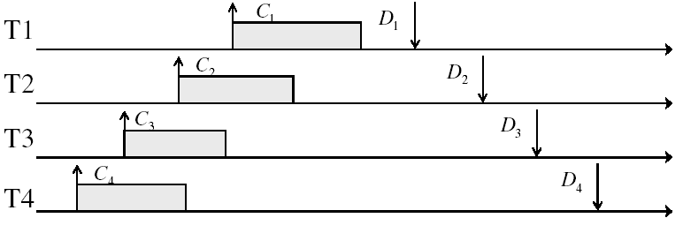
Real-time Example
Preemptible tasks with known deadlines (D) and compute times (C)

Slide 56
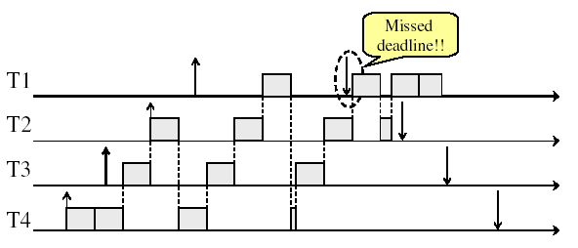
Real-time Example: With RR

Slide 57
Real-time Example: With SRTF
T1
T2
T3
Missed
Deadline!
T4
Guaranteed performance != minimum response time

Slide 58
Earliest Deadline First (EDF)
Priority scheduling with preemption
Priority ~ Time to Deadline
Example with periodic tasks:
0
5
10
15

Slide 59
EDF: Schedulability Testing
Problem: Even EDF won't work if you have too many tasks
Theorem [Liu and Layland, 1973]:
  A task set T1, T2, …, TN with periodic tasks (released after each deadline), deadlines Di, and computation times Ci is schedulable by the earliest deadline first (EDF) scheduling algorithm if

Slide 60
Evaluating Schedulers
Most good schedulers are based on heuristics
Trading off starvation and response time
Estimating response time
How do you know how good they are?
  Implement them and run something important
  Implement them and run a simulation
  Do math and try to prove something

Slide 61
Scheduling Summary (1)
Round robin
  Fixed CPU quanta, cycle between ready threads
Lottery scheduling:
  Share CPU in proportion to "tickets"
Shortest Job First/Shortest Remaining Time First:
  Ideal policies for average response time
  Can't actually use: needs to know the future!

Slide 62
Scheduling Summary (2)
Multi-level feedback scheduling:
  Multiple queues at different priorities
  RR within each queue with different time slices
  Promotion/demotion to approximate SRTF
Linux Completely Fair Scheduler:
  Share CPU "fairly" with latency guarantees
  Based on "virtual time"
Realtime scheduling
  Earliest deadline first (EDF)
  Guaranteed deadlines (if not too much load)
  Sacrifice response time/throughput

Slide 63
Which scheduler should you use?
I care more than anything else about...
  CPU Throughput:
  Average Response Time:
  I/O Throughput:
  Fairness – long-term CPU:
  Fairness – wait time for CPU:
  Meeting deadlines:
  Favoring important users:

Slide 64
Which scheduler should you use?
I care more than anything else about...
  CPU Throughput: First-Come First-Served
  Average Response Time: SRTF approximation
  I/O Throughput: SRTF approximation
  Fairness – long-term CPU: something like Linux CFS
  Fairness – wait time for CPU: something like RR
  Meeting deadlines: Earliest Deadline First
  Favoring important users: Strict Priority

Slide 66
Break

Slide 69
Recall: Disabling Interrupts
Critical sections in the kernel
On a single processor, nothing else can run
  Critical section!
Multiprocessor?
  Only disables interrupts on the current CPU
  Don't know what's running elsewhere

Slide 70
Multiprocessors and Locks
Disabling interrupts doesn't prevent other processor from doing anything
Solution: Hardware support for atomic operations

Slide 71
Recall: Atomic Operations
Definition: an operation that runs to completion or not at all
  Need some to allow threads to work together
Example: loading or storing words
Some instructions not atomic
  e.g. double-precision floating point store
  (many platforms)

Slide 72
Outline
Hardware support for locks and spin locks
Semaphores
Monitors

Slide 73
Outline
Hardware support for locks and spin locks
Semaphores
Monitors

Slide 74
Atomic Read/Modify/Write
Recall: atomic load/store not good enough
Hardware instructions (or instruction sequences) that atomically read a value from (shared) memory and write a new value
Hardware responsible for making work in spite of caches

Slide 75
Read-Modify-Write Instructions
test&set (&address) { /* most architectures */
result = M[address];
M[address] = 1;
return result;
}
swap (&address, register) { /* x86 */
temp = M[address];
M[address] = register;
register = temp;
}
compare&swap (&address, reg1, reg2) { /* 68000 */
if (reg1 == M[address]) {
M[address] = reg2;
return success;
} else {
return failure;
}
}
load-linked&store conditional(&address) {
/* R4000, alpha */
loop:
ll r1, M[address];
movi r2, 1; /* Can do arbitrary comp */
sc r2, M[address];
beqz r2, loop;
}

Slide 76
Locks with test&set
int value = 0; // Free
Acquire() {
while (test&set(value)) {
// do nothing
}
}
Release() {
value = 0;
}
test&set (&address) {
result = M[address];
M[address] = 1;
return result;
}
Lock free: test&set reads 0, set value to 1, returns 0 (old value) → acquire finishes
Lock not free: test&set reads 1, sets value to 1, returns 1 (old value) → acquire waits

Slide 77
Locks with test&set: Busy waiting
int value = 0; // Free
Acquire() {
while (test&set(value)) {
// do nothing
}
}
Release() {
value = 0;
}
test&set (&address) {
result = M[address];
M[address] = 1;
return result;
}
Busy-waiting: consumes CPU time while waiting
  Keeps other threads from using CPU
  Maybe even the thread holding the lock!
These are called "spin locks" (because they spin while busy)

Slide 78
A Note on Memory Traffic
test&set requires communication!
  Local cache needs to "own" the memory address to write to it exclusively
Means while(test&set(value)); spams the memory bus!
  Hurts the performance of all processors

Slide 79
Test and Test and Set
Solution to memory traffic problem:
int mylock = 0; // Free
Acquire() {
do {
while(mylock); // Wait until might be free
} while(test&set(&mylock)); // exit if get lock
}
Release() {
mylock = 0;
}
while (mylock) stays in local cache
  waits for cache invalidation from lock holder

Slide 80
Recall: Disable Interrupts
int value = FREE;
Acquire() {
disable interrupts;
if (value == BUSY) {
put thread on wait queue;
run_new_thread()
// Enable interrupts?
} else {
value = BUSY;
}
enable interrupts;
}
Release() {
disable interrupts;
if (anyone waiting) {
take a thread off queue
} else {
Value = FREE;
}
enable interrupts;
}
Idea: disable interrupts for mutual exclusion on accesses to value

Slide 81
Locks with test&set
Use "spinlock" to build better locks
  Like we use disabling interrupts to build "proper" locks
int guard = 0;
int value = FREE;
Acquire() {
// Short busy-wait time
while (test&set(guard));
if (value == BUSY) {
put thread on wait queue;
run_new_thread() & guard = 0;
} else {
value = BUSY;
guard = 0;
}
}
Release() {
// Short busy-wait time
while (test&set(guard));
if anyone on wait queue {
take thread off wait queue
Place on ready queue;
} else {
value = FREE;
}
guard = 0;
Same problem with releasing lock as enabling interrupts before → need help from scheduler
or allow spurious wakeups

