Slide 1
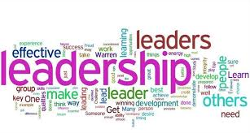
Leadership Skills
4th Grade
Notes:
My course theme is leadership skills in the fourth grade.

Slide 2


Why is leadership important?
Inspiration
Motivation
Goals
Role models
Communication
Notes:
Leadership is important because good leaders inspire and motivate others. The world needs more and better leaders to set goals and serve as role models to the youth and public. Leaders tend to excel in communication, which is what society is based on a lot in todays world.

Slide 3

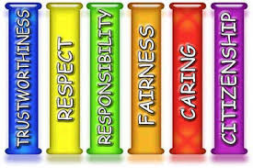
School
Student of the month
Positive reinforcements
Character lessons
Help other students
Notes:
Teaching leadership in the classroom is important because it creates character. Students need to learn the right things to do at an early age. School is the best place to teach this because they are there a majority of the year, so it creates a structured environment to learn leadership.

Slide 4


Community
Community service
Volunteering
Giving back
Role model
Notes:
Demonstrating leadership skills in the community is not hard to do. Elders in the community especially enjoy when kids give back to the community. It creates a sense of family by caring. Leaders do things like community service, which can develop them into role models.

Slide 5
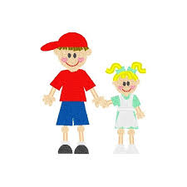

Family
Big brother/ big sister
Associate the family name with good characteristics
Do things to keep your family proud
Responsibility
Notes:
Being a leader in your family is important. Parents are the primary leaders, however if you are the bigger brother or sister, it is good for you to have leadership skills. Responsibility can consist of things such as chores and manners.

Slide 6


Career
Time management
Organization
Cooperation
Deadlines
Notes:
It can take some time to become a high placed leader in your workplace, however the basic leadership skill are essential to the workforce. It is important to manage time, stay organized, and cooperate with co-workers.

Slide 7
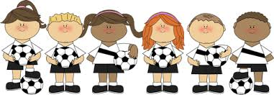
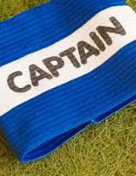
Team
Showing good sportsmanship
Working together efficiently and effectively
Notes:
Just like in the workplace, it is essential to work together efficiently and effectively. Being a team captain on a sports team is a privilege, that’s why the best leaders are put into that position. Leaders in sports are good at showing sportsman like conduct and keeping their cool. Even if they teammate messes up, they deal with it the right way.

Slide 8
Video
https://youtu.be/pWmxgYwcrLE
Notes:
Watch this cute video from “Kid President” about leadership and teamwork.

