Slide 1

Efforts in Ozone Planning
2019 California Desert Air Working Group
November 6, 2019
Cleaning The Air That We Breathe…
Cleaning The Air That We Breathe…

Slide 2
Presentation Outline
3. Implementation of 2016 Air Quality Management Plan (AQMP)
4. Contingency Measure Plan Addressing CAA Section 182 (e)(5) Requirements
2. Upcoming Ozone State Implementation Plan (SIP) Obligations
1. Background

Slide 3
1. Background

Slide 4
What is South Coast AQMD?
Air pollution control agency
Orange County and the major portions of Los Angeles, Riverside and San Bernardino counties
People we serve
More than 17 million in population
Environmental Justice communities
Responsibilities
Control emissions from stationary sources
Monitor air quality and meet federal and state air quality standards
Permit and inspect 28,400 affected businesses

Slide 5

Ozone National Ambient Air Quality Standards (NAAQS)
U.S. Environmental Protection Agency (EPA) establishes NAAQS for various air pollutants to be protective of human health
Areas not meeting the standards are designated as nonattainment areas based on exceedance level (Marginal, Moderate, Serious, Severe, Extreme)
1979 1-hour Standard
1997 8-hour Standard
2008 8-hour Standard
2015 8-hour Standard

Slide 6
Ozone Nonattainment Classification
for South Coast AQMD
Standard | Concentration | South Coast Air Basin |  | Coachella Valley
 |  | Classification | Attainment Year | Clasification | Attainment Year
1979 1-hour Ozone | 120 ppb | Extreme | 2022 | Attainment | -
1997 8-hour Ozone | 80 ppb | Extreme | 2023 | Extreme | 2023
2008 8-hour Ozone | 75 ppb | Extreme | 2031 | Severe-15 | 2026
2015 8-hour Ozone | 70 ppb | Extreme | 2037 | Severe-15 | 2032

Slide 7
Progress in Overall NOx Reductions Since 1997
1997 Baseline - 1144
620
Last remaining 11% reductions needed
2012 Baseline - 524
2023 Baseline – 269
128
2023 Carrying Capacity – 141

Slide 8
Ozone Design Value has been Trending Down
Year

Slide 9
Basin Precursor Emissions Also Decreasing
Year

Slide 10
Annual Average NO2 Concentrations
in The South Coast Air Basin
Year
75% data completeness criteria was applied.

Slide 11
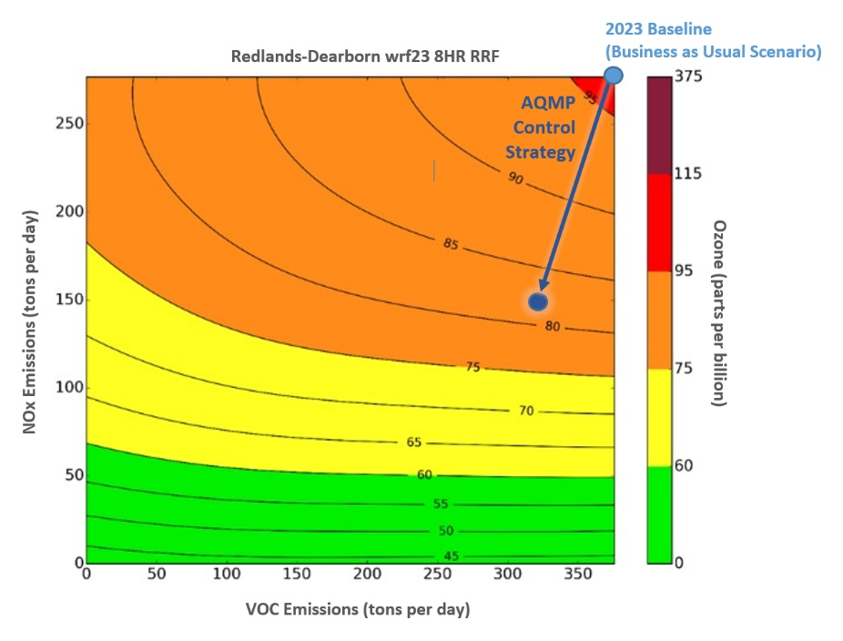
2016 AQMP - NOx Reductions, Most
Efficient Control Path For Ozone Attainment

Slide 12
2. Upcoming Ozone SIP Obligations

Slide 13
Ozone SIP Obligations Through 2022
Criteria Pollutant | NAAQS Year | NAAQS Level | Air Basin | Classification | Attainment Date | Major Obligation | Due to U.S. EPA
Ozone | 1997 | 80 ppb | South Coast | Extreme Nonattainment | June 15, 2024 | 182(e)(5) Contingency Measure | Dec. 31, 2019
Ozone | 1997 | 80 ppb | Coachella Valley | Extreme Nonattainment | June 15, 2024 | Extreme Area SIP | July 10, 2020*
Ozone | 2015 | 70 ppb | South Coast | Extreme Nonattainment | Aug. 3, 2038 | RACT, Base Year Inventory | Aug. 3, 2020
 |  |  |  |  |  | Nonattainment NSR | Aug. 3, 2021
 |  |  |  |  |  | Attainment Demonstration, RACM, Control Strategies, Contingency Measure | Aug. 3, 2022
 |  |  | Coachella Valley | Severe Nonattainment | Aug. 3, 2033
*Pending U.S. EPA’s final determination of SIP submittal date.

Slide 14
2022 AQMP Schedule and Purpose
Purpose
Address 2015 8-Hour Ozone Standard for South Coast Air Basin and Coachella Valley
Update attainment demonstrations for other standards
Schedule
SIP submittal due August 3, 2022
Emission inventory
Control strategy
Contingency measures
Attainment demonstration

Slide 15
3. 2016 AQMP Implementation

Slide 16
South Coast AQMD
Control Measure and Rule Developments
 | Rule | Adoption Date | Reduction NOx (tpd) | Reduction VOC (tpd)
Adopted Rules Since 2016 AQMP | Rule 1113 – Architectural Coatings | 2/5/2016 |  | 0.88
 | Rule 1168 – Adhesive and Sealant Applications | 10/6/2017 |  | 1.4
 | Rule 1111 - Natural-Gas-Fired, Fan-Type Central Furnaces | 3/2/2018 | 0.017
 | Rule 1135 – Electricity Generating Facilities | 11/2/2018 | 1.8 | 0.014
 | Rule 1146, Rule 1146.1, Rule 1146.2 – Non-Refinery Boilers and Heaters | 12/7/2018 | 0.27
 | Rule 1118.1 – Non-Refinery Flares | 1/4/2019 | 0.2
 | Rule 1134 – Stationary Gas Turbines | 4/5/2019 | 2.8
Rules in Development | Rule 1110.2 – Emissions from Gaseous- and Liquid-Fueled Engines* | Scheduled to be heard in Nov 2019 | 0.29
 | Rule 1109.1 – Refinery Equipment | Working Group #8 in June 2019
 | Rule 1117 – Emissions of Oxides of Nitrogen from Glass Melting Furnaces | Working Group # 1 in August 2019
 | Rule 1147 – Series NOx Reductions from Miscellaneous Sources | Working Group #4 in October 2019
 | Rule 1147.1 – NOx Reductions from Large Miscellaneous Combustion
 | Rule 1147.2 – NOx Reductions from Metal Processing Equipment | Working Group #3 in November 2019
 | Rule 1150.3 – Emissions of Oxides of Nitrogen from Combustion Equipment at Landfills | Working Group #3 in November 2019
 | Rule 1179.1 – NOx Emission Reduction from Combustion Equipment and Publicly Owned Treatment Work Facilities | Working Group #3 in November 2019

Slide 17
Facility-Based Mobile Source Measures
Sector | May 2018 Board Direction | Key Upcoming Actions
Airports | Pursue MOUs to implement airport clean air plans | Board to consider adopting MOUs in December 2019
Ports | Pursue MOUs to implement specific Clean Air Action Plan measures; pursue introduction of cleaner vessels | Following port adoption of truck rate in November 2019, Board to consider adopting MOU in early 2020
New /Redevelopment | Continue to work with stakeholders to develop rule concepts and preliminary costs/benefits | Release construction equipment/ technology costs study RFP October 2019
Warehouses | Develop rule concept; conduct economic impacts study to inform rule concept | Board considers adopting ISR May 2020
Rail yards | Pursue rulemaking; explore potential for new agreements/MOUs beyond the 1998 and 2005 agreements | Board considers adopting ISR December 2020

Slide 18
Incentives RFP
(CMB-01, CMB-02, CMB-04, ECC-03)
In Jan 2018, Board approved RFP to incentivize emission reduction or technology demonstration projects
58 (out of 81 submitted) technically qualified with $211 M requested
26 projects awarded totally ~$48 M
Mobile Sources – emission reduction/technology demo
Zero emission vans, terminal equipment, electric refrigeration transport, tugboats, harbor craft, refuse trucks
Stationary Sources – emission reduction/technology demo
Residential energy efficiency, street sweeping, restaurants, fuel cells
Anticipate 88 tons/year of NOx and 2 tons of PM2.5/year reductions

Slide 19

CARB’s Adopted 2016
State SIP Strategy Measures
Measure Title | Board Date Adopting the Subsequent Rule
South Coast On-Road Heavy Duty Vehicle Incentive Measure | March 22, 2018
Heavy-Duty Diesel Vehicle Emission Control System Warranty Regulation Amendments | June, 2018
Zero-emission Airport Shuttle Regulation | June 1, 2019
Zero-Emission Powertrain Certification Regulation | June 1, 2019
Electric Vehicle Supply Equipment Standards | June 1, 2019
Ocean-Going Vessel At Berth And At Anchor Regulation | Scheduled December, 2019

Slide 20
4. Contingency Measure Plan for the 1997 8-hour Ozone Standard (80 ppb)

Slide 21
2016 AQMP - Overall Control Strategy (NOx)
Sources | NOx
Year 2023 Baseline¹ | 269
Carrying Capacity | 141
Total Emission Reductions (All Measures): | 135
Defined Measures: | 27
South Coast AQMD’s Stationary Source Control Measures | 7
South Cost AQMD Additional Mobile Source Control Measures | 16
CARB’s Defined Measures | 4
Further Deployment of Cleaner Technologies | 108
Set Aside Budget² | 3
2023 Remaining Emissions | 137³
¹ Reflects CARB’s 2018 Updates to the California State Implementation Plan ² As SIP reserve for potential technology assessment and for general conformity purposes ³ Reflects an additional 4.2 tons per day of NOx emission reductions beyond the projected carrying capacity of 141 tons per day to accommodate changes in ocean-going vessel (OGV) emission inventory and CARB’s SIP strategy for OGV.

Slide 22
Progress in Overall NOx Reductions Since 1997
1997 Baseline - 1144
620
Last remaining 11% reductions needed
2012 Baseline - 524
2023 Baseline – 269
128
2023 Carrying Capacity – 141

Slide 23
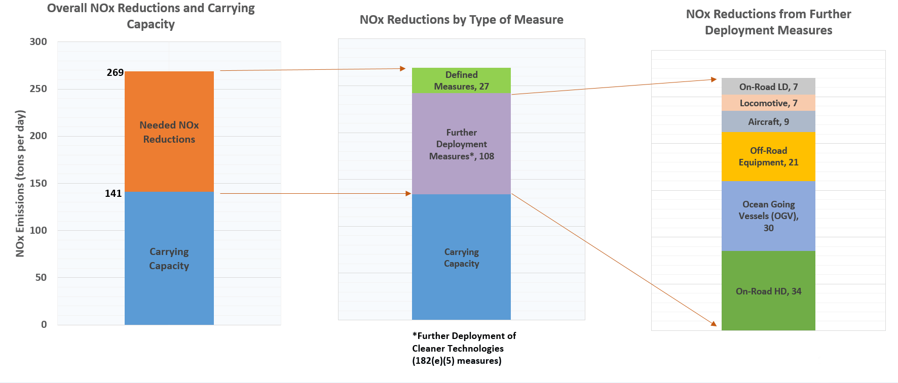
Further Deployment of Cleaner Technologies Measures by Mobile Source Category (2023)

Slide 24
CAA Section 182(e)(5)
for Extreme Non-Attainment Areas
Federal CAA Section 182(e)(5) allows for anticipated development of new control techniques or improvement of existing control technologies for attainment demonstration in extreme areas
Contingency measures required 3 years prior to implementation of plan provisions (i.e., 2023 attainment date)
Provide full reductions assigned to 182(e)(5) measures

Slide 25
Reduced Reliance on Control Strategies Approved
Under 182(e)(5) Long-Term/Further Deployment Measures

Slide 26



Draft Contingency Measure Plan
Identified Emission Reduction Strategies
Additional Incentive Funding
Federal Measures/Responsibilities

Slide 27
Identified Emission Reduction Strategies
Measures Description | Agency | NOx Reductions (tpd)
RECLAIM Transition Rules | South Coast AQMD | 2
Ports MOU | South Coast AQMD | 3-5
Airports MOU | South Coast AQMD | 0.5
Metrolink Locomotives | South Coast AQMD | 3
OGV Vessel Speed Reduction | South Coast AQMD | 0.2
Funding Incentives (Expected Future Funding) | South Coast AQMD | 1.5
Low Carbon Fuel Standard and Alternative Diesel Fuels Regulation | CARB | 1.7
ATCM for Portable Engines, and the Statewide Portable Equipment Registration Program Regulation | CARB | 0.25
HD Inspection and Maintenance (I/M) program | CARB | 4.2
Innovative New Measures | CARB | 3.0
Total Reductions Towards 182(e)(5) Commitment* |  | 24-26 tpd
*Preliminary estimates; also includes 4.2 tons per day of reductions associated with updated OGV emissions inventory and CARB’s SIP Strategy for OGV

Slide 28
CARB’s Innovative New Measures
Co-Benefits of Climate Change Scoping Plan Building Electrification
Tier 5 Off-Road Diesel Engine Standard
Reduction in Single-Occupancy Vehicle Travel Growth
State Green Contracting
Locomotive Emission Reduction Measure
VMT and Land Conservation
Regional VMT Reductions

Slide 29
Additional Incentive Funding
2016 AQMP
Over $1 Billion per year over 14 years
Current effort will update this estimate based on latest information
Expected Future Funding (approximately $800 M over 4 years)
AB 617-related Incentives – $80-90 M/yr
Carl Moyer - $40-50 M/yr
Prop 1B - $30 M
VW Settlement - $67 M
AB2766 Subvention Fund - $22 M/yr
Mobile Source Air Pollution Reduction Review Committee - $17 M/yr
Additional Funding Needed
Voting District Authorization legislation - $1.4 B/yr
Other Mechanisms - TBD
Expected 2023 NOx Reductions: 15 tons per day

Slide 30

Emission Trends for Major Sources

Slide 31
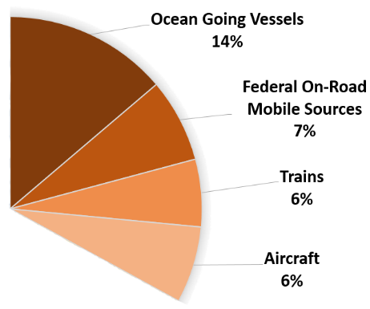
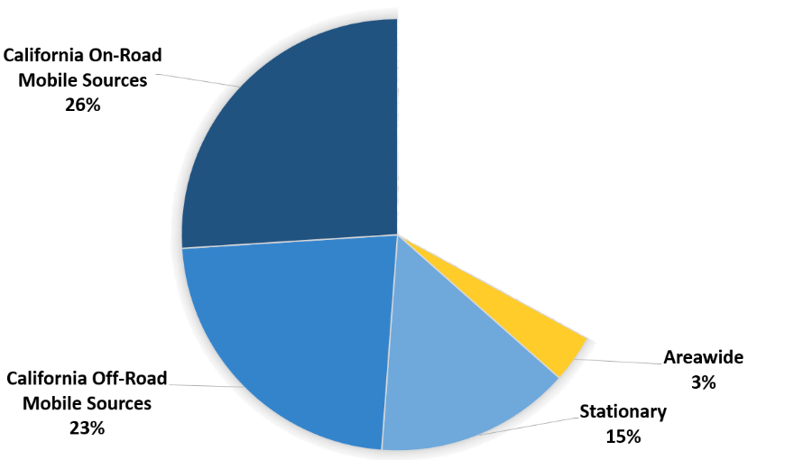
Contribution of Federal Sources
(2023 NOx emissions)
Federal Sources 33%

Slide 32
Potential Federal Measures
Measures | Measure Description | 2023 NOx Reductions (tpd)
Low-NOx Heavy-Duty Vehicles | Heavy-duty vehicles (above 14,000 lbs. GVWR) powered by low-NOx engines in 2023 | Up to 35
Low-NOx Ocean-Going Vessels | Ocean-going vessels coming to California powered by Tier 3 engines in 2023 | Up to 28
Low-NOx Locomotives | Locomotives coming to California powered by Tier 4 engines in 2023 | Up to 11
Low-NOx Aircraft | Aircraft NOx reductions assumption of 20% if emissions are held at 2012 levels. | Up to 4
Total Possible Reductions Towards 182(e)(5) Commitment |  | Up to 78 tpd
31

Slide 33
Contingency Measure Plan
Strategies to Address 182(e)(5) Reductions
Strategy | 2023 Reductions (tpd)
Identified Emissions Reduction Strategies | 24-26
Additional Incentive Funding | 15
Federal Measures and / or Funding | 67-69
All Strategies | 108

Slide 34
A Call to Action
California is doing all we can to reduce emissions with current funding and authority
All levels of government need to take action to reduce emissions
More incentive funding is needed to accelerate turn over of existing fleet to cleaner technologies to meet air quality standards
Federal action is absolutely needed on sources California cannot address

Slide 35



Public Process
October
December
April
November
8th – Release of Draft Contingency
Measure Plan for Public Comment
18th – Mobile Source Committee
18th – Public Workshop
15th – Mobile Source
Committee
6th – Board Consideration

Slide 36
SOUTH COAST AIR QUALITY MANAGEMENT DISTRICT
?
?
?
Questions and Answers

