Slide 1
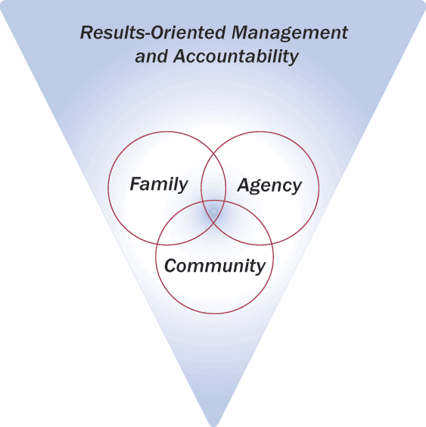
Introduction to
ROMA
This project is financed, in part, by a DHHS grant from the Office of Community Services. © 2006 -2012 Community Action Association of Pennsylvania

Slide 2
What is ROMA?
Sometimes agencies will talk about their “ROMA report” or about the “ROMA program.”
ROMA is, however, a complete management and accountability process that is focused on the results achieved as a result of your agency’s activities.

Slide 3
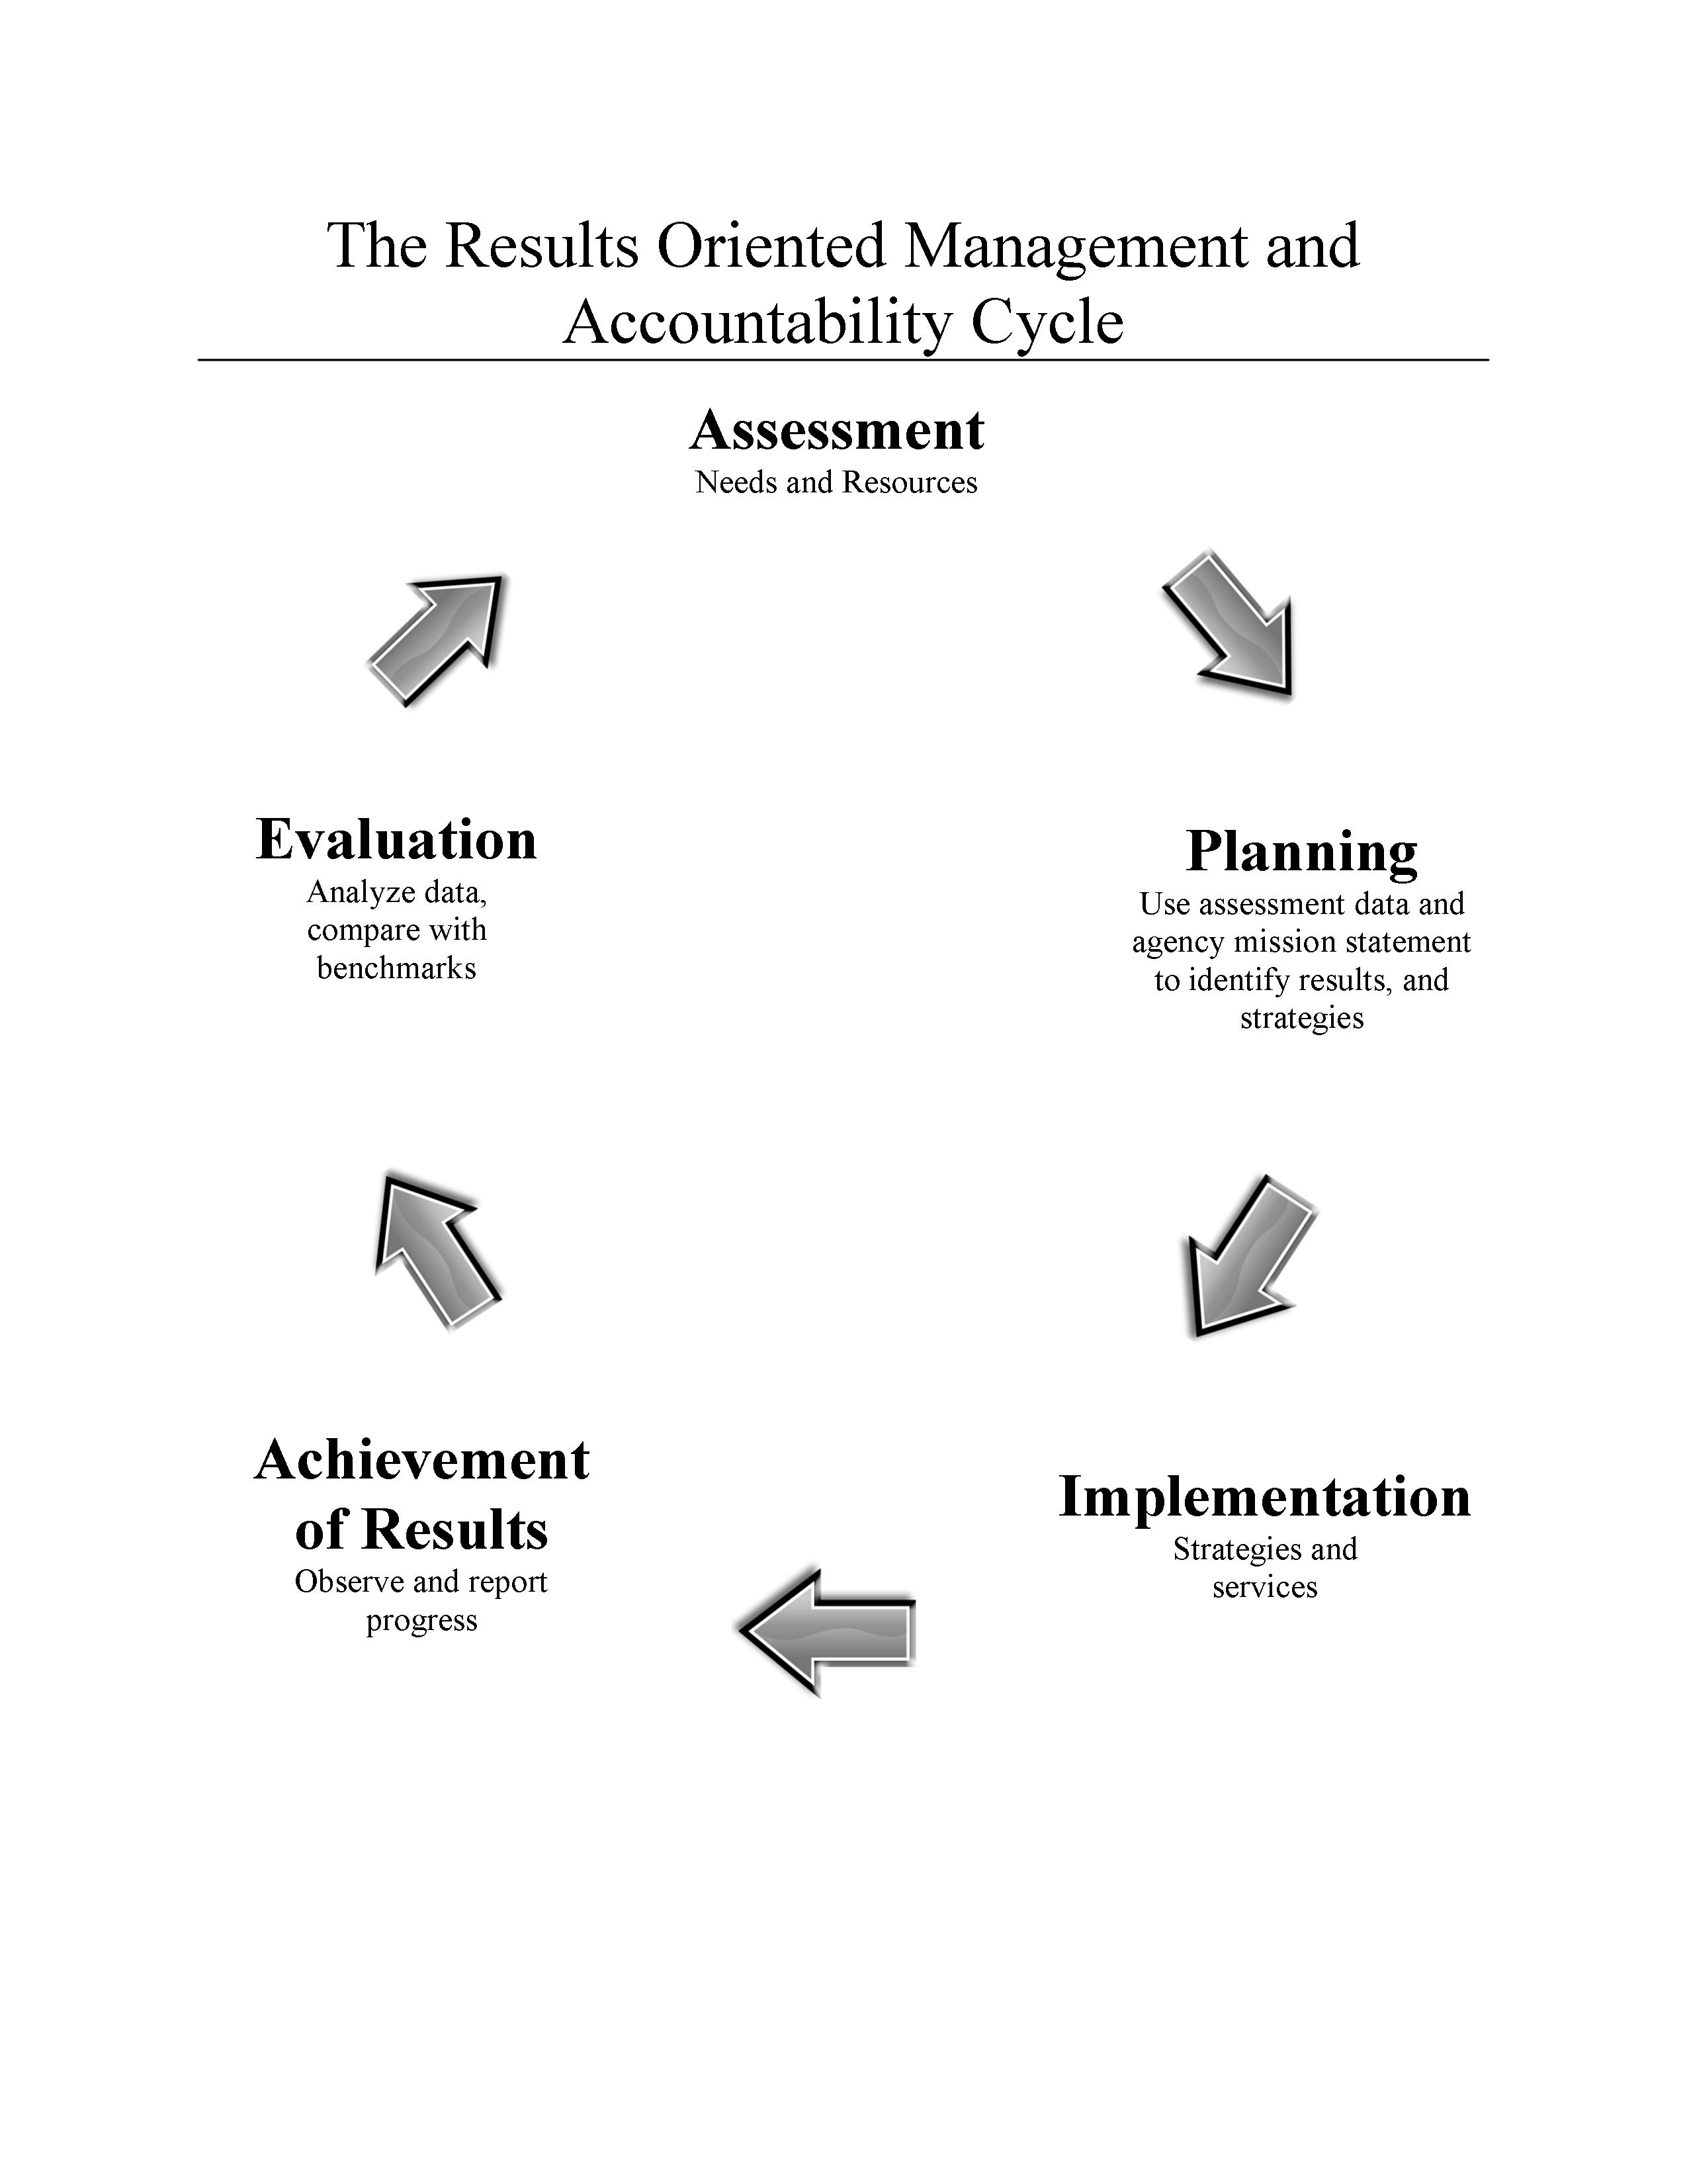
These activities are all a part of the ROMA Cycle
Cycle graphic created by B. Mooney and J. Jakopic from the Core Activities identified in OCS Information Memo 49, 2001

Slide 4

But why ROMA?
How did we get to this crossroad?

Slide 5
In 1993, Congress passed the
Government Performance and Results Act (GPRA)
"The purposes of this Act are
to improve Federal program effectiveness and public accountability
by promoting a new focus on results, service quality and customer satisfaction."
GPRA -- Section 2 (b) Purposes
GPRA applies to ALL organizations that receive federal dollars. It began a movement that continues today – where we are being asked “What happened?” as a result of our use of federal dollars.

Slide 6
The Office of Community Services formed the Monitoring and Assessment
Task Force (MATF)
In 1994, the MATF produced a
National Strategic Plan
which endorsed a “results-oriented” approach for CAAs.
In the Strategic Plan,
the MATF identified
Six National Goals,
representing the outcomes they found being reported across all CAAs.
This was a way for the network to talk about their results using common terms. The Six National Goals were the primary results around which the CAA performance management was to be built.

Slide 7
The Six National Goals
Representing three levels of results:
Goal 1. Low-income people become more self-sufficient. (Family)
Goal 2. The conditions in which low-income people live are improved. (Community)
Goal 3. Low-income people own a stake in their community. (Community)
Goal 4. Partnerships among supporters and providers of
services to low-income people are achieved. (Agency)
Goal 5. Agencies increase their capacity to achieve results. (Agency)
Goal 6. Low-income people, especially vulnerable populations, achieve their potential by strengthening family and other supportive systems. (Family)

Slide 8

Next, in 1998,
the CSBG Act was amended,
mandating implementation of a comprehensive performance-based management system, across the entire Community Services Network.
“Results-Oriented Management and Accountability,”
or ROMA, was identified as that system.
Required performance reporting
for the CSBG Network
began October 1, 2001.

Slide 9
ROMA was defined as:
“a sound management practice
that incorporates the use of
outcomes or results
into the administration,
management,
and operation
of community action agencies.”
1998, CSBG Act

Slide 10
In addition to the services
and activities provided by a CAA,
CAAs must focus on the results,
the outcomes,
or
the changes,
of the programs it provides.
Remember, results can be individual/family, agency or community level.

Slide 11

Community Action helps people
change their lives for the better,
and helps communities become better places to live.
Community Action Agencies are unique!
CAAs are change agents
-- not simply service providers --
and the “change” we focus on is
the “transition to self sufficiency.”

Slide 12

CAAs have historically measured things like:
  the number of food baskets distributed
  the number of Meals-on-Wheels delivered
  the number of children attending Head Start centers
  the number of families receiving WIC services
  the number of adults attending GED classes
  the number of clients served per day

Slide 13
While this is important,
we must also be able to identify
how these interventions
produce
results.
What changed because of these interventions?

Slide 14

Why is reporting on services provided by your agency not enough?

Slide 15

Take Me Out to the Ballgame:
Baseball Case Study

Slide 16
Situation:
The team finished last in the prior season.
To boost dwindling attendance, the team promotes that:
Outfielders ran three times more laps during spring training.
Pitchers threw twice as many pitches during spring training.
Batters took four times as much hitting practice during spring training.
The team hired two new coaches and invested $100,000 in a state-of-the-art communications system to enable the Manager to talk with them so they can give real-time perspectives on each play from their strategic vantage points in the stands during the games.
By the All-Star break, the team is taking an average of 17 more swings at pitches per game . . .

Slide 17

And the fans say,
“So what?”
because they’re still in last place,
without a single player
who deserves to be on
the All-Star Team.

Slide 18
The fans don’t care
about the process,
if they don’t get
the results.
What they care about
is
winning!

Slide 19
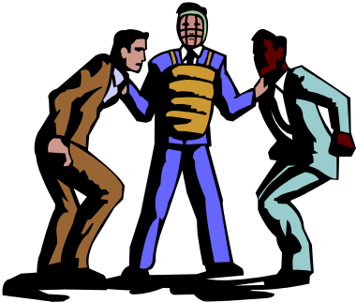
Playing Ball with
Community Action
The Board of Directors
is like the Owner and General Manager of a ball team.
The Executive Director
is like the Manager.
The funders, community, and clients
are like the fans who want to see results.

Slide 20
For Community Action Agencies,
changing lives
and
improving communities
is how we
score runs
and win games.

Slide 21
If all we tell the community is how much service we provided,
Is it no wonder that our “fans”
may also say:
“so what?”

Slide 22
Community members,
just like the baseball fans,
don’t care about the process,
if they don’t see that we
get the results.
What they care about, too,
is winning …
changing lives
and
improving communities!

Slide 23
Just like the baseball team
that must hit the ball
to score runs
and win,
Community Action won’t change lives
without delivering services efficiently,
compassionately, and intelligently.
But….

Slide 24

Documenting
the achievement of results
is how we prove
that we are a winning team.
Remember:
our results are
changing lives
and improving communities.

Slide 25
How will “lives be changed?”
In what ways will “communities be improved?”
It is important that your agency staff and Board understands:
the community needs and resources,
the agency mission,
and the results that are to be achieved by agency activities
BEFORE you decide on what services and strategies you will support.

Slide 26

Is this good management?
We got the grant!
Now we need to figure out what to do with it!

Slide 27
How do CAAs know what services to provide?
They review their mission statement.
They do a community assessment to identify needs and resources.
They get input from clients, partners, staff and supporters.
They consider the results they want to achieve. (Use the Six National Goals as general guide.)
Only then do they identify the strategies would enable them to get these results.

Slide 28
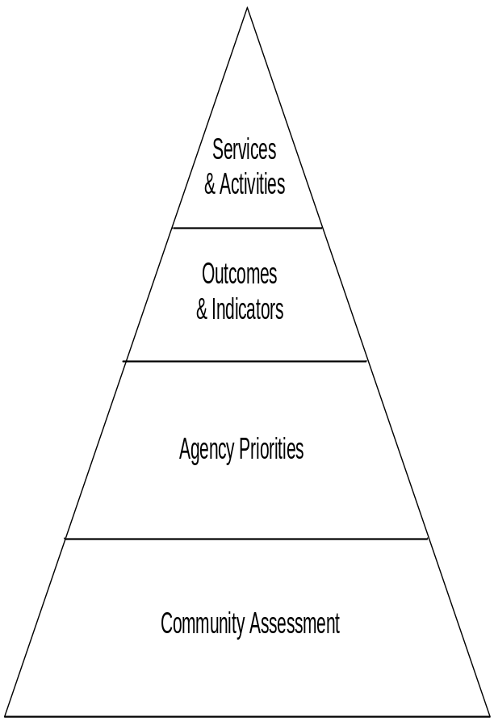
ROMA Activities*
Start at the base of the pyramid.
(4) Design & develop services and activities based on the identified outcomes to be achieved, priorities established and resources available to the agency.
(3) Identify outcomes and indicators that align with the agency priorities and community assessment.
(2) Develop priorities to address needs -- based on mission and vision.
(1) Identify needs and resources of the community.
* From the ROMA Cycle

Slide 29
How do CAAs know what strategies will lead to the results they identify?
I think we have to add some more detail to our plan!
CAA PLAN
Outcome:
Reduce poverty!
Steps:
1. Get funds
2. Abracadabra
3. Presto
Don’t rely on magic to accomplish your goals!

Slide 30
Consider the kinds of services your agency will provide:
Are they short term and crisis focused? Or are they designed for long term results, like self sufficiency?
Have you taken into account a full range of community and family needs and other resources in the community?
Don’t just approve funding for “what we have always done” but consider what needs to be strengthened and what
needs to be abandoned.

Slide 31
Community Action Agencies are more than service providers.
PROVISION OF SERVICES MODEL
Agencies that are organized to meet specific short term services (such as emergency services, transportation, Weatherization) sometimes serve many customers. The challenge is being able to identify long term change in the customers’ lives.
Providing services only because funding is available can distract you from a more effective selection of services and strategies.
Failure to link activities together to form a comprehensive set of services and advocacy strategies may reduce your effectiveness in assisting customers to move out of poverty.
Sometimes there are unintended
consequences doing the same services you always have done -- enabling the continuation of poverty.
STRATEGIC THINKING MODEL
The development of comprehensive strategies must include an understanding of the power of “bundling services” rather than providing services that meet an isolated need.
Agencies must find ways to identify the combination of services that is most effective for helping to change lives and support movement out of poverty.
In addition to providing direct services, agencies must explore the impact of creating community engagement strategies, advocacy and policy change strategies, and other activities that are focused on reduction of poverty.
Agencies must strengthen partnerships to meet the needs that the agency cannot address alone.

Slide 32

Part of the Planning Process
Identifying Realistic Results

Slide 33
As a CAA Board Member, you are the owner of the “team.”
You will take a leadership role in helping staff
identify what results are expected for the families and communities you serve.
When you identify results that are expected, you will try to estimate how many people will be able to achieve the results.

Slide 34
What is the rate of success?
Your agency will be tracking how many people’s lives have been changed and how communities have been improved.
But how do you know if the results you expect are realistic?
What is the rate of success you should expect?
Let’s look at some measures
of successful results from industry.

Slide 35
What we have learned from baseball.
Consider a superstar baseball player.
What is his “batting average?”
If the team has batters who have an average of .30*, they know they will win games.
Why?
Because baseball has been keeping statistics for well over a hundred years, and they have found that if a player *hits the ball and gets on base one out of three times at bat , the overall performance will mean winning games.

Slide 36
What baseball has done.
Clearly defined the performance indicator (hit and get on base) related to the outcome (winning games)
Observed performance and kept records
Analyzed the data
Developed a benchmark of excellence based on the analysis
Publicized what they have learned (so the public knows that 30% is excellent).

Slide 37
Let’s look at Success Measures in Industry:
Executive management recruitment, ___ % placement rate.
New Magazine, ____ % survives over 12 months.
Movies ____ in 6 or ____ % make a profit.
Broadway ____ in 7 or _____ % make a profit.
Music Recordings, ____% make a profit.
Prescription drugs, ____ % make it to market.
Of the prescription drugs that make it to the market,
____ % make a profit.
Pfizer ____ in 100 new drugs or _____% make it to the market, 10 – 12 years to develop a product.
DuPont ____ in 250 or _____% of ideas to generate one major marketable new product
On Time Railroad Delivery + or - ____ hours.
Baseball: __ in 3 or ___ % is a superstar.
___in 4 or __%) is a successful hitter.

Slide 38
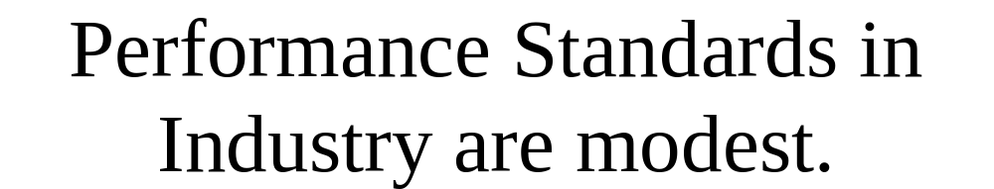

While they are modest, these performance standards are not arbitrary. They come from a long-term commitment by industry executives to collect and analyze data to determine what is possible and realistic.
Community Action must establish its own standards of performance and communicate these standards of performance to your “fans” (funders, supporters, staff, etc.)

Slide 39
Keep in mind:
while we are not expected to “hit the ball” every time we are “up,”
we need to eventually
“win games”
(help families and communities achieve results)
to show our “fans” we are worthy of their support.

Slide 40
As CAAs collect and analyze results data over time,
we will have the documentation (the evidence) to support our projections of the kinds of results we expect for families and communities.
We will document the movement of families from poverty to self sufficiency and the positive changes in communities.

Slide 41
Implementation of National Indicators of Community Action Performance
Beginning in 2005
OCS reviewed the data submitted by local CAAs and State offices in the first mandatory reporting for 2001.
As a result of this data review, and in response to a need for a standardized system of reporting CAA results, OCS has established National Performance Indicators (NPIs).
For us the NPIs are a list of expected outcomes, like the “hit and get on base” indicator in baseball.

Slide 42
Targeting Services and Results
The NPI report is sometimes called the ROMA report, because it is the “accountability” portion of the ROMA Cycle.
In your CSBG work plan, CAAs are to project (or estimate)
the number of units of service they will provide
the number of people to be served, and also
the number of results that will be achieved by these participants.

Slide 43
Performance and Analysis of Results
After the service is provided and the results documented, your agency will complete a report for the state office. In the NPI report (your state may call it something different but it contains the NPIs), you will compare the actual performance data to that you projected in your work plan.
This is a way to evaluate both an agency’s performance rate and also its ability to make projections about performance.
As a Board Member, you should review your agency’s NPI data before
it is submitted to the state office.

Slide 44
NASCSP Standard Monitoring Principles and Practices for CSBG
The National Association of State Community Service Programs has provided Standard Monitoring Principles as a guide for state offices to use in their monitoring responsibilities and practices.
These principles are based on OCS IM 102 which establishes a checklist of items related to compliance with CSBG funding regulations.
However, they focus on the concept of: “beyond compliance to excellence.” They support the best practices of results oriented management and accountability throughout the network.

Slide 45
Community Action leaders need to work together to ensure the Network is strong.
“The overall health of a community action agency encompasses more than just a technical compliance with specific program mandates.
In order for a CAA to be truly ‘healthy,’ it must be continually striving to find better ways to use programmatic resources to help people move out of poverty.
Programs operated by a CAA must contribute to the agency’s overall mission, and each program must achieve measurable outcomes that help to change the lives of low-income people.
NASCSP Standard Monitoring Principles and Practices

Slide 46

Getting ready for accountability
Establishing Measures and Indicators

Slide 47
What do you measure?
How do the advocacy activities in which your agency staff, volunteers and board members engage help move families to self sufficiency and improve communities?
How do the services your agency delivers help move families to self sufficiency and improve communities?

Slide 48
How will you know?
How does getting a food basket, Meals on Wheels or WIC help strengthen vulnerable populations?
How do Head Start services impact families?
How does helping adults to get a GED or improve job skills really impact on their family self sufficiency?
(exercise follows)

Slide 49
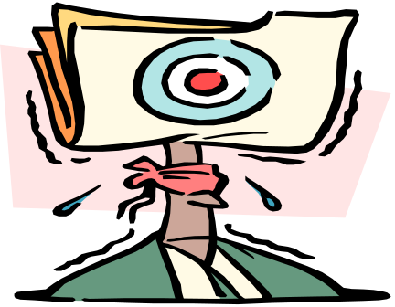
How do you know
if you are meeting your goals
and producing results?
You need to establish reliable
measurement tools
for those results
you are trying to achieve,
and processes that enable you to
observe and document the indicators.

Slide 50

As a Board Member,
you will help staff identify measures and processes that will let you know when you have “hit a home run” and when you have “won a game.”

Slide 51
The NPI Report is about results achieved in each of the Six National Goals.
In addition to reporting on family results (Goals 1and 6)
CAAs also report on “what happened” while working on community revitalization (Goal 2),
customer participation (Goal 3) and building agency capacity (Goals 4 and 5).

Slide 52


Community Goals!
Goal 2. The conditions in which low-income people live are improved.
Goal 3. Low-income people own a stake in their community.

Slide 53
Community goals are often the hardest to define.
This means that they are also the hardest to identify results and indicators.
However, it is an important part of our original mission to help improve communities so that low income people have opportunities to improve their lives.

Slide 54


Some examples of community results where conditions are improved:
Low-Income people have improved access to essential services.
Municipal infrastructure is
maintained or improved.
The supply of jobs, adequate and affordable housing, community facilities, capital and lending programs is increased.

Slide 55

Some examples of increased participation:
Low-income people volunteer
and participate in formal public organizations, government, boards or councils that provide them the ability to be involved in decision-making and policy setting activities.
Low-income people participate
in advocacy activities.
Low-income people own businesses or homes in their communities.

Slide 56

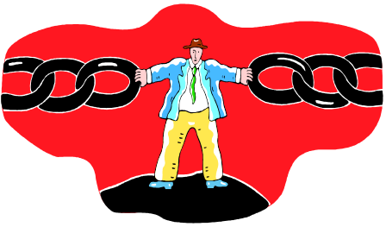
Don’t forget the Agency Goals!
Goal 4. Partnerships among supporters and providers of services to low-income people are achieved.
Goal 5. Agencies increase their capacity to achieve results.

Slide 57
You have many connections in the community
that will help develop
the capacity of your CAA.
You will help staff create
and maintain partnerships
to help families and communities
achieve results.

Slide 58

Periodically, you will help evaluate the results of these partnerships.
You will be asked to answer this question:
What is better because of this partnership?

Slide 59
Your agency will have diverse funding support to assure financial stability.
Acquiring multiple funding streams is a way to meet the CSBG Act mandate to “focus all available resources” on the elimination of the causes of poverty.
What percent of your total budget is the CSBG grant?

Slide 60

Based on the goals
you and your agency set,
you will help and support staff,
to manage your “team,”
and evaluate your results --
so that you move closer and closer
to having an All Star Team.

Slide 61
Remember:
  The public perception of human service agencies is not always positive.
  Demonstrating success will win public support and improve public image.
  The individual human-interest story is not a substitute for overall agency impact. It is a way to demonstrate the kinds of results that are being achieved.
  Nothing is as powerful as documentation of how lives and communities have been positively impacted by association with your CAA.

Slide 62
The War is not over!
"In the sixties we waged a war on poverty, and poverty won," Ronald Reagan said (1987), in one of the one-sentence pronouncements he has sometimes made to the press while walking across the White House lawn to his helicopter. Most people would probably agree with him.
Copyright © 1988, Nicholas Lemann. The Unfinished War"; The Atlantic Monthly, December, 1988, issue. Volume 262, Number
Don’t let this be the last word!
Now, in the 21St century, let us use ROMA as a weapon to fight the War On Poverty.

Slide 63

Implementing ROMA in your agency:
What are the steps you need to take to assure that ROMA is integrated into the operation of your agency?

Slide 64

Power Point presentation prepared by
under a grant from the US Department of Health and Human Services, Office of Community Services.
© 2006 -2012 Community Action Association of Pennsylvania

