Slide 1
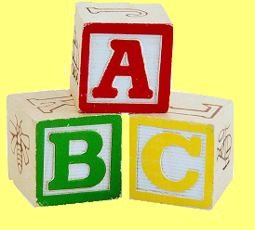

The ABC’s of Healthy Relationships
Run your relationships.
Don’t let them run you.
Funded by a grant from Youth Venture
Notes:
The purpose of this project is to help teens make the healthiest choices they can make in relationships and understand the consequences associated with their behavior.
On the “We’re Talking” teen health web site, www.pamf.org/teen, at the Palo Alto Medical Foundation, we noticed that many of the questions submitted to the site were from kids who were struggling with emotional or physical situations in relationships. Because these kids are submitting questions anonymously, they must perceive that they have nobody to talk to and are looking for information on the Internet.

Slide 2

- Mission
We believe that young people of all backgrounds deserve the opportunity to lead, participate, and get the guidance and support they need.
While the Youth Venture opportunity is available to all youth 12-20 years of age, the focus of our limited resources is primarily on young people from disadvantaged backgrounds.
We believe young people are capable.
We seek systemic change rather than “retail” assistance to individual youth.
Notes:
Last year, we applied for a Youth Venture Grant, which provided the money to develop The ABC’s of Healthy Teen Relationships.

Slide 3
Run your relationships.
Don’t let them run you.
Notes:
Our slogan for the ABC’s is: Run your relationships, don’t let them run you. We believe that you are in charge of each of your relationships and that you deserve respect in EVERY relationship. But sometimes it is too easy to live with relationships that are not good for us. We want to help you take control of your relationships and be able to evaluate decisions so things don’t “just happen” and you find yourself in a situation where you feel scared, confused, and pressured into doing things you are not comfortable with.
During this presentation, when we say “relationship,” we mean every relationship, not just intimate or romantic relationships. However, especially because of the high rates of teen dating violence, because many questions from teens tend to be about this kind of relationship, and because you will all be in an intimate relationship later in life, we are going to focus a bit more on intimate romantic relationships later in the presentation. However, we will first talk about the healthy and unhealthy components of all types of relationships.

Slide 4
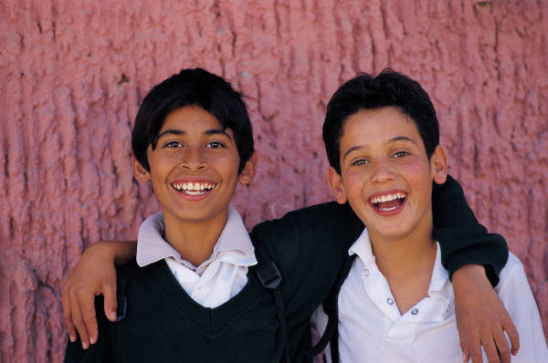
Types of Relationships
What types of relationships are there?
Family (such as siblings and parents)
Friends
Romantic (boyfriends or girlfriends)
Casual:
  Professional (such as teachers, clergy or medical professionals)
  Acquaintances (such as people you know and recognize in passing)
Notes:
When you think of the word “relationship,” what people or situations come to mind?
Quickly highlight each type of relationship
In thinking about different types of relationships, I want to point out that you can have an intimate relationship with anyone, it doesn’t have to be in the context of a romantic relationship. Many people think that “intimate” means being physically intimate, such as being in a sexual relationship. However, an intimate relationship can be with anyone who you are really close to and who you can be completely open and honest with.

Slide 5
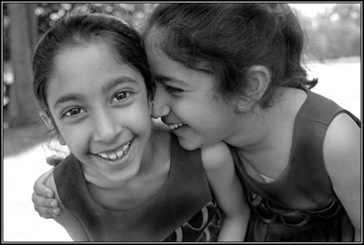
Why are Healthy Relationships Important?
Everyone is part of relationships
Being in a good relationship helps us:
  Know ourselves
  Develop as a person
  Grow emotionally
  Communicate and maintain meaningful bonds with other people
  Have fun!
1
Notes:
Each and every one of us are in relationships with other people, so having good relationships is extremely important. Why? Because being in good relationships helps us know ourselves. Having a healthy relationship with yourself and respecting your own body and values can help you have healthy relationships with others.
Good relationships also help us develop as a person, grow emotionally, and teach us how to communicate and maintain meaningful bonds with other people. And of course, being in a good relationship is fun! We like to spend time with people who make us feel good, who we can be ourselves with and who are fun to be around.

Slide 6
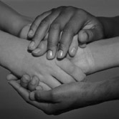
What is a Healthy Relationship?
  Individual identity and freedom
  Encouragement and support
  Boundaries
  Cooperation and compromise
  Consideration
2
  Communication
  Trust
  Respect
Notes:
In a good or healthy relationship between two people, each person is allowed to be an individual within the relationship. Both people are allowed to grow independently of each other and as a pair or couple. This kind of healthy relationship involves freedom, encouragement and support of each other’s efforts, boundaries, cooperation and compromise, and being considerate.
That all sounds easy- but as we all know, relationships take work, and we need to be conscious of our feelings.

Slide 7

What is an Unhealthy Relationship?
An unhealthy relationship may include:
  Teasing or bullying
  Power struggles
  Angry outbursts
  Withholding love
  Coercion or peer pressure
  Unreasonable demands
  Humiliation
3
Notes:
There are many types of relationships, and all relationships have good days and bad days. However, the ones you want to avoid are those that make you feel bad about yourself, like you have to do what the other person says or make you feel afraid or in danger. A healthy relationship NEVER includes teasing or bullying, power struggles, angry outbursts, withholding love, coercion or peer pressure, unreasonable demands, or humiliation.
A very unhealthy relationship might include relationship violence. It is a pattern of abuse that happens between people in any type of relationship and may include unwanted sexual contact, physical, verbal and/or emotional abuse. No one deserves abuse. It doesn’t matter what the person’s appearance, attitude, or actions are. There is no excuse for abuse. In addition, being in unhealthy relationships means that things are more likely to “just happen” and become out of control.

Slide 8

The Media and Relationships
Exposure
  How are relationships portrayed in the media?
Facts
  Most relationships on TV are superficial, short term and “easy.”
  Out of the TV shows that contain overt sexual content, only 15% discuss risk and responsibility.
Notes:
Teens like you are getting exposed to examples of unhealthy relationships earlier and more often then your parents were- through what we see at home, TV, movies, magazines, friends, and online. Most often, these media sources do not accurately depict a real relationship. Instead, they are most often superficial, short term and “easy.” Think of the “reality” TV shows. Can you share any examples you have seen?
Teens report that media is a main source of information about sex, dating, and sexual health. However, out of the 68% of TV shows that contain overt sexual content, like reality TV shows, only 15% discuss risk and responsibility. (commonsensemedia.org) This is one example of how the media is giving teens some unhealthy messages about relationships.

Slide 9
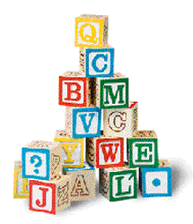
The ABC’s
Notes:
So how can you create and maintain healthy relationships in spite of the media influences? This is where the ABC’s come in.

Slide 10

A: Awareness
What is awareness?
    General knowledge
    Knowing consequences
    Prevention of violence
Notes:
A stands for “Awareness.” Awareness means:
General knowledge and using what you know to respect others and demand respect from others
Knowing consequences of unhealthy relationships and recognizing danger signs and what your boundaries are
Preventing violence by recognizing a lack of power and respect, requiring that you apply the knowledge you have to change unhealthy relationships into healthy ones.

Slide 11

B: Balance
What does balance mean?
  Nothing is one-sided
  Communication
    Both people have
    valuable opinions
  Having other friends and interests
Notes:
B: Balance, being in synch with your partner and having a relationship that is not one-sided- meaning that one person doesn’t have more control or power than the other.
Communication is key to staying balanced- you have to both listen and talk about what each person wants. Both people need to recognize that they each have valuable opinions, and then work together to balance their desires.
You and your friends probably have similar interests- but you’re not completely the same. The same is true for your family and your boyfriend or girlfriend. You can certainly do things together, but remember that you can have different interests, too. Make sure you have time to do these things. If you change in a relationship and adopt all of the other person’s favorite things, hobbies, lifestyle etc., this is a very bad sign.

Slide 12

C: Choices
Make a conscious choice
  Don’t let things
  “just happen”
Notes:
C stands for Choices- most importantly conscious choices. Conscious choices include being able to decide what the next step in a relationship is, making sure things don’t “just happen.” This is a common excuse teens use for getting into emotional or sexual situations they don’t know how to handle.

Slide 13
So, how can knowing
the ABC’s
help you have
healthy relationships?

Slide 14
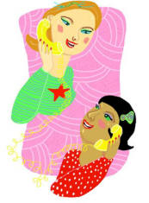
Keys to Healthy Relationships
The Base of the ABC’s:
  Communication
  Trust
  Respect
Notes:
In order to be aware, balanced, and make healthy choices- you need communication, trust and respect. They are the keys to a healthy relationship and are at the base of the ABC’s.

Slide 15
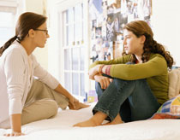
Communication
Communication= talking and listening
Open and honest
4
Notes:
Communication involves talking and listening- they go hand in hand. Relationships are two sided- each person has a responsibility to make themselves heard and to hear other people. If you are always listening, or if you are always talking, the relationship is not balanced.
What are some ways to be a good listener?
Asking them questions
Adding advice or a similar experience
Really listening to what they have to say, without trying to think of a response or your next line while they are speaking
Supporting the other person’s endeavors

Slide 16
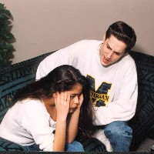
Communicating –
Body Language and Tone
Body language and tone can express more than your words!
Activity: Using Body Language
6
Notes:
When we communicate with another person, what we say is not necessarily the most important part of our message. Our body language and our tone can say so much more than our words.
We’re going to do an activity demonstrating how your body language and tone can emphasize the meaning of your words. (Have two students come up and demonstrate in front of class.)
Have someone invite another person to a party saying “What are you doing this weekend? Do you want to come to the party?” First say like he/she doesn’t mean it (sarcastically) then switch roles and have the other person invite them to the party and say it like he/she means it and wants them to come.
Between two skits, ask the class: How did the tone and body language influence how the person invited to the party felt? How did the other person interpret their words based on the body language and tone of the person inviting them?

Slide 17
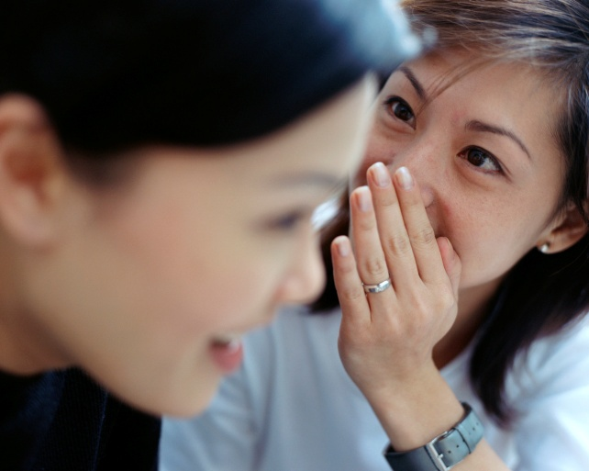
Trust
Being honest
Proving you are reliable and responsible
What happens in a relationship without trust?
  Second guessing
  Not believing each other
  Betrayal by sharing secrets
  Obsessively checking on the person
Notes:
In any relationship, it is important to be able to trust each other. This means being honest with the other person in the relationship. Having trust in a relationship also means proving to each other that you are reliable and responsible, showing that you are dependable.
What happens in a relationship without trust? What can you add to the points on the slide?

Slide 18
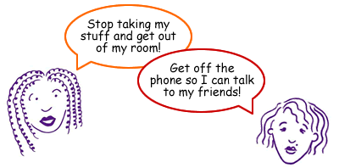
Respect:
You have to give it to get it!
Everyone deserves respect.
Trust and support each other
Value each other's independence
Have the freedom to be yourself
Talk honestly
8
Notes:
What does respect mean to you? What are examples of respect in a relationship?
Respect is a pattern of behavior that's found in healthy relationships. With respect, you have to give it to get it and everyone deserves respect. People who respect each other:
Trust and support each other
Value each other’s independence
Have the freedom to be themselves
Talk honestly and freely
Make decisions together and compromise
Respect boundaries
Encourage each other to spend time with friends and family

Slide 19
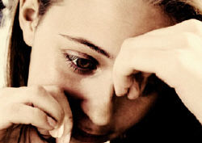
Being Respectful
Respect yourself
Show respect with your words and actions
Verbal and emotional abuse is a sign of an unhealthy relationship.
9
Notes:
The best way to be respectful is by making sure you are respecting yourself. You should have opinions, express opinions, and feel good about a relationship. You shouldn’t feel pressured to do something just because it seems like everyone else is doing it, or because someone else is trying to get you to do something.
It is important to show respect not only with your actions, but also with your words. What are some examples of verbal and emotional abuse?
Belittling, put-downs, and unreasonable accusations are forms of verbal and emotional abuse. They are not a part of a healthy relationship. (Mention if needed: someone calls you stupid, ugly or fat, in front of others or when you’re alone, sometimes ignores you when certain people are around, calls you constantly, is jealous of everyone, needs to know where you are at all times.)

Slide 20
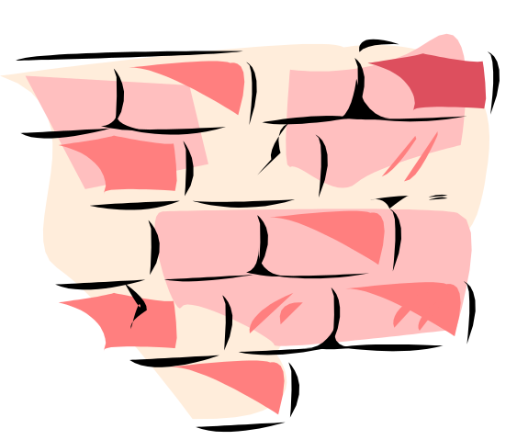
Boundaries
Understand and honor boundaries
Each relationship can have different boundaries
Understand when boundaries can/cannot be crossed
Notes:
Personal boundaries are limits we use to protect ourselves, and they are formed by having good self-understanding and clear personal values. An important part of respecting yourself and other people is understanding and honoring these boundaries. Each relationship has its own set of boundaries to be respected.
Part of having boundaries is understanding each other’s values. This ensures that you are remaining an individual in the relationship and not changing what you believe based on the other person.
There are some situations, however, in which these boundaries should be crossed, such as when there is a threat to a person’s health or life. Can you give an example?

Slide 21


The ABC’s in Action:
Evaluating a Friendship
Is the friendship worth it?
Are you aware of all the risks?
Is there balance in your friendship?
What are your choices? Make a conscious choice.
→Is this a healthy friendship?
10
11
Notes:
You can use the ABC’s to help you evaluate any relationship. Let’s apply the ABC’s to this example (from previous slide--about crossing a boundary)
Ex: If a friend tells you they are thinking of hurting themselves…
A: Are you aware of all the risks? To you? To your friend? The consequences?
B: Is there balance in your friendship? Are you balancing your friendship with all the consequences? Helping friendship vs. helping your friend
C: What are your choices? Making the choice to help a friend even if it hurts your friendship.
Evaluate- Is this a real friendship? Is it healthy? Is it worth staying friends with this person if they continue these behaviors?

Slide 22
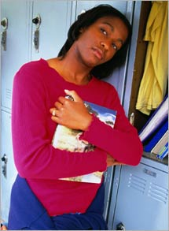
The ABC’s in Action:
Sexuality
Is your romantic relationship ready for sexuality?
  Consider:
    Are you aware of your options and the consequences of being sexual?
    Are you balancing all aspects of your life in your decision, including your present desires and future goals?
    Make a conscious choice.
12
Notes:
Second, let’s now consider a situation that many teens face after they have been dating for a long time: whether or not they are ready to have sex. (read points on slide)
One expert says, “The short answer is that you are definitely NOT ready if you haven’t talked about and prepared ways to avoid pregnancy and sexually transmitted infections.”
You have a choice about the kind of relationships you want to have with a boyfriend or girlfriend. Remember, if you are pressured or forced to have sex or perform sexual acts against your will, you are a victim of dating violence.
Also, just letting it happen can have consequences too. For those of you not thinking about sexuality, please don’t tune out now- someday you’ll also face these choices.

Slide 23

Danger Signs
Not talking and avoiding problems
Lack of trust
Jealousy
Lack of balance
Lack of respect
Notes:
Sometimes relationships don’t work out. The “danger signs” of an unhealthy relationship should be easily recognizable- lack of talking and no communication, inability to listen, no trust, jealousy, no balance, and no respect…
Do you have examples of these from your friend’s or your own relationships?

Slide 24
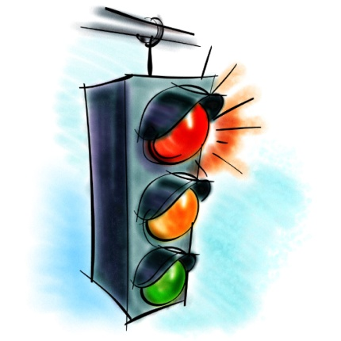
Red Lights
Does the other person…?
Put you down
Get extremely jealous or possessive
Constantly check up on you
Tell you how to dress
Try to control what you do and who you see
Have big mood swings
Make you feel nervous (like you are walking on eggshells)
Criticize you
Threaten to hurt you
Notes:
Abuse always escalates, and it rarely gets better.
Specifically, if you experience any of these things, you may be involved in an unhealthy relationship:
Does the other person…
Put you down?
Get extremely jealous or possessive?
Constantly check up on you?
Tell you how to dress?
Try to control what you do and who you see?
Have big mood swings - being angry and yelling one minute, and the next minute being sweet and apologetic?
Make you feel nervous or like you’re "walking on eggshells"?
Put you down or criticize you and make you feel like you can't do anything right or that no one else would want you?
Threaten to hurt you?
Knowing these warning signs can help act as red lights in your relationship. You can stop and figure out if your relationship is abusive- before things get out of control.
Not all of these signs will be in every abusive relationship. If one or more of these warning signs exist in your relationship, it doesn't necessarily mean that your relationship is abusive, but your relationship may not be as healthy as you deserve it to be.

Slide 25
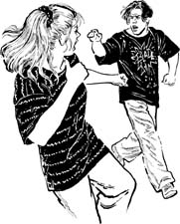
One Outcome of Bad Relationships…
Dating Violence
How common is dating violence?
About one in four adolescents reports verbal, physical, emotional or sexual abuse each year.
Recent studies show that 1/3 of teens experience some form of abuse in dating relationships.
More than half of the teens surveyed know someone who has been abused.
13
Notes:
Adolescents and adults are often unaware about how regularly dating abuse occurs.
Here are some statistics about dating abuse and how common it is:
One study found that 1 in 4 adolescents reports verbal, physical, emotional or sexual abuse each year. (www.chooserespect.org/)
Recent studies shows that 1/3 of teens experience some form of abuse in dating relationships
More than ½ of the teens surveyed know of someone who has been abused.
Especially because of these kinds of statistics, it is very important to recognize the danger signs of an abusive relationship so that you can make sure you get out as soon as possible.

Slide 26
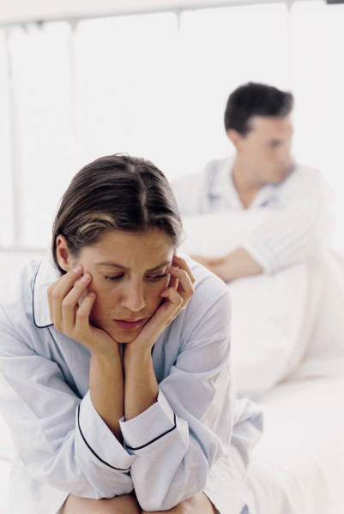
What is the Dating Violence Cycle?
  Tension: Criticism, yelling, swearing, angry gestures, coercion or threats
  Violence: Physical and sexual attacks or threats
  Seduction: Apologies, promises to change or gifts
  →Jealousy and Possessiveness
14
Notes:
What exactly is the dating violence cycle? It includes: (read points on the slide)
Jealousy and possessiveness are two of the most common warning signs of dating abuse. Abusers use them to control the other person’s behavior.
These elements can keep the cycle in motion:
Love for the abuser: Believing that the relationship is not entirely bad
Hope: Thinking things will change or it's just a phase
Fear: Worrying that threats will become a reality and so are afraid to end the relationship

Slide 27
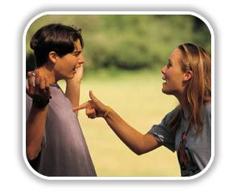
Myths of Dating Violence
“He/she will never do it again.”
“I am not being abused.”
“I will leave when the time is right.”
“It only happens to girls.”
15
Notes:
Many people in abusive relationships are in denial. They cling to the myth…
1) …that their partner will never do it again. Saying he or she will never do it again is futile because violence is a pattern of behaviors. Rarely does someone abuse their partner only once.
2) …that they are not being abused. Dating abuse does include physical and sexual violence. But it also can include emotional and verbal abuse, which includes put-downs, insults, and threats.
3) …that they will leave when the time is right. People stay in abusive relationships for a variety of reasons. These include fear of being alone, emotional dependence, confusion, low self-esteem, not realizing that it’s abuse, or a belief that the abuser will change.
4) …that it only happens to girls. Males can also be victims in controlling and abusive relationships. They can be embarrassed to confess that they are being abused because they, the abuser, and other people sometimes have a bias that “only females are abused…”

Slide 28

Helping a Friend - Warning Signs
Is your friend:
  Becoming more isolated?
  Not participating in activities he/she formerly enjoyed?
  Spending an excessive amount of time with the other person?
  Displaying physical and emotional signs of abuse?
16
Notes:
What about if you suspect that a friend is in an unhealthy relationship? How would that friend act? (Ask students to first make suggestions, then list questions below.)
Ask yourself if your friend:
Constantly cancels plans for reasons that don’t sound true?
Always worry about making their boy/girlfriend angry?
Give up things that are important?
Show signs of physical abuse, like bruises or cuts?
Tell you that they get pressured into having sex, or talk about feeling like a sex object?
Have a boy/girlfriend that wants them to be available all the time?
Has become isolated from friends or family?
If the answer is “yes” to a significant number of these questions, that friend could be in an abusive relationship.

Slide 29
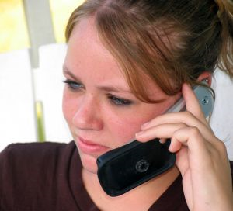
What Should You Do?
In an unhealthy relationship, you can:
    Work it out
    End the relationship
    Tell someone about the abuse
Helping your friend
    Do not make them feel bad about their choices
    Offer to go with them to get help
    Remember you cannot “rescue” them
17
Notes:
What can you do about abusive relationship? If you are being abused, you should consider how much you care about the relationship. If you really care about the relationship, try to work it out before you end it. Maybe you should spend some time apart, and then figure out what went wrong after you have cooled off. Although, if the relationship is violent, it will be better to end it now! Reporting physical abuse can help protect you in case the abuser pursues you after you leave the relationship.
If a friend is in an unhealthy relationship, talk to him/her, explain why you think it is harmful, and offer to help him/her get help. There are also hotlines, internet sites and counselors dedicated to offering teens advice and support.
Here are some suggestions for helping a friend deal with an unhealthy or violent relationship.
Help them to recognize that feeling bad about themselves is not "normal" and that they deserve a healthy, non-violent relationship.
Encourage their strength and courage.
Do not make them feel bad for their choices - even if you think these choices are wrong.
Offer to go with them to find a counselor or support group, or to talk to their family, friends or teachers.
Remember that you cannot "rescue" them.
Have you ever had any of these experiences, such as recognizing an unhealthy or abusive relationship, ending a relationship, helping a friend? What decision did you make?

Slide 30
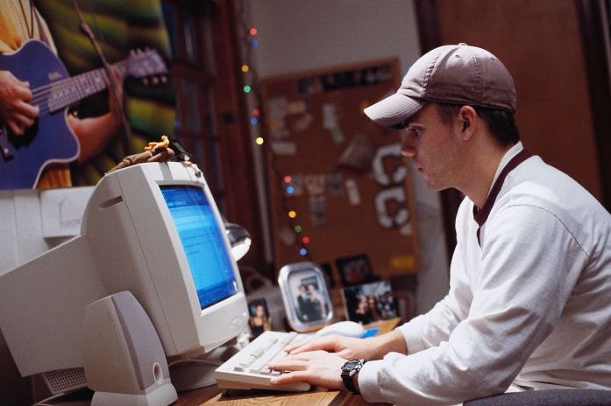
Resources
National Domestic Violence Hotline
    800-799- SAFE (7233)
Break the Cycle
    http://www.breakthecycle.org/
    1-888-988-TEEN (8336)
Rape, Abuse and Incest National Network
    http://www.rainn.org/
    1-800-656-HOPE (4673)
Notes:
What are some resources that you know of? List resources above.
Building on communication, trust and respect, make sure you practice the ABCs: Awareness, Balance, and Choices, and use them as guidelines to help you have healthy relationships.

Slide 31
Thank You!
This presentation, along with other health information and resources, is available online at:
www.pamf.org/preteen
www.pamf.org/teen

Slide 32
Picture Credits
1. www.vish.me.uk
2. www.arlingtondiocese.org
3. www.dominie.com.au
4. www.girlshealth.gov
5. www.redcross.ca
6. www.youngwomenshealth.org/healthy_relat.html
7. att.iparenting.com/teenagers/bdd.htm
8. www.troubledteen.us
9. www.bbc.co.uk
10. www.mnohs.org
11. http://www.cpcanchorage.com/am_i_pregnant.html
12. health2.uml.edu
13. www.ci.escondido.ca.us
14. www.honeysmith.com
15. www.sxc.hu

Slide 33

Group Activity:
Crossing the Line
Size
Gender
Interests
Race
Clothing
Brains
Notes:
(If there is time, try this great activity!)
Relationship violence, like discrimination touches everyone’s lives - through friends, family members, and neighbors.
Line up on one side of the room. If the answer is yes to any question, cross over to the other side…
Have you ever made fun of somebody?
Been made fun of for your…
Size?
Gender?
Race?
Brains/Grades?
Clothing?
Age?
Family?
Friends?
Belongings?
Goal: Demonstrate that everyone has been bullied, harassed, been made fun of at some point. If the students realize that everyone has been a victim at some point, they can begin to be more conscious of what they say to others.

Slide 34
Run your relationships.
Don’t let them run you.
Notes:
Our slogan for the ABC’s is: Run your relationships, don’t let them run you. We believe that you are in charge of each of your relationships and that you deserve respect in EVERY relationship. But sometimes it is too easy to live with relationships that are not good for us. We want to help you take control of your relationships and be able to evaluate decisions so things don’t “just happen” and you find yourself in a situation where you feel scared, confused, and pressured into doing things you are not comfortable with.
During this presentation, when we say “relationship,” we mean every relationship, not just intimate or romantic relationships. However, especially because of the high rates of teen dating violence, because many questions from teens tend to be about this kind of relationship, and because you will all be in an intimate relationship later in life, we are going to focus a bit more on intimate romantic relationships later in the presentation. However, we will first talk about the healthy and unhealthy components of all types of relationships.

Slide 35
Laws and Teen Sexual Behavior
Agreed Sexual contact with someone under 18 years of age
Gross sexual imposition
Corruption of a minor
Sexual Assault
Fornification

Slide 36
North Dakota Law:
Two people under 18 who agree to have sex
Could be charged with fornication, class B misdemeanor
Could receive 30 days in jail, $1000 fine, or both

Slide 37
If you are 4 years older:
15,16,17 years of age
Could be charged with corruption of a minor
Could be charged with a felony

Slide 38
Too drunk to know or give consent;
Could be charged with a Class A felony
Could be charged with Rape

Slide 39
Date Rape Drug
Fooling around with someone who was given “date rape” drug:
You can be in just as much trouble
Could be charged with a sex crime

Slide 40
If you are 18 or older:
And you just “ask” a person under 15 to do a sexual act;
Could bring you one year in prison, $2000 fine, or both

Slide 41
Surreptitious intrusion is a crime;
Video taping and photographing to satisfy a sexual desire
Window Peeping

Slide 42
If you are convicted of a sexual crime;
You could be required to register as a sex offender:
For up to 10 years
In every city and state you live in and visit
And you may have to be tested for HIV/AIDS

Slide 43
You have the right to say “no” to any type of sexual contact, to anyone, at any time, at any place
YES

Slide 44
A person planning sexual intercourse has the right to know whether or not the partner is using a birth control method
YES

Slide 45
A person has the right to know the intentions (what the sex means) of a partner before they have sex
YES

Slide 46
You have the right to know if a potential sex partner has an STD or has been exposed to one
YES

Slide 47
Sexual Right or Not
You have the right to have sex at any age as long as you both agree to it
NO

Slide 48
If you are a female, you have the right over your own pregnancy no matter what your age
YES

