Slide 1

Document Decontamination:
Mitigating Malice in the Archive

Slide 2
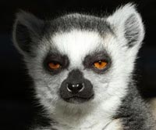
Release and waiver of liability; disclaimer and indemnity agreement
The procedures outlined herein in the following presentation (hereafter referred to as ‘The Presentation’) and in all preceding, subsequent, and tangential presentation materials (hereafter referred to as ‘The Materials’) are not enacted realities, but rather purely potent potentialities. The locations, events, and, but not necessarily limited to, objects depicted in The Materials and presented in The Presentation are fictional. Any similarity to actual locations, events, and, but not necessarily limited to, objects, past or present, is purely coincidental.
The presentation of various views and opinions within The Presentation are presented solely as those belonging to those referenced and do not necessarily represent the views and opinions of the presenter.
The use of any particular tense, style, or of any other rhetorical, literary, or polemical mode is not intended to portray, depict, or otherwise (re)present instruction. The writer of the text herein in The Materials and the speaker of The Presentation presenting The Materials henceforth is not responsible for any actions of the reader(s), event attendee(s), and/or viewer(s) and is hereby indemnified against any potential damages resulting thereof.
No person in the area, whether physical, recorded, and/or streaming, in which The Presentation is taking place (hereafter referred to as ‘The Location(s)’) who is neither an exponent nor proponent nor practitioner of unbridled practices of knowledge sharing, nor seeks to become such, should participate in The Presentation and should immediately leave The Location(s). By attending and participating in The Presentation, and in viewing The Materials, you are confirming that, you are either an exponent or proponent or practitioner of knowledge sharing.
By remaining in The Locations, you agree to indemnify and hold harmless the presenter and writer against any damages which may arise.
The description of any potential means or methods are anthropological, not instructive; serving to highlight existent practices, not to advocate for the use thereof. Should the descriptions of said means or methods be acted upon, it is the actor’s responsibility to act in accord with any applicable laws in a given jurisdiction.
Failure to abide by these conditions, and proceeding to enact legal proceedings against the presenter and/or writer may result in counter-proceedings being instigated against you.

Slide 3


Slide 4
Pineapples contain the protein-digesting enzyme bromelain
Deeply needle-pricked fingers + fresh pineapple juice = temporary loss of fingerprints

Slide 5
What is Watermarking?
For our purposes, we can define watermarking as:
  The manipulation—whether through the addition, extraction and/or subtraction of information—of source material to facilitate the surveillance of said material.

Slide 6
Watermarking and DRM
Digital Rights Management (DRM) is an umbrella term for access control technologies
  Example: An ebook which may only be accessed from a specific application on a specific device by a specific user.
Watermarking is sometimes seen as distinct from DRM, as it deploys subtle coercion in lieu of cryptographic shackles
Watermarking is at times called ‘social DRM’: aims to control access to content via the threat of penalty for unauthorized distribution
  Example: An ebook which may be access from an unrestricted application on any device by any user, but if any user other than the authorized one accesses it, the authorized user may be punished.
Nomenclatural debates are ultimately a red herring, as they have no bearing on the underlying operationality
  In other words: it doesn’t matter what you call it, it still does the same thing

Slide 7
What kinds of information could a watermark contain?
Name of procurer (e.g. purchaser)
Institutional/organizational affiliation
Location (e.g. IP address)
Time/date of procurement
Source of procurement
This may all be expressed in plaintext
  E.g. ‘This ebook was purchased by Jane Smith, ACME Corporation, from 127.0.0.1 on August 20, 2016, at 12:00:01 (GMT+4), via eBook Market.’
Or as a singular fingerprint (which corresponds to a database entry containing all of the above)
  E.g. ‘5093D900CFB17C0531EED0A95626C5E8’

Slide 8
Watermarking as Surveillance
Watermarks turn books into tools of oppression and surveillance
This is not just paranoia, but an explicit part of the marketing plan
  E.g. “Digital watermarking and fingerprinting [...] promise to facilitate critical business functions, such as [...] Viewer Tracking”
    Milano, Dominic. 2009. “Content Control: Digital Watermarking and Fingerprinting”. https://www.digimarc.com/docs/default-source/technology-resources/white-papers/rhozet_wp_fingerprinting_watermarking.pdf. p. 1.
Coerce readers into not sharing what they have with others

Slide 9
Surveillance Scenarios
You forget your ereader on the train. Someone finds it and shares all the books on it online (so that if you can’t get your ereader, at least you can still get all your books). Publisher tries to pin the blame on you.
You anonymously write a negative review of a book, reproducing a page or an image or quoting a passage from the book in your review. A disgruntled fan of the book uncovers your identity from a watermark in, say, the book image you used, and sends you death threats.
  Now replace ‘disgruntled fan’ with ‘disgruntled nation state’, and strike-out ‘threats’

Slide 10
Potential Kinds of Watermarks
Overt watermarks are readily perceptible
  Visible ‘downloaded from … by … on …’ text in the marginalia of an ebook
  Visible text or image in the background of pages in the documents
Covert watermarks are not readily perceptible
  Stylistic watermarks (CSS modification, font, and color choices)
  Spatial watermarks (image, word, character, and line positioning)
  Out of bounds watermarks (outside visible margins)
  Metadata watermarks (both existing and custom fields)
  Natural language watermarks (‘Yesterday, we went to the park’ vs. ‘We went to the park yesterday’ vs. ‘Yesterday, we visited the park’.

Slide 11
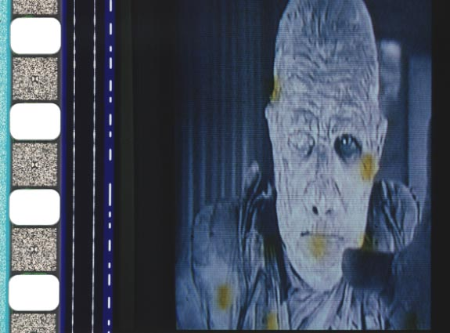
Video Watermarks

Slide 12
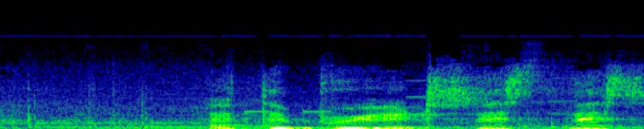
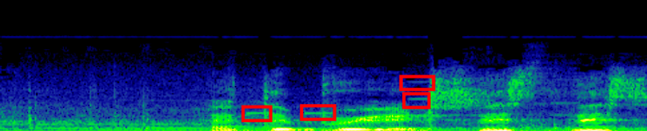
Audio Watermarks

Slide 13
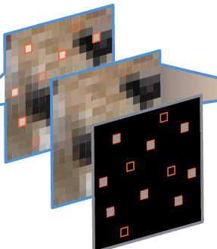
Image Watermarks

Slide 14
Textual Watermarks
Downloaded on September 23, 2016,
13:30:13+02
Don’t
trust
the margins
There are at least seven potential watermarks on this slide.
Where are they?
This text is hidden.

Slide 15
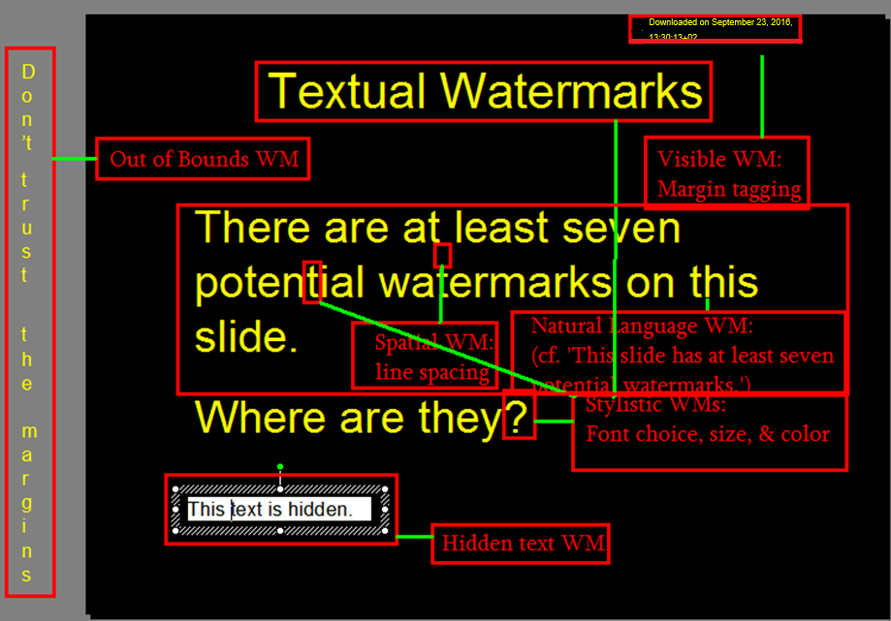

Slide 16
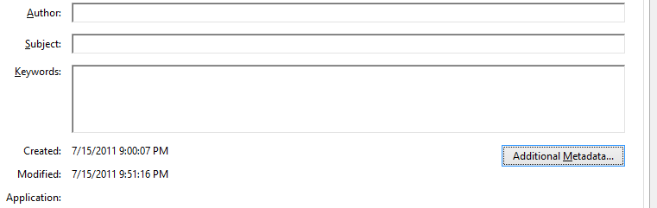
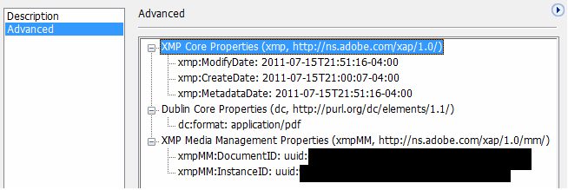
Case Study 1: PDF

Slide 17
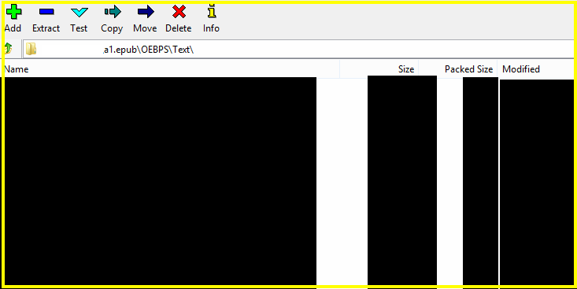
Case Study 2: epub

Slide 18
‘Can’t I just run diff?’
Comparing two versions for differences against each other may not be sufficient to identity all watermarks in a given text.
Consider, if the goal is identical, watermark-free copies:
copy1.epub
copy2.epub

Slide 19
When two is not enough…
diff copy1.epub copy2.epub:
…Leads us to believe the difference between the two copies are only B and C. Surely if we then remove watermarks B and C, we’d reach our goal of identical (watermark-free) copies? But what if that’s not the whole picture?
copy1.epub
copy2.epub
A
A
B
C

Slide 20
…Try three
diff3 copy1.epub copy2.epub copy3.epub
Adding a third copy to the analysis flushes out the previously-undisclosed existence of watermark E in copy1 and copy2.
  where E could reveal more-general, but still potentially identifying information such as the institutional account with which each individual account is affiliated, etc.
copy1.epub
copy2.epub
copy3.epub
A
E
A
E
A
F
B
C
D

Slide 21
Lessons Learned?
Convoluted file formats allow for the clandestine nesting of multiple nefarious undesirables.
For a comparison set to be appropriate, it must be adequately diverse to allow for the identification of all watermarks.
Diversion tactics (overt watermarks) lull one into a sense of false confidence
Phantom tactics (nonexistent watermarks) lull one into a sense of false doubt
Thus, balance vigilance with prudence

Slide 22
Manifold Manifestation of Watermark Malice
Multifaceted malice:
Operant technological manifestations
  The actual ‘technical means’ of implanting/extracting watermarks
Legal, ideological materializations
  ‘Intellectual property’, which not merely enables but enacts violence
1+2 = 3; micro-states of surveillability albeit creating myriad opportunities for slippage

Slide 23

Don’t Panic
Heightened security consciousness, a developed familiarity with the myriad of existent and emergent threats to safety, mustn’t lead to a debilitating inaction, but should empower one towards informed, vigilant action

Slide 24


