Slide 1
ACS Web Portal
Eligibility Inquiry Enhancement

Slide 2
What Is the Enhancement?
Users of the ACS web portal (http://owcp.dol.acs-inc.com) can view the diagnosis code(s) OWCP has accepted for a specific claim.

Slide 3
Why was the Portal Enhanced?
Making this information readily available to injured workers, medical providers, and employing agencies is intended to help facilitate the medical authorization and billing processes.

Slide 4
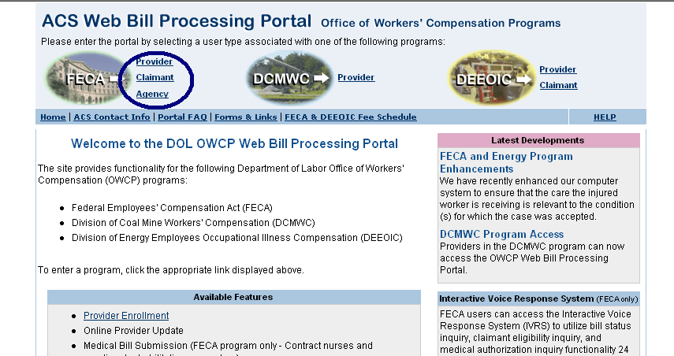
Accessing the ACS Web Portal http://owcp.dol.acs-inc.com
Select type of User

Slide 5
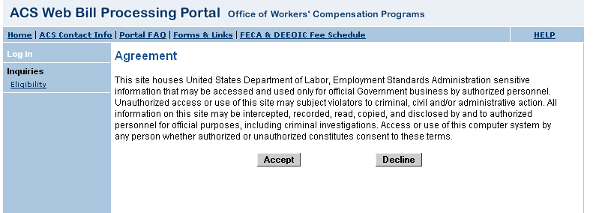
Accessing the ACS Web Portal http://owcp.dol.acs-inc.com
Click on Accept

Slide 6
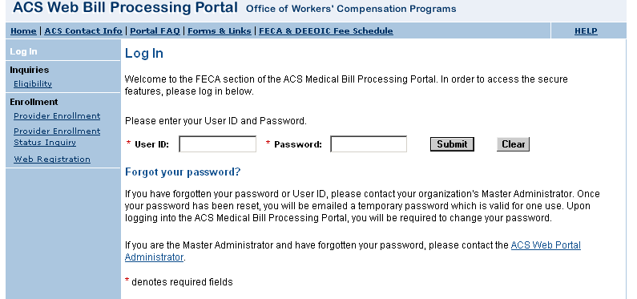
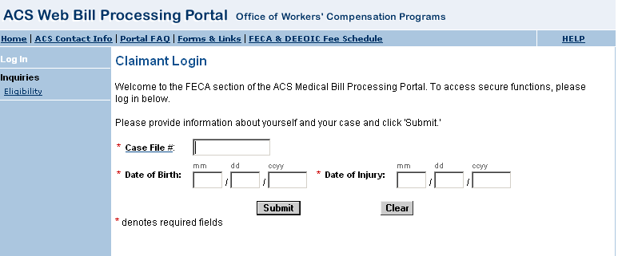
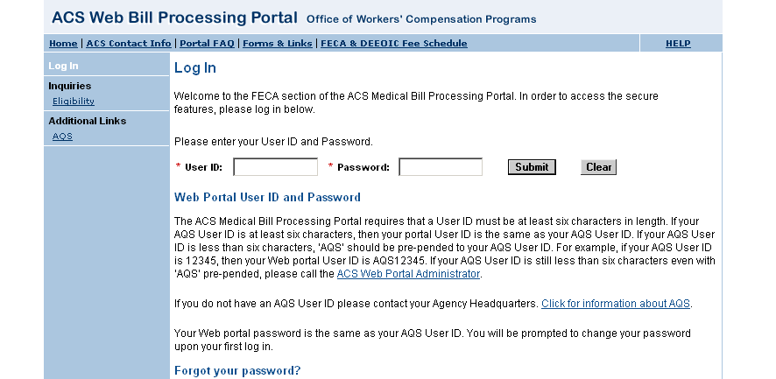
Logging into the ACS Web Portal http://owcp.dol.acs-inc.com
Log into the Portal

Slide 7
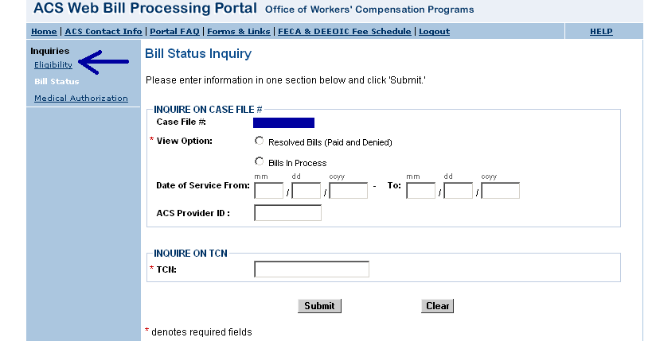
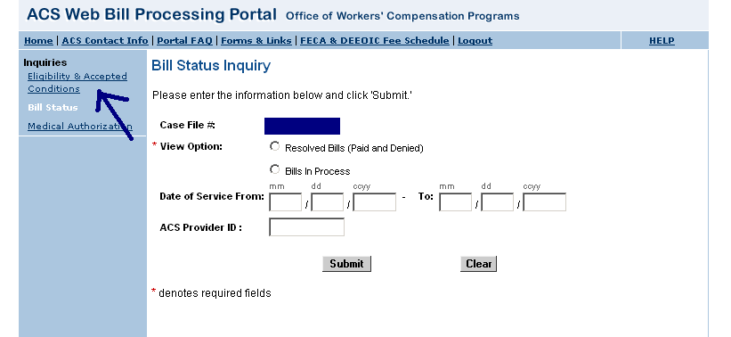
Eligibility & Accepted Conditions Functionality of the ACS Web Portal http://owcp.dol.acs-inc.com
Click on Eligibility or Eligibility & Accepted Conditions
What you see depends on if you are an Injured Worker, Provider, or Employing Agency

Slide 8
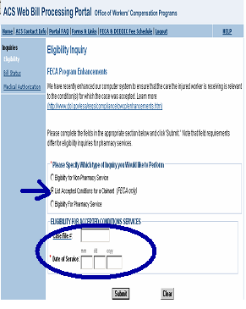
Eligibility & Accepted Conditions Functionality of the ACS Web Portal http://owcp.dol.acs-inc.com
Click on “List Accepted Conditions for a Claimant (FECA only”
Enter Claim number
Enter approximate date of service

Slide 9
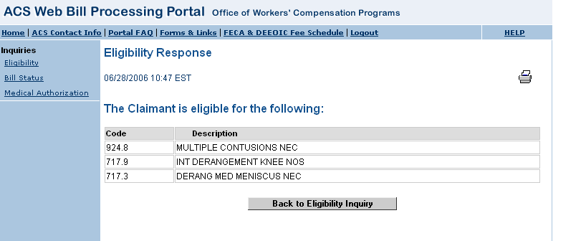
Eligibility & Accepted Conditions Functionality of the ACS Web Portal http://owcp.dol.acs-inc.com
Shows conditions accepted at time of inquiry for date of service entered

Slide 10
What if An Injured Worker Thinks an Additional Condition Should be Accepted on a Claim?
If an injured worker believes that additional or different conditions warrant acceptance on a claim, s/he needs to provide OWCP with medical documentation supporting expansion of claim for review by the claims examiner.
As is the case with anything sent to OWCP, medical documentation must include the injured worker’s claim/case number on every page.
Mail medical Documentation to
  U.S. Department of Labor
  DFEC Central Mailroom
  P.O. Box 8300
  London, KY 40742-8300

