Slide 1
Chloride Ion Channels
Alexander Chew
Florida State University
BSC5936
February 2005

Slide 2
Types
ELG
CFTR
  ABC
CLC
CLNS1A
CLIC
CLCA
Note: Often chloride ion channels are permeable to other anions. Chloride happens to be the most abundant anion.
Notes:
ELG (extracellular ligand-gated)
Each subunit has 4 transmembrane domains
Receptors function as pentamers (post synaptic and GABA and Glycine receptors
CFTR (cystic fibrosis transmembrane conductance regulator)
ABC (ATP-binding cassette transporters)
Transmembrane domains: 2 sets of 6
Gating controlled by ATP and/or phosphorylation by cAMP- , cGMP- dependant kinases.
CLC (voltage gated chloride channels)
17 alpha helical membrane associated
Double barreled pores
CLNS1A (nucleotide/volume sensitive)
CLIC (chloride intracellular channels)
No membrane spanning domains
Electrolyte composition and acidification of intravescular spaces
CLCA (calcium activated)

Slide 3
Functions
Regulate cell volume
Regulate membrane potential
  Resting potential
  Depolarization
Signal propagation
Transport processes
Notes:
Chloride channel homologues can be found in almost every type of eukaryotic cells.
Chloride Ion channels are found in both plasma membranes and in intracellular membranes. For example, in the endosomes and lysosomes, in this example they work in concert with v-type proton pumps to control conductance and modify ph levels.

Slide 4
Gating Mechanisms
Voltage
Volume (swelling)
Ligand Binding
Ion Concentration
Phosphorylation
ATP

Slide 5
Some Diseases Associated With Chloride Ion Channels
Cystic Fibrosis
Genetic disorder
Gland secretions are abnormally thick
Chloride Ion Channels may be targeted as a treatment for some Respiratory Diseases by regulating abnormal mucus production.
  Asthma
  COPD (Chronic Obstructive Pulmonary Disease)
  Chronic Bronchitis
Notes:
Cystic Fibrosis has many affects
abnormally thick and sticky gland secretions
many organs in the body are affected by clogging mucous
the lungs are most affected. Air passages are blocked and the mucous also serves as a growth environment for bacteria
giving rise to respiratory infections.
The decrease in oxygen levels also causes pulmonary arteries to constrict leading to high blood pressure and
increases the strain on the heart. 98% of all patients die from cardiopulmonary complications.
1 in 1500 Caucasian children are affected.
CFTR protein contains both the chloride channel and the regulator.

Slide 6
Myotonia Congenita
Genetic neuromuscular disorder
Symptoms include muscle stiffness and enlargement
Notes:
Symptoms include muscle stiffness and enlargement
Mutations in the chloride ion channels of muscle cell plasma membranes

Slide 7
Barter’s Syndrome
Covers a group of disorders characterized by defective salt reabsorbing mechanisms

Slide 8
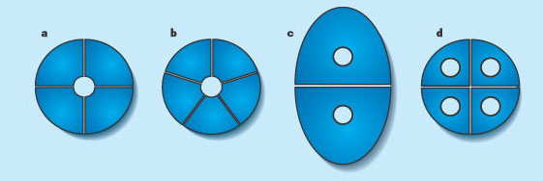
“The different ways in which ion channels composed of more than one protein can form pores. a, In tetrameric potassium channels, a single pore is formed by four identical or structurally similar proteins (subunits). b, In 'ligand-gated' cation or anion channels (such as channels that detect the neurotransmitters acetylcholine or GABA), the single pore is formed by five identical or structurally similar subunits. c, Chloride channels from the CLC family are dimers, in which each subunit has its own pore. d, Aquaporin water channels are tetramers, again with one pore per subunit.”
http://www.nature.com/nature/journal/v415/n6869/fig_tab/415276a_F1.html

Slide 9
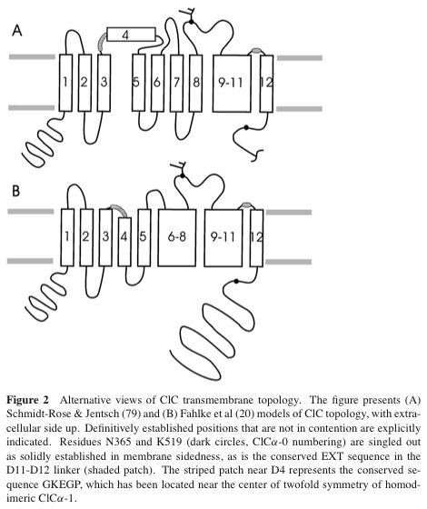


Slide 10
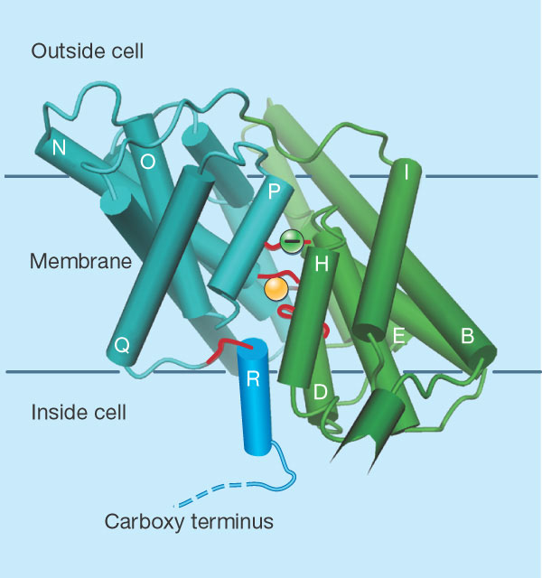
“Chloride-channel structure, as revealed by Dutzler et al.2. This is a side-on view of one of the two subunits of a CLC channel, looking at the side that interacts with the other subunit. -Helical structures are indicated by cylinders, coloured in green and cyan to indicate the two 'repeated' units. Regions directly involved in formation of the ion-permeation pore are in red. A negative charge that might be involved in gating the channel is shown as a green circle; it is just above where the chloride ion (shown in yellow) is coordinated. The amino terminus of helix R (bright blue) contains a tyrosine amino acid, which helps to coordinate the Cl- ion; the carboxy terminus emerges into the cell. In mammalian CLCs, helix R is connected to a large intracellular region, indicated by the dashed line.”
http://www.nature.com/nature/journal/v415/n6869/fig_tab/415276a_F2.html

Slide 11

Papers
1
2
3
4

Slide 12
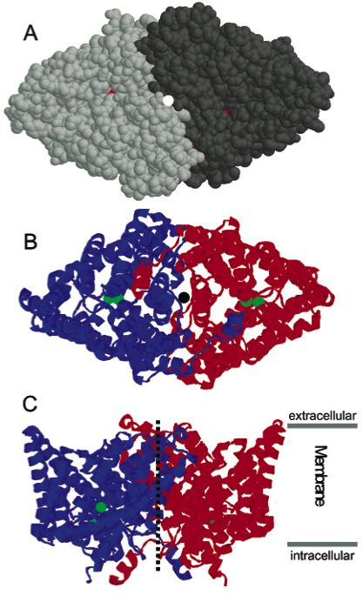


Slide 13
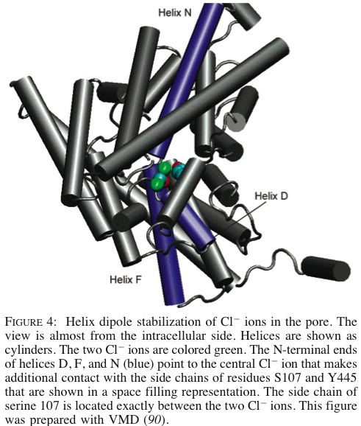

Slide 14
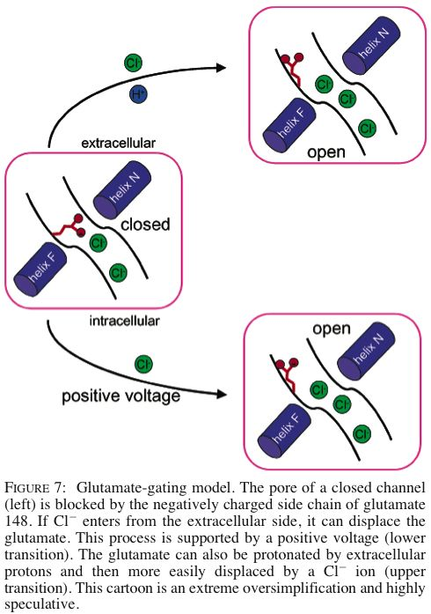

Slide 15
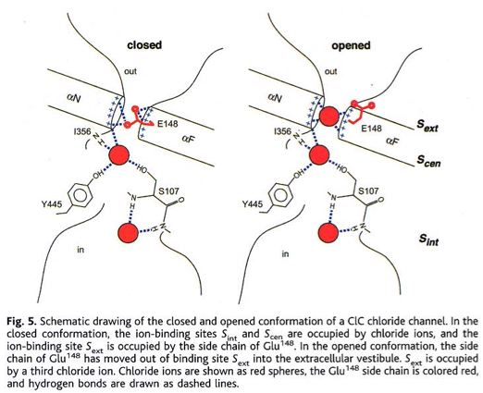

Slide 16
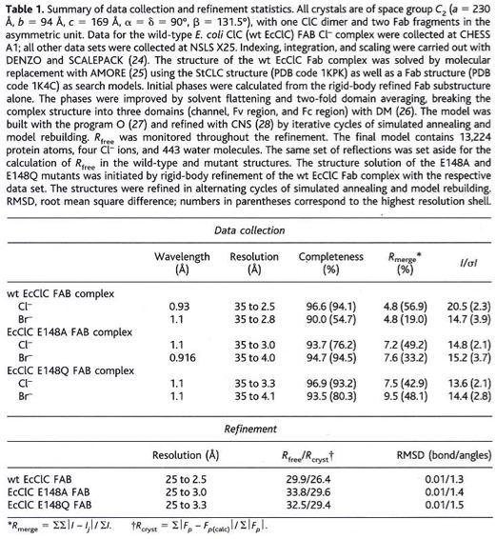

Slide 17
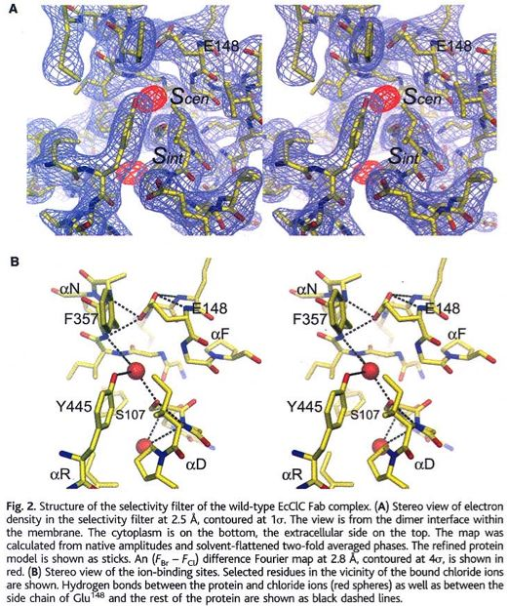

Slide 18
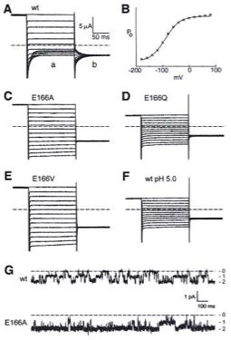
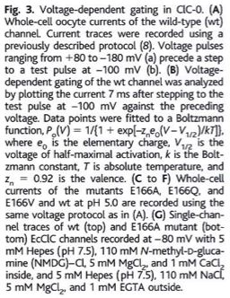

Slide 19
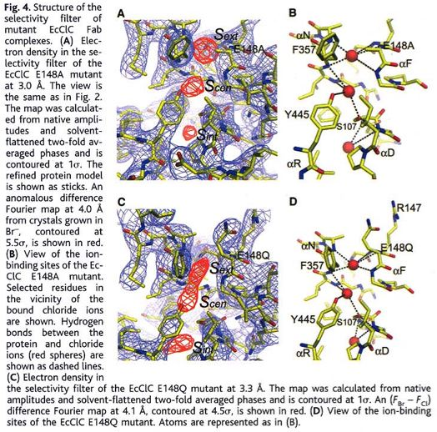

Slide 20
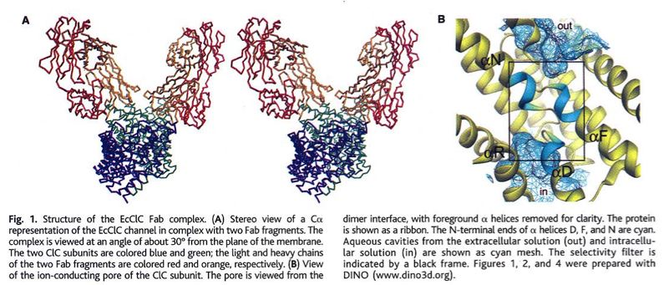

Slide 21
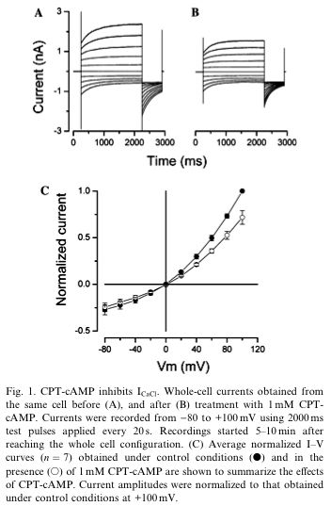

Slide 22
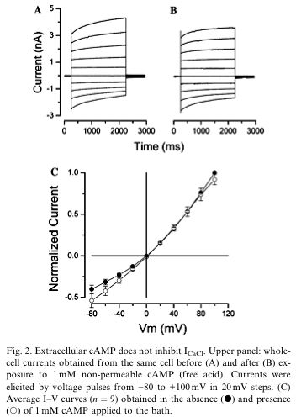

Slide 23
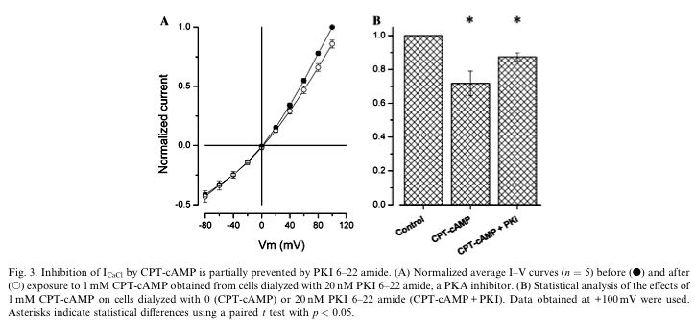

Slide 24
