Slide 1

A Galactic Experience and Extending Galaxy Sample Tracking
Jelle Scholtalbers
Translational Oncology and Immunology (TRON)
Mainz, Germany
Computational Medicine & Medical Genomics
Jelle Scholtalbers (jelle.scholtalbers@tron-mainz.de ), John Castle, Michael Koslowski, Martin Löwer, Michael Rauer, Thomas Rösler, Ludmila Schemarow, Marius Byl, Thomas Bukur, Jos de Graaf, Valesca Boisguérin, Beate Stradmann-Bellinghausen, Ugur Sahin
25.05.2011

Slide 2
Why Galaxy?
Introducing lab technicians to bioinformatics
  Needed an interface to command line scripts
Workflows/Pipelines
  Local tools
  Keep data in-house
Keeping track
  Something better than linux history
25.05.2011

Slide 3
Tools and uses
Simple converters & Text manipulation
  sort myUnsortedIDs.txt | uniq –d
  Search & Replace
Alignments
  NCBI Blast
    Basic until wrappers in repository became available
  TimeLogic® DeCypher cmd tools
    Nicer queuing, retrieve references using fastacmd, database creation
Send GFF to GMOD GBrowse
25.05.2011

Slide 4
General comments
Would like to have
  Text editor
  Expanded conditional statements
  More advanced workflow functions
    Loops
      Foreach ‘split fasta’ do ‘alignments’
    Conditional
Most thankful for
  History -> Workflow
  E-mail support!
    galaxy-user & galaxy-dev@lists.bx.psu.edu
25.05.2011

Slide 5


Building Bridges
“ There does not exist a category of science to which one can give the name ‘applied science.’ There are science and the applications of science, bound together as the fruit of the tree which bears it.” Louis Pasteur
Biotechnology &
Pharma
Strengths:
Innovation
Basic research
Applied research
Clinical research
Patient access
Range of tasks
Innovation
Innovation maturation
Implementation of ideas to Proof-of-Concept (PoC)
Value add
Link research and clinics
Link academia and pharma
Attract top talent / researchers
Spin-offs
Strengths:
Adequate budgets
Process control
Product focused
Value add / markets
Needs:
Translation of new concepts
Patent exploitation
Access to
- Innovative medicines
- Innovative diagnostics
- Technology
Needs
Integration in excellent academic environment
Access to mature innovations
Patient-oriented research
25.05.2011
Ugur Sahin, Director

Slide 6
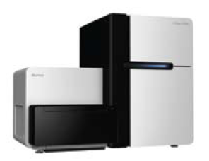
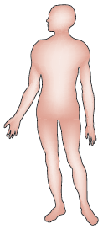
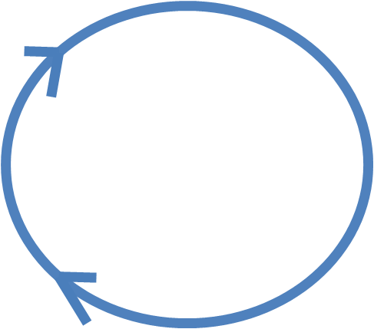
Patient benefit using NGS
Patient sample
10 years
1 week
Individualized medicine
New drugs & biomarkers
Test KRAS mutations before prescribing panitumumab.
Prescribe panitumumab for patient X
25.05.2011

Slide 7



NGS Process
New Project
Experimental design
Pricing
Reads
Alignments
Expression (eg)
Pathways
Samples
Lab
NGS
Processing
Analysis
Interpret
Deliverable
Cells, FFPE, Total RNA
HPC (HIGH PERFORMANCE COMPUTING)
Galaxy
Galaxy Pages
Cloud Storage
Wiki
Report &
Data
Goal: 7 days for clinical samples
25.05.2011

Slide 8
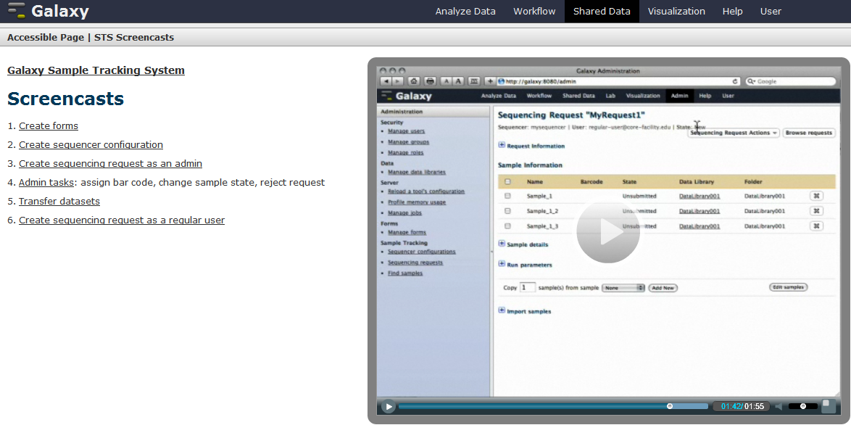
Galaxy Sample Tracking
25.05.2011

Slide 9
Wishes
Better layout
  Easier navigation
Flowcell design
  Illumina HiSeq2000
Track sample information
  Library preparations
  QC data/Bioanalyser pictures
25.05.2011

Slide 10
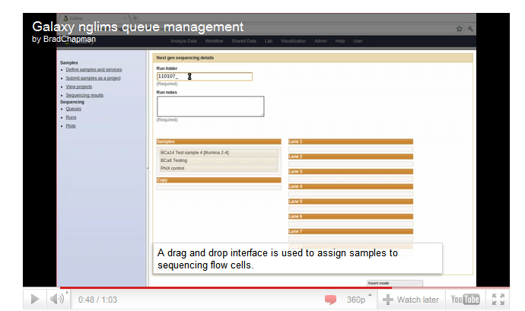
Massachusetts General Hospital
Brad Chapman - http://bcbio.wordpress.com/
25.05.2011

Slide 11
Great, but..
Define 1 sample over 3 pages
  Expected experiments will have >300!
Users define the multiplexing barcodes/indexes
  Many will not know what to do…
  Limits flowcell design
25.05.2011

Slide 12
Custom
Keep it simple
Borrow flowcell design idea from Brad Chapman
Make small interface modifications
Send requests and flowcell information to a wiki
25.05.2011

Slide 13
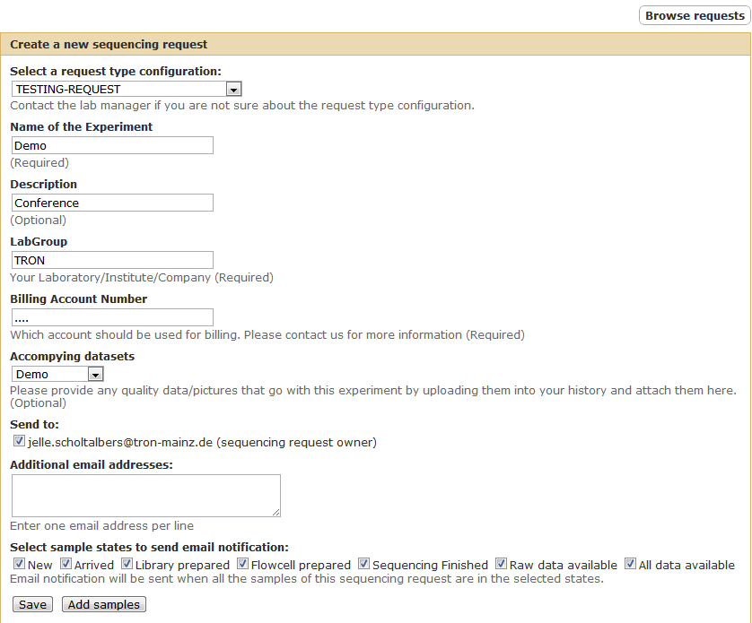
Interface - notifications
25.05.2011

Slide 14
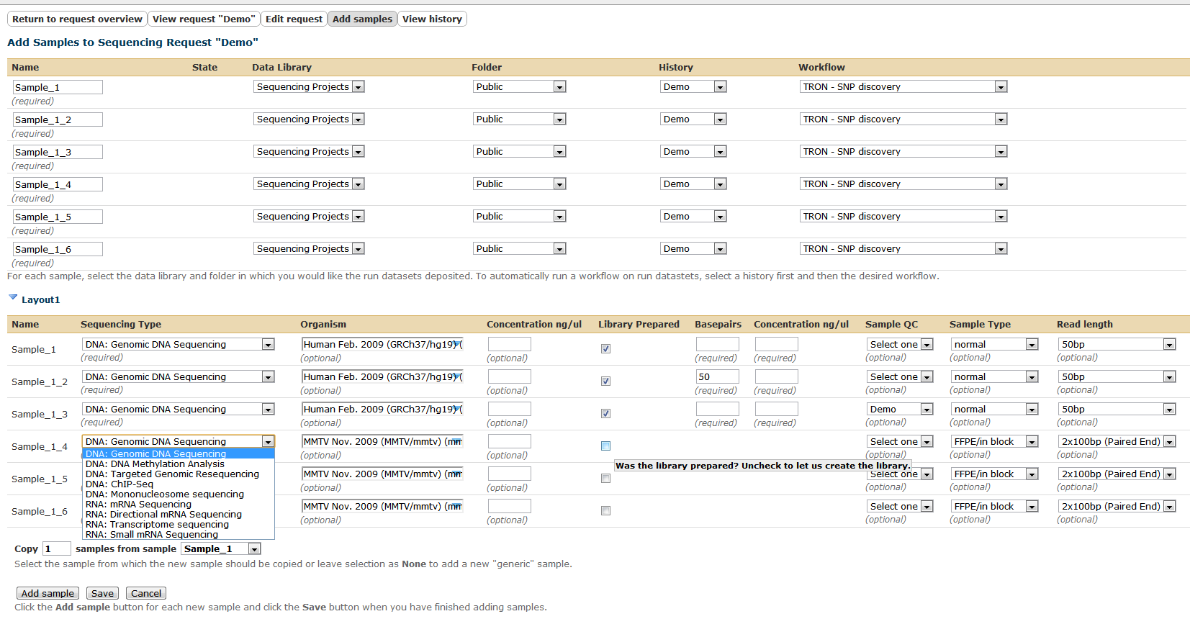
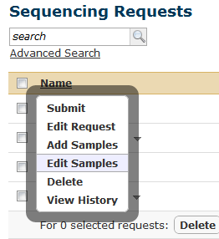
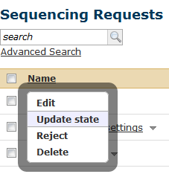
Interface - add samples
25.05.2011

Slide 15
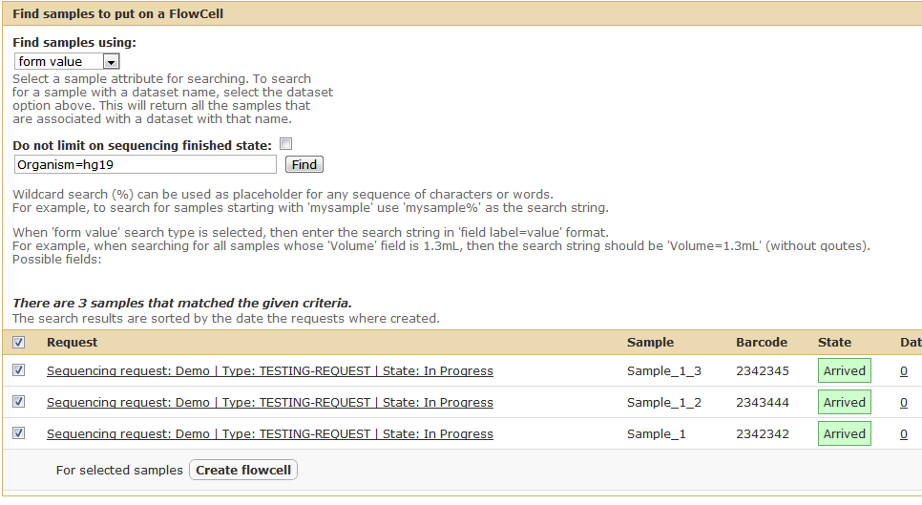
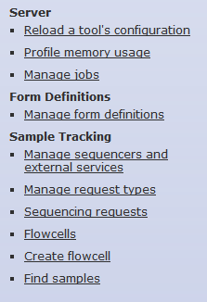
Interface - Admin
25.05.2011

Slide 16
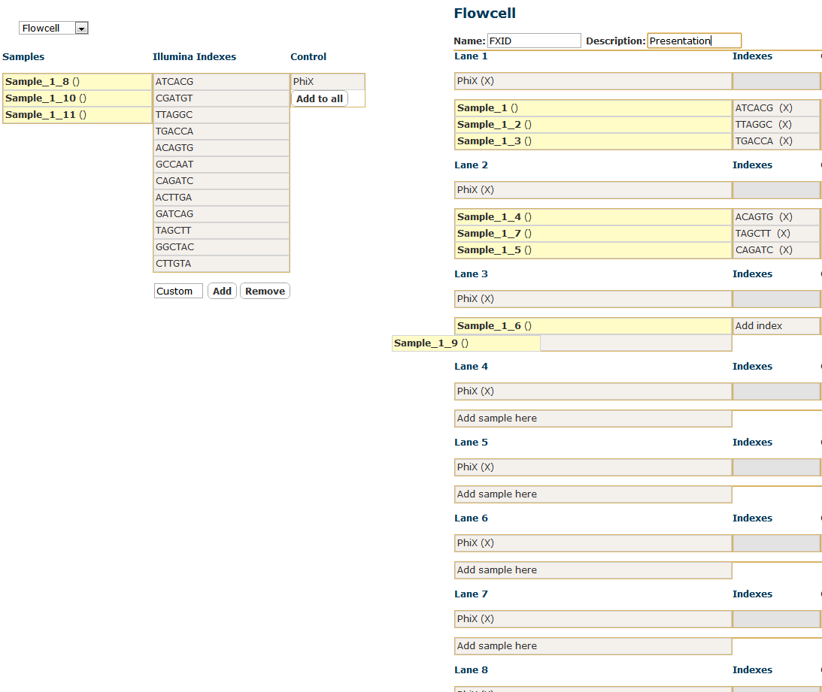
25.05.2011

Slide 17
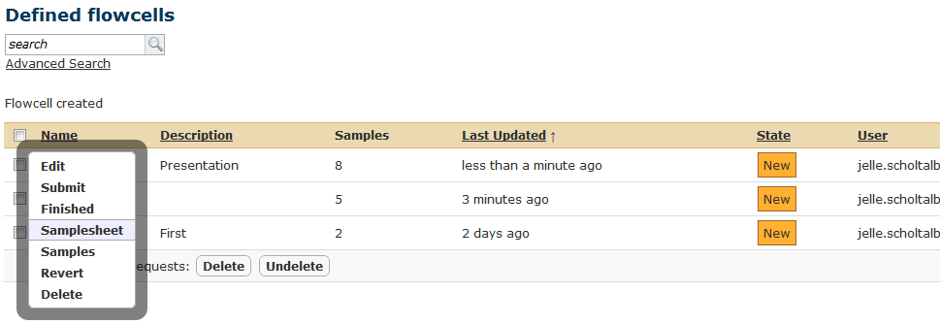
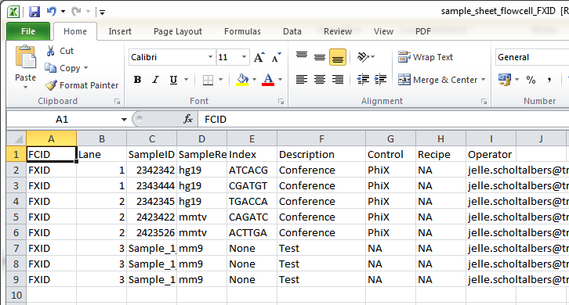
25.05.2011

Slide 18
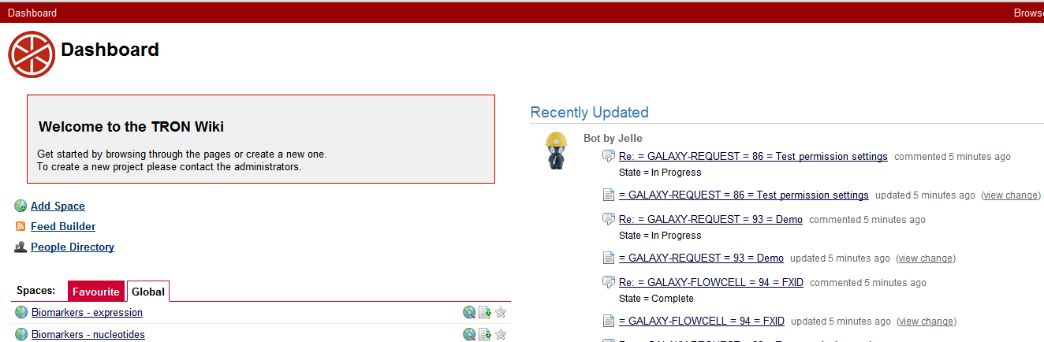

Wiki – Confluence
25.05.2011

Slide 19
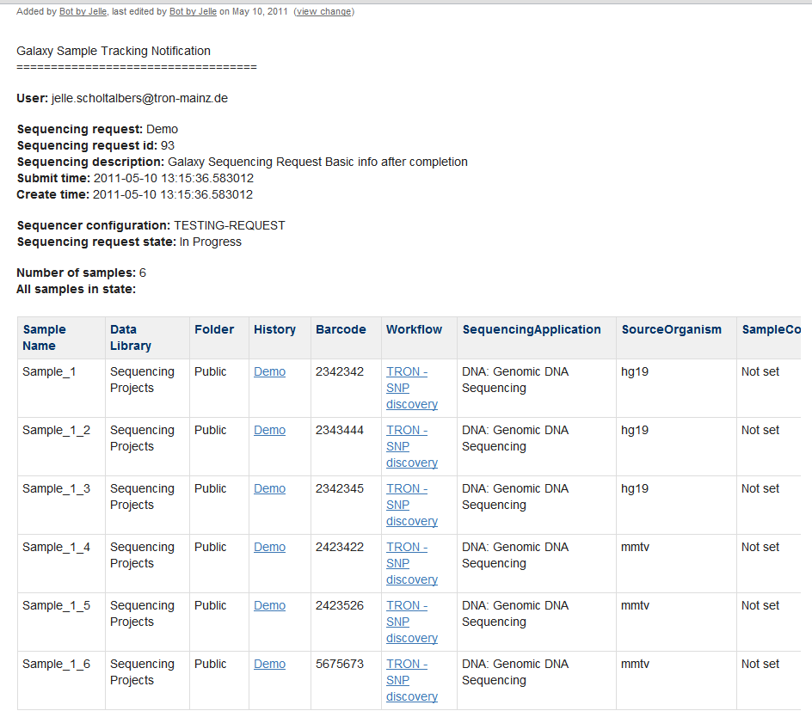
25.05.2011

Slide 20
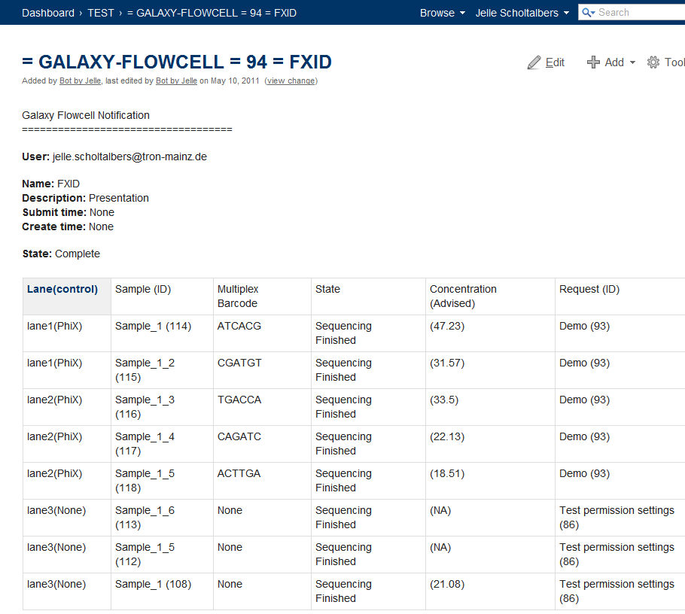
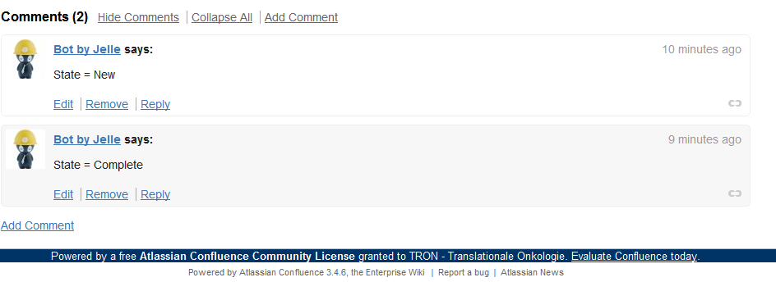
25.05.2011

Slide 21
Technical
Flowcell ~ Request
  request_type = ‘’
Flowcell Form
  Describes lanes, controls, indexes
  Data is stored in the form_values
1 column ‘illumina_index’added to Sample table
RabbitMQ – AMQP
  Used for sending Wiki updates
  Both Confluence and (Semantic) MediaWiki supported
25.05.2011

Slide 22
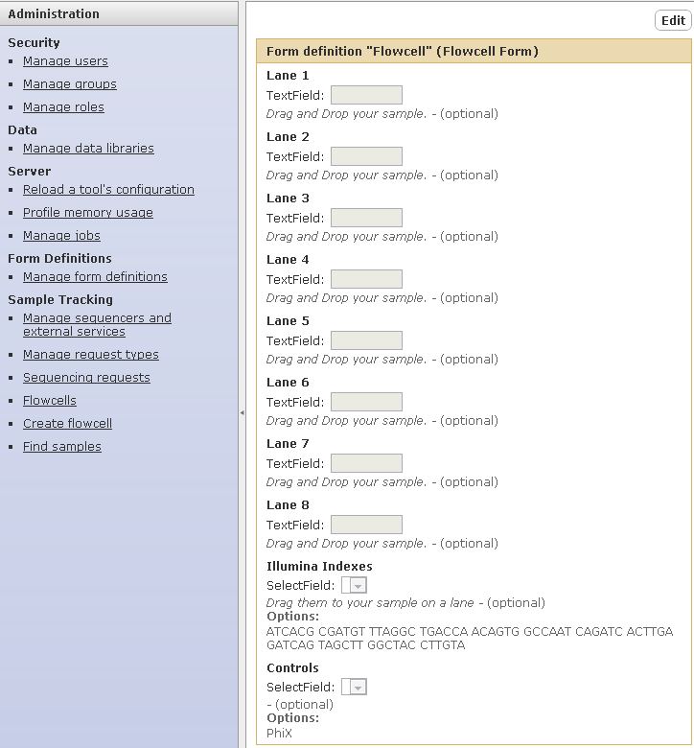
25.05.2011

Slide 23
Outlook
Setting up the actual data transfer and analyses
  Waiting for new Illumina preprocessing software
Enable semantics on Confluence
  zAgile Wikidsmart
Send data to Ingenuity
25.05.2011

Slide 24
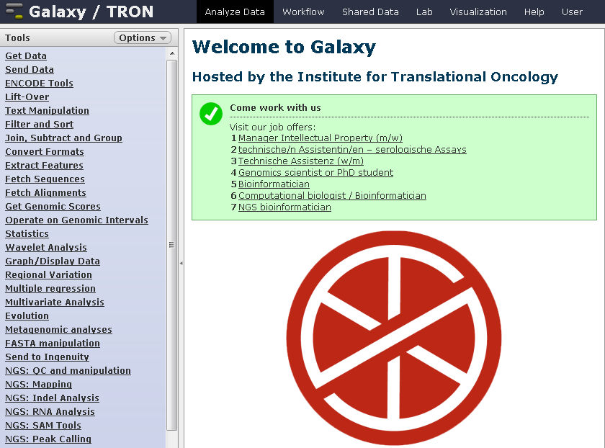
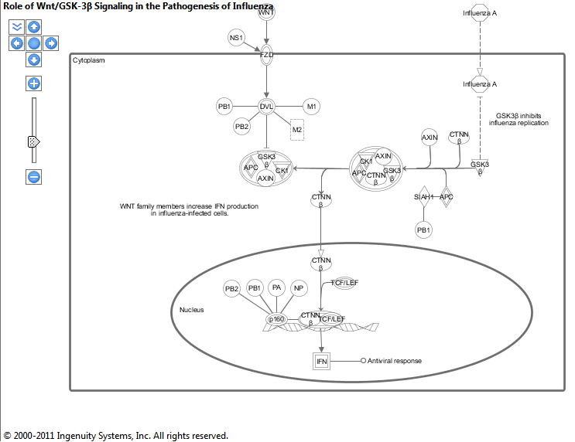
Send to Ingenuity
25.05.2011

Slide 25
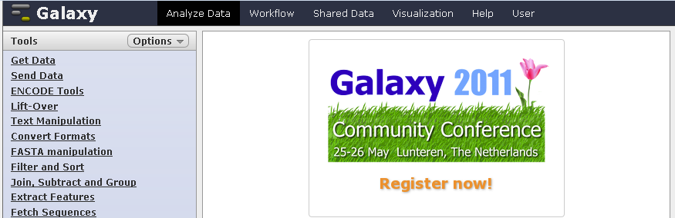

Acknowledgements
Massachusetts General Hospital
Brad Chapman
Ugur Sahin
Jos de Graaf
Valesca Boisguérin
Martin Löwer
Thomas Rösler
John Castle
Ludmila Schemarow
Marius Byl
Thomas Bukur
Michael Rauer
25.05.2011

