Slide 1
Network Bandwidth Allocation
(and Stability)
In Three Acts
Notes:
Connection to problem (feedback, area exam)
Stability featured in papers, larger ideas

Slide 2
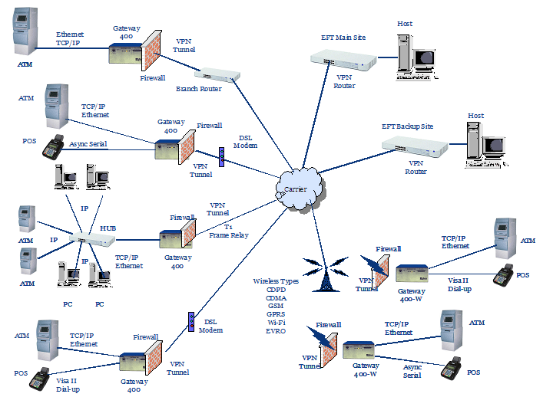
Problem Statement
How to allocate bandwidth to users?
How to model the network?
What criteria to use?
Notes:
More generally, resources:
Processor scheduling

Slide 3
Act I
Modeling

Slide 4








A Physical View
Host
1
Host
2
Host
3
Host
4
Host
5
Router : interconnect, where links meet.
Host : multi-user, endpoint of communication.
Link / Resource : bottleneck, each has finite capacity C_{j}.

Slide 5






System Usage
Host
1
Host
2
Host
3
Host
4
Host
5
Route : static path through network, supporting N_{i}(t) flows with Λ_{i}(N(t)) allocated bandwidth.
Flows / Users : transfer documents of different sizes, evenly split allocated bandwidth along route. Dynamic. Not directed.

Slide 6
Simplification
Extraneous elements have been removed.

Slide 7
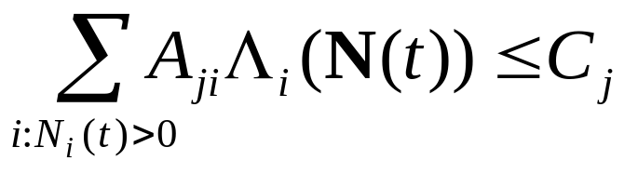
Abstraction
Routes are just subsets of links / resources.
Represented by [A_{ji}] : whether resource j is used by route i.
Capacity constraint:

Slide 8








Stochastic Behavior
020
220
120
130
110
121
Model N(t) as a Markov process with countable state space.
Poisson user arrivals at rate ν_{i}.
Exponential document sizes with parameter μ_{i}.
Define traffic intensity ρ_{i} = ν_{i} / μ_{i}.
Notes:
Is this a good model? What questions can it help us answer?
Dynamic behavior driven by usage. Resource usage. User perception.
Accuracy? Would like more general distributions. More general capacity (cost vs. bound).
Tells us about allocations, does not give protocols.
Can get complicated – dependence on Λ

Slide 9
Act II
Performance
Criteria

Slide 10




Allocation Efficiency
An allocation Λ is feasible if capacity constraint satisfied.
A feasible allocation Λ is efficient if we don’t have μ ≥ Λ for any other feasible μ.
Defined at a point in time, regardless of usage.
Notes:
Clearly desirable within the model.
Local optimum. Allocation not unique.

Slide 11
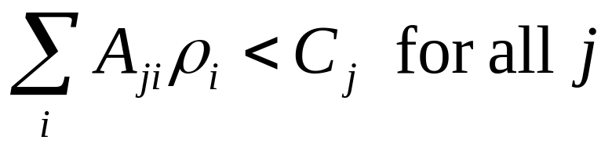
Stability
Stable ↔ Markov chain positive recurrent.
Returns to each state with probability 1 in finite mean time.
Necessary, but not sufficient condition:
How tight this is gives us an idea of utilization.
Does not uniquely specify allocation.
Notes:
Break ri = vi * 1/mi. Average bitrate.

Slide 12
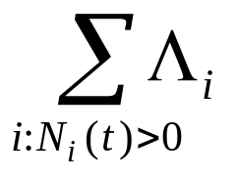
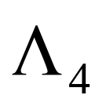
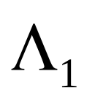
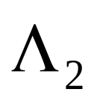
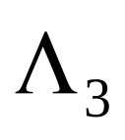
Maximize Overall Throughput
That is, max
No unique allocation.
Could get unexpected results.
10
10
10
Notes:
More bandwidth to a route with lots of users or to one with a single user?
Preemption. Stability constraint reduced to r4 < \prod (1 – r_i).
More general statement about priority-based routing. “This suggests current proposals for a differentiated services Internet may lead to suboptimal utilization of network resources.”
What about the users – what do they want?

Slide 13
Max-Min Fairness
Increase allocation for each user, unless doing so requires a corresponding decrease for a user of equal or lower bandwidth to satisfy the capacity constraints.
Uniquely determined.
Greedy algorithm. Not distributed.
12
12
Notes:
Starting with an empty network, increase the allocation for all flows equally until a resource constraint is hit.
Fix the allocations for routes passing through this bottleneck, and repeat the procedure with the rest.
Correctness proof.
If 1 user each route:
Max-min : 6, 6, 6.
Max throughput : 12, 12, 0.
Proportional fair: 8, 8, 4.

Slide 14
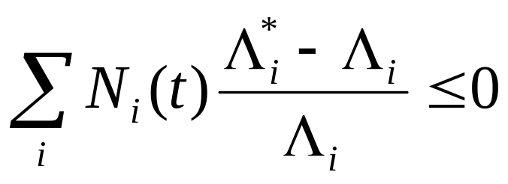
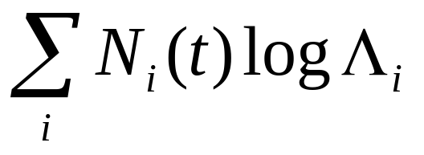
Proportional Fairness
Λ is proportionally fair if for any other feasible allocation Λ* we have:
Same as maximizing:
Interpret as utility function.
Distributed algorithms known.
Notes:
Consider a change L + D. Weigh number of users and amount of bandwidth already allocated.
Proof. Feasible allocations convex set, so only direction of change matters in def. So can just look at small deviations. Def eq becomes directional derivative <= 0.
Expand utility function idea.

Slide 15
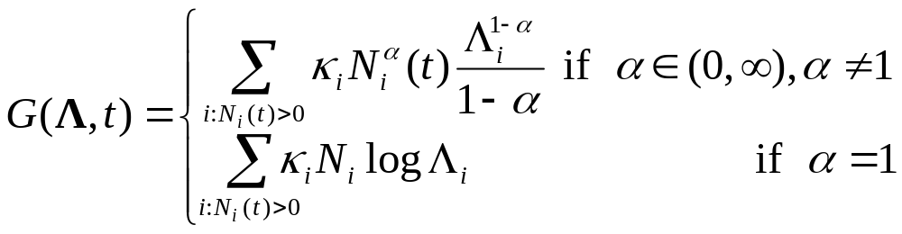
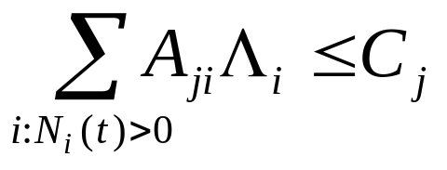
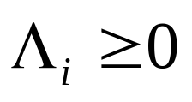
α-Fair Allocations
Maximize
Subject to
With κ_{i}=1,
α → 0 : maximize throughput
α = 1 : proportional fairness
α → ∞: max-min fairness
With κ_{i} = 1 / RTT_{i}²,
α = 2 : TCP
Notes:
a controls performance / fairness tradeoff.
a = inf: smallest allocations dominate the objective function.
a = 1: expand Li^(1-a)/(1-a) = 1/(1-a) + 1 (L – 1) - a/2 (L – 1)^2 + a(1+a)/6 (L – 1)^3… drop first term, set a=1, get log Li.

Slide 16
TCP Bias
Congestion window based on additive increase / multiplicative decrease mechanism.
Increase for each ACK received, once every Round Trip Time.
Timeouts based on RTT.
Bias against long RTT.
RTT
timeout

Slide 17
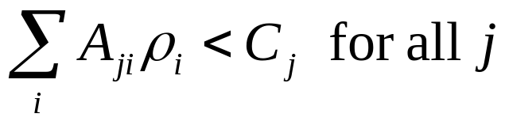
Properties of α-Fair Allocations
Assume N_{i}(t) > 0.
Let Λ(N(t)) be a solution to the α-fair optimization.
The optimal Λ exists and is unique.
It’s positive: Λ > 0.
Scale invariance: Λ(rN) = Λ(N), for r > 0.
Continuity: Λ is continuous in N.
System is stable when
Notes:
E+U: Constraints define compact convex set. G continuous and strictly concave in L.
Positive: a < 1 : dG/dLi -> +inf as Li -> 0.
a >= 1 : G -> -inf as Li -> 0.
Scale : easy.
Continuity: messy, but intuitive since G uniformly continuous.

Slide 18
Act III
Fluids &
Formalities

Slide 19
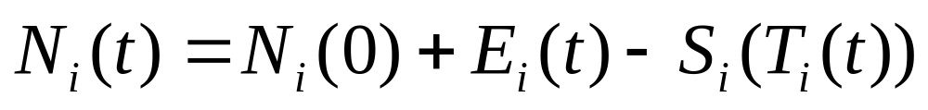
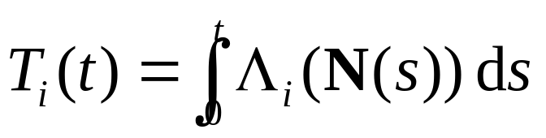
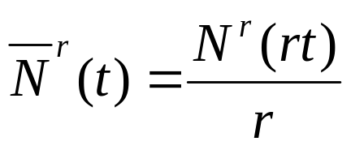
Fluid Models
Decompose into non-decreasing processes:
N_{i}(0) : initial condition
E_{i}(t) : new arrival process
T_{i}(t) : cumulative bandwidth allocated
S_{i}(t) : service process
Consider a sequence indexed by r > 0:

Slide 20
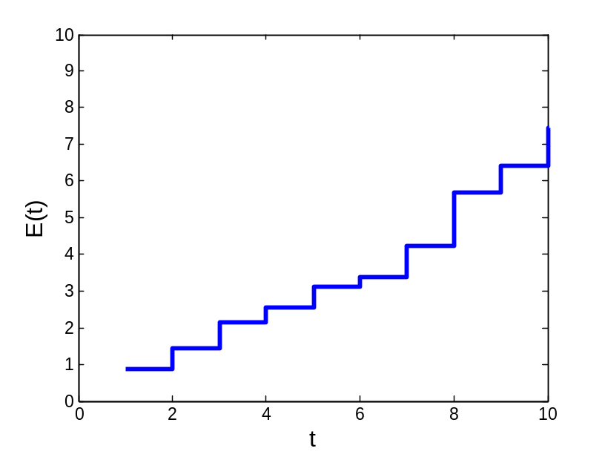
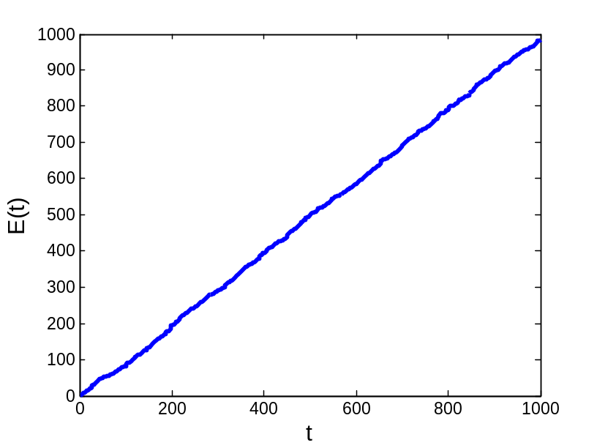
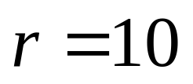
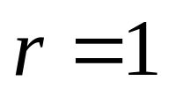
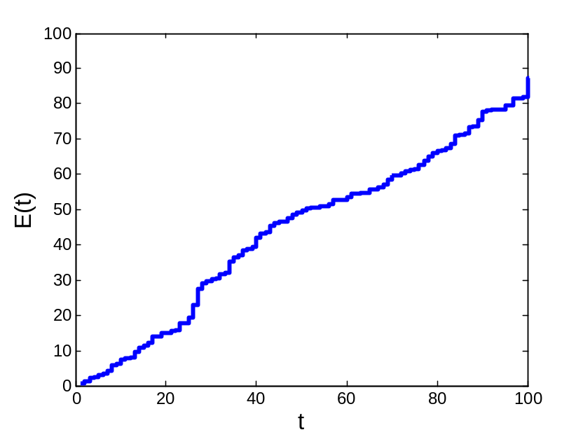
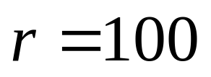
Fluid Limit : Visual

Slide 21
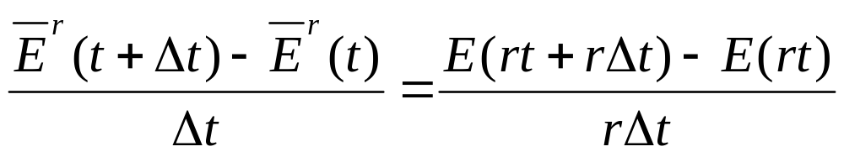
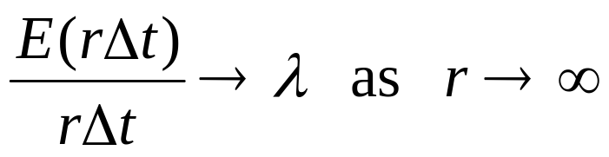
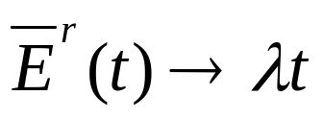
Fluid Limit : Math
Look at slope:
By strong law of large numbers for renewal processes:
Thus
with probability 1.
Notes:
S_N(t) / N(t) <= t / N(t) <= S_{N(t)+1} / N(t)
Know S_n / n -> \bar{X} with probability 1 by SLLN.
So t / N(t) -> \bar{X}.

Slide 22
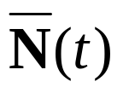
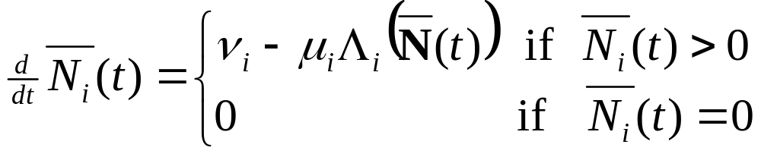
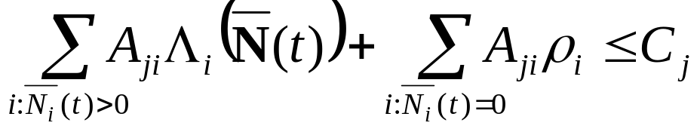
Fluid Model Solution
A fluid model solution is an absolutely continuous function
so that at each regular point t and each route i
and for each resource j
Notes:
Infinitesimal drift.
Allocated bandwidth cannot exceed capacity of any link, where unused route counts as rho.

Slide 23
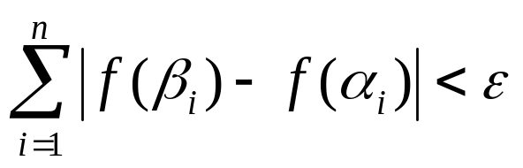
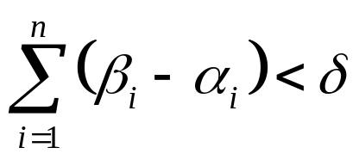
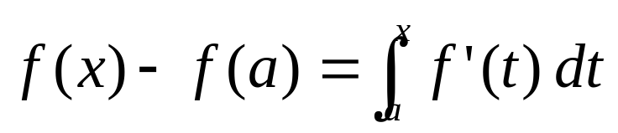
Fluid Analysis is Easier
Definition
A complex function f is absolutely continuous on I=[a,b] if for every ε > 0 there is a δ > 0 such that
for any n and any disjoint collection of segments (α₁,β₁),…,(α_{n},β_{n}) in I whose lengths satisfy
Theorem
If f is AC on I, the f is differentiable a.e. on I, and

Slide 24





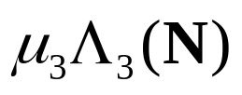
Visualizing Fluid Flow

Slide 25
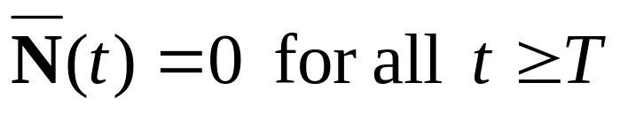
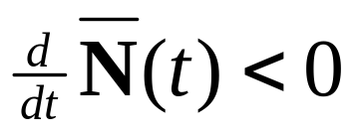
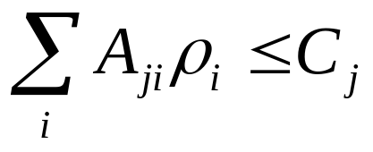
For Stability
If fluid system empties in finite time, then system is stable.
Show that
In general, what happens as t →∞ when some of the resources are saturated?
We approach the invariant manifold, aka the set of invariant states

Slide 26

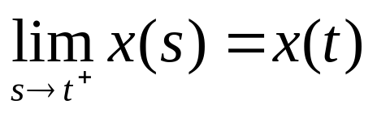
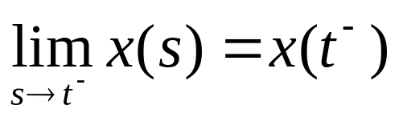

Towards a Formal Framework
Interested in stochastic processes with samples paths in D_{ℜ}[0, ∞), the space of right continuous real functions having left limits.
Well behaved. At most countably many points of discontinuity.
Notes:
An = {t > 0 : r(x(t), x(t-)) > 1/n} An has no limit points, so countable. Thus U An countable.

Slide 27


Why we need a better metric.
…
…
What goes wrong in L^{p} ? L∞ ?
Notes:
Need to scale down in time so in the space.
Need to warp time axis when comparing.
Can’t restrict functions to be complex valued. Want to deal with measures.

Slide 28
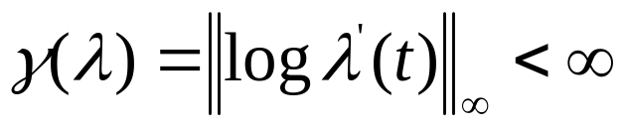

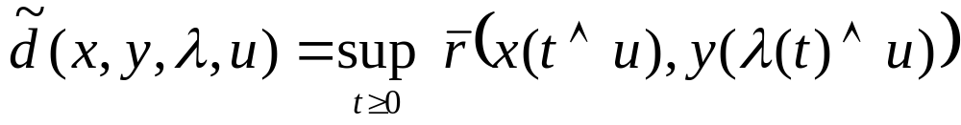
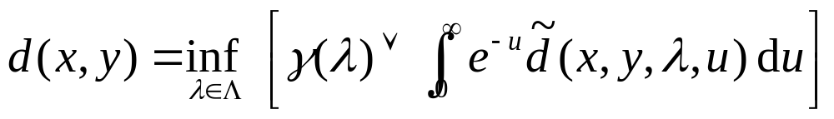
Skorohod Topology
Let Λ be the set of strictly increasing Lipschitz continuous functions λ mapping [0,∞) onto [0,∞), such that
Put
(standard bounded metric)
For functions mapping to any Polish (complete, separable, metric) space.
Notes:
|f(x) – f(y)| <= K |x – y| : slope limited by constant
^ : min

Slide 29
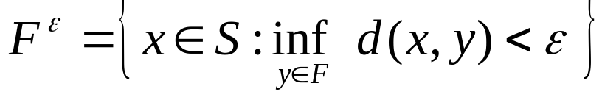
Prohorov Metric
Let (S,d) be a metric space,
B(S) the σ-algebra of Borel subsets of S,
P(S) family of Borel probability measures on S.
Define
The resulting metric space is Polish.

Slide 30
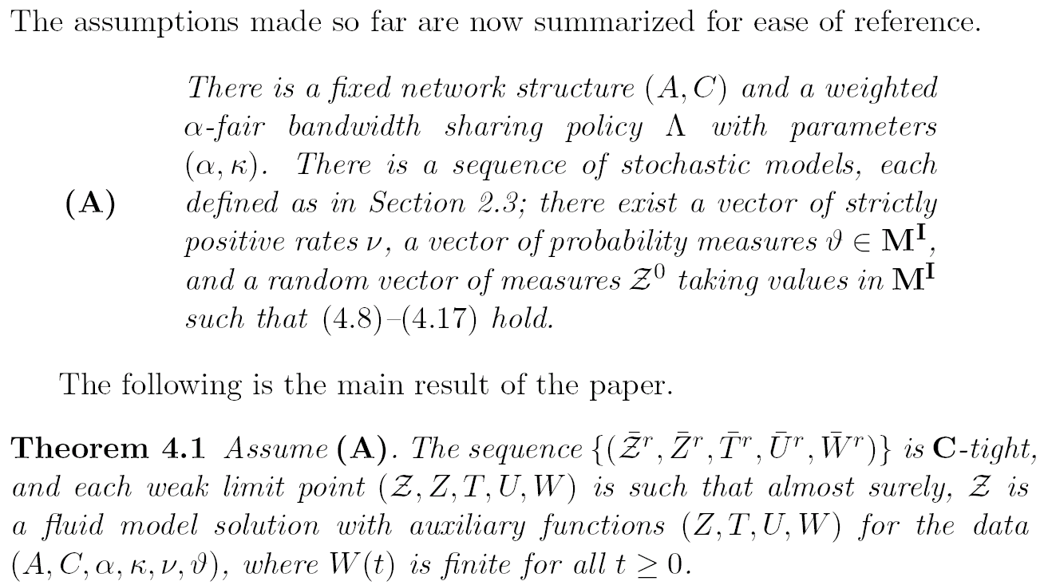
Fluid Limit Theorem
from Gromoll & Williams
Notes:
Probability measure P is tight if for e > 0 there is a compact set K \sub S such that P(K) >= 1 – e.
C-tight : any weak limit point has continuous sample paths almost surely.

Slide 31
Outline of Proof
Apply functional law of large numbers to load processes.
Derive dynamic equations for state and bounds.
State contained in compact set with probability 1 in limit.
State oscillations die down with probability 1 in limit.
Sequence is C-tight.
Weak limit points are fluid solutions with probability 1.

Slide 32
Papers
1995
2000
2005
Dai
Bonald,
Massoulié
Gromoll,
Williams
Kelly
Kelly,
Maulloo,
Tan
Kelly,
Williams
Mo,
Walrand
Massoulié

