Slide 1

The Making of an Adaptive Expert
Maria Mylopoulos, PhD
Bridget O’Brien, PhD

Slide 2
Goals for today
At the end of this workshop, you will be able to:
Describe your own clinical practice through the lens of adaptive expertise
Discuss the implications of adaptive expertise for your practice as an educator
Identify strategies for fostering adaptive expertise in your trainees.
Clinical Reasoning

Slide 3
Definition of adaptive expertise
Accrued knowledge + reformulation of practice efficiency dimension/innovation dimension
‘Optimal Adaptability Corridor’ Focus on balancing dimensions of expert practice
Expert = knowledge + experience + reformulation of practice
Notes:
From an adaptive expertise perspective an expert has extensive accrued knowledge that they use effectively and efficiently to solve problems of practice. This is termed the efficiency dimension of practice. In addition, an adaptive expert is able to break free of routines and create new knowledge to improve their practice. This is termed the innovation dimension of practice.
Most importantly, They work within what is termed the optimal adaptability corridor, in that they balance these two dimensions of their practice effectively.
An adaptive expert is therefore defined by her amount of knowledge and experience and the ability to consistently reformulate her practice when necessary.

Slide 4
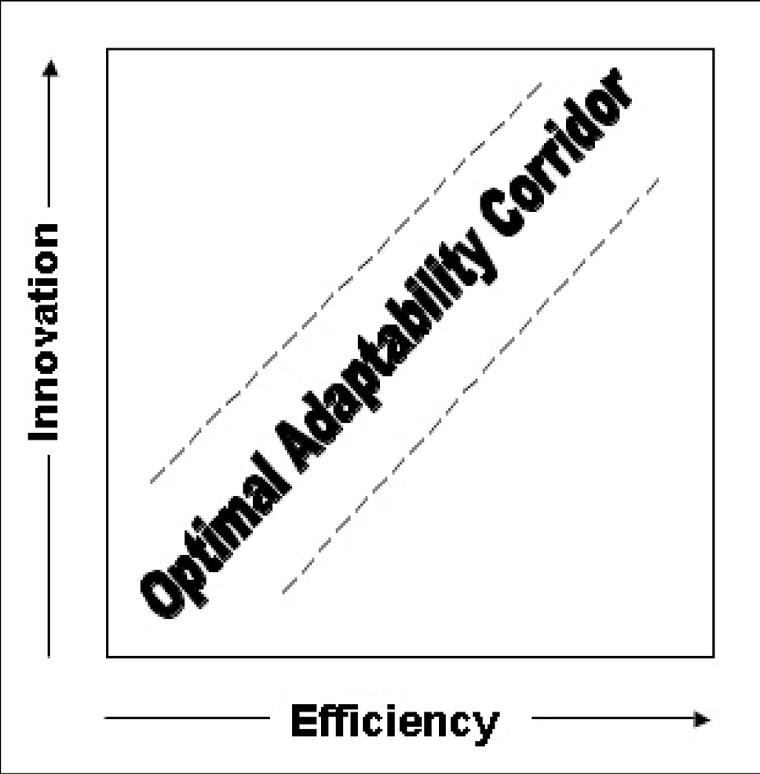
Optimal adaptability corridor

Slide 5
What an expert looks like
Deep understanding of practice
Assumptive knowledge
Balance between innovation & efficiency
Learning is reformulation of practice
Notes:
An adaptive expert is thought to have deep understanding of their practice, meaning that they can flexibly apply their conceptual knowledge and construct new knowledge to improve their practice. They recognize that their knowledge is assumptive, in that they purposefully seek to test, explore and transform their knowledge and practice.
The adaptive expert balances the efficiency and innovation dimensions of the practice. And finally, within the framework of adaptive expertise, learning is emphasized as an ongoing reformualtion of practice.

Slide 6
A deep understanding of their domain of practice
“To sort of get to the underlying cause of things, asking that why question like the two year old, ‘why do zebras have stripes’? And kind of getting to that level of not just accepting things at face value, but really... keep going, drilling through, persevering and trying to get to the root cause. I think that sense of discovery is important”.
Adaptive experts have
Notes:
An adaptive expert is thought to have deep understanding of their practice, meaning that they can flexibly apply their conceptual knowledge and construct new knowledge to improve their practice. They recognize that their knowledge is assumptive, in that they purposefully seek to test, explore and transform their knowledge and practice.
The adaptive expert balances the efficiency and innovation dimensions of the practice. And finally, within the framework of adaptive expertise, learning is emphasized as an ongoing reformualtion of practice.

Slide 7
A skeptical stance towards their knowledge
“Not to the point of an anarchist or a rebel but to think that every time I do something that I’ve learned to do or learned for the data, you wonder how long this is going to be true and that’s what I mean by becoming comfortable with the absence of certitude”.
Adaptive experts have
Notes:
They recognize that their knowledge is assumptive, in that they purposefully seek to test, explore and transform their knowledge and practice. - They are willing to question everything that they think they know when they are problem solving.
The adaptive expert balances the efficiency and innovation dimensions of the practice. And finally, within the framework of adaptive expertise, learning is emphasized as an ongoing reformualtion of practice.

Slide 8
Balance between innovation & efficiency in their practice
“The main resource I used was my experience and knowledge of the natural history of this infection and the knowledge that this was not behaving as an uncomplicated infection should act.”
Adaptive experts have
Notes:
The adaptive expert balances the efficiency and innovation dimensions of the practice. And finally, within the framework of adaptive expertise, learning is emphasized as an ongoing reformualtion of practice.

Slide 9
Learning is reformulation of practice
“I think being humble. I think humility means learning from your mistakes also because you remember when you didn’t do something fundamental so you don’t do it the next time. That’s part of being an expert too”.
Adaptive experts have
Notes:
The adaptive expert balances the efficiency and innovation dimensions of the practice. And finally, within the framework of adaptive expertise, learning is emphasized as an ongoing reformualtion of practice.

Slide 10

From theory to application
Can you think of an example from your daily practice when your expert knowledge was insufficient for solving a problem? What did you do?
Notes:
In Breakout groups -Example of efficiency + example of innovation from daily practice/ teaching

Slide 11
Development of adaptive expertise
Two courses of spontaneous development
routine expertise/adaptive expertise
‘Optimal Adaptability Corridor’
Experts identify as ‘accomplished novices’

Slide 12

Developing an adaptive expert
Foster an understanding of innovation as a core competency of expertise
Emphasize that excellence in practice requires more than knowing all the answers
Develop adaptive expertise by providing opportunities for guided deliberate practice
Notes:
We already do a pretty good job with efficiency

Slide 13
Developing an adaptive expert
Foster an understanding of innovation as a core competency of expertise
Notes:
We already do a pretty good job with efficiency

Slide 14
Developing an adaptive expert
Emphasize that excellence in practice requires more than knowing all the answers
Notes:
Students learned either with an invention method or a tell-and-practice method.
15 classes of ninth-grade students, compared the value of asking students to invent statistical methods versus imitate and practice shown methods.
In invention condition, nobody succeeded in making a general solution, so by many accounts, this
would seem inefficient. But later, when both groups were given a problem that they had not seen before the invention group performed much better. They were able to flexibly use knowledge to come up with a solution, while the tell and practice group simply did not know.

Slide 15
Developing an adaptive expert
Develop adaptive expertise by providing opportunities for guided deliberate practice
Notes:
Students learned either with an invention method or a tell-and-practice method.
15 classes of ninth-grade students, compared the value of asking students to invent statistical methods versus imitate and practice shown methods.
In invention condition, nobody succeeded in making a general solution, so by many accounts, this
would seem inefficient. But later, when both groups were given a problem that they had not seen before the invention group performed much better. They were able to flexibly use knowledge to come up with a solution, while the tell and practice group simply did not know.

Slide 16
From theory to application
When working with learners, what strategies do you use that might fall in the category of training for adaptive expertise?
Could you give a specific example of one or two of these strategies – including the content, context (what setting, what's your relationship with this learner), and level of learner?
Notes:
Focus on teaching

Slide 17
From theory to application
Fostering Deep Understanding
I constantly ask learners questions that help them connect the current problem that they may not be familiar with to problems they do know. I tell them that understanding how things happen and why they manifest a certain way greatly reduces the effort of remembering, because it becomes understanding rather than memorizing . Another strategy I use very often is to point out commonalities between problems, or contrasts.
Notes:
Deep understanding?

Slide 18
From theory to application
What opportunities are currently available on your service for trainees to develop along the efficiency dimension of expertise?
What opportunities are currently available on your service for trainees to develop along the innovation dimension of expertise?
Notes:
Focus on teaching

Slide 19
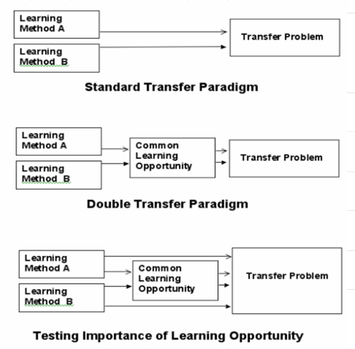
Preparation for future learning
Notes:
MARIA
The framework of ‘Adaptive expertise’ encompasses a few theories and models of expertise that have emerged in education research over the course of the last 20 years.
These models are rooted in theories of knowledge-building, problem solving and instruction.
There is a particular focus on using naturalistic methods to explore meta-cognitive expert processes and the impact of instructional design on expertise development.
While research exploring adaptive expertise has been flourishing in domains outside of medicine,to date there has been relatively little work specific to medical education. Despite the fact that there are signifcant potential implications for research and curriculum in the health professions.

Slide 20
From theory to application
What opportunities can you construct on your service for trainees to develop both the innovative and efficiency dimensions of practice?
Notes:
Focus on teaching

Slide 21



LEARNING INSTITUTE
maria.mylopoulos@utoronto.ca

Slide 22
Developing an adaptive expert
Training that supports invention encourages more effective problem solving
(Schwartz & Martin, 2004)
Notes:
Students learned either with an invention method or a tell-and-practice method.
15 classes of ninth-grade students, compared the value of asking students to invent statistical methods versus imitate and practice shown methods.
In invention condition, nobody succeeded in making a general solution, so by many accounts, this
would seem inefficient. But later, when both groups were given a problem that they had not seen before the invention group performed much better. They were able to flexibly use knowledge to come up with a solution, while the tell and practice group simply did not know.

Slide 23
Adaptive expertise
Emerging model in education
Theories of knowledge-building, problem solving & instruction
Naturalistic exploration of meta-cognitive processes & impact of instructional design
Implications for research & curriculum in health professions
Adaptive Expertise
Notes:
MARIA
The framework of ‘Adaptive expertise’ encompasses a few theories and models of expertise that have emerged in education research over the course of the last 20 years.
These models are rooted in theories of knowledge-building, problem solving and instruction.
There is a particular focus on using naturalistic methods to explore meta-cognitive expert processes and the impact of instructional design on expertise development.
While research exploring adaptive expertise has been flourishing in domains outside of medicine,to date there has been relatively little work specific to medical education. Despite the fact that there are signifcant potential implications for research and curriculum in the health professions.

Slide 24

Our expert
Has extensive accrued knowledge & experience
Applies knowledge efficiently and effectively
Constructs/reformulates knowledge effectively
Notes:
MARIA

Slide 25
Our expert
Learning in practice consists of:
  Increasing efficiency
  Acquisition of new knowledge & routines
  Construction of new ideas in practice
  Reformulation of practice
Notes:
MARIA

