Slide 1


Adverse Childhood Experiences
and their Relationship to
Adult Well-being, Disease, and Death :
Turning gold into lead
A collaborative effort between
Kaiser Permanente and the Centers for Disease Control
U.S. Department of Justice
Washington, DC December 12, 2012
Robert F. Anda, M.D. Vincent J. Felitti, M.D.
Notes:
1

Slide 2
ACE Study Design
Survey Wave 1
71% response (9,508/13,454)
n=13,000
71% response
Mortality
National Death Index
Morbidity
Hospital Discharges
Doctor Office Visits
Emergency Room Visits
Pharmacy Costs
vs.
Present
All medical evaluations
abstracted
&
Health Status
Survey Wave II
n=13,000
17,337 adults
All medical evaluations
abstracted

Slide 3
Empirically Selected Categories of
Adverse Childhood Experiences
Abuse, by Category
Psychological (by parents) 11%
Physical (by parents) 28%
Sexual (anyone) 22%
Major Neglect, by Category
Emotional 15%
Physical 10%
Household Dysfunction, by Category
Alcoholism or drug use in home 27%
Loss of biological parent <18 23%
Depression or mental illness in home 17%
Mother treated violently 13%
Imprisoned household member 5%
Prevalence (%)

Slide 4


Who would ever suspect – without routinely asking
Notes:
Here is a good example of what we’re talking about. Superficially, this woman looks like she is doing fine, stressing the importance of routine inquiry of everyone.

Slide 5

Smoking to Self-Medicate
The Functionality of ‘dysfunctional’ behavior
Notes:
And this looks like a hard-working man – and he is, but there is vastly more. DESCRIBE CHILDHOOD HX and imprisonment for attempted murder. He speaks of the psychoactive BENEFITS of nicotine that have been overlooked in the public health onslaught against smoking. Why were these benefits needed when their future risk is so well known?

Slide 6
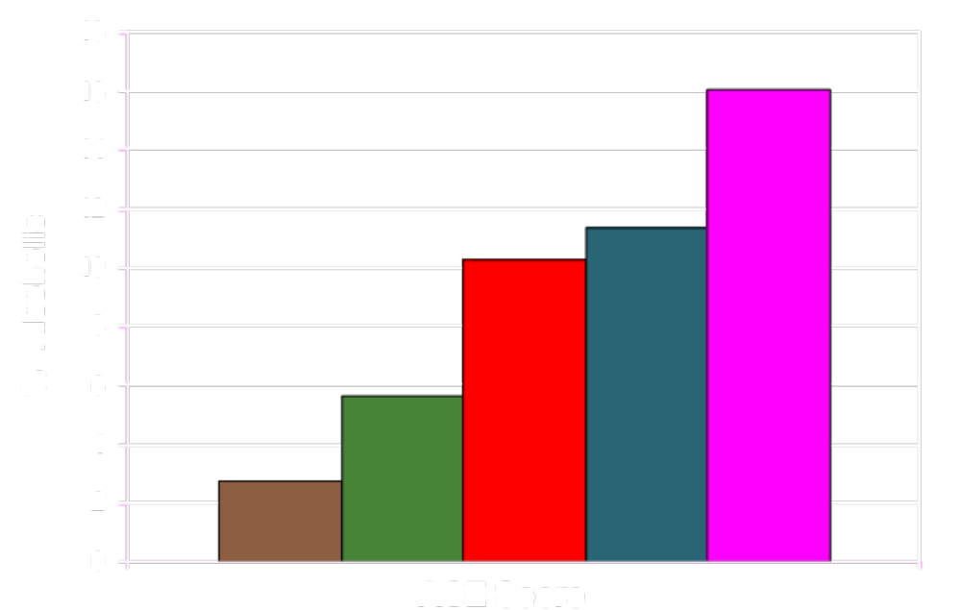
Health Risks
Childhood Experiences vs.
Adult Alcoholism
4+
3
2
1
0

Slide 7
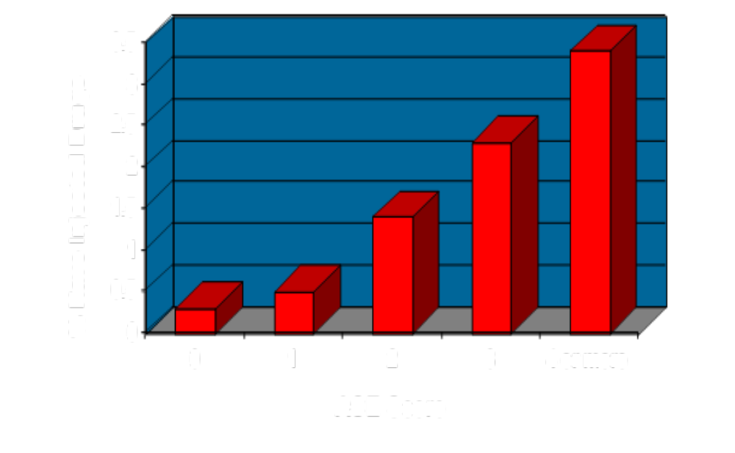
ACE Score vs. Intravenous Drug Use
Health Risks
p<0.001
Notes:
One thing it means is that there is a PUBLIC HEALTH PARADOX wherein what we see as a public health PROBLEM is often also a SOLUTION for the person involved.

Slide 8
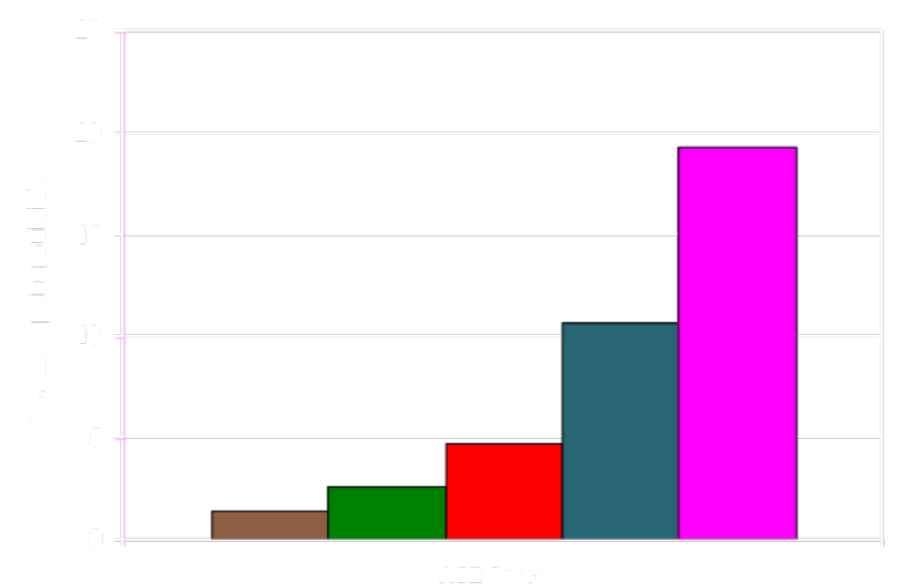
Death
Childhood Experiences
Underlie Later Suicide
4+
3
2
1
0
Notes:
. With 6 or more categories of traumatic experience, the likelihood of subsequent suicide attempt is between 31-50 TIMES that of a person having no such traumatic experiences.

Slide 9
Well-being
ACE Score and the
Risk of Perpetrating Domestic Violence
__________________________________
15
Women
Men
10
Risk of Perpetration (%)
5
0
0 1 2 3 4 >5
0 1 2 3 4 >5
ACE Score
Notes:
This is interesting because we found that adverse childhood experiences make men and women equally likely to be perpetrators of domestic violence. We’re not used to thinking of that parity, but that’s only because children are the usual victims of women, and children are not In a position to make these experiences public. Violence begets violence. Remember the electrician.

Slide 10

Turning Research into Practice a beginning
Comprehensive biomedical evaluation provides a net 11% reduction in DOVs in the subsequent year.
Comprehensive bio-psycho-social evaluation, which incorporates ACE Study findings, provides a 35% reduction in DOVs in the subsequent year compared to the prior year. (125,000 patient sample)
Imagine the possibilities!
Notes:
A history of traumatic experiences in childhood is primary to our most common medical, social, and public health problems. We need to create an inexpensive and reliable system to identify all cases, literally on a population-wide basis. In other words, we need to identify mental health problems in their EARLIEST form before they progress to violence, addictions, biomedical disease, and premature death.

Slide 11
What Can We Do Today?
Routinely seek a history of traumatic childhood experiences from all patients, inmates, and children in foster care.
Acknowledge their reality by asking, “How has this affected you later in life?”
Develop programs for primary prevention.

Slide 12
Further Information
www.acestudy.org
http://www.cdc.gov/NCCDPHP/ACE
Google Scholar (search: Felitti or Anda or ACE Study)
VJFMDSDCA@mac.com
AVAHealth.org (Detailed DVD)
www.ACEsTooHigh.com (useful blog on the subject)
Notes:
I shown you a skeletal outline of what we have found thus far in the 17 years of the ACE Study. If you would like to know more, here are some sources

