Slide 1
Strategies to Foster Authentic Family, School, and Community Partnerships

Slide 2
What does impactful community family and school partnerships look like in a hybrid world?

Slide 3
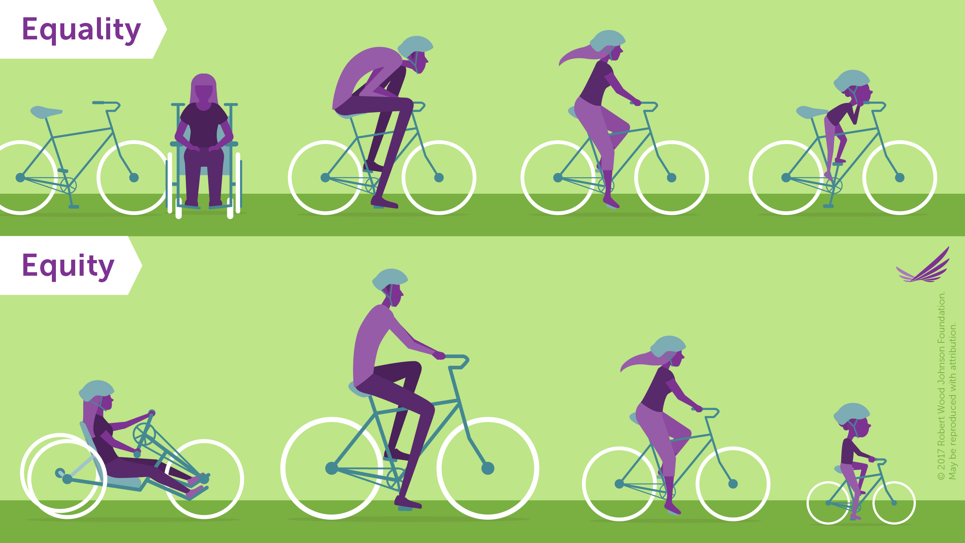
equitable outcomes for opportunity, access and inclusion

Slide 4
Activity think, pair and share
THINK: What reasons might prevent parents from being involved in their student’s education or school experience?
After a few minutes of brainstorming yourself, share your answers.
listen to one another’s answers. Discuss and then determine what you agree on.

Slide 5
Status Quo?
“In some schools there are still educators who say, ‘If the family would just do its job, we could do our job.’
And there are still families who say, ‘I raised this child; now it is your job to educate her.’
These words embody a view of separate spheres of influence.
Other educators say, ‘I cannot do my job without the help of my students’ families and the support of this community.’
And some parents say, ‘I really need to know what is happening in school in order to help my child.
These phrases embody the theory of overlapping spheres of influence.”
Notes:
The Overlapping Spheres of Influence model recognizes that there are some practices that family, school and community conduct separately and that there are others that they conduct jointly in order to influence the growth and learning of the child. According to Epstein, successful partnerships must be forged between these three spheres in order best to meet the needs of the child.

Slide 6
Dietz(1997) argued that when a school limits parental involvement to a particular type of involvement (e.g. fundraising, committee membership) then only a small proportion of parents become involved. As a result the school neither really involves parents, nor reaps the potential benefits from involvement.

Slide 7
Instead, a more comprehensive model of parental involvement which elicits a wide variety of parental involvement is advocated (Dauber & Epstein, 1993). Epstein and colleagues (Epstein, 1992) thus developed a typology which aimed to comprehensively categorize the variety of involvement activities in which could potentially engage.

Slide 8
Define Parent engagement
How do you currently define parent / family engagement?

Slide 9
What is the culture of your family engagement structure and strategies
Are you trying to attract diverse families using euro-centric tactics

Slide 10
Versions of Family-School Partnerships
Fortress School
Come-if-We-Call
Open-Door
Partnership School

Slide 11
Core Beliefs of Family Engagement
All families have dreams for their children and want the best for them.
All families have the capacity to support their children’s learning.
Families and school staff are equal partners.
The responsibility for cultivating and sustaining partnerships among school, home, and community rests primarily with school staff, especially school leaders.

Slide 12
School Centric or community centric
Is community engagement led with community perspectives at the center?
Are families conforming to the school or is the school conforming to the community?
Muhammad Khalifa, Culturally responsive school leadership

Slide 13
Family involvement
Families participate in School Events & Activities
School Leads with its Mouth
Schools respond to families’ concerns with a narrow focus

Slide 14
Family engagement
Families Help Create and Oversee School Events & Activities
School Leads with its Ears
Schools respond to families’ concerns by encouraging connections to move toward broader action.

Slide 15
Relational Leadership model
Includes the following components:
Inclusiveness
Empowering
Purposeful
Ethical, and
Process oriented

Slide 16
Transformational leadership model
Relational Leadership refers to a model or perspective on leadership that focuses on the idea that leadership effectiveness has to do with the ability of the leader to create positive relationships within the organization. Wheatley (1992) describes the principle as follows:
Leadership is always dependent on the context, but the context is established by the relationships we value.

Slide 17
Belonging
Belonging is the feeling of security and support when there is a sense of acceptance, inclusion, and identity for a member of a certain group. It is when an individual can bring their authentic self to work

Slide 18
Inclusion
Inclusion is a dynamic state of feeling, belonging, and operating in which diversity is leveraged and valued to create a fair, healthy, and high-performing organization or community. An inclusive culture and environment ensure equitable access to resources and opportunities for all.

Slide 19
Relational conferences
Teacher who flipped the conference format
Family and parent engaged needs assessment
Relationships that recognize and respect DIFFERENCES – including differences in opinions
Relationships that are built on TRUST
Partnerships that value COLLABORATION
Mapp (2015)

Slide 20
Joyce Epstein’s “Big Six”: Family-School-Community Partnerships
Parenting: Help families build on their strengths and parenting skills. Identify resources and support to help families nurture children.
Communicating: Plan and conduct workable methods of two-way communication focused on child’s learning.
Learning at Home: Provide ways for families and school staff to develop learning goals and continue children’s learning at home and in the community to meet the goals.

Slide 21
Joyce Epstein’s “Big Six”: Family-School-Community Partnerships
Volunteering: Recruit and organize volunteer help from families and the community.
Decision making: Include parents in school decisions to develop leaders and represent all families in the school.
Collaborating with the Community: Identify and connect community resources to strengthen families, school programs, and student learning.

Slide 22
Pair share
Address Differences
What cultures are included in your school family?
What do you know about family expectations and priorities for their children’s educational needs? Trust and Collaboration
What opportunities do families have to participate in the school culture?
How are you building the school/family team?

Slide 23
ACTIVITY A Family Gathering
We are having a family gathering.
How will you reach out to all members of the family to include them?
What will you do to make them feel welcome and part of the family?
What kinds of things will you do to help them to feel connected after this event?

Slide 24
What is something you are thinking about?
What will you take back to your community as a result of our work today?
Awareness without action is a waste of time
What are your next steps?

Slide 25

Contact Information for Bill de la Cruz
Twitter: @Billdelac
IG: @Billdelac
Podcast: The Origination Point Podcast
Email: inclusiontalk@comcast.net
Book: Finding The Origination Point, Understanding Our Biases To Create a More Peaceful World.

