Slide 1
Agile Development and Scrum Methodology

Slide 2
Overview
Discuss Agile and Scrum
What it is
Benefits
Negatives
Let’s look at IAB data

Slide 3
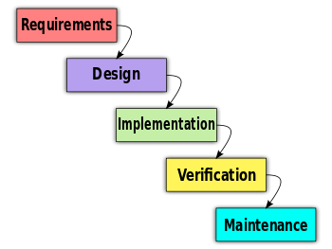
Agile software development
Evolution of the waterfall:
First get requirements
Develop
Then release
Benefits:
Actions happen in lockstep
Steps can be “completed” before the next step
Negatives:
If the things on the ground change, you can’t adapt. (e.g. mobile devices become important)

Slide 4
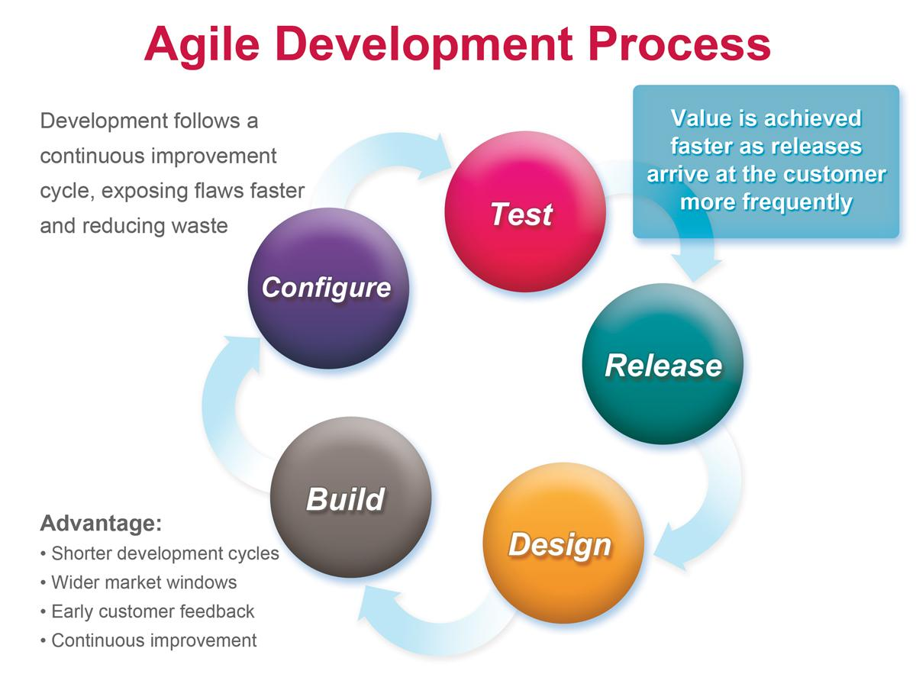
Agile
Tight iteration of design, build, test, release
Adapt all the time
Small teams, short duration
http://agilemanifesto.org
Benefits
Continuous improvement
Change quickly to change
Constant feedback
Negatives
Constantly testing ideas
Hard to scale
Hard to conform to standards

Slide 5
Scrum
Method (one of several) to implement agile
Team makeup
Product manager - represents the customer/owner
Scrum master - manages the scrum team
Protects the team from distractions
Organizes the scrum board
Ensures everyone is working at optimal efficiency
Scrum team - small team with expertise
User Studies - executes the evaluation
Everyone knows their jobs
Everyone codes, everyone talks to users, everyone participates in evaluation

Slide 6
Sprint
A block of time
2 weeks to 1 month
Don’t change sprint goals
You will do one week sprints
Start of sprint - sprint plan
Daily scrum meetings
What did you work on yesterday?
What are you working on now?
Is anything blocking you?
End of sprint
Retrospective (Lead: SM)
Test/Build/Release (Lead: SM)
Show customer latest designs, build, etc. (Lead: PM, US)

Slide 7
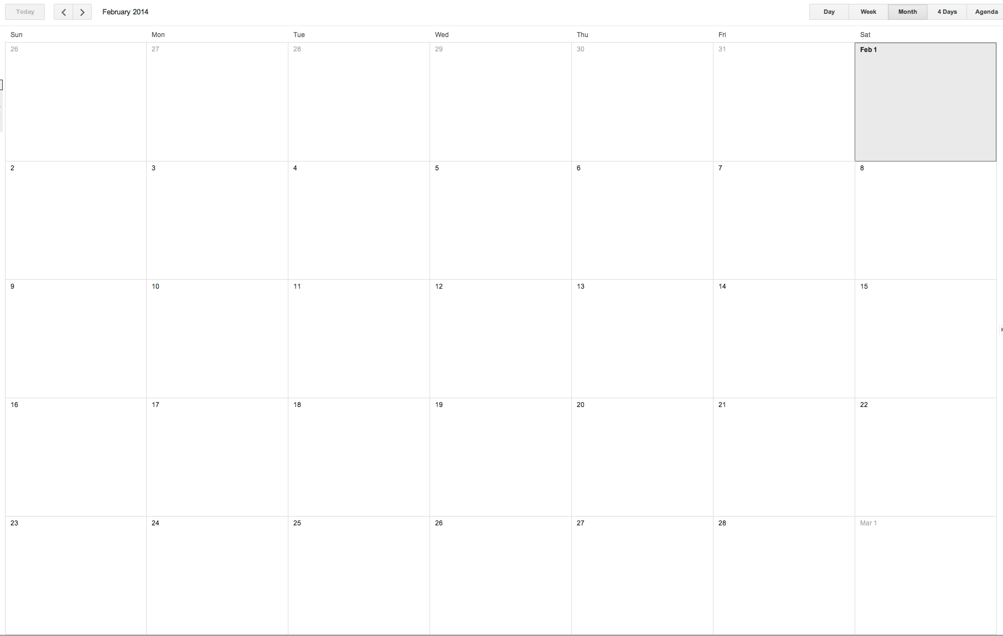
Plan
Retro
Standup
Standup
Standup
Demo
Plan
Retro
Standup
Standup
Standup
Plan
Retro
Standup
Standup
Standup
Demo
Plan
Retro
Standup
Standup
Standup

Slide 8
Planning
Break up tasks into epics, stories, tasks, and subtasks
Epics - large goals
Address a user need
Stories - As a X, I want to do Y to Z.
Tasks - things that will need to be developed to realize stories
Sub-tasks - breaking down tasks into smaller sized chunks
Planning poker
Points
Let’s go through an exercise: I want to address the issue of getting the best deal when shopping on the internet.

Slide 9
Planning
I want to address the issue of getting the best deal when shopping on the internet.
Epics - large goals
Address a user need
Stories - As a X, I want to do Y to Z.
Tasks

Slide 10
Standup
Daily scrum meetings
What did you work on yesterday?
What are you working on now?
Is anything blocking you?
Let’s Roleplay

Slide 11
Retrospective
What worked well
What didn’t work well
What did we want to work on this week
Code review
PM and US show latest draft to customers

Slide 12
Minimal Viable Product
When developing a solution to a task, consider it a hypothesis.
Develop the minimal viable product to evaluate the hypothesis

Slide 13
Agile/Scrum
Breakdown goals for targets months away
Identify realistic capacity
Identify if you are on pace to achieve goals
Plan for the interdisciplinary teams
Negatives
More overhead, but i think more efficient
Better planning, less stress
Good Agile management systems: Trello, Jira
Agile for life
https://www.youtube.com/watch?v=J6oMG7u9HGE

