Slide 1



Don’t F*** With Cats
OSINT techniques to catch a killer

Slide 2


Overview
In 2010 videos began appearing online showing the gruesome murder of animals…specifically kittens
Shortly afterwards a group of angry internet strangers began an untrained (mostly) investigation to identify the murderer
This presentation aims to talk about some of the OSINT techniques they used with their investigation and expand the topic of OSINT skills beyond the typical pentest

Slide 3


Slide 4
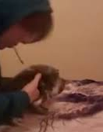
The beginning
First video emerged in 2010. This image is a still from that video and provided most of the early clues.
OSINT TIP #1 – Use Google
Where was the blanket sold?
OSINT TIP #2 – If possible, crowd source the information
Where are these brands of cigarettes sold with the same packaging?
Potential drawback - this can be loud and noticeable by your target
Brand of cigarette
Blanket is of a single wolf
Notes:
The YouTube account that posted the video appears to be a sock puppet account
Blanket was being sold on eBay, only 1 buyer, but shipped internationally so it wasn’t helpful
The Facebook group helps identify that the cigarettes come from North America because of a surgeon generals warning on the package
A vacuum in the room is seen in another part of the video, going to a vacuum enthusiast forum let them find out that the vacuum is only sold in North America
Television in the background was playing a show with Russian language….ultimately doesn’t lead anywhere

Slide 5
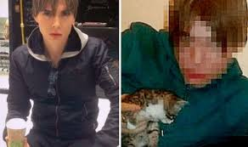
The Story Continues
Ultimately the investigators fail to get much progress. Another video is released providing more clues but not much progress is made.
Someone reaches out and gives them a name of their target, Luka Magnotta.
Google searching the name reveals huge amounts of data.

Slide 6
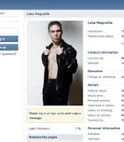


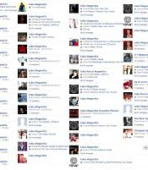
Social Media SOCMINT
Various social media scrappers available
Sites like namechk.com allow us to find all instances with the same username registered
You are only as secure as those you associate with
One study found that in 2014, about 80 percent of federal, state, and local law enforcement in the United States were using social media platforms as intelligence-gathering tools

Slide 7
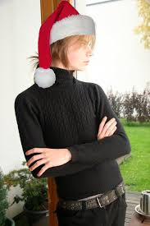
Reverse Image Search
Reverse image search takes image meta data, hashes, and other details and looks to see where else they are posted.
https://tineye.com/
http://fotoforensics.com/ by hacker factor
Notes:
Using the results from the reverse image search they find various other profiles and locations with the same image, allowing the investigators to gain even more information.

Slide 8
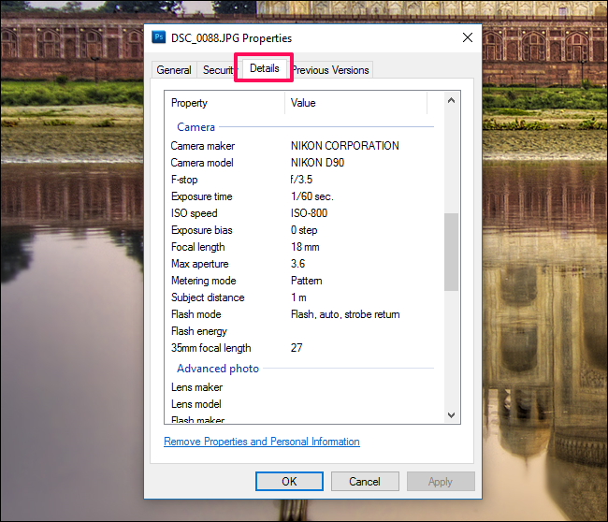
EXIF data
EXIF is short for Exchangeable Image File
Image meta data. What device, what location, date, etc.
EXIF data can be extracted from images using easily available tools
https://exifdata.com/
Various tools and techniques can be used to remove this information
Many social media sites have begun stripping EXIF data by default.
Notes:
Extracting exif data from tons of social media and online photos eventually led the researchers to GPS coordinates in Toronto

Slide 9
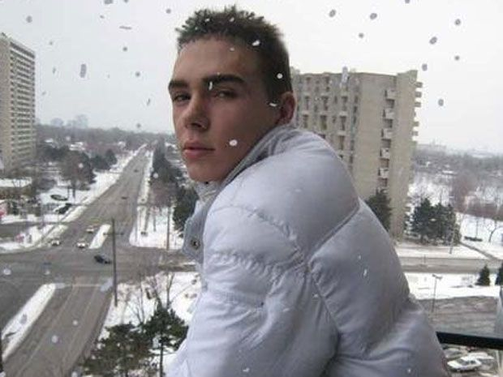
Google Earth and location data
Using Google Earth you can walk around and perform distant recon
Use shadows to judge time of day
Weather for historical weather comparison
Google Maps and Google Earth has become a primary source for military and law enforcement intelligence gathering
Deep analysis of how to better use Google maps can be found at bellingcat
Interesting looking intersection and gas station
Notes:
From the exif data they knew Toronto. From this image they were able to narrow down that intersection and which gas station it was. Using Google maps they are able to look around and identify the balcony the photo is taken from . Talking to the building management confirms that a Luka Magnotta used to live at this location. Unfortunately he has supposedly left the country.

Slide 10

Things get crazy
Another video gets posted, but this time it is of a murder. The victims name Jun Lin
Using the same OSINT techniques as previously talked about the internet strangers identify that the murder likely happened in Montreal
At this point it becomes an official police investigation. The entire things escalates to an international manhunt. Eventually Luka is arrested.
Notes:
One of the social media accounts that they monitored posted a new picture of Luka. The picture had budding trees and a traffic light in the background. The combo of the tree and the type of traffic light allowed them to narrow down the location to Montreal.

Slide 11
Take Away
OSINT can be an incredibly powerful tool to leverage
To get the most out of OSINT data you need to think outside of the box and connect the dots
Trace Labs – Crowd sourced OSINT for finding missing people
https://www.tracelabs.org/

Slide 12
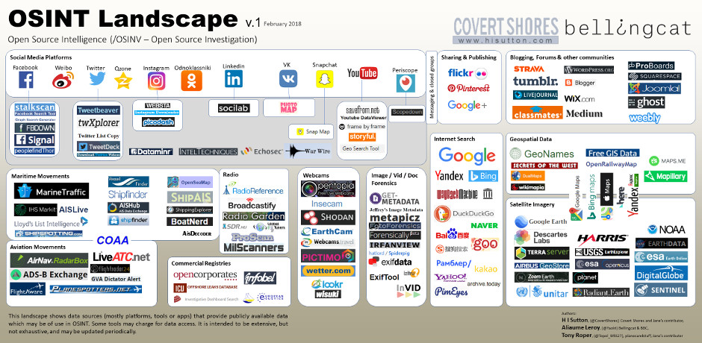
Do you want to learn more?
IntelTechniques
https://inteltechniques.com/
OSINT Curious podcast
https://osintcurio.us/

Slide 13

Questions?

