Slide 1
JA3/JA3S
Brought to you by Office Design Ideas

Slide 2
SSL/TLS refresher
Notes:
1: Client sends a request to begin encrypted traffic along with a list of all the SSL/TLS versions it supports
2: Server responds with its certificate including its public key
3: client takes the public key and generates a “pre-master” key then sends it to the server
4: server decrypts the pre-master using it’s private
5:client and server both now use the pre-master key to create a shared secret
6: client and server validate the shared secret works
7: encrypted traffic continues using the shared secret

Slide 3
What is JA3/JA3S
A way of fingerprinting SSL/TLS traffic and looking for potentially bad things
A more efficient way to detect malware over SSL than IP or domain

Slide 4
How Does It Work?
After the 3-way handshake the SSL/TLS handshake occurs.
This handshake happens in the clear before any encryption begins.
SSL/TLS handshakes are unique depending on various options used by the application
These options can be used to fingerprint traffic

Slide 5

Nothing new, just new(ish) use case
SSL/TLS fingerprinting has been around for a long time, way before the idea of JA3. Early blog post are from the SSLlabs developers grabbing statistics by fingerprinting visitors.
https://blog.ivanristic.com/2009/07/analysis-of-googlebots-frugal-cipher-suite-list.html
https://idea.popcount.org/2012-06-17-ssl-fingerprinting-for-p0f/
https://github.com/synackpse/tls-fingerprinting

Slide 6
How JA3/JA3s signatures are created
JA3 gathers the decimal values of the bytes for the following fields; SSL Version, Accepted Ciphers, List of Extensions, Elliptic Curves, and Elliptic Curve Formats. It then concatenates those values together in order, using a “,” to delimit each field and a “-” to delimit each value in each field.
Example
This value is then MD5 hashed to produce a fingerprint
769,47–53–5–10–49161–49162–49171–49172–50–56–19–4,0–10–11,23–24–25,0
ada70206e40642a3e4461f35503241d5

Slide 7
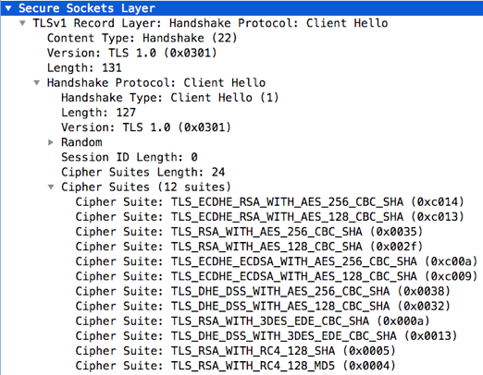
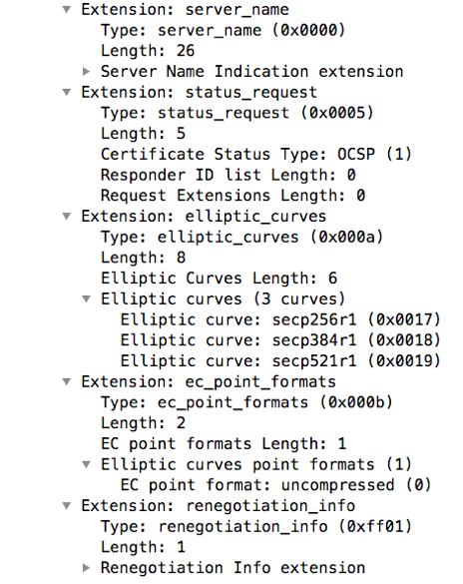
In PCAP form
SSLVersion = 0301 = 769
Cipher = 0xc014 = 49172
Cipher = 0xc013 = 49171
Cipher = 0x0035 = 53
…continue…
SSLExtension = 0x0000 = 0
SSLEXtension = 0x0005 = 5
SSLExtension = 0x000a = 10
SSLExtension = 0x000b = 11
SSLExtension = 0xff01 = 65281
EllipticCurve = 0x0017 = 23
EllipticCurve = 0x0018 = 24
EllipticCurve = 0x0019 = 25
EllipticCurvePointFormat = 0x0000 = 0
decode of the Poseidon Client Hello Packet and JA3 fingerprint generation

Slide 8
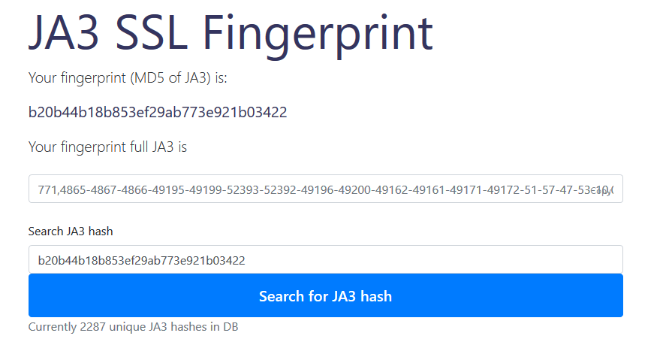
My browser fingerprint
https://ja3er.com/

Slide 9


Two modes
Know Normal(whitelist)
Know normal traffic and handshakes for your environment. This requires fingerprinting everything an making a database. Then look for unusual traffic. Much more difficult to implement, more effective.
Know Bad(blacklist)
Compare network JA3 signatures against database of known bad signatures. Easily defeated.

Slide 10
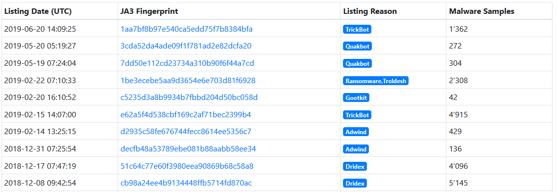
Sample legit signatures
https://sslbl.abuse.ch/ja3-fingerprints/

Slide 11
Let us test it in action
Let’s generate some malicious C2 traffic and see how well it does.

Slide 12
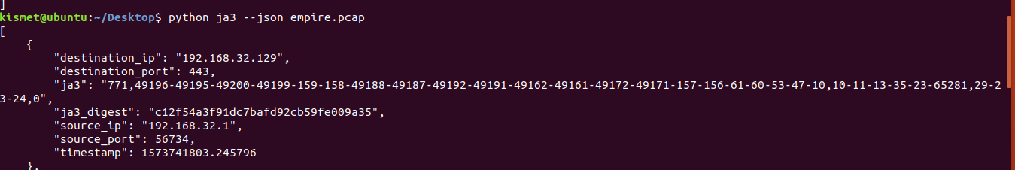
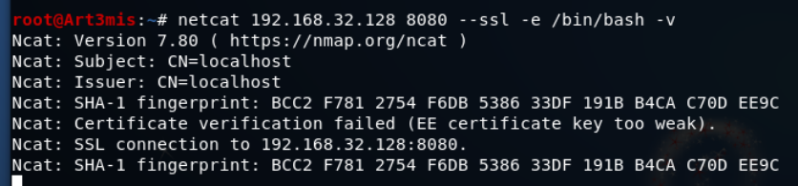
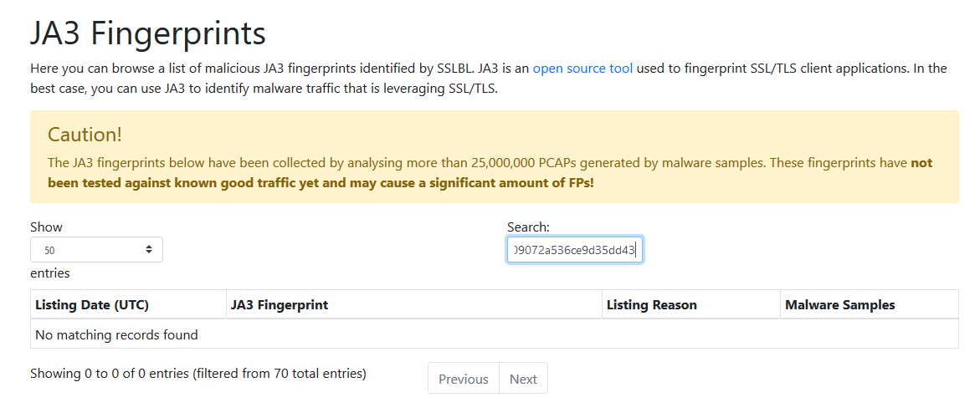
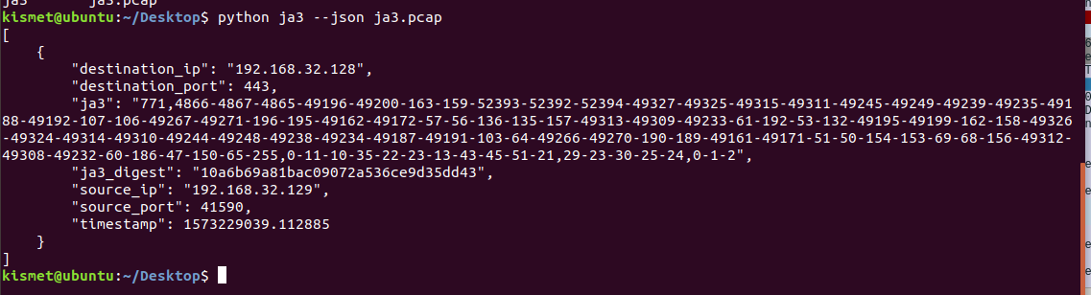
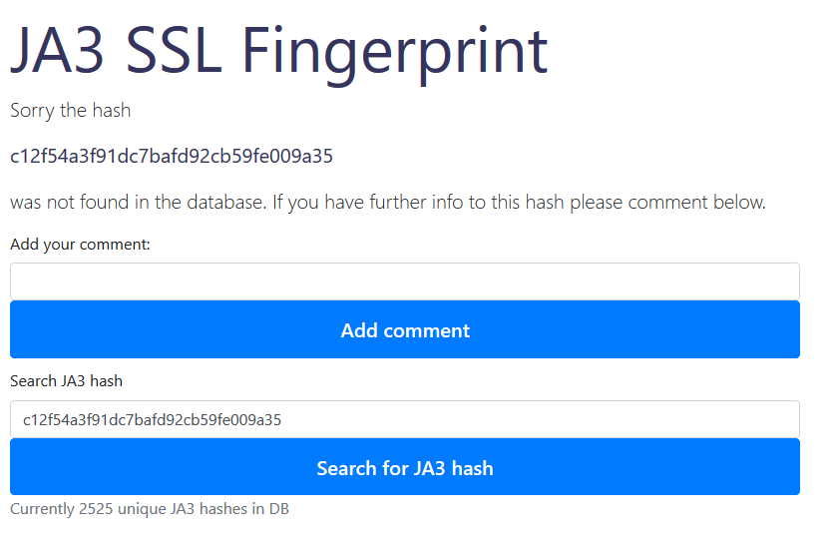
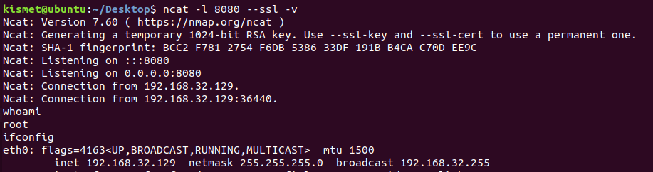
Notes:
So we do everything, and we toss the hash against one of the common databases, and we get no hits. One of the most common databases isn't hat large. And that is the main problem with the concept. There is a very very small, maybe %3 of indexed handshakes for most enterprise network traffic.
Quick note - by default both wireshark and the popular ja3 creation tool assume that the handshake will occur on port 443. If this is not the case wireshark wont tag it correctly and ja3er wont see the handshake in the pcap. Can be fixed by modifying code or creating better wireshark filters.

Slide 13

It’s old news so everyone(mostly) supports it!
Splunk, Bro, Suricata, etc.

Slide 14
Downsides
Signature Based
Needs lots of data to be effective. At this point in time the percentage of identified signatures is very tiny
Must know normal in your environment
Environment must be fairly locked down

Slide 15
https://www.trustwave.com/en-us/resources/blogs/spiderlabs-blog/inspecting-encrypted-network-traffic-with-ja3/
https://ja3er.com/
https://sslbl.abuse.ch/ja3-fingerprints
https://github.com/salesforce/ja3
https://github.com/LeeBrotherston/tls-fingerprinting/blob/master/fingerprints/fingerprints.json
https://github.com/trisulnsm/ja3prints/blob/master/newprints.json

