Slide 1
CSE402 Graduation Thesis 2,Spring 2020
“Disease Diagnosis with Image”

Slide 2
abstract
In this thesis project, it is aimed to facilitate the pre-diagnosis of patients coming to the emergency department and to decrease the mortality rate caused by misdiagnosis in the emergency department.
For preliminary diagnosis, triage method is applied first and patient urgency is graded. The patient whose urgency was detected was grouped as green, yellow and red areas.
Grouping and preliminary diagnosis; It will be performed by evaluating the image to be taken as soon as the patient arrives at the emergency room and vital values ​​to be entered manually.
I tried to create a fuzzy logic model by using python programming language and matlab application in order to get colored region output by evaluating the ratios of vital values. I used random data in the fuzzy logic model I created.
I designed an interface to collect real data.
Vital values ​​entered in the interface, the symptoms seen and patient images to be taken will make estimates by combining the results with machine learning algorithms by separately estimating at the first stage.

Slide 3
. Project Goal
In this thesis project, it is aimed to facilitate the preliminary diagnosis of patients coming to the emergency room and to decrease the mortality rate caused by misdiagnosis in the emergency room.
Project Output
I am going to create a software product for this purpose of project.

Slide 4
Used programs
Python
Matlab(fuzzy model)
Jupyter Notebook(fuzzy)
Spyder
QTDesigner
Tkinter
Visual Studio2010
SQLite Database

Slide 5
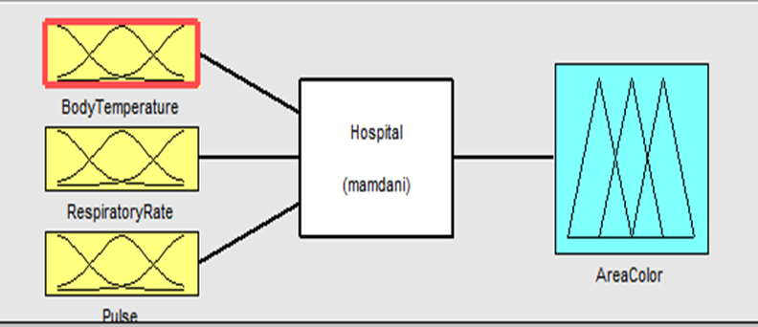
Fuzzy model

Slide 6
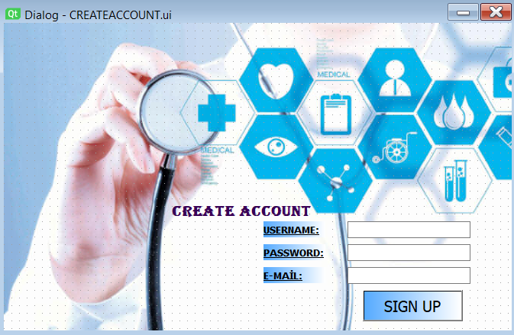
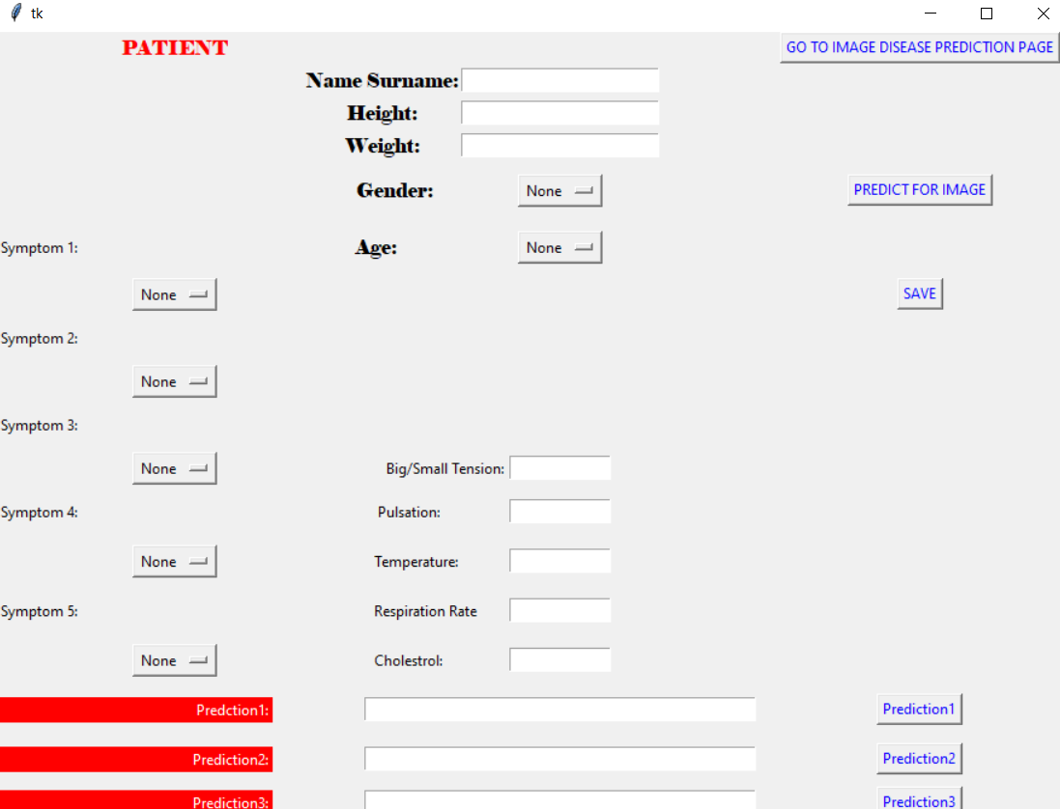
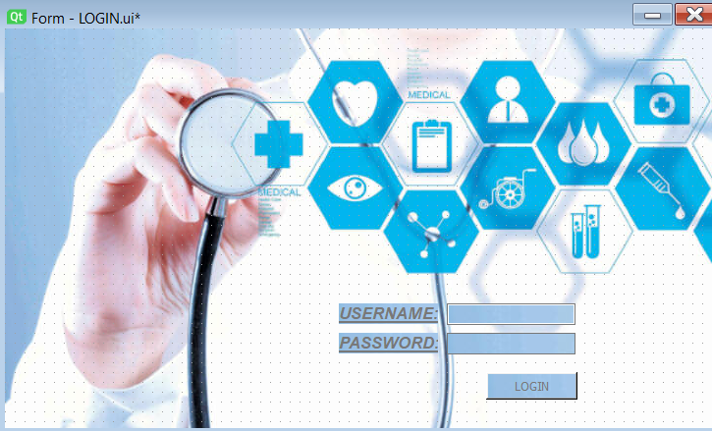
Interfaces

Slide 7
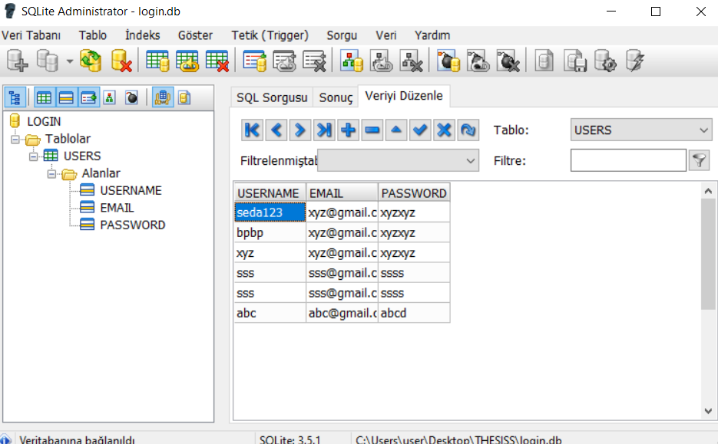

Slide 8
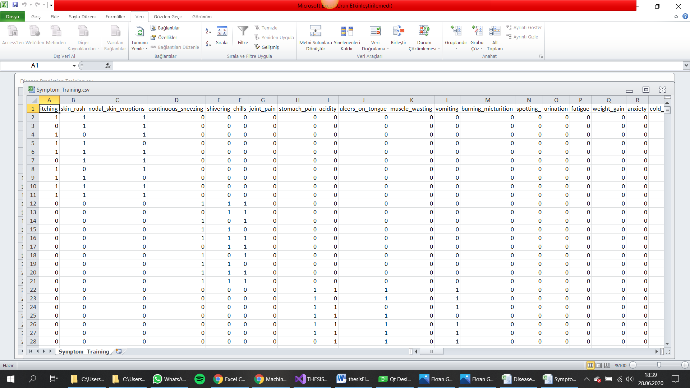
Dataset1 :Symptomps

Slide 9
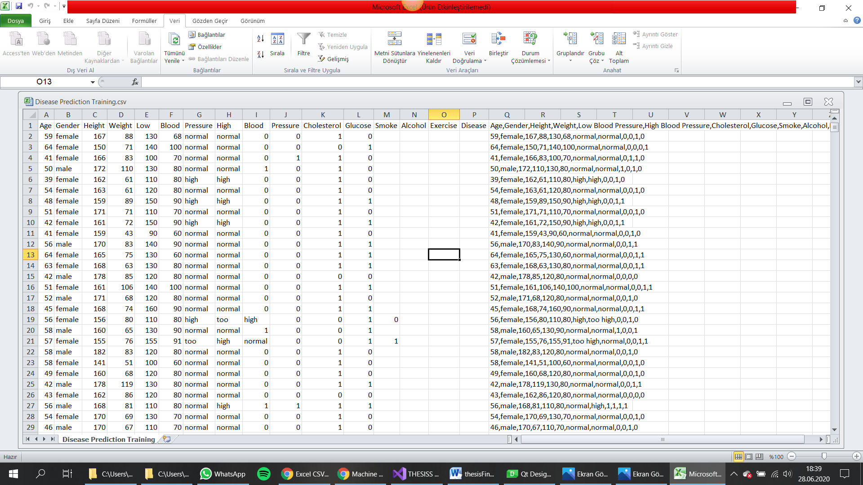
Dataset2:VITAL SIGNS

Slide 10
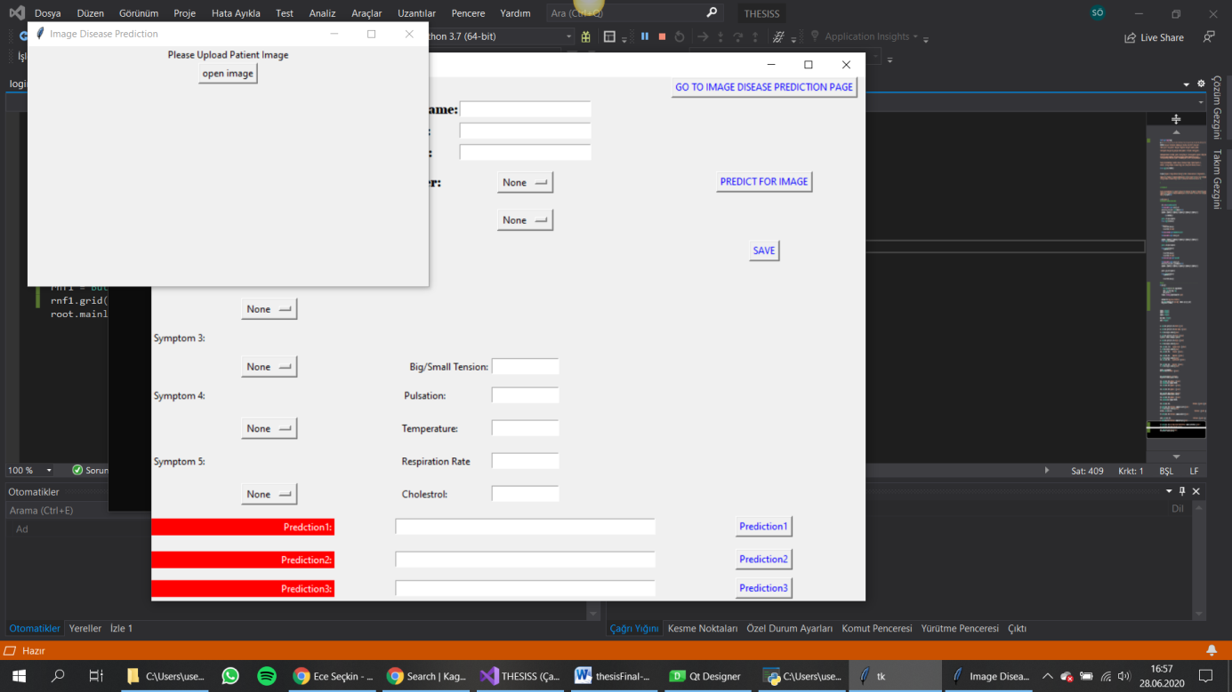

Slide 11
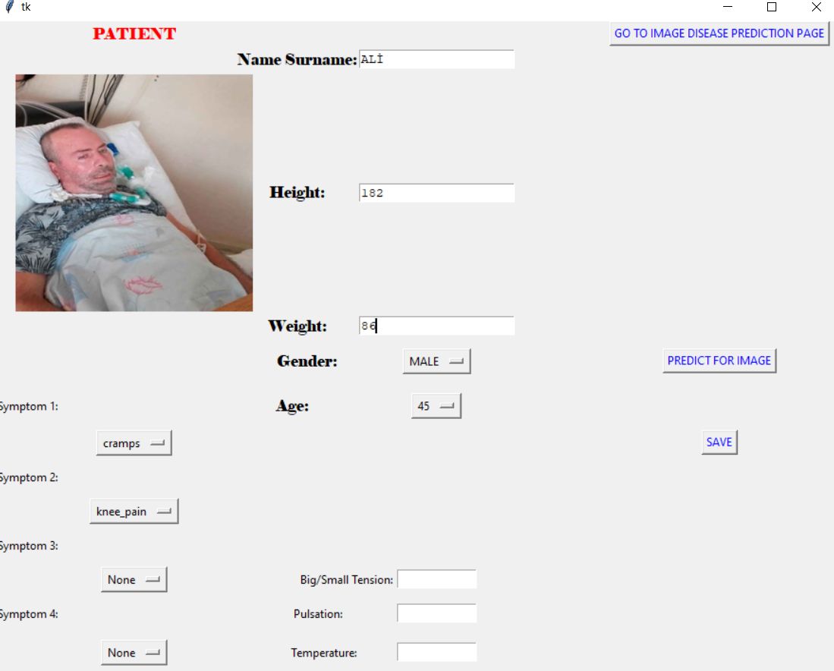

Slide 12
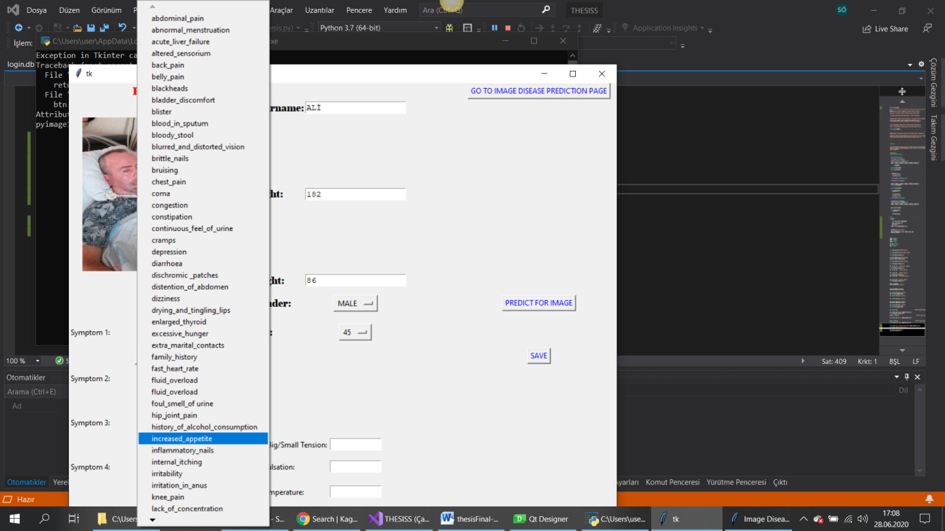

Slide 13
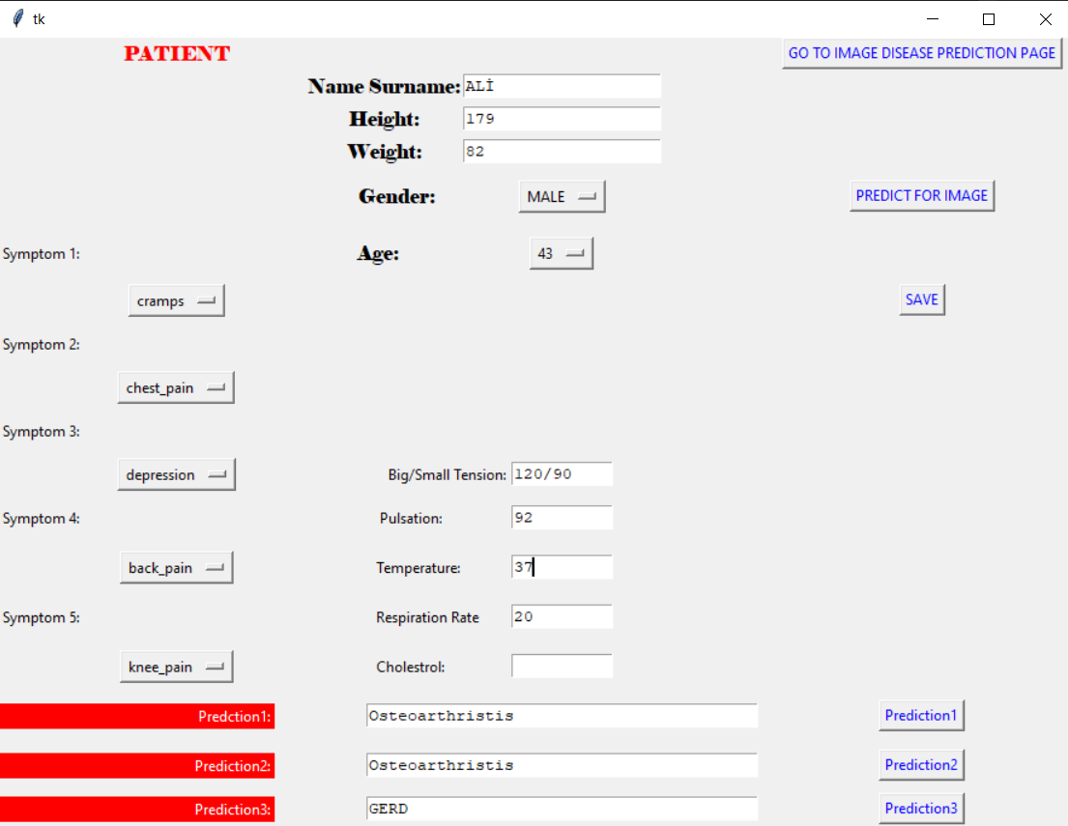
Prediction 1 analyze the symptomps for decision tree Prediction 2 analyze the symptomps for random forest Prediction 3 analyze the symptomps for naïve bayes algorithm.

Slide 14
SYMPTOMPS=['back_pain','constipation','abdominal_pain','diarrhoea','mild_fever','yellow_urine','yellowing_of_eyes','acute_liver_failure','fluid_overload','swelling_of_stomach','swelled_lymph_nodes','malaise','blurred_and_distorted_vision','phlegm','throat_irritation','redness_of_eyes','sinus_pressure','runny_nose','congestion','chest_pain','weakness_in_limbs','fast_heart_rate','pain_during_bowel_movements','pain_in_anal_region','bloody_stool','irritation_in_anus','neck_pain','dizziness','cramps','bruising','obesity','swollen_legs','swollen_blood_vessels','puffy_face_and_eyes','enlarged_thyroid','brittle_nails','swollen_extremeties','excessive_hunger','extra_marital_contacts','drying_and_tingling_lips','slurred_speech','knee_pain','hip_joint_pain','muscle_weakness','stiff_neck','swelling_joints','movement_stiffness','spinning_movements','loss_of_balance','unsteadiness','weakness_of_one_body_side','loss_of_smell','bladder_discomfort','foul_smell_of urine','continuous_feel_of_urine','passage_of_gases','internal_itching','toxic_look_(typhos)','depression','irritability','muscle_pain','altered_sensorium','red_spots_over_body','belly_pain','abnormal_menstruation','dischromic_patches','watering_from_eyes','increased_appetite','polyuria','family_history','mucoid_sputum','rusty_sputum','lack_of_concentration','visual_disturbances','receiving_blood_transfusion','receiving_unsterile_injections','coma','stomach_bleeding','distention_of_abdomen','history_of_alcohol_consumption','fluid_overload','blood_in_sputum','prominent_veins_on_calf','palpitations','painful_walking','pus_filled_pimples','blackheads','scurring','skin_peeling','silver_like_dusting','small_dents_in_nails','inflammatory_nails','blister','red_sore_around_nose','yellow_crust_ooze']

Slide 15
disease=['Fungal infection','Allergy','GERD','Chronic cholestasis','Drug Reaction','Peptic ulcer diseae','AIDS','Diabetes','Gastroenteritis','Bronchial Asthma','Hypertension',' Migraine','Cervical spondylosis','Paralysis (brain hemorrhage)','Jaundice','Malaria','Chicken pox','Dengue','Typhoid','hepatitis A','Hepatitis B','Hepatitis C','Hepatitis D','Hepatitis E','Alcoholic hepatitis','Tuberculosis','Common Cold','Pneumonia','Dimorphic hemmorhoids(piles)','Heartattack','Varicoseveins','Hypothyroidism','Hyperthyroidism','Hypoglycemia','Osteoarthristis','Arthritis','(vertigo) Paroymsal Positional Vertigo','Acne','Urinary tract infection','Psoriasis','Impetigo']

Slide 16
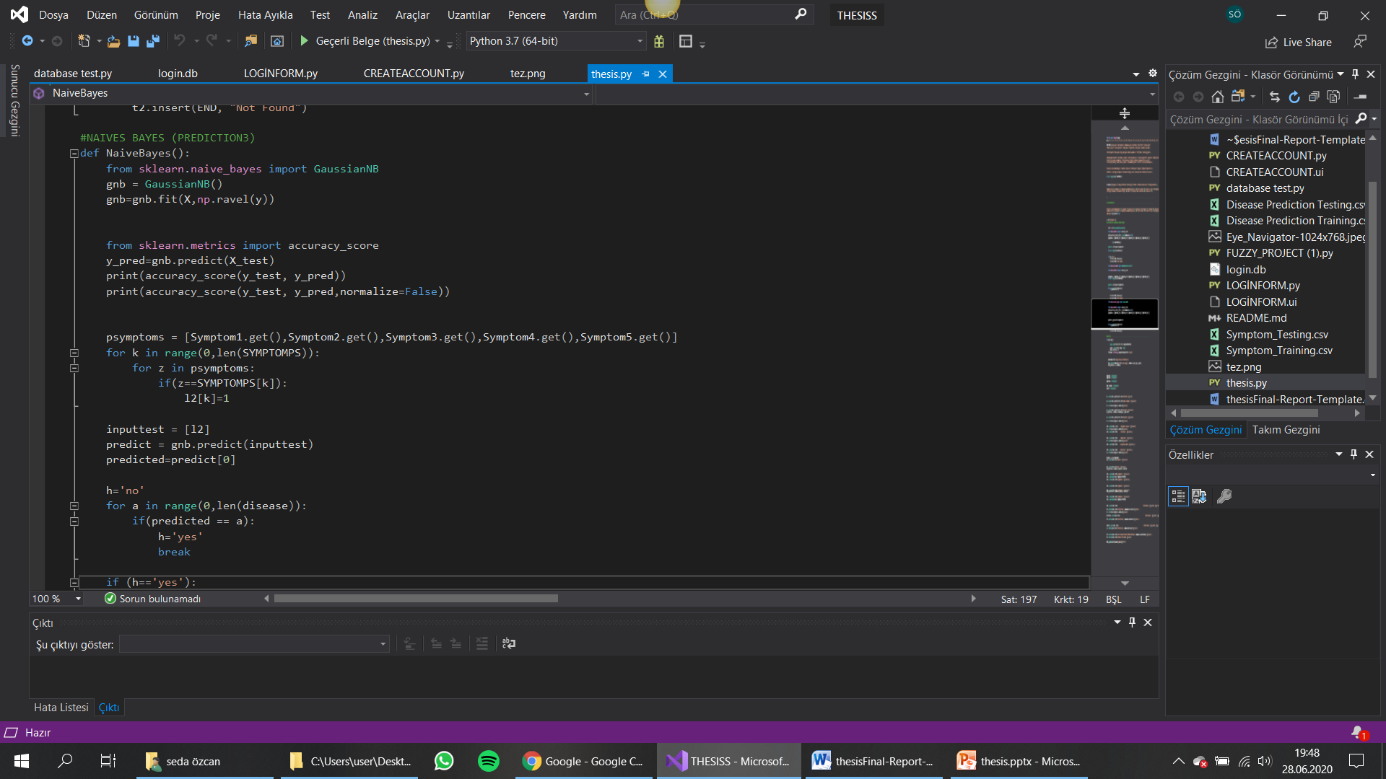

Slide 17
Benefits of the Project
Thanks to this project
To determine the risk group of patients coming to the emergency department
To accelerate the first intervention and referral of these patients
To facilitate the emergency department team to perform their duties
To reduce the number of patients lost due to late and incorrect intervention in the emergency department
to diagnose patients easily
will become possible.

Slide 18
. Future Work
In the continuation of the project: real images and real vital data will be collected with the interface. With the image processing, the data collected from the image and the vital data taken manually from the interface will be blended preliminary diagnosis study will be done.
I will collect real image datas
I will complete image process part of project
I will test and develop to reach most qualified and useful version of project.
I will save delete mods for results in this platform.

Slide 19
LIMITATIONS and REVİEWS
I couldn’t create image processing and image data collect.
And I couldn’t work real datas.
I create a fuzzy model but I did not get healthy results
In the other hand, Machine Learning algorithms based on symptoms worked more healthy
I think that if I can develop and make this project the most efficient, it will be a great convenience for the health sector in our country and in the world and will support human health. and then I want to continue developing this project.

Slide 20
THANKS FOR LISTENING☺
SEDA ÖZCAN (151805016)

