Slide 1
Web
Django框架基本使用
申世东
2021-10-20

Slide 2
一、Web基础教学
目 录
二、Django框架使用
三、JSON的拓展
四、展开

Slide 3
PART 01
Web基础教学

Slide 4
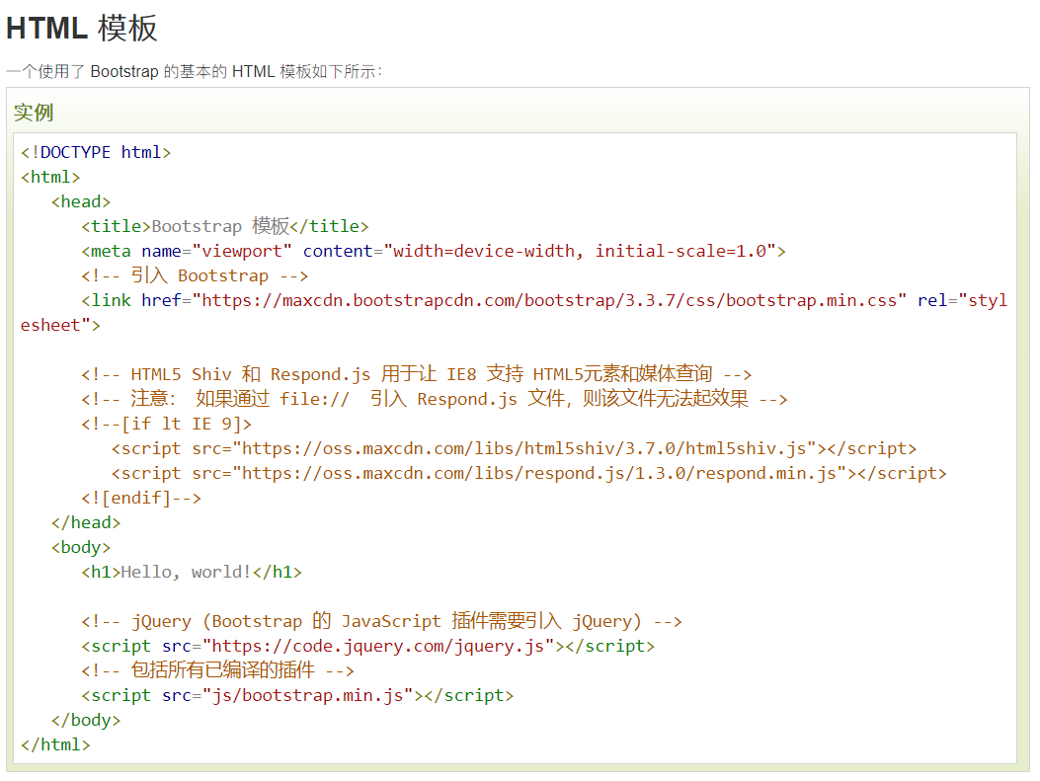
Web基础教学
https://v3.bootcss.com/css/#grid
https://www.runoob.com/bootstrap/bootstrap-environment-setup.html

Slide 5
GET和POST请求

Slide 6
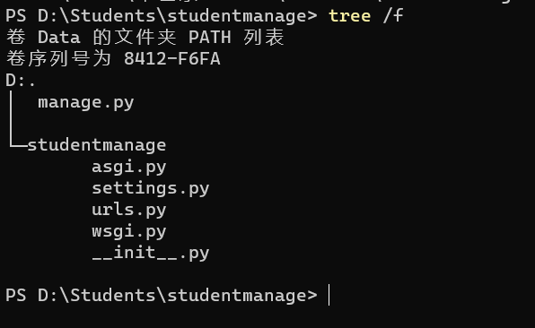
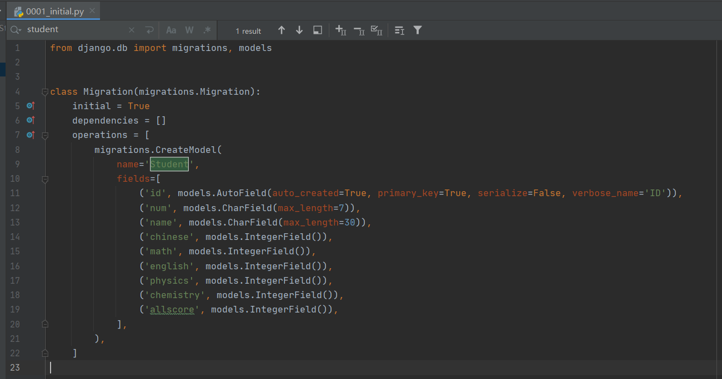
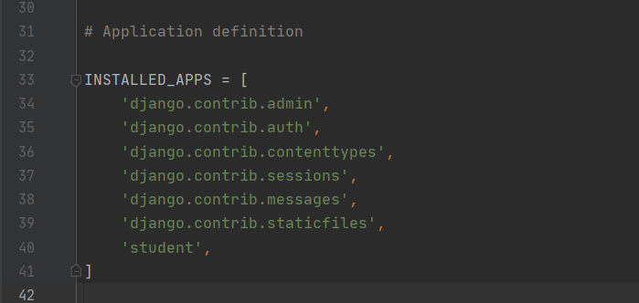
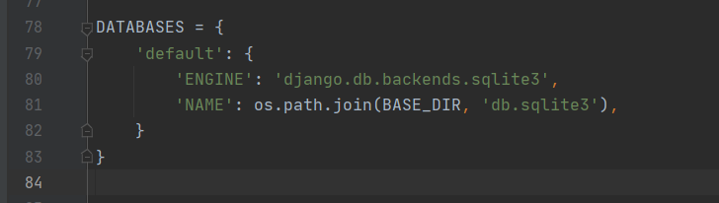

Slide 7
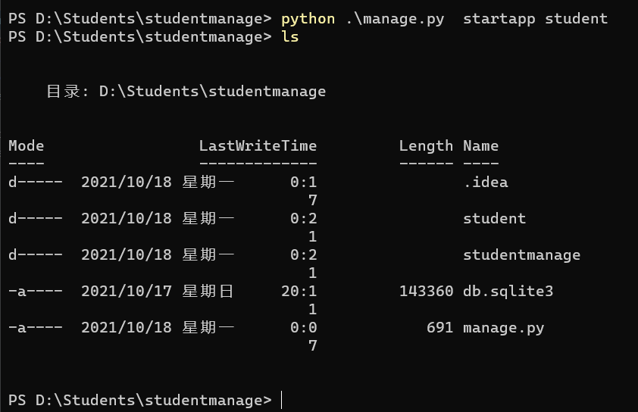
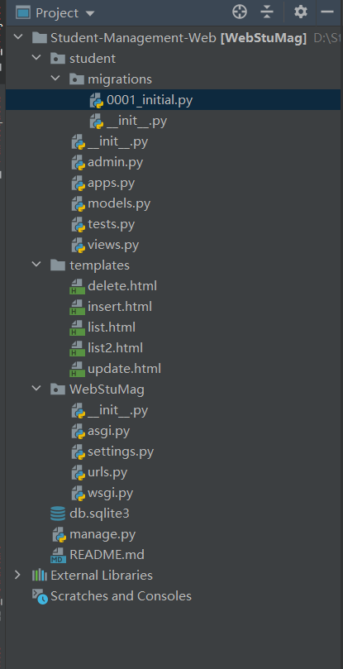
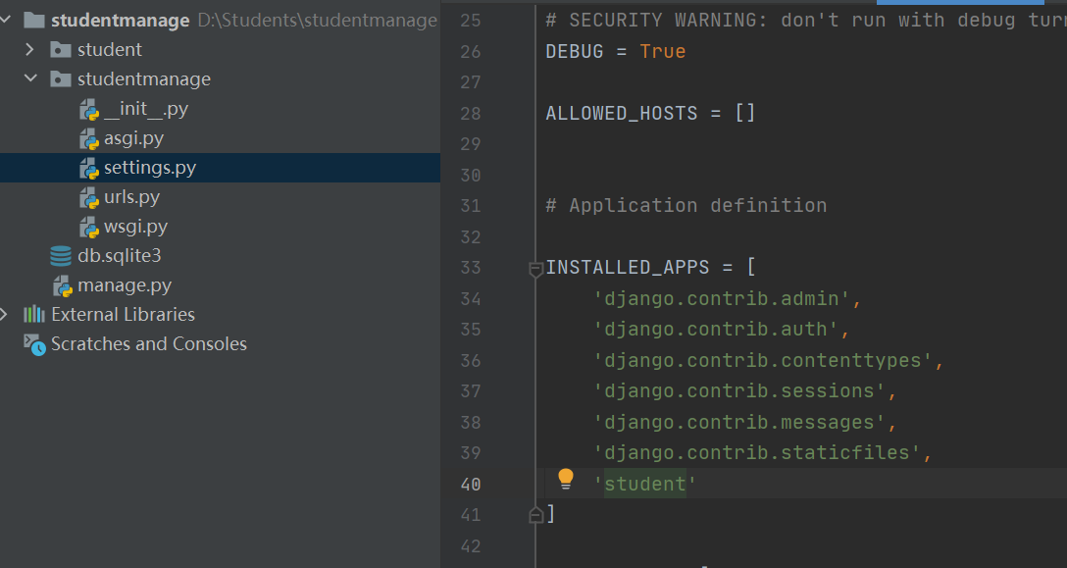

Slide 8
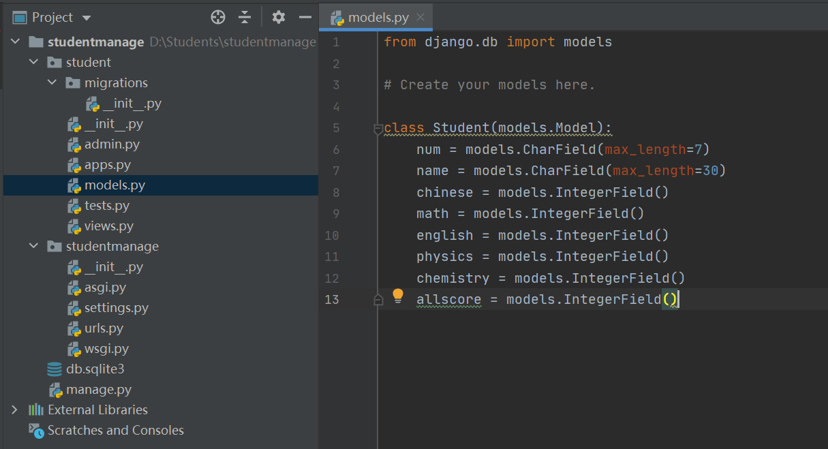

Slide 9
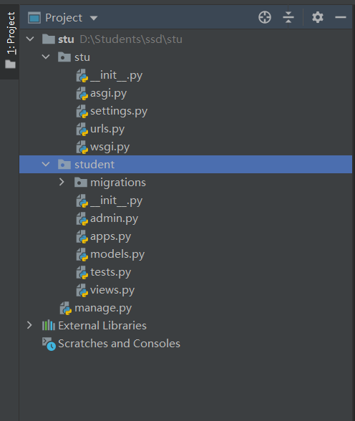
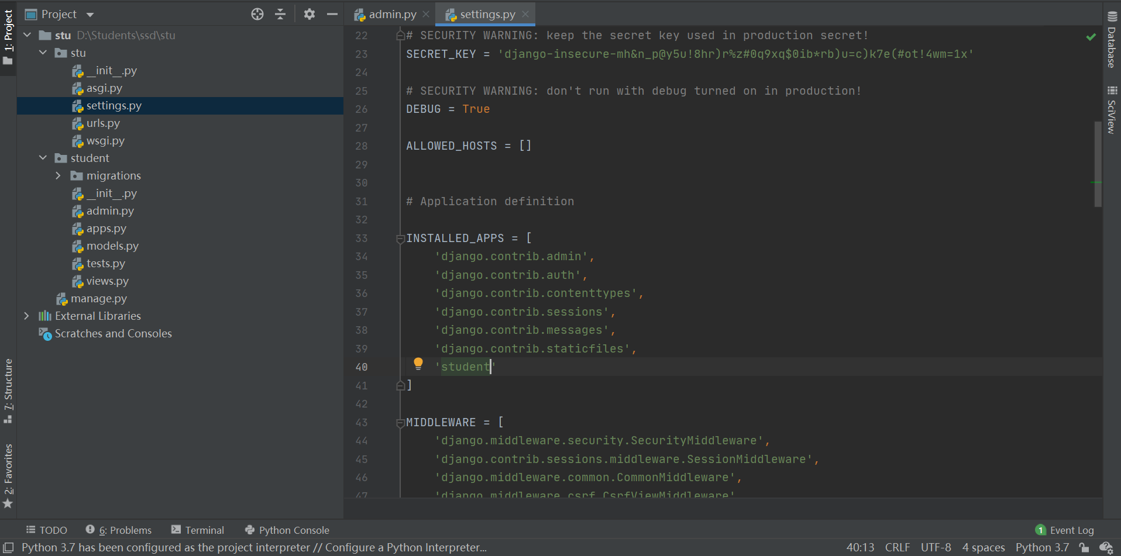

Slide 10
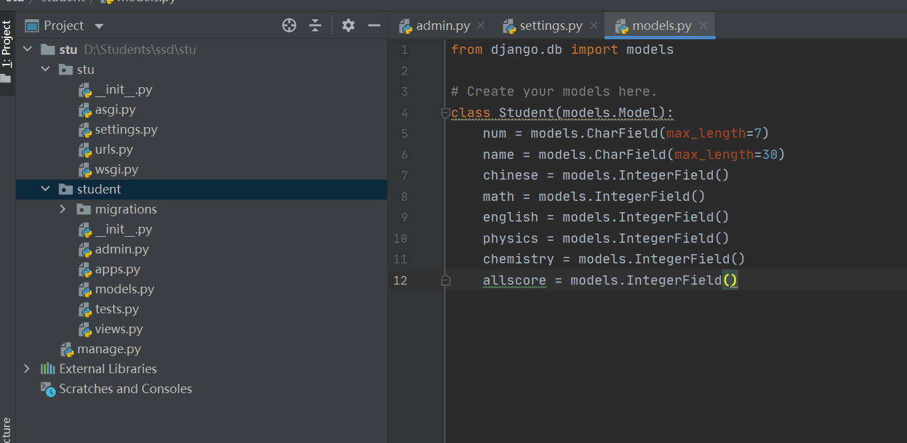
from django.db import models
# Create your models here.
class Student(models.Model):
num = models.CharField(max_length=7)
name = models.CharField(max_length=30)
chinese = models.IntegerField()
math = models.IntegerField()
english = models.IntegerField()
physics = models.IntegerField()
chemistry = models.IntegerField()
allscore = models.IntegerField()

Slide 11
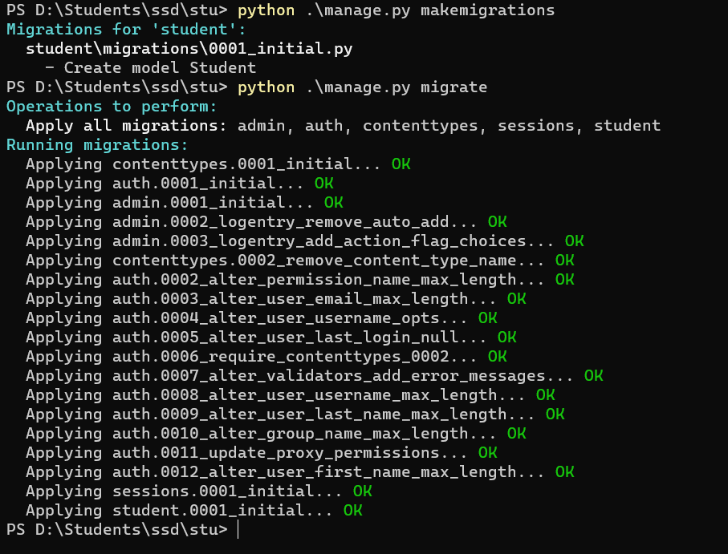
PS D:\Students\ssd\stu> python .\manage.py makemigrations
Migrations for 'student':
student\migrations\0001_initial.py
- Create model Student
PS D:\Students\ssd\stu> python .\manage.py migrate
Operations to perform:
Apply all migrations: admin, auth, contenttypes, sessions, student
Running migrations:
Applying contenttypes.0001_initial... OK
Applying auth.0001_initial... OK
Applying admin.0001_initial... OK
Applying admin.0002_logentry_remove_auto_add... OK
Applying admin.0003_logentry_add_action_flag_choices... OK
Applying contenttypes.0002_remove_content_type_name... OK
Applying auth.0002_alter_permission_name_max_length... OK
Applying auth.0003_alter_user_email_max_length... OK
Applying auth.0004_alter_user_username_opts... OK
Applying auth.0005_alter_user_last_login_null... OK
Applying auth.0006_require_contenttypes_0002... OK
Applying auth.0007_alter_validators_add_error_messages... OK
Applying auth.0008_alter_user_username_max_length... OK
Applying auth.0009_alter_user_last_name_max_length... OK
Applying auth.0010_alter_group_name_max_length... OK
Applying auth.0011_update_proxy_permissions... OK
Applying auth.0012_alter_user_first_name_max_length... OK
Applying sessions.0001_initial... OK
Applying student.0001_initial... OK
PS D:\Students\ssd\stu>

Slide 12
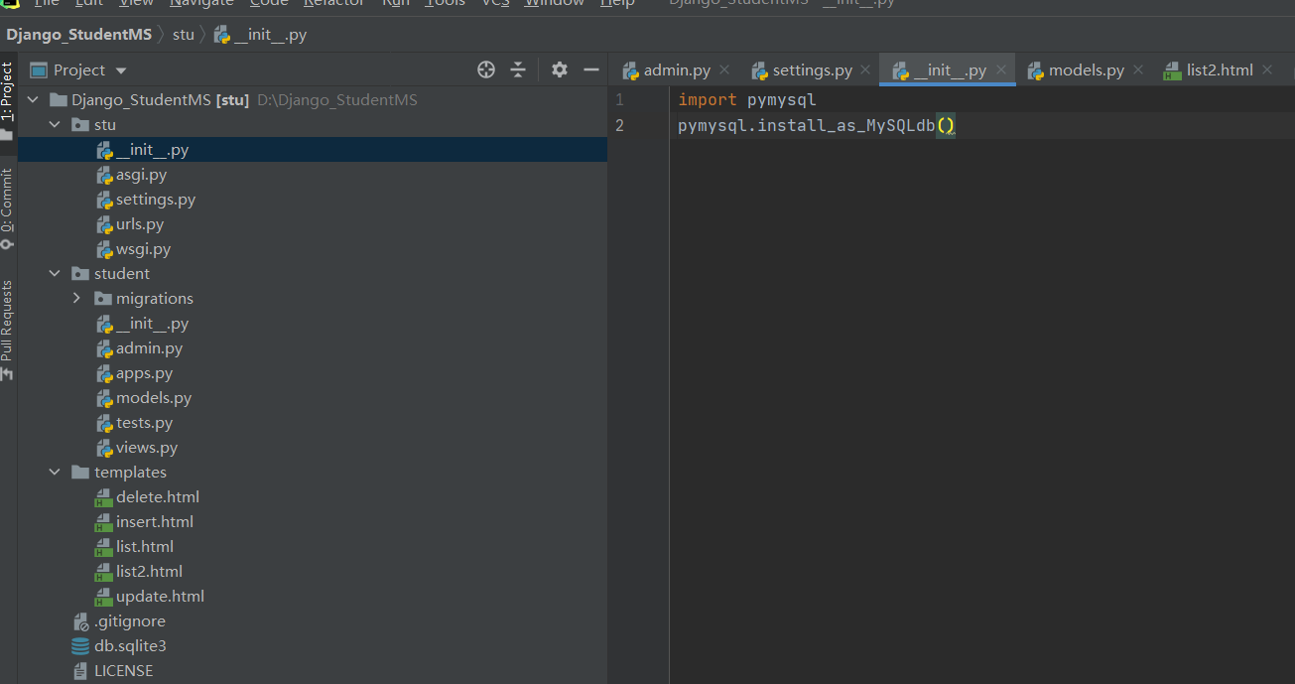
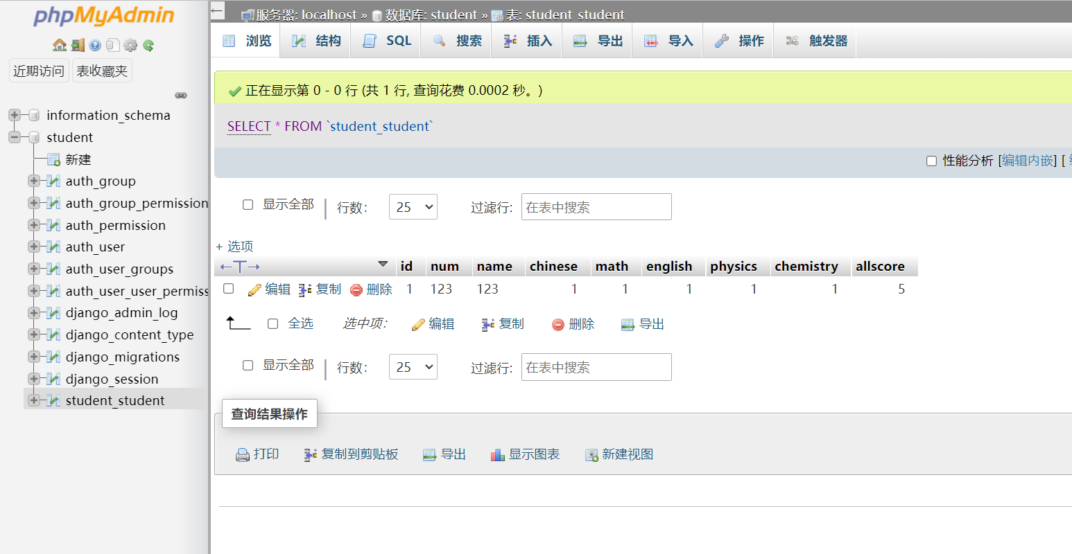

Slide 13
JSON

Slide 14
SeddonShen/Django_StudentMS: A Django Demo Project of Students Management System (github.com)

Slide 15
Web
谢谢大家！
2021-10-17

