Slide 1
Housekeeping
Today:
Cumulative distributions and cdf plots. (Chapter 4)
Actually looking at arrays – sr. citizen moment from last time.
Next:
We’ll look at EDA – exploring data with stuff we’ve covered - a bit. (Workbook 005)
Quiz! Yay! (Handfull of MC on theory, a few ‘calculate this’ that are either MC/numeric).
Workbook 006 is a self check on single variable stats.
After – we’ll work on analytical distributions and estimation.
If any part (code or concept) is shaky, try to address it (ask, read, practice) now-ish.
Note: there’s a textbook repository link, you can clone that if you want as well*.

Slide 2
Cumulative Distributions

Slide 3
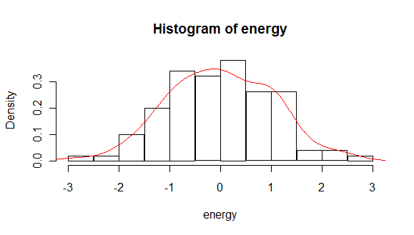
Distribution Charting
We normally plot distributions using a histogram or some histogram-esqe plot.
This shows how many results occur ‘here’.

Slide 4
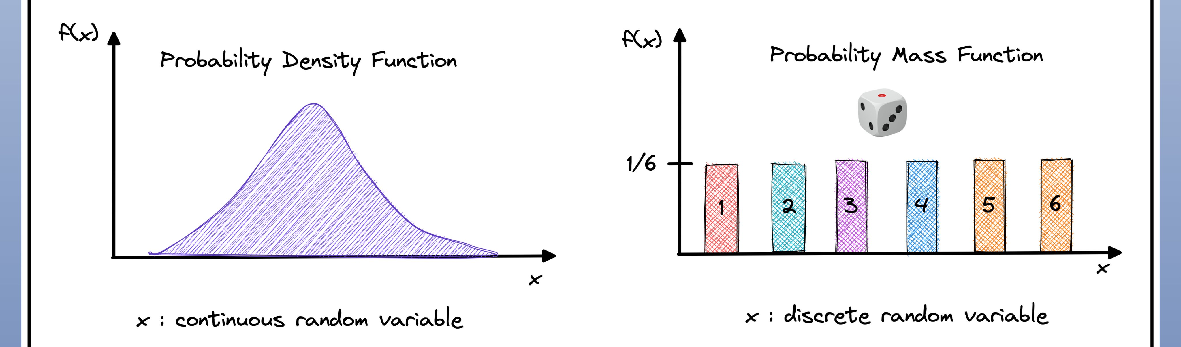
Date with Density
With a histogram is to look at density (percentage) instead of raw count.
Allows for comparisons of different size datasets.
The density version of a histogram is a PMF – probability mass function.
A smoothed version of the PMF is the PDF – probability density function.
PDF is in more detail later in text, but it’s the most common thing we use to look at distributions.
These things are directly convertible back and forth.

Slide 5
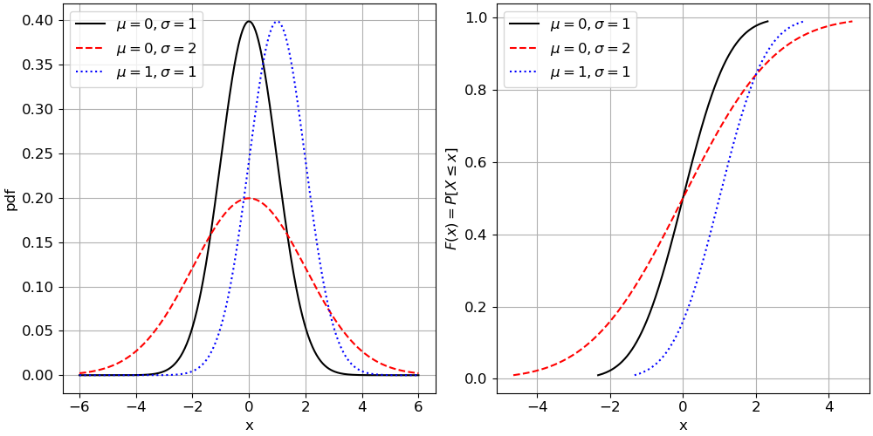
Cumulative Distributions
We can also look at distributions cumulatively.
How many occurrences happened ‘below’ this point.
Foundational for several concepts:
Hypothesis testing.
Percentiles.
Can also be good for comparing distributions.

Slide 6
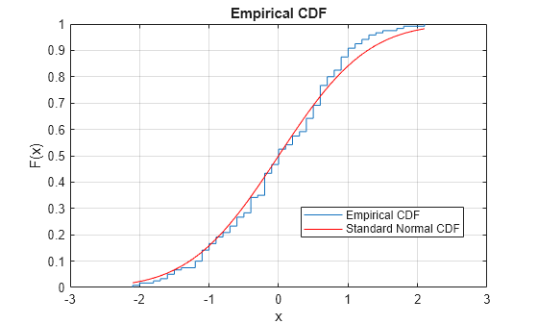
A CDF – Cumulative Distribution Function
CDFs plot the accumulation of values.
The x value is the value examined.
The y value at any point is ‘% less than’.
A.k.a. percentile.
Median is f(.5).
CDFs can be both empirical and analytical.
CMF sometimes used.

Slide 7
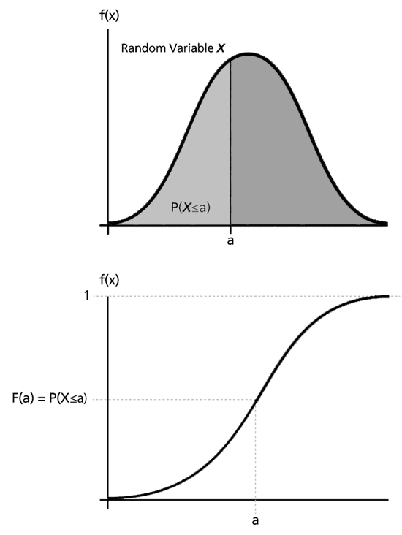
Math me, Bro!
If you’ve done some calculus, the relationships here should show.
The cumulative chart shows the total of the PDF ‘up to this point’ – the integral.
The PDF shows the slope, or rate of increase in total, at this point – the derivative.
This means there’s a calculus calculation that translates between the two.

Slide 8
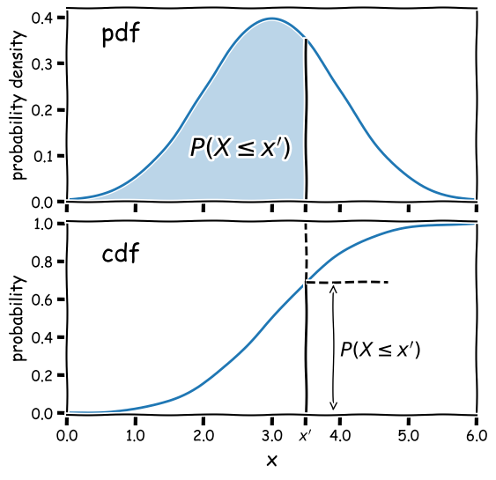
Math me, Bro!
If you’ve done some calculus, the relationships here should show.
The cumulative chart shows the total of the PDF ‘up to this point’ – the integral.
The PDF shows the slope, or rate of increase in total, at this point – the derivative.
This means there’s a calculus calculation that translates between the two.

Slide 9
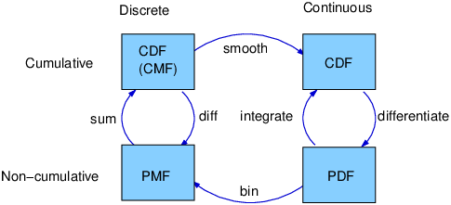
Chart Relationships
All of the charts we use for distributions are related.
Counts:
Histogram, PMF, CDF/CMF.
Curves:
PDF, CDF.
Empirical shows real counts, analytical show pattern.

Slide 10
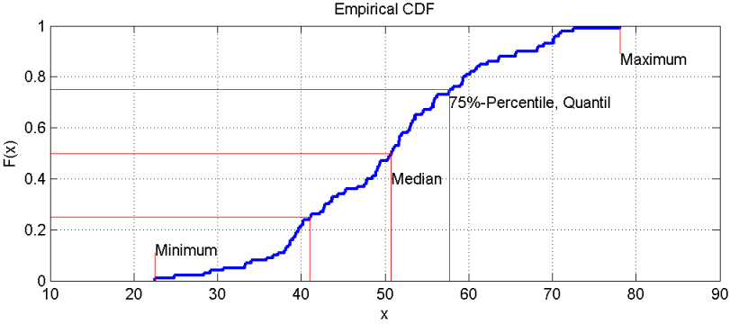
Cumulative Differences
A PDF/PMF/Histogram shows the probability of a value being X.
A CDF shows the probability of a value being less than X.
Bot show the same data and can be made from each other.
Integrate to get cumulative, differentiate to get pdf.
Steepness shows density of values.
CDFs are somewhat more ‘tamper resistant’ vs things like odd bin sizes.

Slide 11
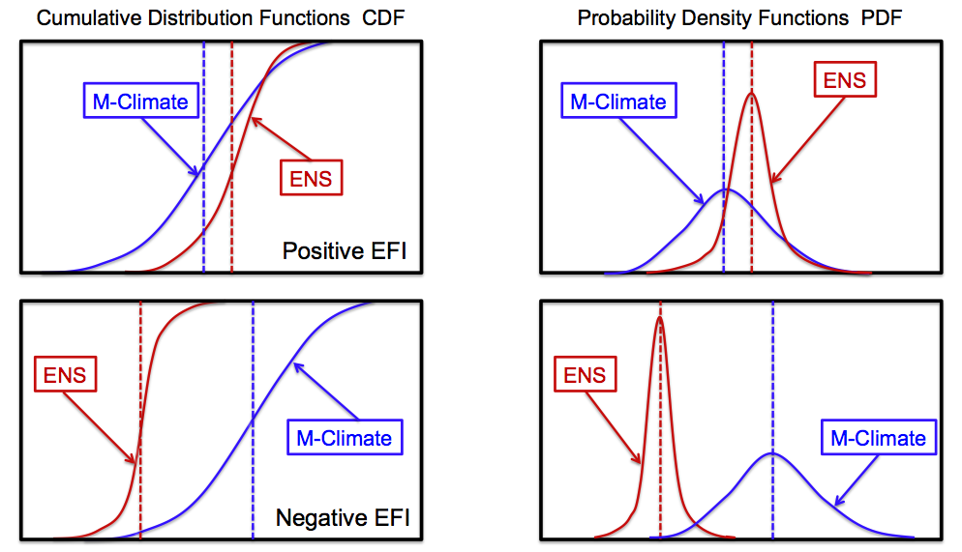

Slide 12
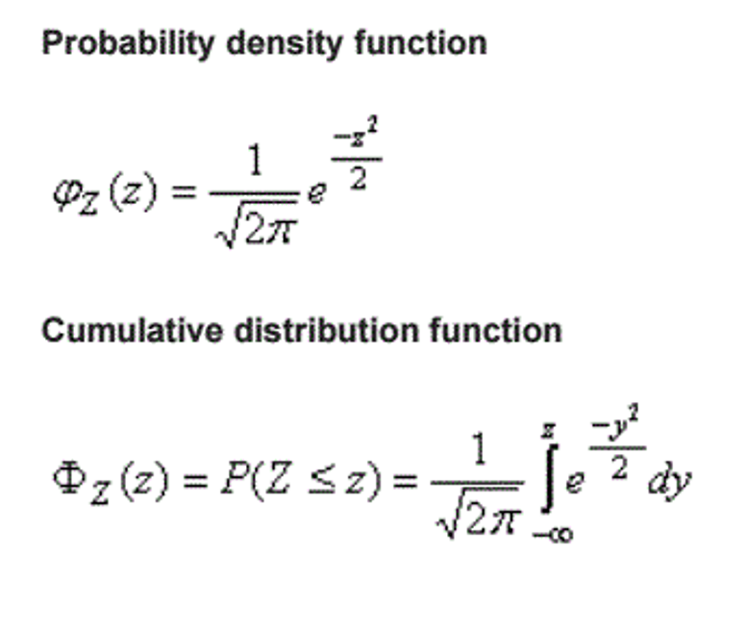
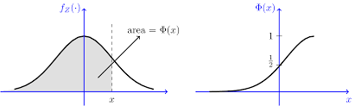
Normal and Cumulative
Most frequently, we’ll deal with a normal distribution.

Slide 13
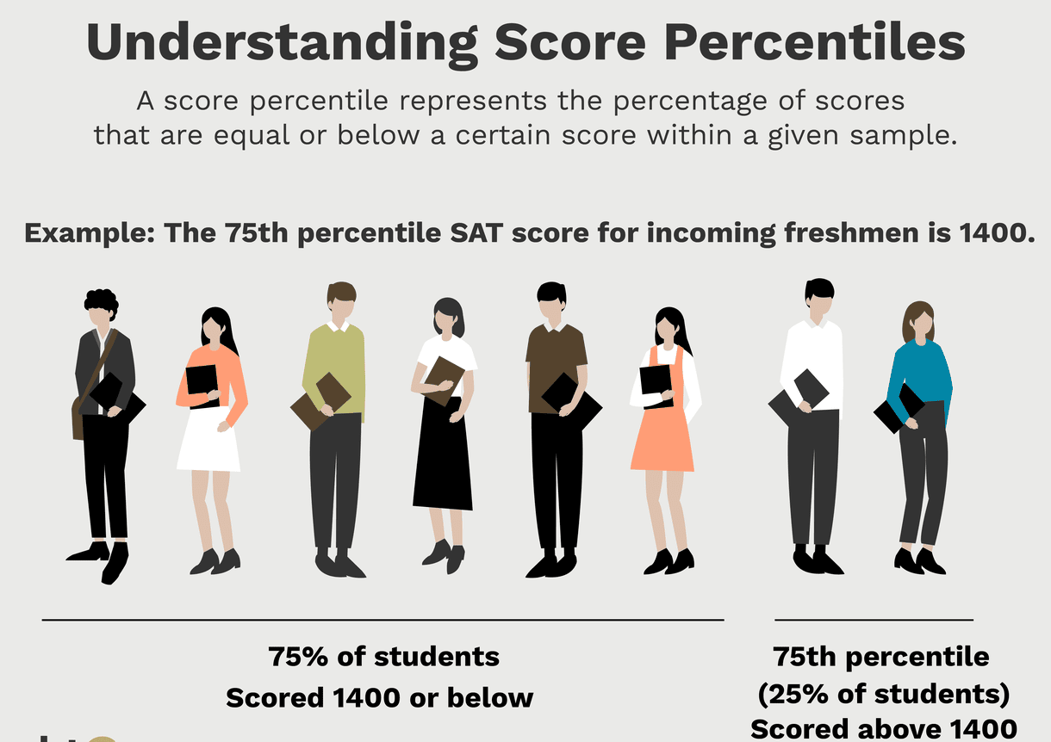
Percentiles
The percentile is the proportion of items that are lower than a given item.
A CDF looking at data cumulatively makes percentiles clear.
Y value is the percentile.
Used in comparison and benchmarking.
Test scores, salary, economic outcomes…
It doesn’t matter what the value is, only how it compares to others.

Slide 14
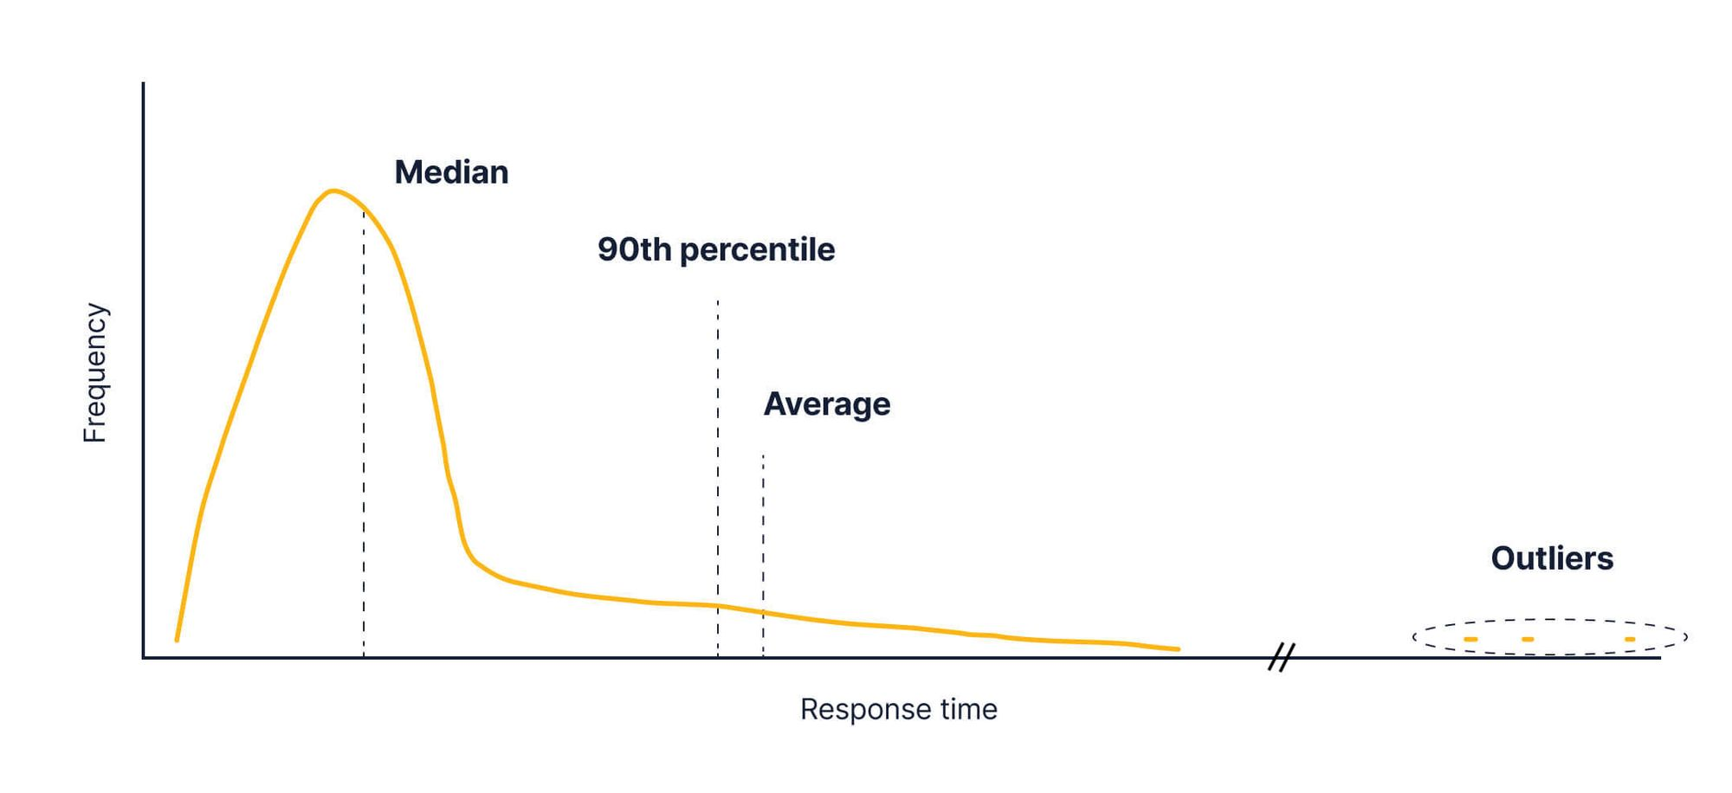
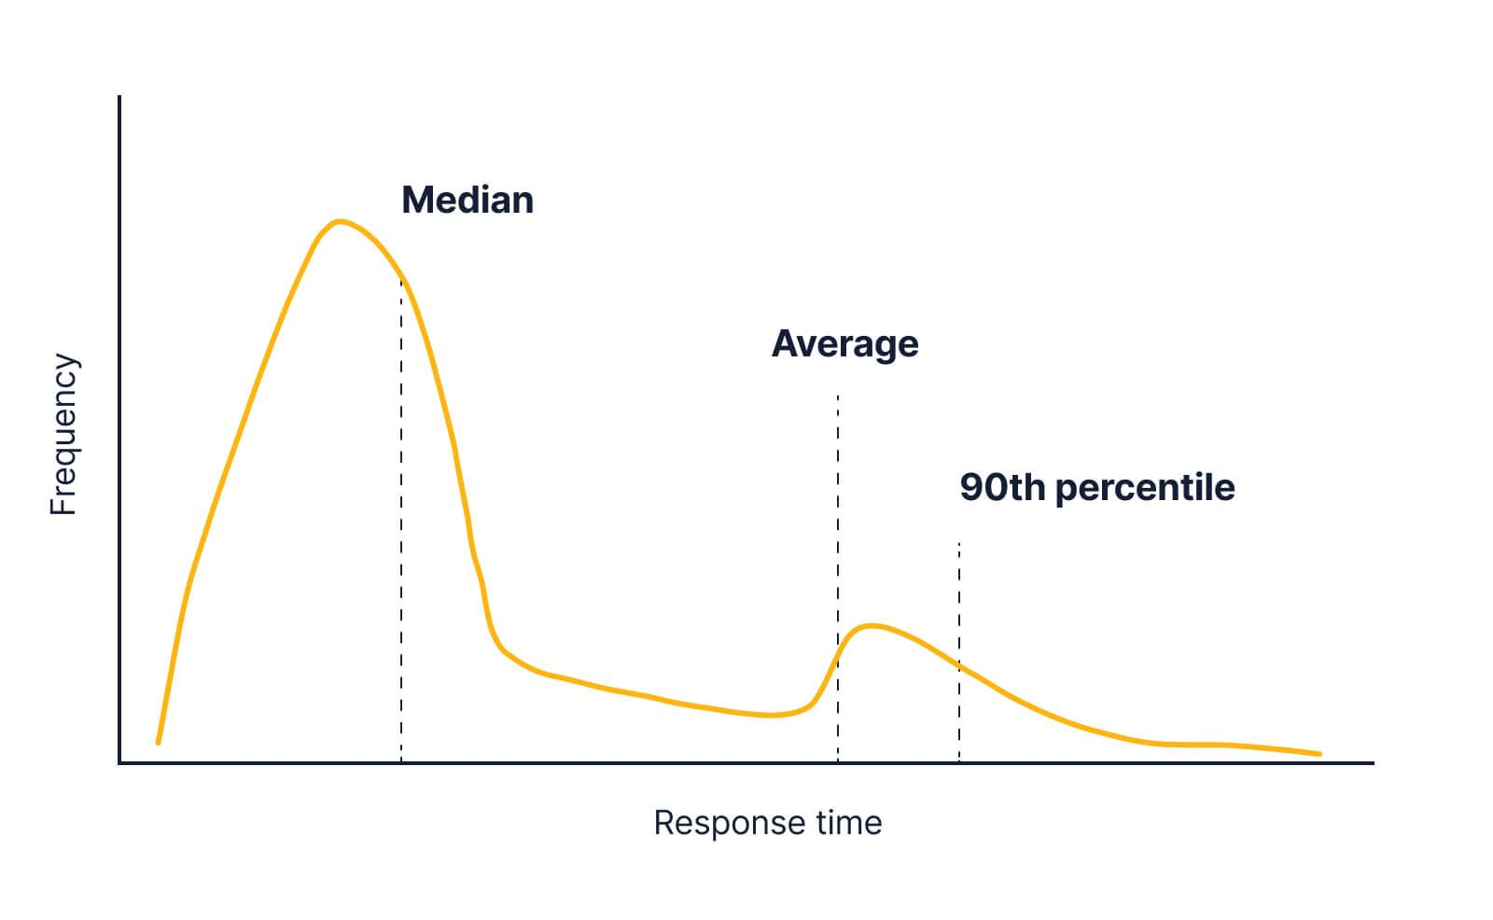
Nerdy Percentile Usage
This example comes from response times for an online service’s API.
When occasional issues occur, those raise the mean, but not 90th percentile.
i.e. a few people have very long waits.
Mean rises due to value, but it isn’t that many people.
When real bad issues occur, the percentile raises.
A larger number of people have long waits.
Even if the mean doesn’t move much, prob is noticed.
Larger number of items, less extreme difference.

Slide 15
Percentile Lingo
The term percentile can be a bit confusing as it is kind of used in different ways.
Percentile rank:
Given this actual value, what percentage are lower. (Look up Y).
E.g. I got 87% on the exam and my percentile rank is 92% (better than 92% of others).
Percentile:
Given this percentile rank, what is the value at that point. (Look up X).
E.g. the 92nd percentile is at 87% score on the exam. (The value above 92% of others).
”I’m in the 92nd percentile” is more obvious as “my percentile rank is 92”

Slide 16
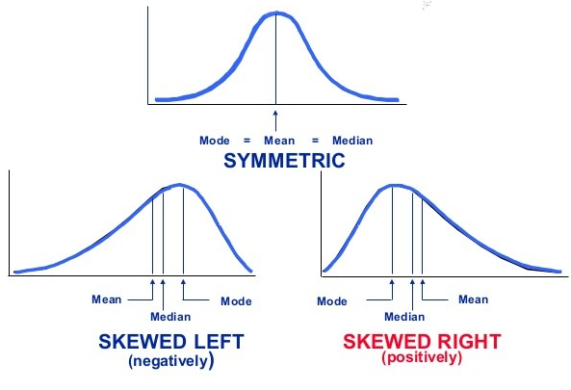
Median
The median is one special percentile – the value in the middle.
Often represents the center of data better than mean.
Especially in cases of odd distribution patterns – outliers, skew, etc…
In analysis we may sometimes take the median in place of mean.
In normal data, mean and median (and mode) are the same.

Slide 17
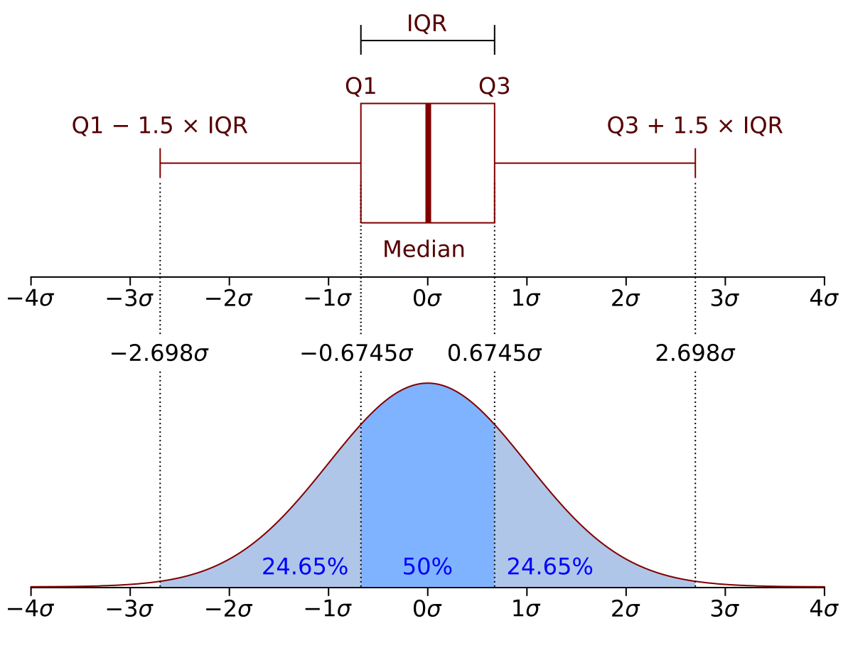
IQR and Ranges
Can also use percentile for IQR – interquartile range.
Common in stats to get an idea of “the typical value”.
E.g. the IQR of income kind of mirrors the ”middle class”.
There’s other ranges, but the idea is the same.
E.g. middle 3 of 5 quintiles.
Can also help with automated outlier ident./filter.
N multiple of IQR as a cutoff.
Smart filtering based on the actual data.
What if the data is not normal…

Slide 18
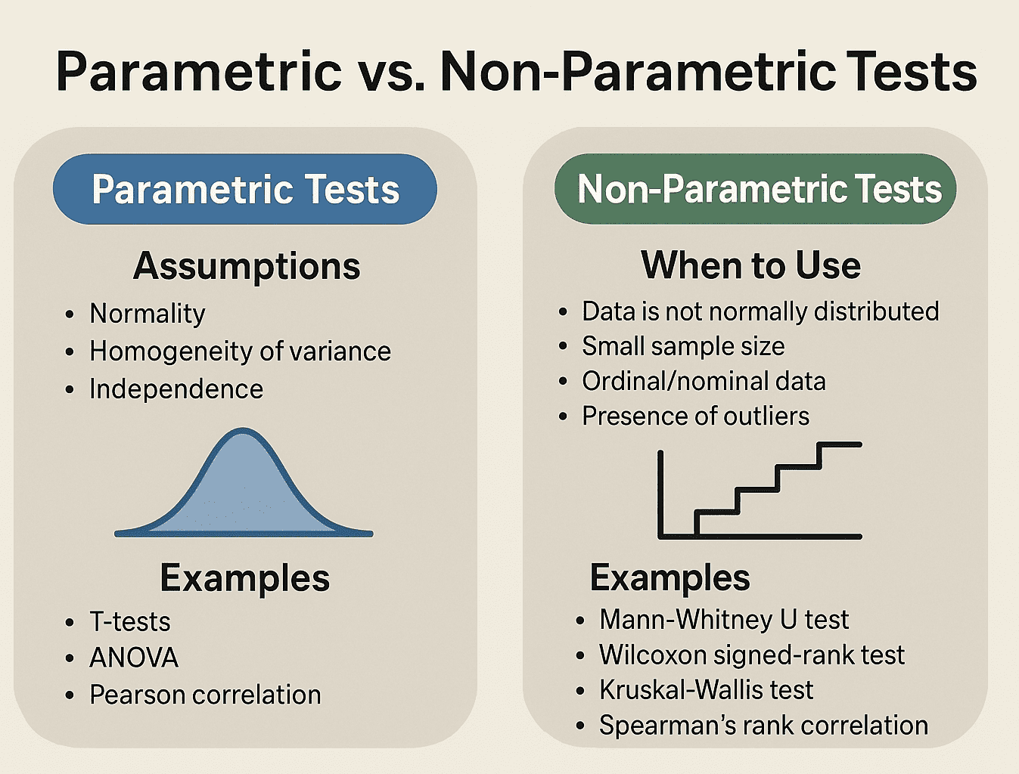
Side Note - Parametric
In stats we often use the term parametric, often with tests – z, t, etc…
Means that there are some assumptions about the population data.
In most cases that means we use things that assume data is normal.
E.g. normality gives us the distribution of values by standard deviation.
Hypothesis testing, effect size, etc… are all parametric.
The assumptions allow for more powerful/insightful methods than non-parametric.
We can base rules off of those assumptions.
Will still work with ‘bad’ data, but results get less reliable.

Slide 19
For later - Distributions and Probability
When we count data we can create an empirical distribution.
Once we have a distribution, we can also think of its relationship with random data.
If we generate a random value following a distribution pattern, what do we get?
Capture data, establish distribution, use to project/simulate/predict…

Slide 20
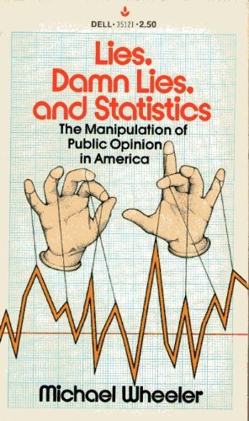
Conclusion
Histograms, pmf, pdf, mean, all look at raw data values row by row.
How many things do I have/expect at each value.
CDF, percentiles, and median look at ordering/rank within a group.
Of the things I have, where each this positioned.
Tend to be outlier resistant.
Each presents a different interpretation of the same data.
Depending on what we need, either may be useful – context dependent.
When looking at large amounts of data, the interpretation chosen matters.
“Incomes are up”, but what actually is…

Slide 21
Bonus – Arrays!
For this workbook we’ll look at arrays.
You’ll do this in more detail in the programming class, but these are common.
An array is roughly a fixed length/type list – one type, set length.
We can refer to a position via an index in square bracket – e.g. my_list[7]
No ‘appending’, every item goes to a preexisting spot.
Pandas specific functions don’t apply - .info(), .mean(), etc… are ‘part of’ pandas.
Otherwise, they are mostly interchangeable.
We’ll use arrays here to get some exposure – we commonly mix container types.
Many/most functions we use implement ‘duck typing’ and can be used interchangeably.
You can always convert if confused – make it work, then make it elegant.

Slide 22
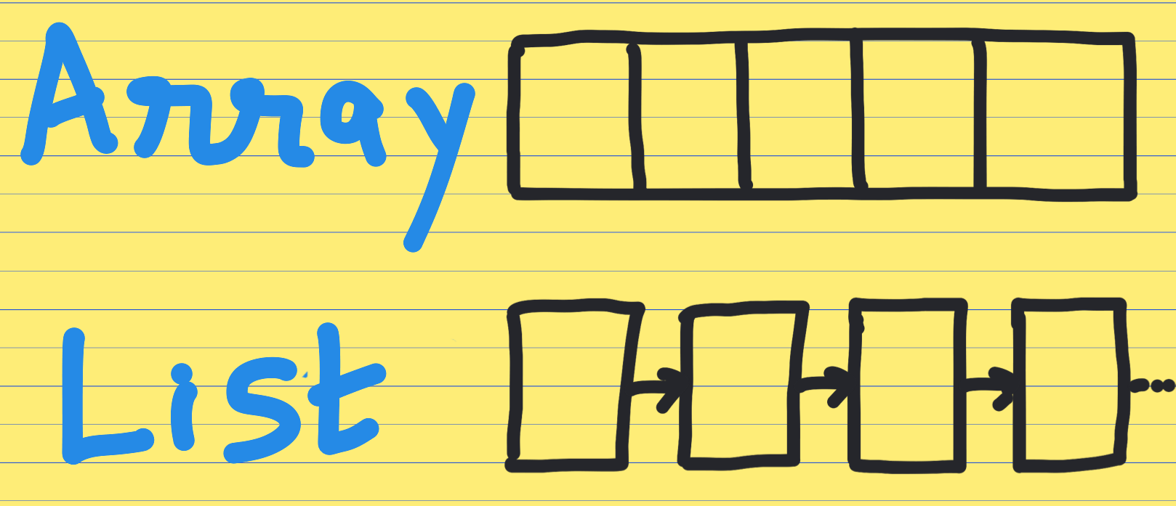
What’s an Array?
An array is one of the OG data structures of modern computing.
The array represents a physical slice of memory that size.
This is why the size can’t change; it also makes it fast to access and go through.
Resizable containers are relatively new – they are an abstraction of the physical memory.
Arrays are commonly used now when we need speed, not flexibility.
If we have a fixed size set of data, doing stuff to it as an array will be faster and mem efficient.
Algorithms commonly require or convert data to an array before processing. (NN)
We typically need to convert data to an array, and commonly interact with arrays.
Python makes this a minor concern to us – thank someone for that.
Main concern is the constraints – arrays have more rules and less flexibility than most.
In most places we can pass array data interchangeably with list, series, etc…

