Slide 1
Housekeeping
Today:
Analytical distributions – normal and lognormal, using analytical distributions.
Some long-ish exercises in there.
Normal testing and plots.

Slide 2
Using Analytical #1

Slide 3
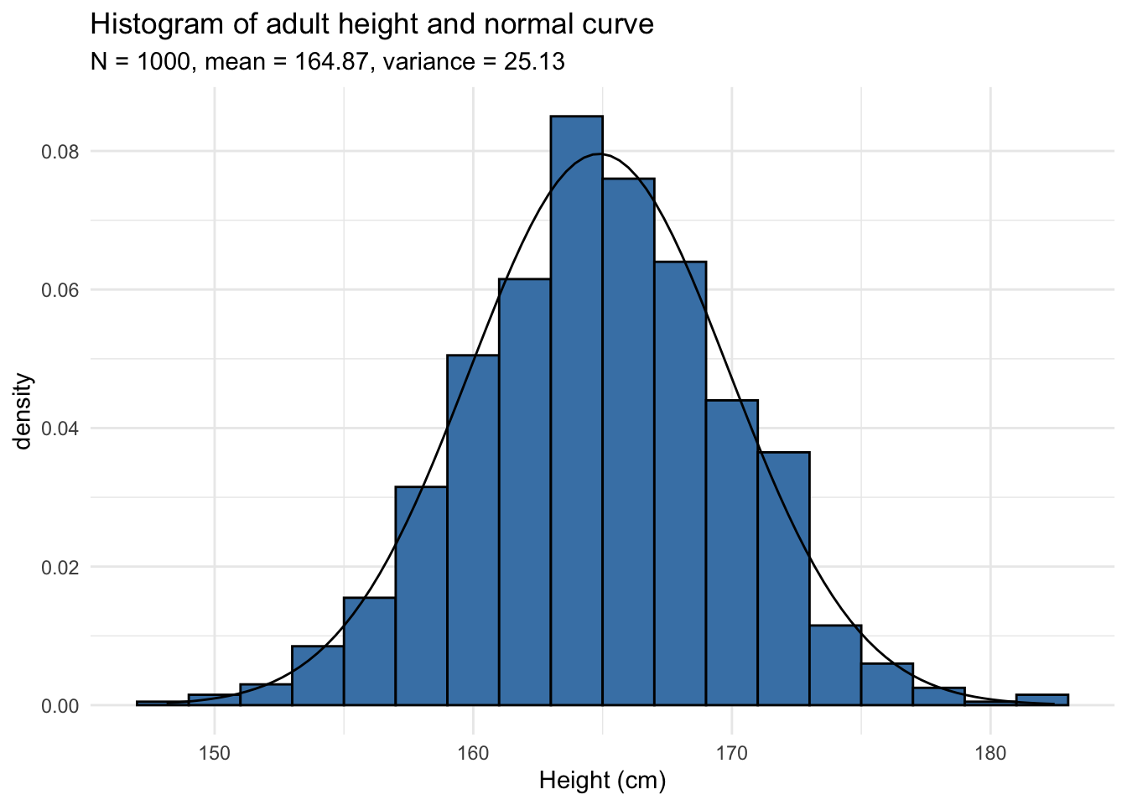
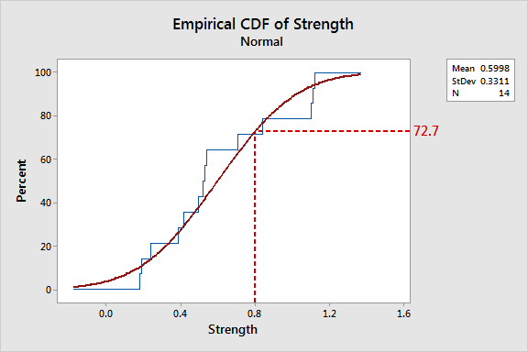
Are you Normal?
We can generally identify matching distribution patterns visually with either:
Histogram, pmf, pdf
Cdf
Match the shape!

Slide 4
Calculating Normality
Normal data is the most common and we have lots of tools for dealing with it.
Including make-normal transformations to make data normal.
There are other methods of evaluating “is this normal”.
Alternate graphs.
Calculations.

Slide 5
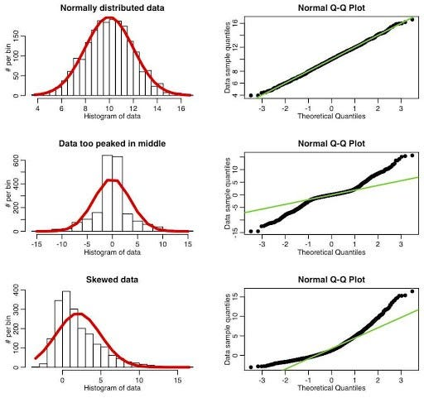
Normality Plot
The normal plot compares data to expected normal distribution.
The line is a generated dataset with same mean, std, and count as data. Sorted.
Dots are our data. Sorted.
Each point is the n^{th} point in a series:
X = theoretical value.
Y = actual value.
Chart shows discrepancies.
Above line – values higher than exp.
Below line – values lower than exp.

Slide 6
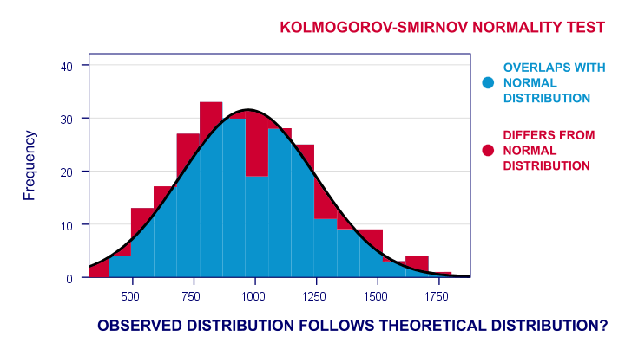
Normality Testing
We can also do a mathematical test for normality.
Version of a hypothesis test (that we’ll do later).
Can we reject the null hypothesis – the data is normal.
If our p value (confidence) is less than .05 (generally), reject it.
I.e. Data is not normal.
What are the odds the differences are due to randomness?
This isn’t better, but it is automatable.

Slide 7
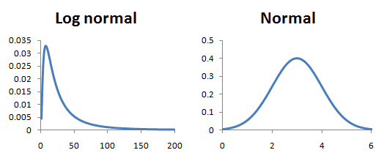
Adaptation and Transformations
This is the same concept as comparing exponential data to a line on log scale.
The line is the expectation.
The dots are data.
We can use the normal version on data that can become normal.
Most common lognormal to normal.

Slide 8
Key concepts
We can match empirical to analytical with charts and/or calculations.
Once the analytical is established, we know the expected shape of population data.
We can calculate the mean and std (or other values) that define the shape.
We are making an assertion, with error – this distribution models this data well enough.
Well enough varies, depending on application.
More representative and larger samples mean less error introduced.
In practice, in code, the analytical distribution is a source of new values.
We can generate samples that match the distribution.
We can use these to test or generalize.

