Slide 1
Review and Today
Remember from last time:
Load data from a csv file into a dataframe.
Run functions “on” that dataframe variable (head, tail, info, describe, …).
Slice columns out of dataframe.
Examine those variables for type (num. v. cat) and basic stats like location and dispersion.
Today:
Samples and populations.
Segmenting data into groups.
More dataframe manipulation and basic python.
Distributions and thinkstats/thinkplot packages.
Textbook references.

Slide 2
You’re supposed to have a quiz soon!
There’s a quiz in a week!
This will be on stuff from the first 4 chapters.
Data, single variable stats, distributions, histograms, effects, pmf, cdf.
There won’t be code tests, but you may want to use code to do some calculations.
It’ll be the final hour, we’ll cover some stuff, then start at 12:45
This isn’t really a hard exam, you’ll be good if you:
Understand the major concepts and what they are for.
Can do the main things in code – load some data, calculate a value, split data, etc…

Slide 3
Distributions

Slide 4
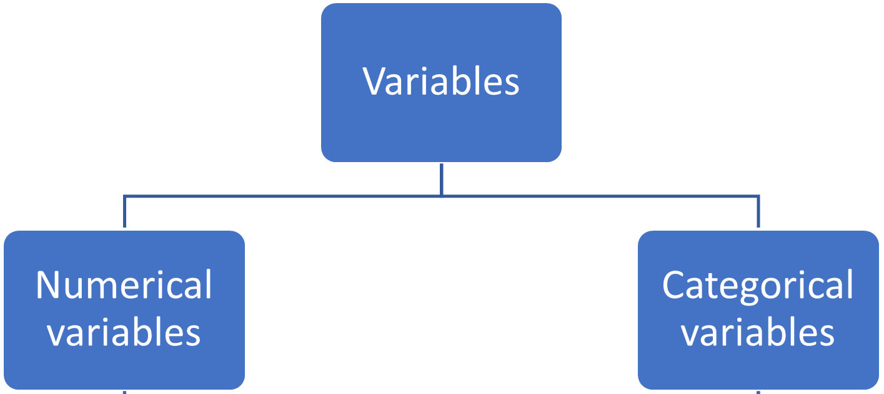
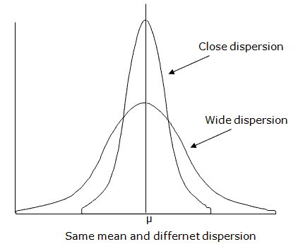
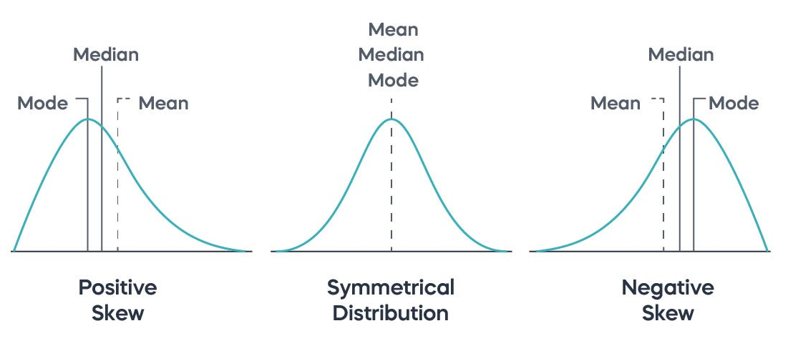
Recall

Slide 5
So Much Data!
Our datasets are normally very large.
Too big to deal with individual records.
Especially large when we move into ML (potentially millions of records).
We understand our data by examining its distribution, rather than the specifics.
Lots of data falls into patterns, and we can use that to more easily understand it.

Slide 6
Populations and Samples
In general, we don’t have all the data, we only have some subset.
E.g. a political poll takes several thousand (or less) responses to estimate an election.
With corporate data it is more likely to have population, e.g. all sales, all products…
Population:
All the data that exists on whatever we are looking at.
Relative to the question asked – e.g. data on college student means the pop is all students, not all humans.
Sample:
The data we have.
Some (maybe very small) fraction of the population.
We want samples that are representative – they mirror the population. More here when we do errors.

Slide 7
What’s a Distribution?
The distribution is a count of:
Which values are in the dataset.
How many times each value occurs.
This is known as the Empirical Distribution – based on the actual data. (More later).
Distribution is normally best illustrated visually:
Histograms.
Density plots.
Can think of the distribution as the ‘shape’ of our data.

Slide 8
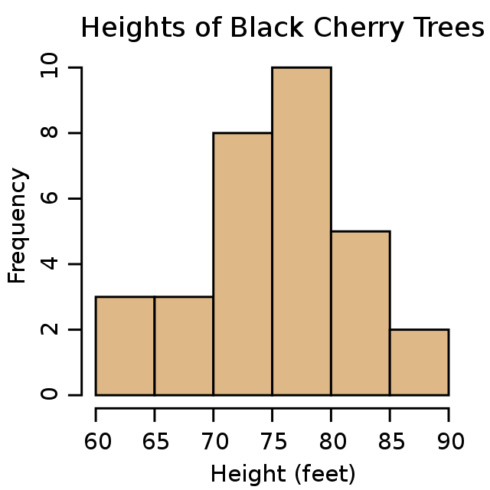
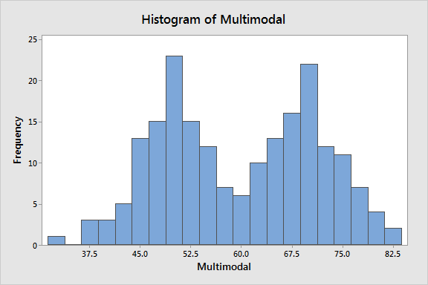
Histograms

Slide 9
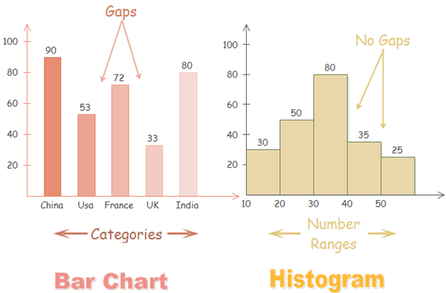
So… A Bar Graph?

Slide 10
Histogram Keys
The size of the bars, or the width of the bins* is flexible:
Choose to illustrate the pattern in the data.
The Y axis is always a count of how many times something occurs.
The X axis is some numerical value – break the range into parts to generate the graph.
This is called binning.
E.g. translation of a percentage grade into a letter grade.
We can visually identify, and generally want to remove outliers.

Slide 11
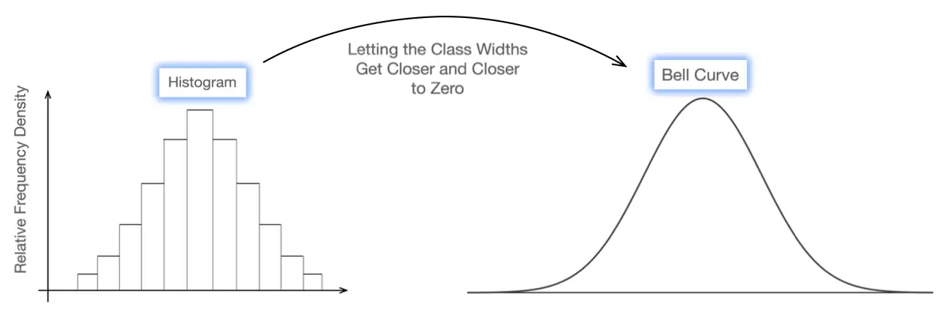
Density Plots
Density plots are effectively a “continuous line” version of a histogram.
Can visualize it as if the bins of a histogram got infinitely small – limit as width -> 0.
Still counts how likely something is to occur.
Y axis is the density, or the percentage of values that have that value.
Useful even when we don’t have the ability to count all the data (more on this later).
Provides a smoothed estimation of the exact counts found in a histogram.
While a histogram is based on sums, a density plot is can be approximated by calculus.

Slide 12
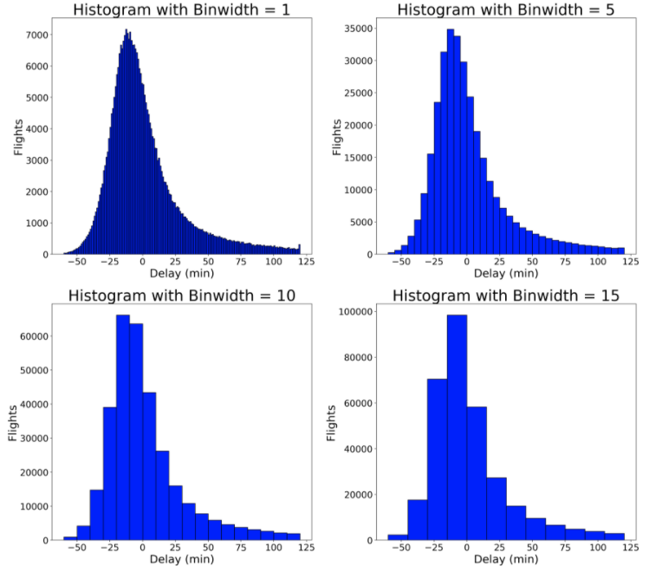

Slide 13
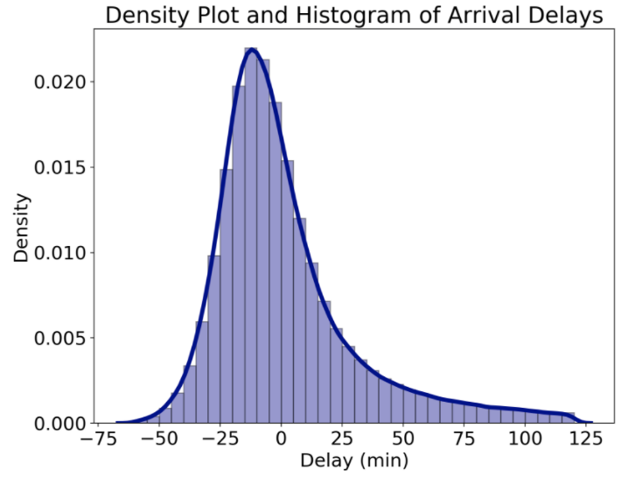
Density Plot on A Histogram

Slide 14
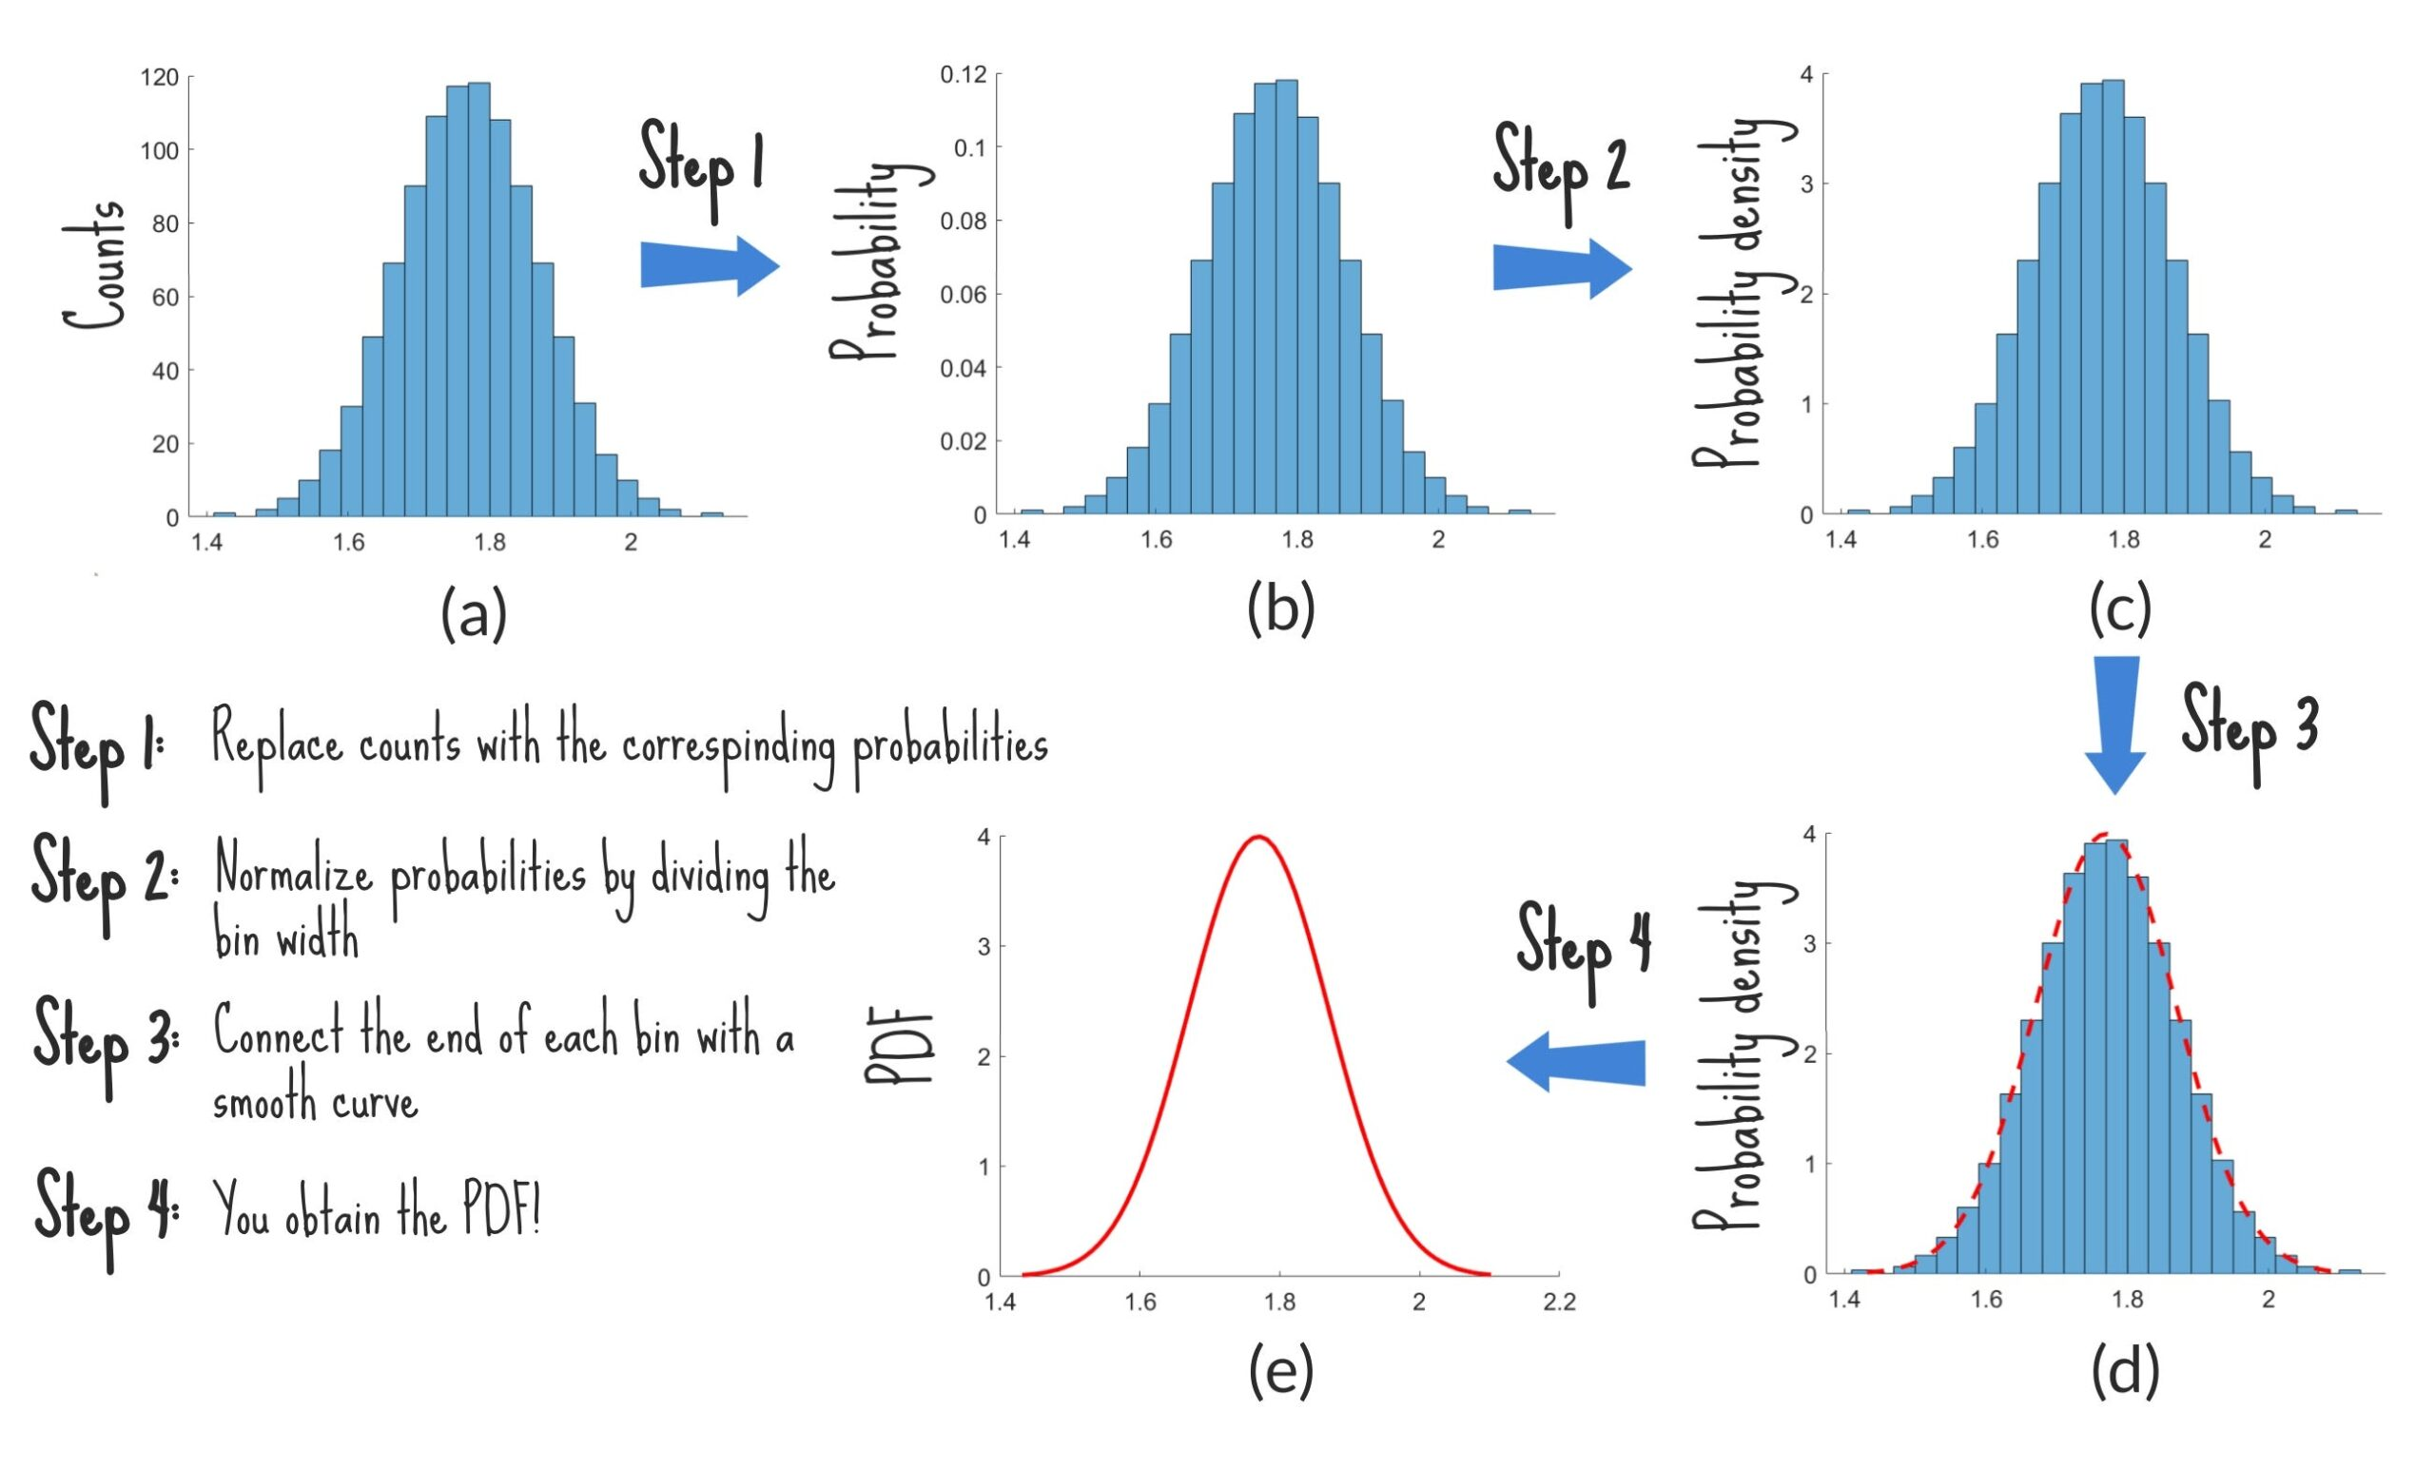

Slide 15
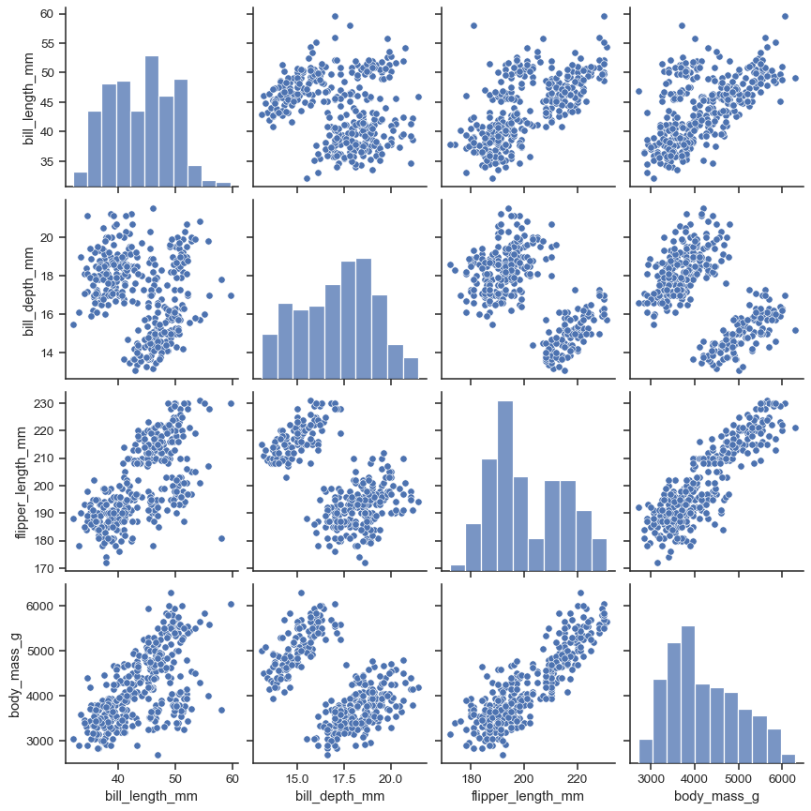
Distributions in tableau
We can make histograms from either thinkplot or seaborn.
Or any other plotting libraries.
If looking at a full dataset, seaborn also offers a pairplot:
All distributions.
All pairs of scatter plots.
This is what I usually use.

Slide 16
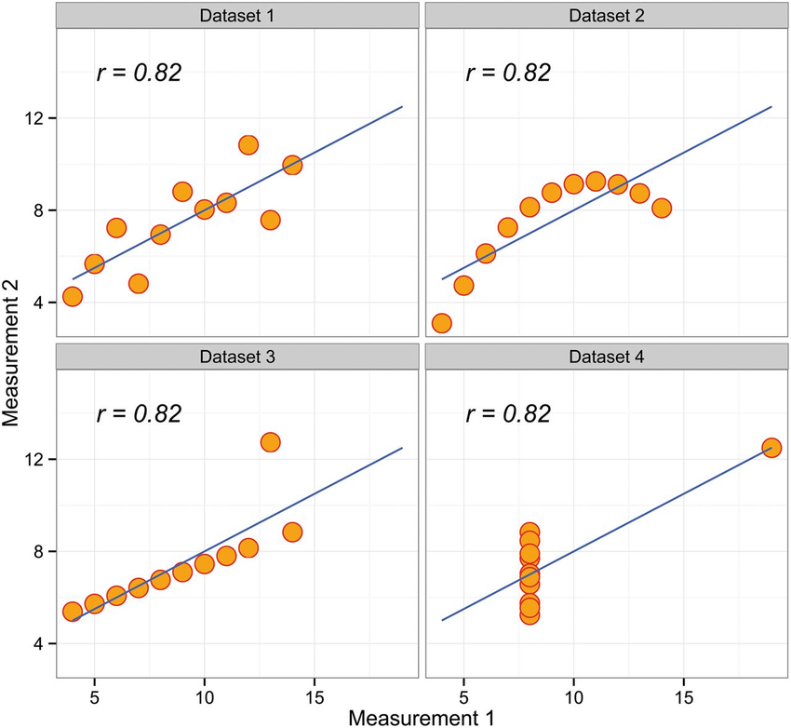
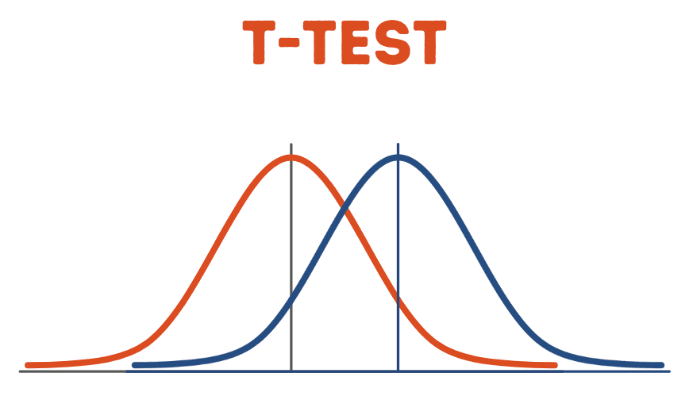
Applying Distributions - Comparisons
Histograms and especially density plots help us see differences between groups.
Why the “especially” there?
We can compare on a more advanced level than comparing means or medians:
See if the two groups are the same shape (distribution).
See if one is more “spread” than the other.
Are there tails that make the averages look more similar?
These all have identical mean, std dev, variance…

Slide 17
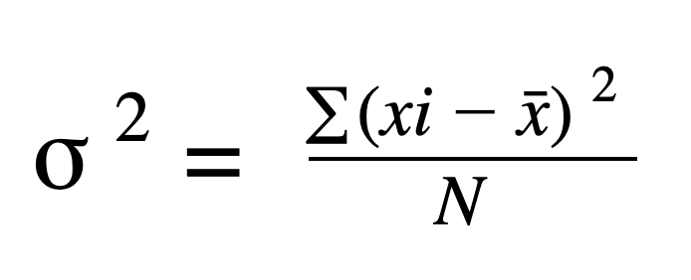
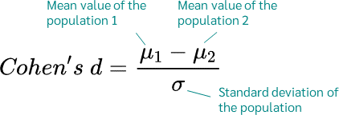
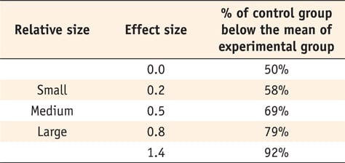
Effect Size
If we compare two groups of data (e.g. income male vs female, life exp. control vs treatment) how do we do it?
Just mean or median doesn’t tell the whole story.
Effect size measures if there’s a difference in groups.
Comparison that encompasses size and dispersion.
Measures ‘how different’ are these two samples.
Roughly – given the variation from item to item is the difference from group to group noticeable?

Slide 18

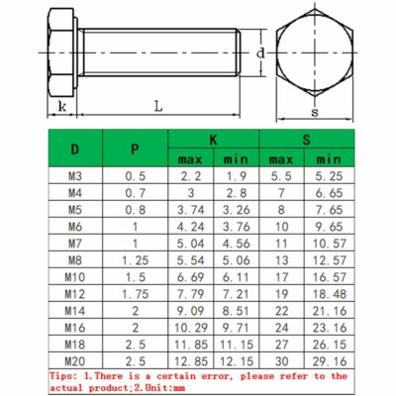
Steak to Nuts
Think of two groups that have different amounts of variance.
Steaks are cut by hand to be a certain thickness, but there’s some variation. (High variance)
Bolts made in a factory are spec’d to be a certain size +/- some very small amount. (Low variance)
If we compared two groups of steaks and noticed that one was slightly larger than another, that may be due to natural variance in cutting – there’s likely no real difference in the two groups. If there was a similar difference in the size of two sets of bolts, that’d indicate they are different types/sizes as bolts barely differ normally – diff size groups is weird.
If there’s high variance many items could be in either group, if low variance each item ‘belongs’ in one.

Slide 19
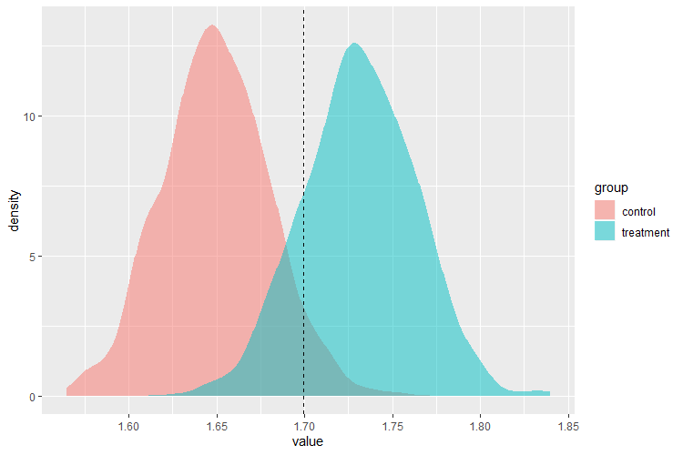
Effect Size Visualized
The effect size shows how much one group is shifted from another.
E.g. # life expectancy post treatment.
Ctrl averages about 1.65 additional years (normalized).
Treatment averages about 1.7.
The effect size is large – almost all of the treated people are better than the average control.
The larger this gap, the more different the groups.
Effect isn’t just dependent on means.

Slide 20
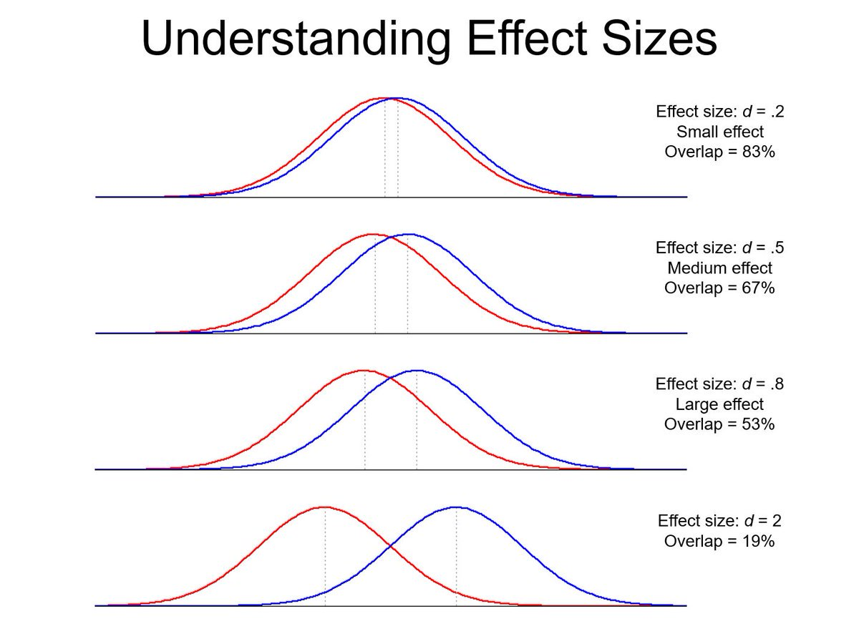

Slide 21
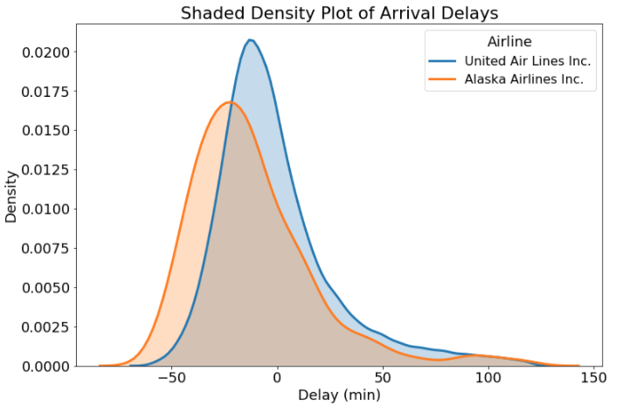
Comparisons on a Density Plot

Slide 22
Analyzing Distribution Patterns
The shape of our empirical distribution could be anything.
Some patterns in distributions tend to occur frequently.
Many/most pieces of data will follow some preexisting pattern:
Many natural things are normally distributed (bell curve).
The larger our sample is, the more we can expect it to fit a distribution pattern.
The density plot is easier to match to a distribution – the smoothing deals with randomness.

Slide 23
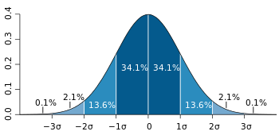
Normal Distribution

Slide 24
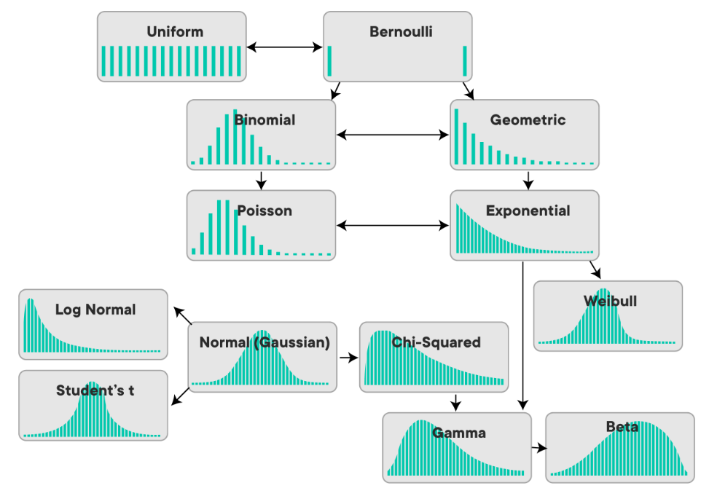

Slide 25
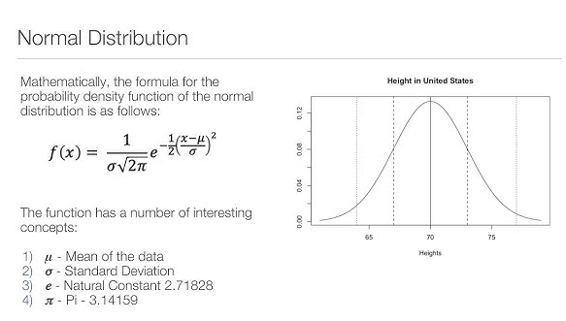
Preview - Analytical Distributions
Analytical distributions define the shape of a distribution mathematically.
I.e. the probability of having an item of value X is a calculation not a count.
Don’t rely on a particular set of data.
Exact shape is determined by parameters.
E.g. mean and standard deviation.
We can ‘match’ our empirical data to a similar analytical distribution.
We can then use the properties of that distribution on our data.

Slide 26
Distribution Benefits
Why match empirical data to an analytical pattern?
We have fast computers, we can crunch the numbers on empirical data and draw pretty charts easily.
Can make use of samples to draw population conclusions.
Political polling, census data, surveys, etc…
Tools/techniques/rules have been developed for analytical distributions in general.
We benefit if we have data from one of those distributions.
E.g. z-scores – how many results do we expect at certain values if we have normal data. Just need mean and std.

Slide 27
Example – Generalizing from Sample
Goal – “How many NAIT students are <5’5” or >6’5””?
Process:
Take a sample of N students, measure them. Calculate mean and std.
We ”know” height is normally distributed. (This is the logical leap).
Generate a normal distribution matching mean and std from sample.
Use standard normal distribution stuff (e.g. z-scores) to answer question.
We are able to take a small subset of know heights, generalize that to the population, and then perform analysis on that generalization.
What may hurt or improve the reliability of this analysis.
If you see a Stats Canada estimate from census data, it is likely done like this.

Slide 28
Conclusions
Understanding distributions is useful in several ways.
We can better communicate about data if we need to.
We can do data exploration before ML stuff more easily.
We can leverage expectations to generalize.
Analytical distributions allow us to take smaller samples and make reliable predictions.
We will spend more time working with generalizing and inferring later.
We want to start thinking about the distribution patterns early.

