Slide 1
Steganography
Stewart Edgeworth
B00091803
School of Informatics Department of Information and Engineering Institute of Technology, Blanchardstown Dublin 15

Slide 2

Introduction To Steganography
Introduction
What is Steganography
Types of Steganography
Image Steganography
LSB
Steganography Coding
RGB
Encoding and Decoding
Hiding Data
Retrieving Data
Main Method

Slide 3
What is Steganography
Steganography is an art that’s been around since 440B.C
The process of hiding a secret message within a larger one
The purpose is to maintain secret communication between two parties

Slide 4
Types of Steganography
Images Steganography
Textual Steganography
Audio Steganography
Network Steganography
Video Steganography

Slide 5
Image Steganography
Digital images are made up of pixels
The arrangement of the pixels make an Image
8-bit and 24-bit images are common
The larger the image size the more information you can hide

Slide 6
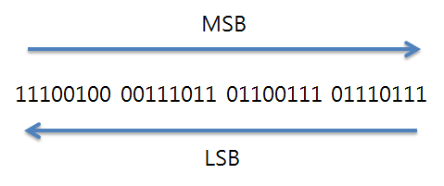
Least Significant Bit (LSB)
The most common and popular method

Slide 7
Least Significant Bit
The most common method of Steganography is LSB of pictures.
The Technique works best when the image file is larger then the message file .

Slide 8
Steganography coding
Open an image and look at its pixels in hexadecimal
If the blue falls in the range of 0-5
1 bit of information can be stored
The end stream of the delimiter is fifteen 1’s and a 0
To manipulate the data several functions are used
Encode, decode, hide and retrieve

Slide 9
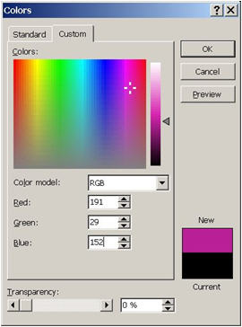
RGB
RED
GREEN
BLUE

Slide 10
RGB
Each colour values vary 0-255
RED 191 (hex BF)
GREEN 29 (hex 1D)
BLUE 152 (hex 98)

Slide 11
Encoding and Decoding
We take a String
Convert it to Binary
We take the Binary
And add it to the hexadecimal of the image
Decoding is done in reverse
Hex-binary-String

Slide 12
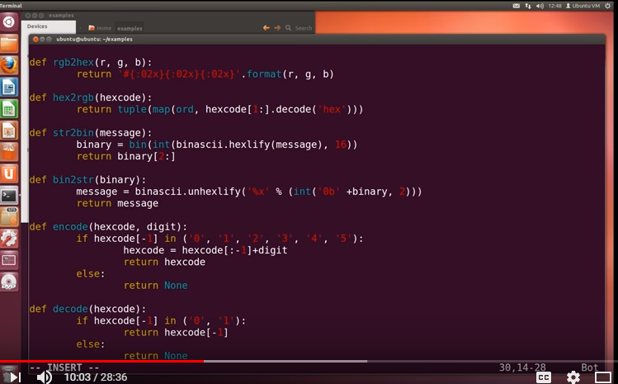
Encoding and Decoding

Slide 13
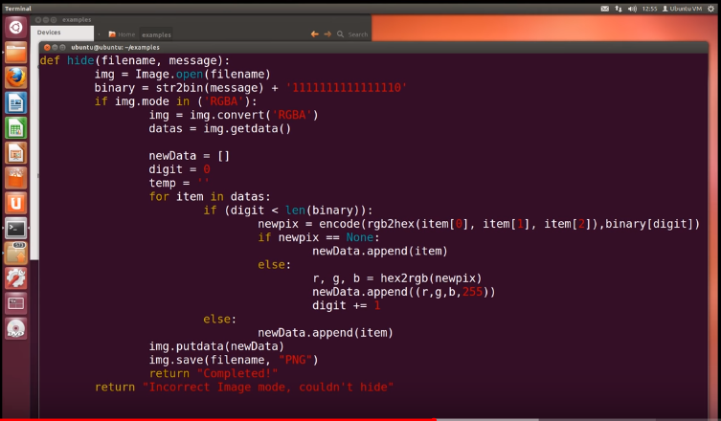
Hiding Data

Slide 14
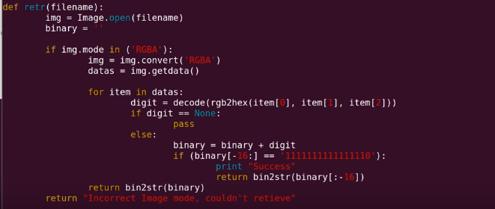
Retrieving Data

Slide 15
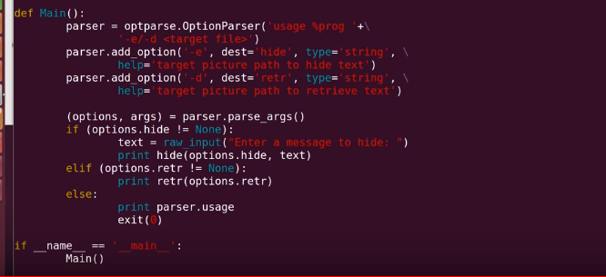
Main Method

Slide 16

Thank you for listening

