Slide 1
PHASE 2 · NODE RANKER & BEYOND
Phase 2 — First Review
AI-Assisted 3D Assembly Design
Presented by: Parthasarathy Perumal · SRN PES2PGE24DS193
Guide: Prof. Gaurav Siwal (Phase 2)
MTECH — Data Science & AI, PES University Bengaluru
25 July 2026

Slide 2
AGENDA
What we'll cover today
Foundation
Phase 2 &amp; beyond
Phase 1 review summary
Novelty proposal
Title &amp; abstract
Proposed system (Phase 2) and algorithms/techniques
Training history — R29 / R30 / R31
Guidance follow-up: cloud compute cost research (INR) &amp; scope decision
Guidance follow-up: 3D generative completion (Path A / Path B, Phase 3 scope)
Expected outcomes &amp; references

Slide 3
1 · RECAP
Phase 1 review summary COMPLETE
What was built
Where Phase 1 ended
STEP file → gmsh + OpenCASCADE + trimesh/SDF → 22-dim node / 6-dim edge assembly graph
3-layer GAT encoder (
AssemblyGNN) + LinkPredictor MLP for missing-component (link prediction) detection
5-fold cross-validated training, early stopping, checkpoint promotion gating
AssemblyTemplateDB — per-category component-type frequency templates
Octree open-surface detector — flags likely locations of missing parts on the 3D model
AIDA (Gemini Skills AI) — explains predictions in engineering language
Streamlit dual-panel UI + FastAPI backend, both deployed and running
Metric | Value
Best historical mean AUC-ROC | R17 — 0.625 ± 0.017 (1,760 graphs)
Serving model at Phase 1 close | R28 — 0.546 ± 0.025 AUC, 0.712 ± 0.014 AP
Targets | AUC ≥ 0.85, AP ≥ 0.82 — AP met on several runs, AUC not yet met
This is the honest baseline Phase 2 inherits and builds on top of.

Slide 4
2 · NOVELTY
Novelty proposal
Phase 1 novelty (established)
Phase 2 novelty (this review)
Geometry-driven, affine-invariant node features (elongation, flatness, sphericity, SDF mean/var, SA/V, hole count) — not just bounding-box statistics
Octree-based free-surface clustering to localize
where a component is missing, not just that one is missing
Natural-language explanation layer (AIDA) grounded in GNN output, not a generic LLM wrapper
Heterogeneous relational encoder
(RGATConv + TypedLinear) — separate parameter sets per component type and per joint/mate relation, derived from existing feature schema with zero data-pipeline migration
Node Ranker — reframes “what's missing” as “what type of component is most likely next,” via a frozen-encoder + BPR-ranked prototype head — cheap to train, decoupled from Phase 1 retraining cost
Proposed extension (Prof. Gaurav Siwal): move from predicting a missing component's type/location to actually synthesizing its 3D geometry — discussed later as Phase 3 scope

Slide 5

3 · TITLE & ABSTRACT
Title &amp; abstract
AI-Assisted 3D Assembly Design: Graph Neural Networks for Missing-Component Detection and Next-Component Ranking in CAD Assemblies
This project models CAD assemblies as graphs — components as nodes, mates/joints as edges — and applies Graph Attention Networks to reason about assembly structure. Phase 1 addressed missing-component detection via link prediction over STEP-derived geometry features, supported by a template-based frequency prior and an Octree-based open-surface localizer, and delivered through a Gemini-backed explanation agent and a Streamlit/FastAPI application. Phase 2 extends the encoder to a heterogeneous, relation-aware architecture (RGATConv + TypedLinear) that gives each component type and joint type its own parameters, and introduces a Node Ranker head that answers a forward-looking question — given a partial assembly, which component type is most likely to complete it next — evaluated via Hit@K, MRR, and NDCG@K. The work is evaluated on real-world STEP assemblies spanning multiple mechanical-engineering categories, with an explicit, honestly-reported target of AUC ≥ 0.85 for link prediction that remains an open research problem addressed through architecture and data-scale experiments (R29–R31) discussed in this review.
The problem this abstract describes, in practice — a GNN-flagged missing wheel component on a bicycle assembly

Slide 6
4 · PROPOSED SYSTEM
Proposed system — Phase 2
STEP assembly
→
22-dim node / 6-dim edge graph
(dataset.py, unchanged)
→
Heterogeneous encoder
RGATConv + TypedLinear
→
LinkPredictor
missing-component detection
↓
Node Ranker
cosine sim + BPR
→
Ranked next-component type
Hit@K / MRR / NDCG@K
Design principle carried through Phase 2
Node Ranker reuses the Phase 1/2 encoder
frozen — only its own small projection layer is trained, so encoder retraining (R29 → R30 → R31) and ranker retraining stay independent, cheap, and clearly attributable
Both heads write to separate checkpoints (best_serving.pt vs node_ranker.pt) with an explicit staleness guard tying the ranker to the encoder it was trained against

Slide 7
5 · ALGORITHM / TECHNIQUES
Algorithm &amp; techniques
Heterogeneous encoder
Node Ranker
Training infra
Node type =
argmax of the existing 8-way component one-hot
Edge type = argmax of the existing 4-way joint one-hot (rigid/revolute/slider/cylindrical)
TypedLinear: per-type input/output projection (8 small Linear layers)
RGATConv × 3 layers, replacing homogeneous GATConv — every layer now relation-aware, not just layer 1
Leave-one-node-out training task: remove a real node, encode the remainder, mean-pool → context vector
Candidates: 8 fixed component-type prototypes (mean raw feature vector per type, embedded frozen)
Loss: BPR (Bayesian Personalized Ranking) — true type ranked above the other 7
Metrics: Hit@K, MRR, NDCG@K
5-fold CV, early stopping (patience 20),
ReduceLROnPlateau
Category-weighted loss (CATEGORY_WEIGHTS) to offset per-category yield imbalance
Checkpoint promotion gate: new run only replaces best_serving.pt if it beats the incumbent on both AUC and AP
train_monitor.sh: stall-detection + auto-resume watchdog for long unattended runs

Slide 8
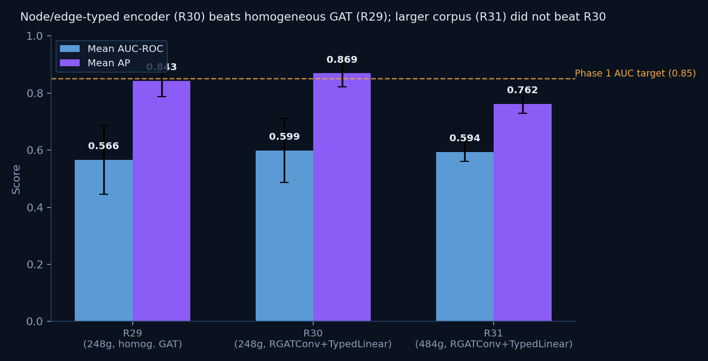
5 · ALGORITHM / TECHNIQUES — TRAINING HISTORY
Training history — R29 / R30 / R31
Run | Change | Mean AUC | Mean AP | Promoted?
R29 | New 8-category real-world corpus, 248 graphs, homogeneous GAT | 0.566 ± 0.121 | 0.843 ± 0.055 | Yes
R30 | Heterogeneous RGATConv + TypedLinear encoder, same corpus | 0.599 ± 0.112 | 0.869 ± 0.047 | Yes — current serving
R31 | Corpus expanded to 484 graphs (2 new categories); OOM/stall infra bugs found & fixed mid-run | 0.594 ± 0.034 | 0.762 ± 0.032 | No — gate correctly declined

Slide 9
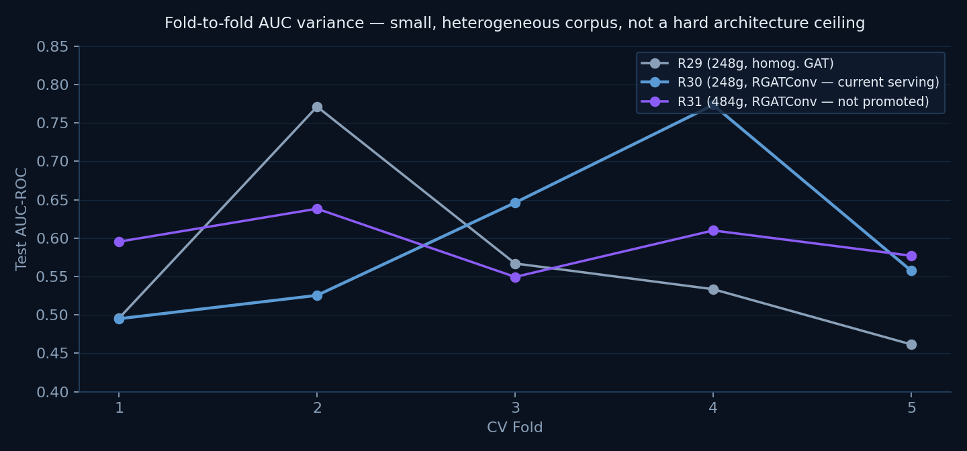
5 · ALGORITHM / TECHNIQUES — TRAINING HISTORY
Fold-level variance &amp; what R31 taught us
Data-scale lever did not pay off (yet)
R31 nearly doubled the corpus (248 → 484 graphs) but scored essentially flat on AUC and
worse on AP than R30 — more data alone, without addressing per-category quality/yield, isn't sufficient
Along the way, found and fixed two real infra bugs: MPS OOM at batch_size=32 on the larger/denser corpus (fixed → 16), and a training-loop stall-detector false-positive (fixed via heartbeat logging)
Promotion gate did its job — best_serving.pt stayed on R30, no regression shipped
Architecture lever confirmed real
R30's heterogeneous encoder beat R29 on
both AUC (+5.8%) and AP (+3.1%) on the identical corpus — a genuine, isolated architecture win
Best single fold ever seen: 0.773 (R30, fold 4) / 0.771 (R29, fold 2) — the model can reach far higher AUC on favorable splits; the mean is dragged down by small-corpus variance, not a hard ceiling

Slide 10
5 · ALGORITHM / TECHNIQUES — NODE RANKER
Node Ranker — first trained results NEEDS RE-RUN VS. R30
Metric | Result | Note
Hit@1 | 0.6344 | vs. 0.5474 majority-class baseline — real lift
MRR | 0.7594 | clears the report's ≥0.64 target
NDCG@5 | 0.8181 | —
Hit@5 | 0.9981 | near-ceiling — expected with only 8 candidates (random baseline 62.5%)
Open item before trusting this number again
These results were trained against the now-superseded R28/R29 encoder —
node_ranker.pt must be re-run against R30's best_serving.pt (the current heterogeneous encoder) before the metrics above can be reported as current
Wired end-to-end regardless: train_ranker.py, infer.py, FastAPI /predict/next-component, and the Streamlit “AI-Ranked Next Component” panel

Slide 11
GUIDANCE FOLLOW-UP
Suggestion — move training to the cloud (M1 limitations)
Why it came up
What we did
During the first guidance call, the suggestion was raised: if the MacBook M1's unified-memory ceiling is limiting training, evaluate cloud GPU compute as an alternative
Directly motivated by what R31 exposed on this hardware: repeated
MPS backend out of memory crashes (~17 GiB / 20.13 GiB ceiling), individual epochs stretching to 8,073s under memory pressure, and full 5-fold CV runs already taking 11.5–19+ hours wall-clock even when nothing fails
A larger, higher-quality corpus (the next lever toward AUC ≥ 0.85 per the R31 lesson) will only make single-machine M1 runs slower and more fragile, not less
Researched cloud GPU rental providers directly comparable to this workload:
RunPod, Vast.ai, Lambda Labs
Priced both a cheap/spot tier and a reliable on-demand tier, since our own local runs already needed several manual recoveries from stalls/OOM — spot preemption would add a second, independent failure mode on top of that
Projected real cost in INR against the remaining Phase 2 workload — next slide

Slide 12
GUIDANCE FOLLOW-UP — COST RESEARCH
Cloud GPU cost research — INR projection
Tier | Example providers / GPU | $/hr | 5-week total (15+ runs × 24h+ = 360+ hrs) | ≈ INR (@ ₹97/$1, Jul 2026)
Budget / spot | RunPod RTX 4090 on-demand, Vast.ai RTX 4090 spot | $0.35 – $0.75 | $126 – $270 | ₹12,200 – ₹26,200
Reliable on-demand | Lambda Labs A100 80GB ($2.06/hr), H100 SXM ($2.99/hr); RunPod H100 ($2.34/hr) | $2.00 – $3.00 | $720 – $1,080 | ₹69,800 – ₹1,04,800
Reading this honestly
The $2–3/hr tier is the realistic one for this project — spot pricing is cheaper but interruptible, and our own local training history shows this workload already needs babysitting through stalls/OOM without adding preemption risk on top
360 hours is a floor, not a ceiling — it assumes exactly 15 runs at exactly 24h each; several of our actual runs (R29 ~19h, R31 with retries much longer) already sit at or above that per-run estimate
Estimate excludes storage, data egress, and idle-VM billing during setup/data-upload — real spend would run higher in practice
₹70,000 – ₹1,05,000 over just 5 weeks, for an individual MTech project, against $0 marginal cost on already-owned M1 hardware

Slide 13
GUIDANCE FOLLOW-UP — DECISION
Decision — stay within the original Phase 1 scope
“The solution is implemented entirely in Python using PyTorch Geometric, without dependency on proprietary CAD software APIs.” — and the dataset curation for this project was explicitly “sized for M1 MacBook Pro training within individual project submission constraints.”
— README.md, scope established with Prof. Sagarika Borah during Phase 1
Given the cost research above, staying on local M1 training
₹70,000–₹1,05,000 for 5 weeks of cloud compute is disproportionate for an individual, self-funded MTech project — the original scope was deliberately sized to run on personal hardware, not a recurring cloud budget
The real lesson from R29→R30→R31 wasn't “we need more compute” — it was “architecture changes help, raw data volume alone doesn't” — a lever we can keep pulling locally without added spend
Cloud compute stays a documented, costed option — not adopted now, but available if a future phase's scope explicitly requires it

Slide 14
GUIDANCE FOLLOW-UP
Suggestion from Prof. Gaurav Siwal
From prediction to synthesis
During the Phase 2 guidance call, Prof. Siwal raised a natural extension of the current scope: the system today predicts that a component is missing, where it likely belongs, and what type it probably is — but stops short of producing the component itself. The suggestion was to explore whether the project could also generate an actual 3D model of the missing component, not just describe it.
Would close the loop: detect → localize → classify →
generate → (eventually) insert into the assembly
A substantial scope increase — geometry synthesis is a different ML problem class (generative 3D modeling) from the graph classification/ranking done so far
We scoped two candidate technical approaches (Path A / Path B, next slides) and assessed both against the remaining Phase 2 timeline

Slide 15
GUIDANCE FOLLOW-UP — PHASE 3 SCOPE
Path A vs Path B — architecture options
Path A — Retrieval &amp; Parametric Fit
Path B — Generative 3D Synthesis
Node Ranker output
predicted type + context vector
Node Ranker output
predicted type + context vector
↓
↓
Component library retrieval
nearest-neighbor match by type + shape descriptor
Conditional generative model
SDF/voxel VAE or diffusion, conditioned on context vector
↓
↓
Parametric fit
scale/orient to bbox + mate-point regression
Implicit surface → mesh
marching cubes
↓
↓
Fitted STEP/BREP geometry
Novel mesh geometry
Lower risk — reuses existing template DB + real CAD geometry (always valid BREP, no mesh cleanup)
Ceiling capped by library coverage — novel/unusual components won't retrieve well
Can produce genuinely novel shapes, not limited to a fixed library
Higher risk — needs a component-level shape dataset, training compute, and mesh→BREP repair before it's usable in real CAD; open research problem on its own

Slide 16
GUIDANCE FOLLOW-UP — PHASE 3 SCOPE
High-level timeline if pursued as Phase 3 NOT COMMITTED — ILLUSTRATIVE
Month 1
Literature review + component-level shape dataset curation (both paths)
Month 2
Path A: retrieval + parametric fit prototype
Month 3
Path A: metric re-eval
Path B: generative model — first training pass
Month 4
Path B: mesh→BREP repair + metric re-eval (IoU, Chamfer dist.)
Month 5
Integrate winning/complementary path(s) into Streamlit deployment
Month 6
Final evaluation + report
Path A alone fits within a focused window; Path B realistically needs its own dataset + compute budget. Both together, done properly, span roughly a full additional phase — hence proposed as Phase 3, not squeezed into the remaining Phase 2 window.

Slide 17
RECOMMENDATION
Recommendation for the remaining Phase 2 window
Stay focused on what Phase 2 already committed to
Re-run
train_ranker.py against R30's heterogeneous encoder — current Node Ranker metrics are stale (trained on a superseded encoder)
Keep iterating on encoder retraining (R32+) toward the AUC ≥ 0.85 target — the architecture lever (R29→R30) is proven real; the next lever to try is per-category data quality/yield, not just raw volume (R31's lesson)
Finish the two items already committed in the Phase 1 report but not yet started: heterogeneous edge-type ablation follow-ups and GNNExplainer integration for interpretability
Continue training locally on M1 — cloud GPU compute was costed (≈₹70,000–₹1,05,000 for 5 weeks) and consciously not adopted, staying within the scope defined with Prof. Sagarika Borah in Phase 1
Defer 3D generative completion to Phase 3
Path A / Path B are real, scoped options — but both require dataset work and evaluation infrastructure that would crowd out finishing Node Ranker and the AUC push if started now
Proposing this explicitly rather than silently dropping it, so it's on record as a deliberate sequencing decision, not an oversight

Slide 18
6 · EXPECTED OUTCOMES
Expected outcomes — end of Phase 2
Deliverable | Status / Target
Heterogeneous encoder (RGATConv + TypedLinear) | Done — R30 serving, AUC 0.599 ± 0.112
Node Ranker wired end-to-end (train/infer/API/UI) | Done
Node Ranker re-trained against current (R30) encoder | Pending — next action
Encoder AUC ≥ 0.85 (Phase 1 target, carried forward) | Open — R29→R30→R31 trend informs next lever
Node Ranker Hit@1/MRR/NDCG@5 above baseline, re-verified | To re-confirm after re-training
GNNExplainer interpretability integration | Planned, not started
3D generative component completion (Path A/B) | Phase 3

Slide 19
7 · REFERENCES
References
Core methods
Tooling &amp; data
Veličković et al., “Graph Attention Networks,” ICLR 2018
Schlichtkrull et al., “Modeling Relational Data with Graph Convolutional Networks” (R-GCN), ESWC 2018
Rendle et al., “BPR: Bayesian Personalized Ranking from Implicit Feedback,” UAI 2009
Ying et al., “GNNExplainer: Generating Explanations for Graph Neural Networks,” NeurIPS 2019
Fey &amp; Lenssen, “Fast Graph Representation Learning with PyTorch Geometric,” ICLR-W 2019
Open CASCADE Technology (OCCT) — B-Rep CAD kernel used for STEP parsing
Willis et al., “Fusion 360 Gallery Dataset,” 2021 — reference corpus for assembly-graph structure
Project-internal: Phase 1 report (
Review_files/ParthasarathyPerumal_PES2PGE24DS193_ProjectReport.pdf)

Slide 20
Thank you
Looking forward to your guidance on Phase 2 direction and the Path A/B sequencing decision.

