Slide 1


M.TECH END-SEMESTER EXAMINATION · DATA SCIENCE & AI · AUGUST 2026
AI-Assisted 3D Assembly Design
Detecting, Ranking & Generating 3D Shape of Missing Components in CAD Assemblies with Graph Neural Networks
STUDENT
Parthasarathy Perumal
SRN PES2PGE24DS193
GUIDE — PHASE 1
Prof. Sagarika Borah
GUIDE — PHASE 2
Prof. Gaurav Siwal
UNIVERSITY
PES University, Electronic City, Bengaluru
TITLE
01 / 20
Notes:
Hero image: an AI assistant projecting a holographic scan of a robot with a missing limb (decorative).

Slide 2

AGENDA
What We’ll Cover Today
Problem Statement & Research Gap
System Architecture & Novel Contributions
01
02
Project Timeline & Review Milestones
Complete Training History — R1 to R39 (4 eras)
03
04
Latest Full-Corpus End-to-End Results
Engineering Challenges Overcome
05
06
Live Demo — real STEP file, right now
Conclusion, Limitations & Future Work
07
08
AGENDA
02 / 20

Slide 3

MOTIVATION
The Problem
Modern CAD tools — SolidWorks, CATIA, Fusion 360 — offer no contextual intelligence during assembly creation. Engineers rely entirely on domain knowledge to choose and position every component.
Knowledge Barrier
Junior engineers lack the assembly patterns built over years of hands-on experience.
No Automation
Existing CAD tools offer no intelligent part suggestion during assembly creation.
Non-Standardisation
Different designers make inconsistent choices for equivalent subassemblies.
Incomplete Assemblies
Partially defined assemblies have no mechanism to detect or fill missing parts.
What this project builds toward — a GNN flags the missing wheel with 98.4% confidence
RESEARCH GAP
No existing system applies graph-based deep learning to recommend components from partial CAD assembly graphs — without proprietary CAD-API dependency.
MOTIVATION
03 / 20

Slide 4
RELATED WORK
Literature Survey
AUTHORS / YEAR | WORK | VENUE
Du et al. (2024) | BrepGen: A B-Rep Generative Diffusion Model with Structured Latent Geometry | ACM SIGGRAPH 2024
Jayaraman et al. (2024) | SolidGen: An Autoregressive Model for Direct B-Rep Synthesis and Editing | ACM ToG, Vol. 43
Wang et al. (2025) | CAD-GPT: Synthesising CAD Construction Sequences with Spatial-Reasoning LLMs | arXiv:2501.09803
— (2024) | Can GNNs Learn Link Heuristics? | arXiv:2411.14711
— (2023) | Heterogeneous Graph Contrastive Learning | arXiv:2303.00995
FOUNDATIONAL — GUIDE’S OWN RESEARCH
Borah & Borah (2020) — PEE-based reversible mesh watermarking (Multimedia Tools & Applications) — its Octree spatial-partitioning concept is adapted here to build the open-surface / missing-joint detector.
Also cited: Kipf & Welling (GCN, 2017) · Veličković et al. (GAT, 2018) · Hamilton et al. (GraphSAGE, 2017) · Koch et al. (ABC Dataset, 2019) · Mo et al. (PartNet, 2019) · Ying et al. (GNNExplainer, 2019)
RELATED WORK
04 / 20

Slide 5
METHODOLOGY
End-to-End Pipeline Architecture
STEP File
Partial or complete CAD assembly
Graph Extraction
dataset.py — gmsh + OpenCASCADE + trimesh
AssemblyGNN
Heterogeneous encoder, frozen after Phase 1
3 Task Heads
Detect · Rank · Generate
Serving
FastAPI + Streamlit + AIDA (Gemini)
→
→
→
→
Phase 1 — LinkPredictor
MLP(h_{u} ‖ h_{v} ‖ dist) → BCE
Missing-component detection
AUC-ROC / AP
Phase 2 — NodeRanker
cosine(ctx, prototypes) × temperature, BPR loss
Next-component ranking
Hit@K / MRR / NDCG@K
Phase 3 — HybridShapeGen
Part-bank retrieval → conditional VAE fallback
Missing-shape generation
IoU / Chamfer distance
SUPPORTING MODULES
AssemblyTemplateDB — Per-category component-type frequency prior; works on single-body uploads too
Octree Surface Analyzer — Spatial partitioning finds open (unmated) joint surfaces — Borah & Borah (2020)
AIDA (Gemini agent) — Explains every GNN prediction in engineering language, live
GNNExplainer — Post-hoc attribution over the frozen encoder + heads; surfaces the influential edges/features behind each prediction, live in the UI
METHODOLOGY
05 / 20

Slide 6
METHODOLOGY
Graph Representation
Node — 34 dimensions
A solid body in the assembly
[0:8] Component-type one-hot — 8-class multi-signal geometric voting
[8:10] log1p(volume) · log1p(exact surface area, via trimesh)
[10:13] Bounding-box Δx/Δy/Δz, scale-relative to the assembly
[13:18] Elongation · flatness · aspect x/y, y/z · sphericity (affine-invariant)
[18:20] SDF mean · SDF variance (inward ray-casting)
[20] Surface-area / volume ratio
[21] log1p(hole count) — geometry-derived since R35
[22:34] Hole geometry (new, R39) — has-holes · through/counterbore/indentation/filled fractions · mean/max diameter · curved-surface-mount flag, 12 dims total
Edge — 6 dimensions
Bodies sharing real boundary geometry after fragment()
[0] Mate-type indicator
[1] Real contact-area weight — shared-surface area ratio (R36; was hardcoded 1.0)
[2:6] Joint-type one-hot — rigid / revolute / slider / cylindrical
pos (3-dim) — body centroid, feeds a spatial link-prediction signal (R36)
Two bodies get an edge iff their boundary face sets intersect — real contact, not proximity
8-class taxonomy: long/short shaft · thick/thin plate · bolt · washer · nut · body — multi-signal voting (hole detection + bolt-head detection + absolute-size gate), replacing single-signal SDF rules at R33.
METHODOLOGY
06 / 20

Slide 7
NOVELTY
Beyond Base Replication — 4 Contributions
AssemblyTemplateDB
Learns per-category component-type frequency distributions from training data; identifies what’s missing even from a single-body upload.
Octree Surface Detector
Spatial partitioning (Borah & Borah, 2020) clusters free-surface centroids after fragment() to flag open mating joints — highlighted live in the 3D viewer.
◆
⬠
Hybrid Shape Generator
Part-bank retrieval first (5,363 real parts), conditional voxel VAE fallback — produces an actual placeable mesh, not just a text label.
AIDA — Gemini Agent
A skills-based explanation agent that reads every GNN prediction and open joint, and explains it in plain engineering language, live.
◇
✦
NOVELTY
07 / 20

Slide 8
TIMELINE
Project Timeline & Review Milestones
Phase 1 — Missing Component Prediction
May 10 – Jul 10, 2026 · Baseline GAT replication
Status: Complete
Phase 2 — Novelty & Improvement
Jul 10 – Sep 10, 2026 · Ranking, generation, hardening
Status: Full pipeline delivered
10 May
Zeroth Review
10 Jul
Phase 1 ESA
25 Jul
Phase 2 First Review
21 Aug
★ Phase 2 Third Review
24 May
First Review
18 Jul
Guidance Call 1
Aug
Guidance Calls 2 & 3
Presentation history: Zeroth Review → First Review → Phase 1 ESA (14 slides) → Phase 2 First Review (20 slides, R29–R31) → Phase 2 Second Review → three Phase-2 guidance calls — full record in Review_files/
TIMELINE
08 / 20

Slide 9
TRAINING HISTORY
R1 → R39 — A Complete Record
185
commits tracked
39
numbered training runs
23 May → 2 Sep
2026 date range
13 → 34+6
feature dims (node/edge)
Four eras of development
R1–R14
Foundation & Data Pipeline
23 May – 14 Jun
From an inflated synthetic illusion to an honest, cross-validated real-geometry baseline.
R15–R28
Feature Engineering & Category Sweeps
20 Jun – 2 Jul
22+6-dim schema locked in; a promotion gate protects the serving model from regressions.
R29–R34
Heterogeneous Architecture
19 Jul – 9 Aug
RGATConv + TypedLinear beats scale alone; 8-class taxonomy migration surfaces real bugs.
R35–R38
Precision Engineering Sprint
10 – 12 Aug
Fixing genuinely dead features drives bigger gains than any hyperparameter search.
TRAINING HISTORY
09 / 20

Slide 10
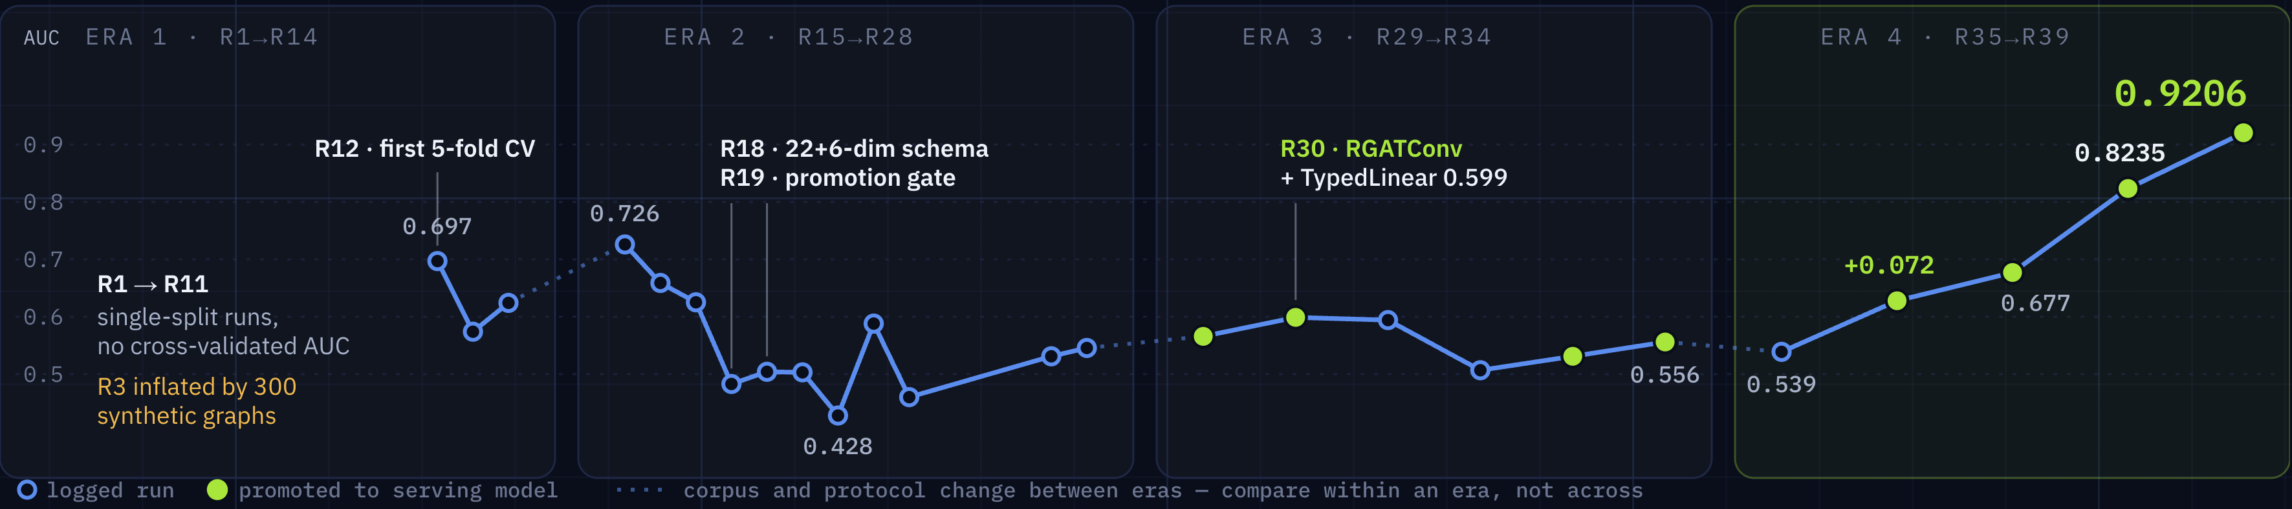
TRAINING HISTORY — FOUR ERAS
39 Runs, Four Eras
ERA 1 · 23 MAY → 14 JUN
Foundation & Data Pipeline
13-dim synthetic mix → real geometry only (R6) → 16-dim SDF features → 5-fold CV (R12).
300 synthetic graphs had inflated R3; removing them gave the first honest baseline.
ERA 2 · 20 JUN → 2 JUL
Feature Engineering & Category Sweeps
22+6-dim schema (R18), promotion gate (R19), category ablations to R28.
AUC swung 0.43–0.73 across category mixes, so only better models may reach serving.
ERA 3 · 19 JUL → 9 AUG
Heterogeneous Architecture
RGATConv + TypedLinear (R30, 602K → 2.44M params); 8-class taxonomy (R33); classifier fix (R34).
R31 (+236 graphs) and R32 (+73) underperformed R30 — the encoder, not corpus size, was the lever.
ERA 4 · 10 AUG → 2 SEP
Precision Engineering Sprint
R35 finds hole-count and joint-type were always 0.0; R36 adds spatial signal; R37 fixes sampling and the gate; R39 retrains on 749 models.
Repairing broken inputs beat tuning: R36 alone added +0.072 AUC.
R12 · first CV 0.697
R19 · promotion gate
R30 ★ · AUC 0.599
0.539 → 0.9206
The pattern: fixing genuinely dead features drives bigger gains than any hyperparameter search — the largest jumps came from repairing what the model could see, not from how it was tuned.
TRAINING HISTORY — FOUR ERAS
10 / 20
Notes:
Chart data (Mean AUC-ROC per logged run; ★ = promoted to serving; corpus and protocol change between eras, so compare within an era).
Era 1: R12 0.697, R13 0.574, R14 0.624 (R1–R11: single-split runs, no cross-validated AUC; R3 inflated by 300 synthetic graphs).
Era 2: R15 0.726, R16 0.659, R17 0.625, R18 0.483, R19 0.504, R20 0.503, R21 0.428, R22 0.588, R23 0.460, R27 0.531, R28 0.5455.
Era 3: R29 0.566★, R30 0.599★, R31 0.594, R32 0.507, R33 0.531★, R34 0.556★.
Era 4: R35 0.539, R36 0.628★ (+0.072), R37 0.677★, Final (16–17 Aug) 0.8235★, R39 0.9206★.

Slide 11
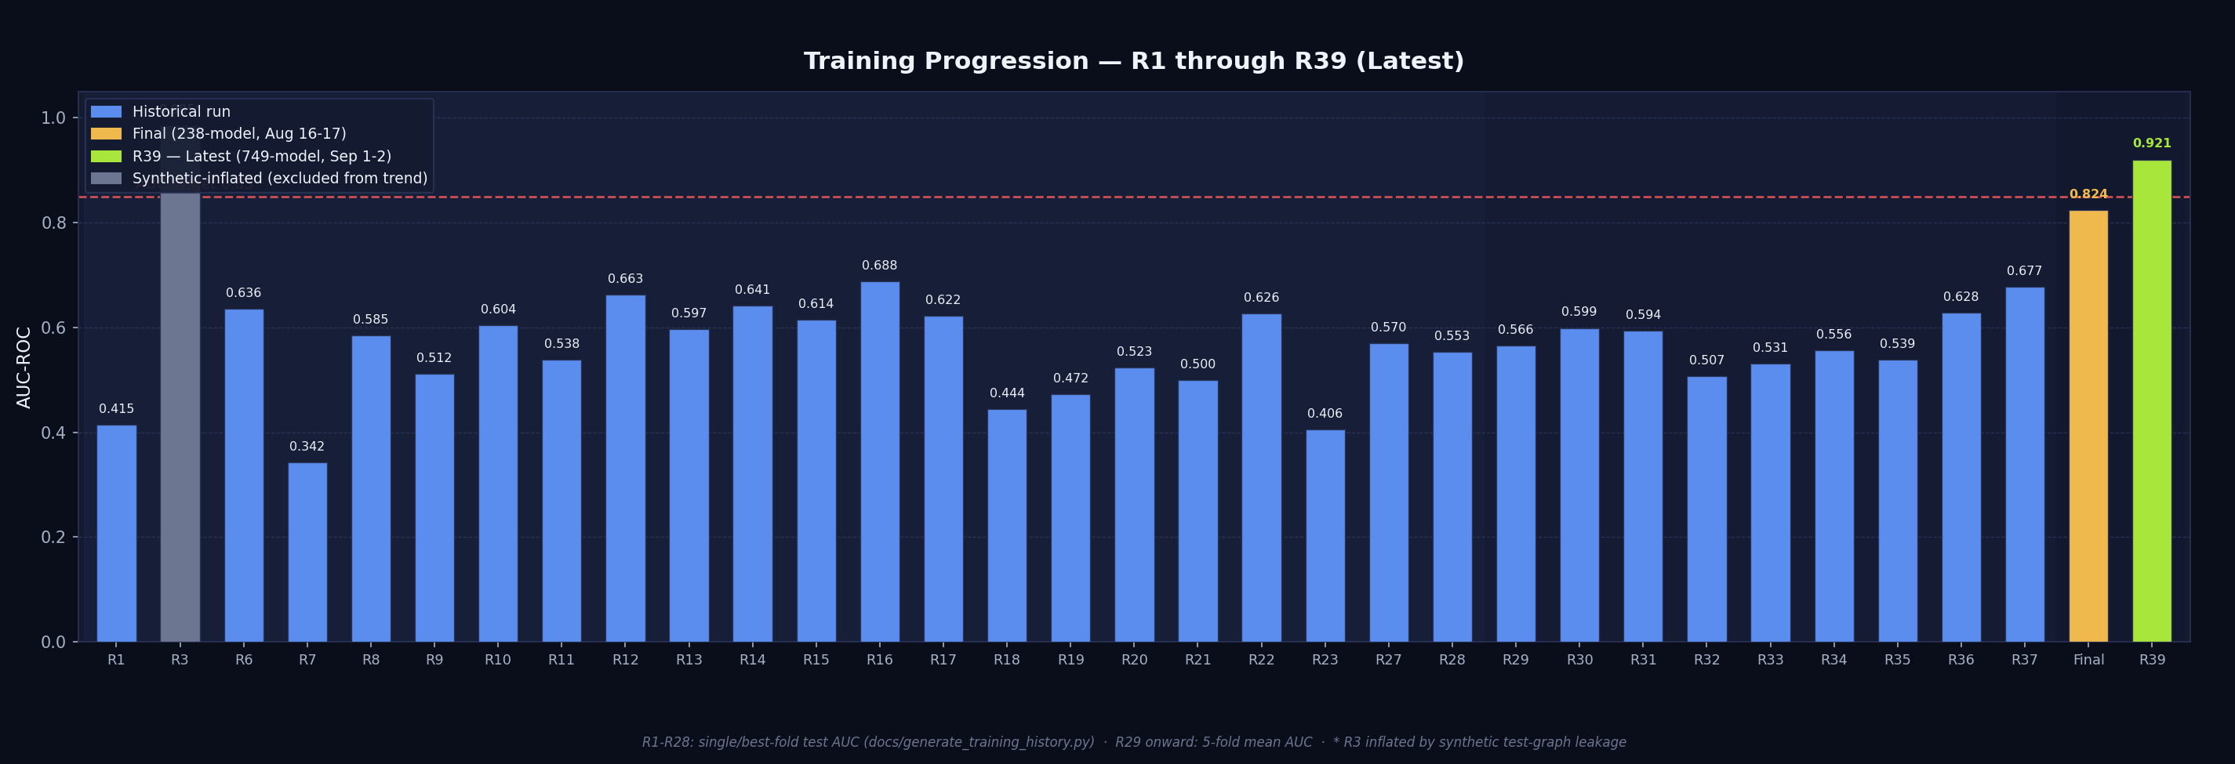
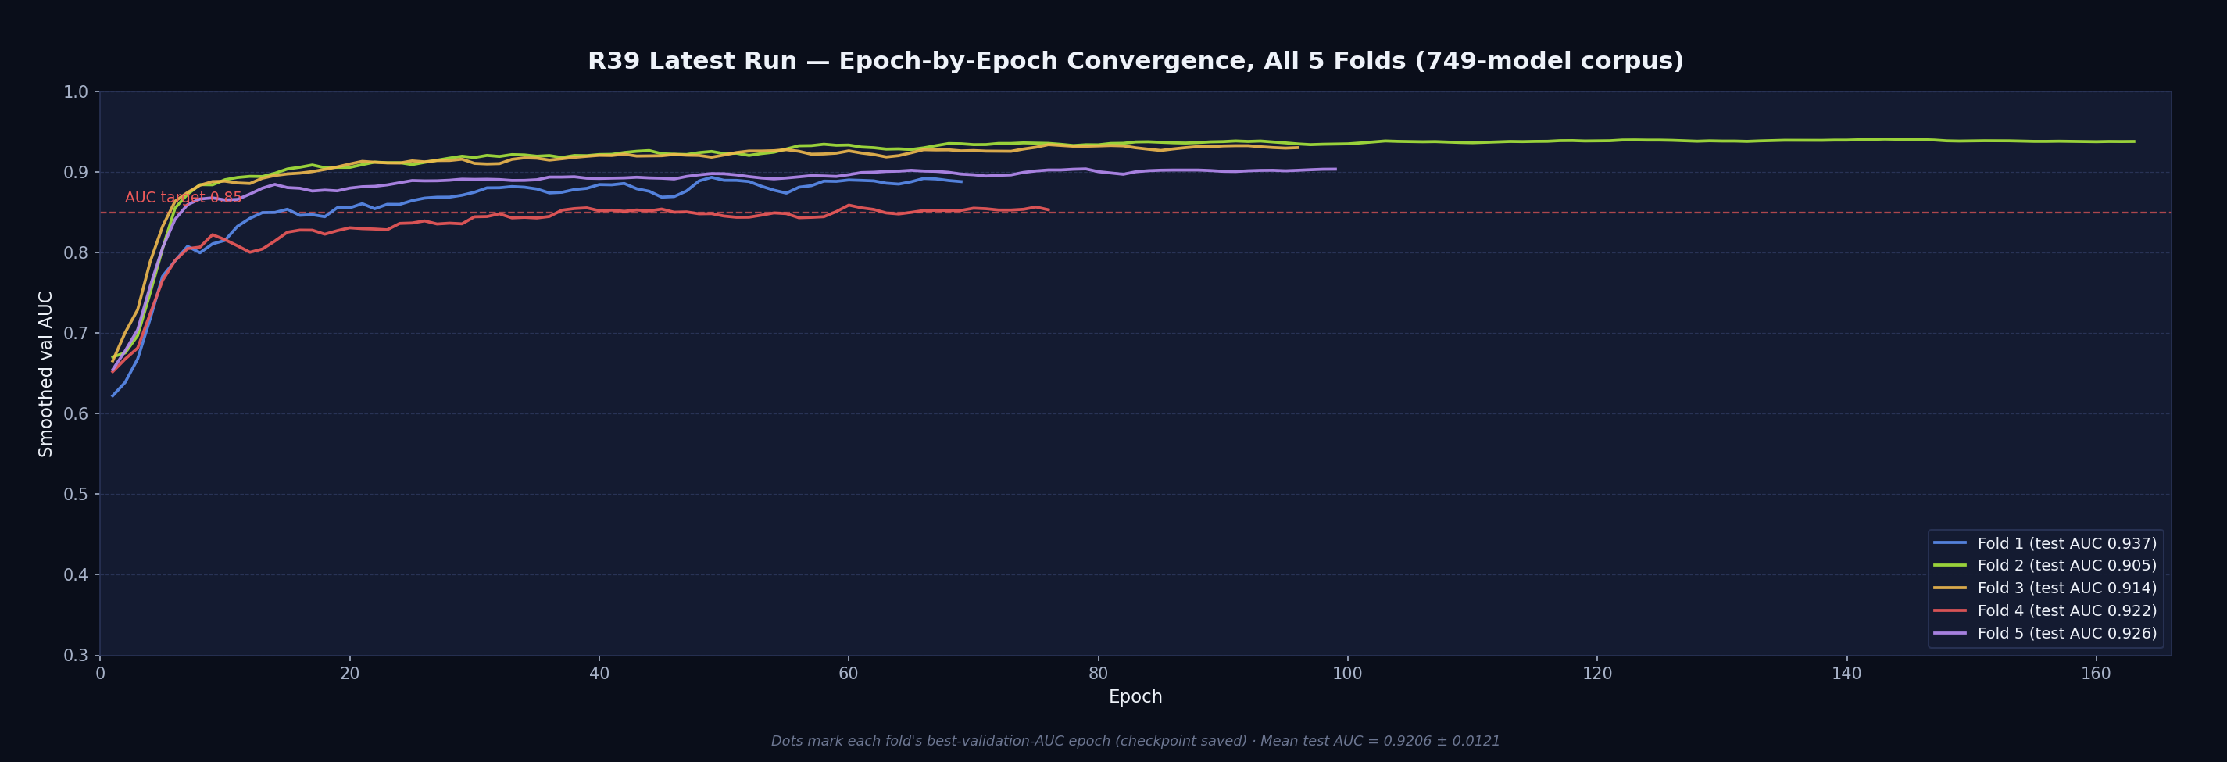
TRAINING HISTORY — FULL ARC
R1 → R38 → R39 (Latest)
Every logged run across three phases, plus R39 — the true 5-fold retrain on the corrected 749-model corpus that supersedes the Aug 16–17 Final run (top) · R39’s epoch-by-epoch convergence, all 5 folds (bottom)
TRAINING HISTORY — FULL ARC
11 / 20
Notes:
Top chart: bar chart of AUC by run, R1 through R39, plus the 238-model final retrain (Aug 16–17) — highlighted bars are the Final and R39 runs.
Bottom chart: line chart of the latest retrain's epoch-wise smoothed validation AUC, all 5 folds (749-model corpus).

Slide 12
THE LATEST RUN — SEP 1–2, 2026
True 5-Fold Retrain on the Corrected 749-Model Corpus
“True 5-fold cross-validation, 749-model corpus” — new 34-dim node features (through/blind holes, counterbore, indentation, curved-surface) and a corpus fully rebuilt on the 7-category taxonomy; supersedes the Aug 16–17 result below.
PHASE 1 — ENCODER / LINKPREDICTOR
PHASE 2 — NODERANKER
PHASE 3 — SHAPE-GEN VAE
Mean AUC
Mean AP
Hit@1
Test IoU / Chamfer
0.9206
0.9020
0.4093
0.6459 / 0.0377
±0.0121
±0.0120
was 0.8235±0.0219
was 0.8114±0.0279
baseline 0.3442
was 0.6277 / 0.0356 (238-model)
+0.097
+0.091
MRR 0.6102 · Hit@5 0.9101
+0.018 IoU · +0.002 chamfer (holds level)
target AUC 0.85 / AP 0.82 · promoted
749-model corpus, true 5-fold CV · genuine beat, not a tie
749-model corpus · both axes still clear their targets by a wide margin
Corpus expanded 238 → 749 models · Part bank rebuilt: 11,954 parts · NodeRanker retrained 30 epochs, Shape-Gen VAE retrained 60 epochs, both from the frozen Phase 1 encoder
FINAL RUN
12 / 20

Slide 13
RESULTS
Deliverables vs. Targets
PHASE | DELIVERABLE | TARGET | ACHIEVED | STATUS
Phase 1 | Missing-component detection (link prediction) | AUC ≥ 0.85 · AP ≥ 0.82 | Mean AUC 0.9206 · Mean AP 0.9020 (749-model corpus, true 5-fold CV) | Target cleared
Phase 2 | Next-component ranking (NodeRanker) | Hit@5 ≥ 0.70 · MRR ≥ 0.60 (revised down from 0.64) | Hit@5 0.9101 · MRR 0.6102 · Hit@1 0.4093 > baseline 0.3442 (749-model corpus, true 5-fold CV) | Target cleared
Phase 3 | Missing-shape generation | IoU ≥ 0.35 · Chamfer ≤ 0.08 | IoU 0.6459 · Chamfer 0.0377 (749-model corpus) | Target cleared
Final | Live demo, thesis, open-source repo | STEP upload → 3D view → prediction → explanation | Demo live, MIT-licensed, run end-to-end today | Delivered
RESULTS
13 / 20

Slide 14
ENGINEERING RIGOR
Challenges Overcome
MPS Memory Leaks
Apple-Silicon GPU cache grew unchecked, RSS ran to 19–51GB and thrashed swap. Fixed with periodic gc.collect() / torch.mps.empty_cache().
Silent Swap-Pressure Kills
Training processes died silently mid-fold under memory pressure. Built auto-resume watchdog scripts that detect the crash and relaunch from the right fold.
⚙
↻
STEP Parse Timeouts
SIGKILL doesn’t guarantee instant death for a stuck OpenCASCADE call on macOS. Bounded polling loops + a single retry at 2× budget.
Promotion-Gate Bug
A lexicographic tuple comparison silently ignored AP whenever AUC tied. Fixed to require both metrics improve before a model reaches production.
⚖
Fastener Orientation Bug
Bolts aligned their short axis onto a joint instead of the long shaft axis. Fixed by using the middle extent to tell rods from disks.
Per-Hole Detection Redesign
A whole-body region guess collapsed 12 real bolt holes into 1 ghost part. Replaced with per-hole cylindrical-face detection — 12/12 now correctly filled.
↗
●
ENGINEERING RIGOR
14 / 20

Slide 15
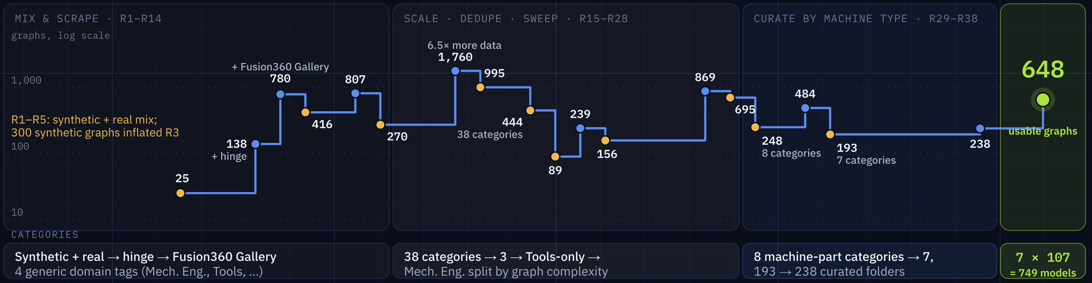
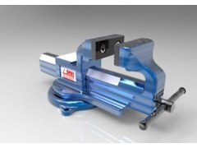
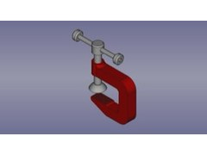
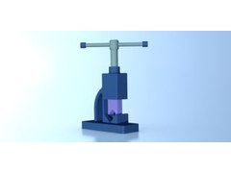
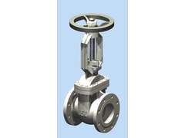
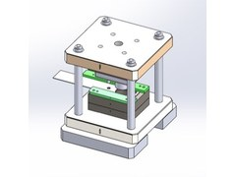
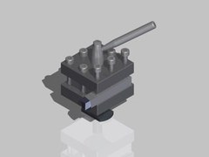
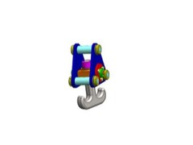
DATA — CORPUS HISTORY, R1 → R39
Finding the Right Corpus
About 20 corpus versions in 39 runs — grown, filtered, re-categorised and curated until it was right. It was the most expensive step of the project, and produced the largest measured gain.
corpus grew
filtered / curated down
final corpus
WHAT THE ORIGINAL SCRAPE TAUGHT US
WHERE WE LANDED: 7 MACHINE-PART CATEGORIES × 107 MODELS
2,271 → 749
Fusion360 scrape vs today’s hand-curated corpus
144
duplicate folders across categories (6.3%): a train/test leakage risk
641
zero-contact assemblies (28.2%): no edges, unusable for link prediction
80.2%
of the scrape was one tag (Mech. Eng.): severe imbalance
Bench Vice
C-Clamps
Pipe Vice
Gate Valve
Press Tool
Tool Post
Crane Hook
107
107
107
107
107
107
107
648 usable graphs · 25,155 classified bodies · one category per model, no cross-category duplicates
DATA
15 / 20
Notes:
Chart data — corpus size (graphs; curated folders from R32) at each logged corpus change:
R6 25 · R9 138 (+hinge) · R10 780 (+Fusion360 Gallery) · R11 416 · R13 807 · R14 270 · R17 1,760 (6.5× more data) · R18 995 (curated) · R20 444 (38 categories) · R21 89 · R22 239 · R23 156 · R27 869 · R28 695 · R29 248 (8 categories) · R31 484 · R32 193 (7 categories) · Final 238 · R39 648 usable graphs from 749 models (7 × 107).
Category lane: Synthetic + real → hinge → Fusion360 Gallery, 4 generic domain tags (R1–R14) · 38 categories → 3 → Tools-only → Mech. Eng. split by graph complexity (R15–R28) · 8 machine-part categories → 7, 193 → 238 curated folders (R29–R38) · 7 × 107 = 749 models (R39).
R1–R5: synthetic + real mix; 300 synthetic graphs inflated R3. R24–R26 were not in the change logs (the line holds the previous corpus). About 20 corpus versions is a tally of distinct logged corpus definitions.

Slide 16
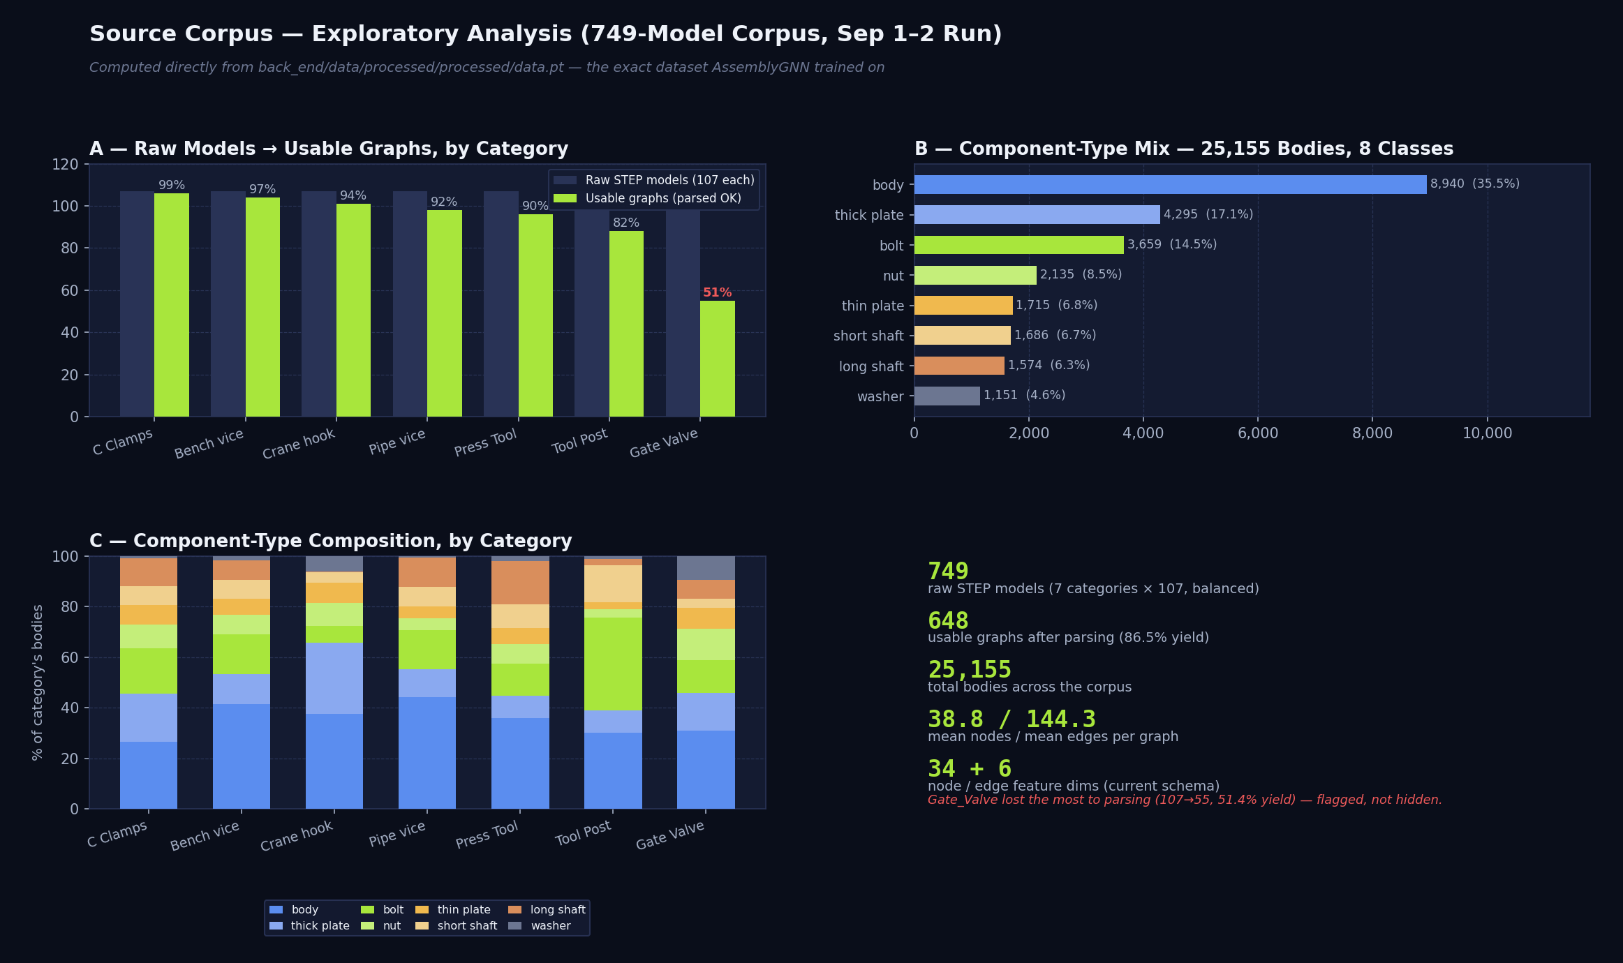
DATA
Source Corpus — Exploratory Analysis (749 Models)
749 raw STEP models (7 categories × 107, balanced) → 648 usable graphs, 25,155 classified bodies — computed directly from the processed training dataset, the exact data AssemblyGNN trained on for the Sep 1–2 (R39) run
Full breakdown — graph-size distributions, hole-geometry prevalence by component type, feature correlations, and two flagged data-quality findings — in the companion 749-Model Corpus EDA report
DATA
16 / 20
Notes:
Image: 749-model corpus EDA dashboard — (A) raw models vs usable graphs by category, (B) component-type mix across 25,155 bodies / 8 classes, (C) component-type composition by category, plus summary numbers (749 raw models, 648 usable graphs, 25,155 bodies, 38.8 / 144.3 mean nodes / mean edges per graph, 34+6 features).

Slide 17
CONCLUSION
What This Project Delivers
✓
Full 3-phase pipeline — detect, rank, generate — working end-to-end on real CAD geometry
✓
39+ tracked training runs, with systematic ablations and honest reporting of regressions
✓
A novel Octree open-surface detector and a hybrid retrieval + VAE shape generator
✓
A live Gemini-powered explanation agent (AIDA) reasoning in engineering language
✓
Phase 3 targets comfortably exceeded — IoU 0.65 vs. a 0.35 target
✓
Post-hoc GNNExplainer interpretability layer, wired live into the Streamlit UI
✓
Interactive Streamlit demo, fully open-source (MIT), zero proprietary CAD-API dependency
CONCLUSION
17 / 20

Slide 18
LOOKING AHEAD
Limitations & Future Work
Limitations
NodeRanker still over-predicts the ‘body’ class (64.7% predicted vs. 41.3% true) — Hit@1 beats baseline but isn’t yet a solved ranking problem
~39.5% of bodies are flagged ambiguous by the classifier’s voting rules — reported honestly, not hidden
Phase 3 shape generation is currently scoped to fasteners (bolt/washer/nut) only
sdf_mean is a dead feature on the 749-model corpus — exactly 0.0 for 99.95% of bodies (25,142/25,155), found during EDA, not caught by training metrics
Future Work
Corpus grown 238→749 models — re-run the learning-curve check on the new corpus to confirm whether it has finally plateaued
Resolve NodeRanker’s majority-class collapse with class-balanced sampling or loss reweighting
Broaden Phase 3 shape generation beyond fasteners to plates and shafts
Fix the dead SDF ray-cast; spot-check why 72%/84% of bolts/washers flag has_holes against real STEP geometry
LOOKING AHEAD
18 / 20

Slide 19
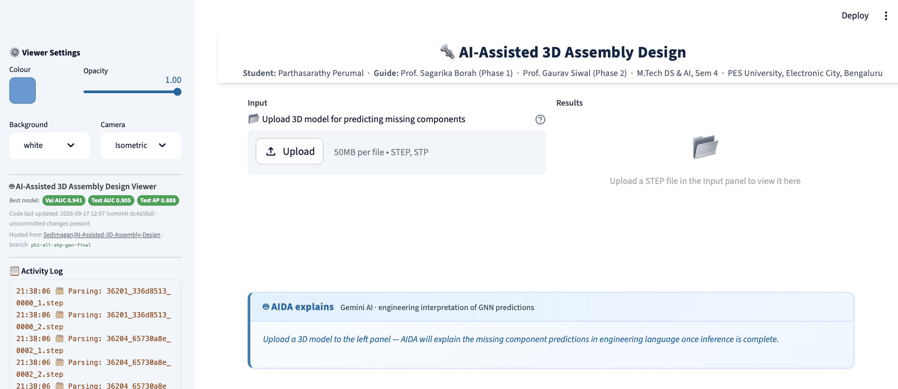
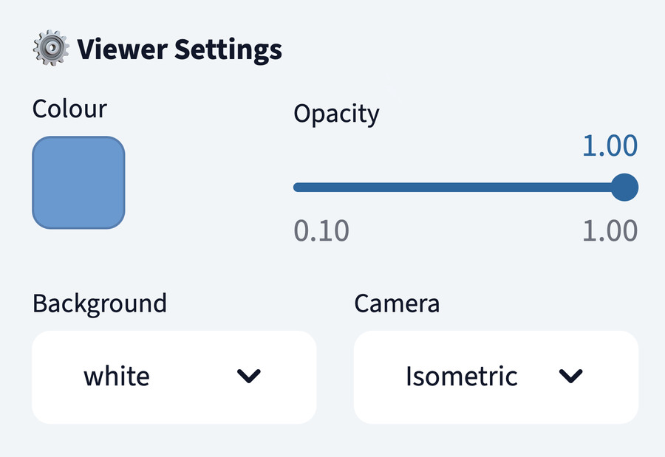
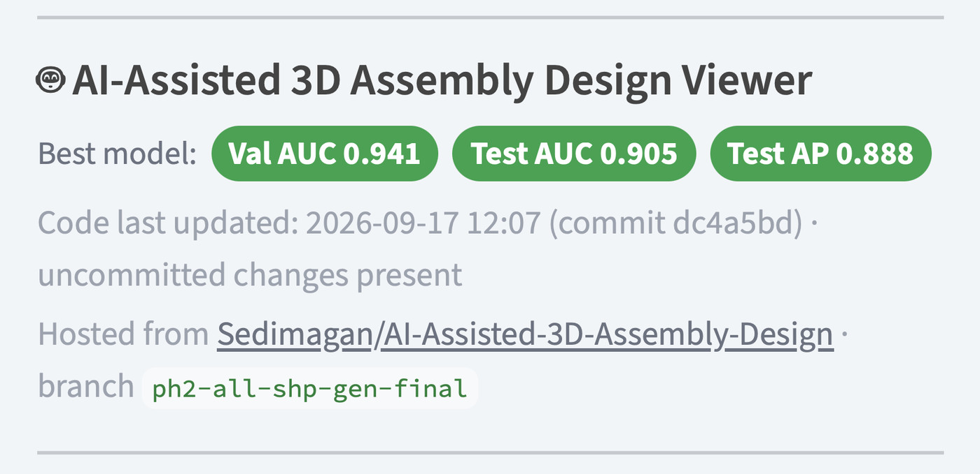
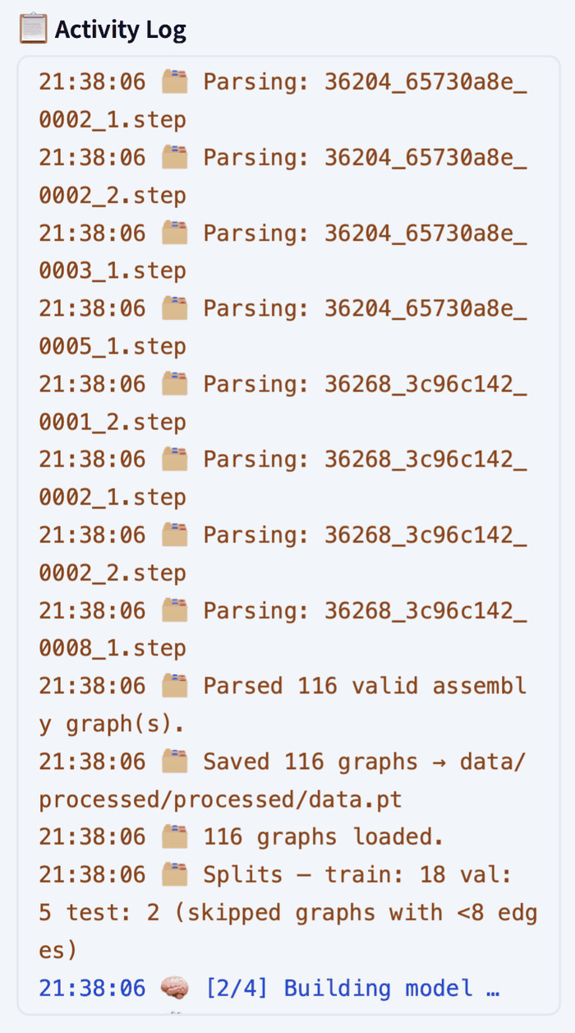
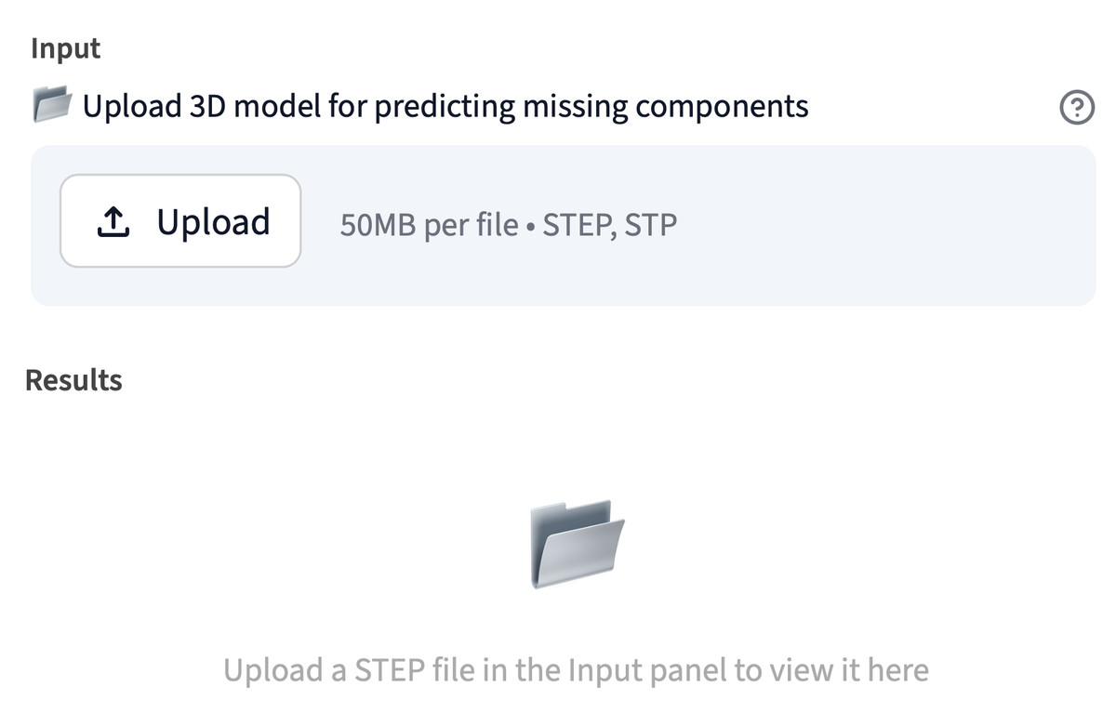
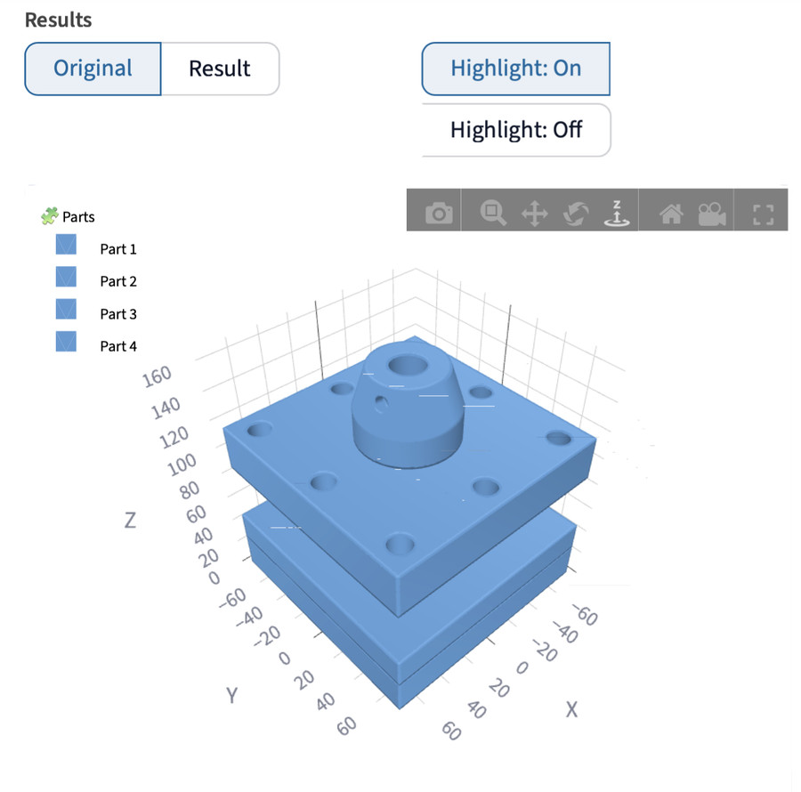
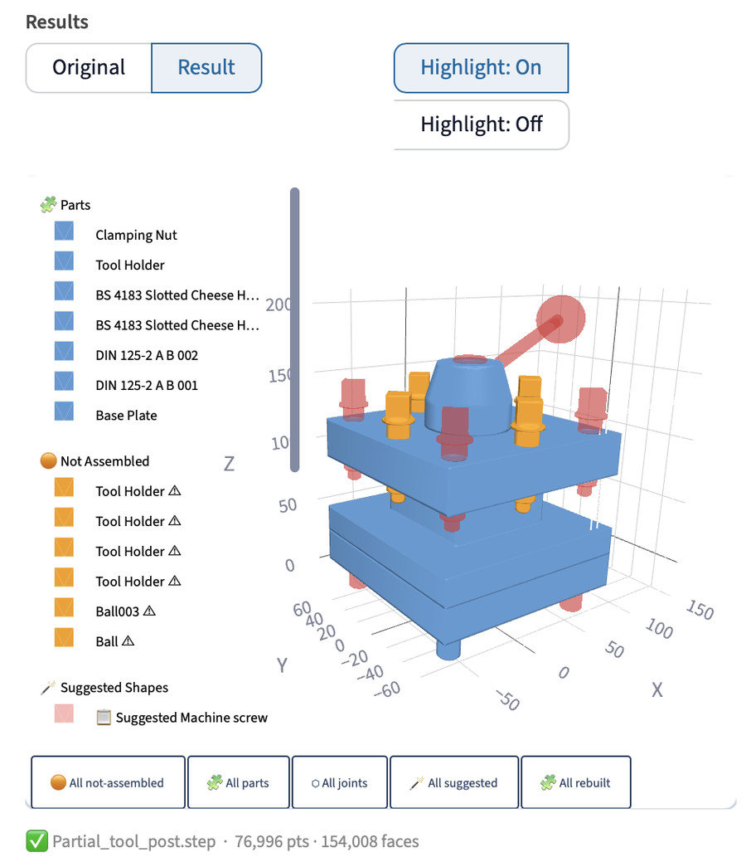
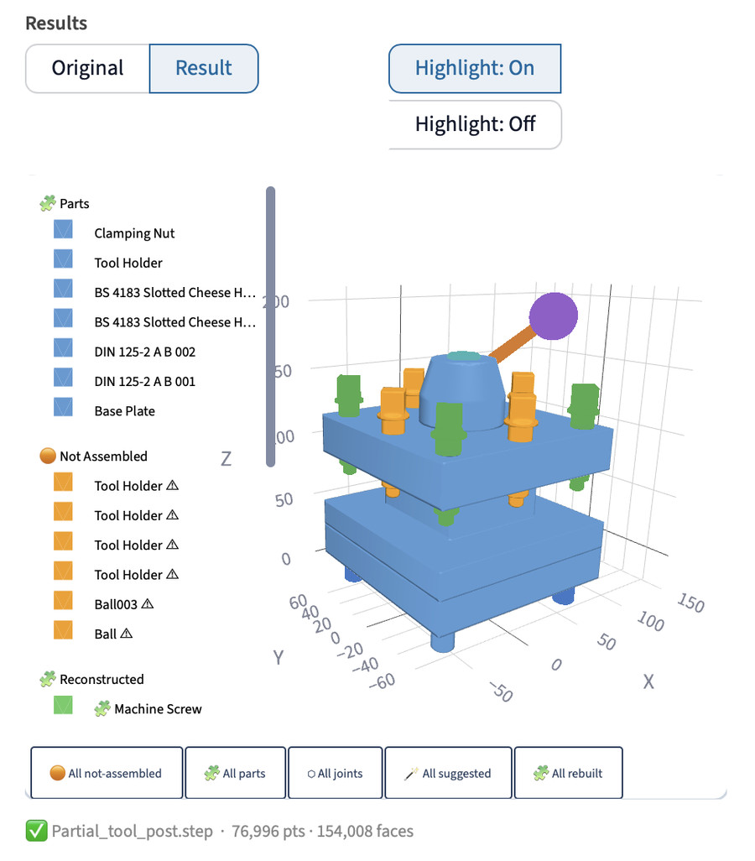
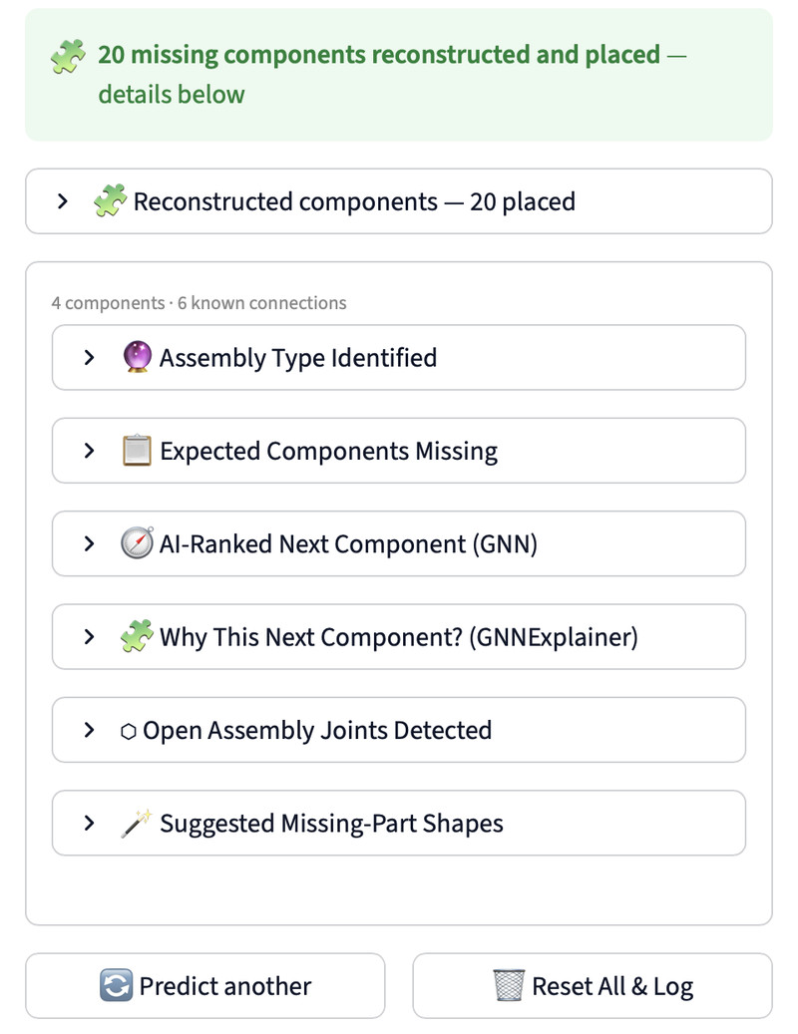
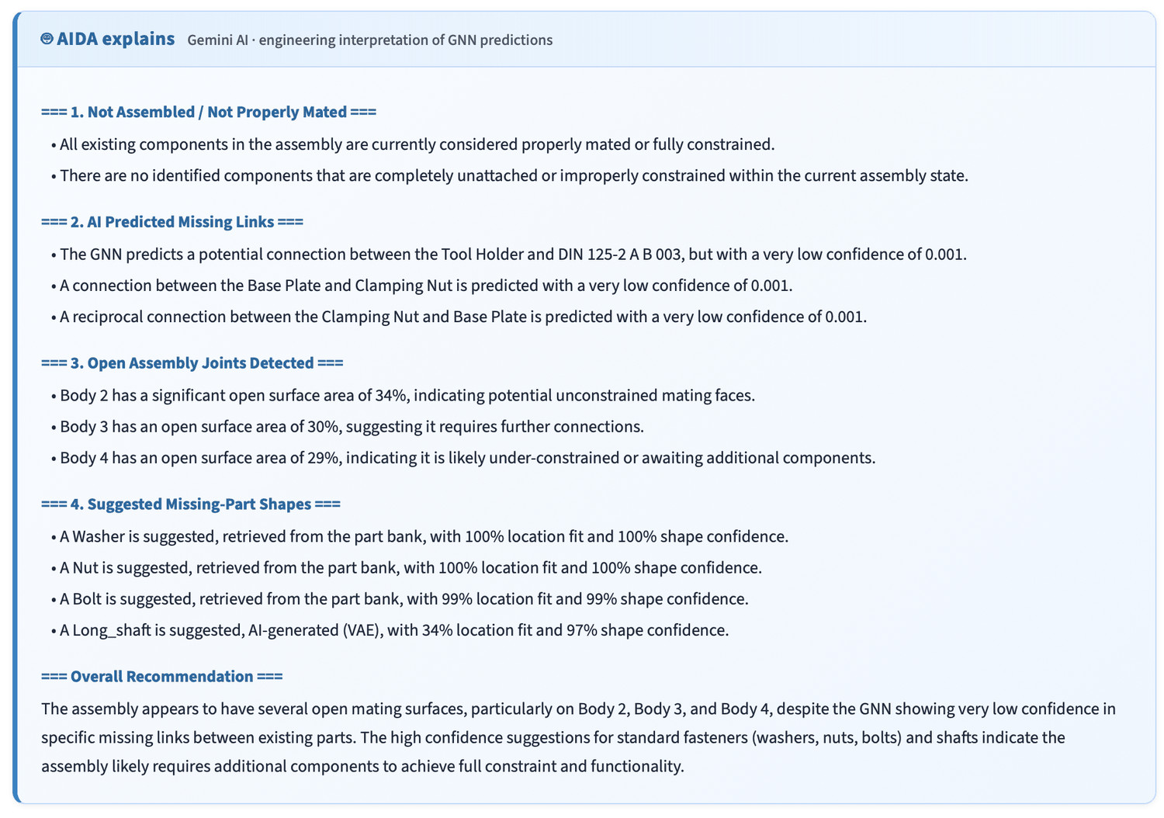
LIVE DEMO ↗ — PARTIAL_TOOL_POST.STEP
The App in 10 Frames
A
Know the workspace sidebar, viewer and model controls
1
2
3
4
1 Full window sidebar · workspace · AIDA
2 Viewer settings colour · opacity · camera
3 Model info checkpoint · code version
4 Activity log timestamped stages
B
Load & inspect check the file first
Predict & rebuild one answer, two views
Read the results numbers, export, explanation
C
D
5
6
7
8
9
10
5 Upload STEP / STP, up to 50 MB
6 Original view rotate · zoom · toggle parts
7 Suggested shapes pink + orange
8 Reconstructed by category
9 Details panel table · .glb export · 6 sections
10 AIDA explains engineering-language report
ONE RUN,
END TO END
≈24 s
STEP upload to AIDA explanation, typical four-body assembly
0.27 mm
mean position error of the rebuilt parts vs the original
0.39 mm
mean shape error (tessellation noise floor: 0.2–0.6 mm)
One assembly, tool-post-tuned: a mechanism check, not a general result.
LIVE DEMO
19 / 20
Notes:
Frames (each a full-resolution screenshot of the running app): 1 Full window: sidebar, Input / Results panels and the AIDA panel · 2 Viewer settings: colour, opacity, background, camera · 3 Model info: serving checkpoint and code version · 4 Activity log: timestamped pipeline stages · 5 Upload a STEP/STP file (up to 50 MB); Results waits · 6 Original view: rotate, zoom and toggle each part · 7 Result view: Suggested Shapes (pink) and Not Assembled parts (orange) · 8 Reconstructed group, coloured by component category · 9 Details panel: reconstruction table, .glb export, six result sections · 10 AIDA: engineering-language interpretation of the predictions.
The 'LIVE DEMO' label links to the local app (http://localhost:8501) — start it first with: bash start_services.sh

Slide 20

Thank You
Questions & Discussion
Parthasarathy Perumal · SRN PES2PGE24DS193
Guide (Phase 1): Prof. Sagarika Borah · Guide (Phase 2): Prof. Gaurav Siwal
M.Tech Data Science & AI · PES University, Electronic City, Bengaluru
Repository: MIT-licensed, open-source
THANK YOU
20 / 20

