Slide 1
M.TECH END-SEMESTER EXAMINATION · DATA SCIENCE & AI · AUGUST 2026
AI-Assisted 3D Assembly Design
Predicting missing components in CAD assemblies with Graph Neural Networks
★
Complete Development History — R1 → R38 & Final End-to-End Results
STUDENT
GUIDE — PHASE 1
GUIDE — PHASE 2
UNIVERSITY
Parthasarathy Perumal · SRN PES2PGE24DS193
Prof. Sagarika Borah
Prof. Gaurav Siwal
PES University, Electronic City, Bengaluru

Slide 2
AGENDA
What We'll Cover Today
Problem Statement & Research Gap
Final Full-Corpus End-to-End Results
01
05
System Architecture & Novel Contributions
Engineering Challenges Overcome
02
06
Project Timeline & Review Milestones
Live Demo — real STEP file, right now
03
07
Complete Training History — R1 to R38 (4 eras)
Conclusion, Limitations & Future Work
04
08
AI-Assisted 3D Assembly Design — End-Semester Review
02

Slide 3
MOTIVATION
The Problem
Modern CAD tools — SolidWorks, CATIA, Fusion 360 — offer no contextual intelligence during assembly creation. Engineers rely entirely on domain knowledge to choose and position every component.
Knowledge Barrier
No Automation
Junior engineers lack the assembly patterns built over years of hands-on experience.
Existing CAD tools offer no intelligent part suggestion during assembly creation.
Non-Standardisation
Incomplete Assemblies
Different designers make inconsistent choices for equivalent subassemblies.
Partially defined assemblies have no mechanism to detect or fill missing parts.
RESEARCH GAP
No existing system applies graph-based deep learning to recommend components from partial CAD assembly graphs — without proprietary CAD-API dependency.
AI-Assisted 3D Assembly Design — End-Semester Review
03

Slide 4
RELATED WORK
Literature Survey
Authors / Year | Work | Venue
Du et al. (2024) | BrepGen: A B-Rep Generative Diffusion Model with Structured Latent Geometry | ACM SIGGRAPH 2024
Jayaraman et al. (2024) | SolidGen: An Autoregressive Model for Direct B-Rep Synthesis and Editing | ACM ToG, Vol. 43
Wang et al. (2025) | CAD-GPT: Synthesising CAD Construction Sequences with Spatial-Reasoning LLMs | arXiv:2501.09803
— (2024) | Can GNNs Learn Link Heuristics? | arXiv:2411.14711
— (2023) | Heterogeneous Graph Contrastive Learning | arXiv:2303.00995
FOUNDATIONAL — GUIDE'S OWN RESEARCH
Borah & Borah (2020) — PEE-based reversible mesh watermarking (Multimedia Tools & Applications) — its Octree spatial-partitioning concept is adapted here to build the open-surface / missing-joint detector.
Also cited: Kipf & Welling (GCN, 2017) · Veličković et al. (GAT, 2018) · Hamilton et al. (GraphSAGE, 2017) · Koch et al. (ABC Dataset, 2019) · Mo et al. (PartNet, 2019) · Ying et al. (GNNExplainer, 2019)
AI-Assisted 3D Assembly Design — End-Semester Review
04

Slide 5
METHODOLOGY
End-to-End Pipeline Architecture
STEP File
→
Graph Extraction
→
AssemblyGNN
→
3 Task Heads
→
Serving
Partial or complete
CAD assembly
dataset.py — gmsh +
OpenCASCADE + trimesh
Heterogeneous encoder
frozen after Phase 1
Detect · Rank ·
Generate
FastAPI + Streamlit
+ AIDA (Gemini)
Phase 1 — LinkPredictor
Phase 2 — NodeRanker
Phase 3 — HybridShapeGen
MLP(h_u ‖ h_v ‖ dist) → BCE
cosine(ctx, prototypes) × temperature, BPR loss
Part-bank retrieval → conditional VAE fallback
Missing-component detection
Next-component ranking
Missing-shape generation
AUC-ROC / AP
Hit@K / MRR / NDCG@K
IoU / Chamfer distance
SUPPORTING MODULES
AssemblyTemplateDB Per-category component-type frequency prior; works on single-body uploads too
Octree Surface Analyzer Spatial partitioning finds open (unmated) joint surfaces — Borah & Borah (2020)
AIDA (Gemini agent) Explains every GNN prediction in engineering language, live
AI-Assisted 3D Assembly Design — End-Semester Review
05

Slide 6
METHODOLOGY
Graph Representation
NODE — 22 dimensions
EDGE — 6 dimensions
A solid body in the assembly
Bodies sharing real boundary geometry after fragment()
[0:8] Component-type one-hot — 8-class multi-signal geometric voting
[8:10] log1p(volume) · log1p(exact surface area, via trimesh)
[10:13] Bounding-box Δx/Δy/Δz, scale-relative to the assembly
[13:18] Elongation · flatness · aspect x/y, y/z · sphericity (affine-invariant)
[18:20] SDF mean · SDF variance (inward ray-casting)
[20] Surface-area / volume ratio
[21] log1p(hole count) — geometry-derived since R35
[0] Mate-type indicator
[1] Real contact-area weight — shared-surface area ratio (R36; was hardcoded 1.0)
[2:6] Joint-type one-hot — rigid / revolute / slider / cylindrical
pos (3-dim) — body centroid, feeds a spatial link-prediction signal (R36)
Two bodies get an edge iff their boundary face sets intersect — real contact, not proximity
8-class taxonomy: long/short shaft · thick/thin plate · bolt · washer · nut · body — multi-signal voting (hole detection + bolt-head detection + absolute-size gate), replacing single-signal SDF rules at R33.
AI-Assisted 3D Assembly Design — End-Semester Review
06

Slide 7
NOVELTY
Beyond Base Replication — 4 Contributions
◆
AssemblyTemplateDB
⬡
Octree Surface Detector
Learns per-category component-type frequency distributions from training data; identifies what's missing even from a single-body upload.
Spatial partitioning (Borah & Borah, 2020) clusters free-surface centroids after fragment() to flag open mating joints — highlighted live in the 3D viewer.
◇
Hybrid Shape Generator
✦
AIDA — Gemini Agent
Part-bank retrieval first (5,363 real parts), conditional voxel VAE fallback — produces an actual placeable mesh, not just a text label.
A skills-based explanation agent that reads every GNN prediction and open joint, and explains it in plain engineering language, live.
AI-Assisted 3D Assembly Design — End-Semester Review
07

Slide 8
TIMELINE
Project Timeline & Review Milestones
PHASE 1 — Replication
PHASE 2 — Novelty & Improvement
May 10 – Jul 10, 2026 · Baseline GAT replication
Jul 10 – Sep 10, 2026 · Ranking, generation, hardening
Status: Complete
Status: Full pipeline delivered
10 May
10 Jul
25 Jul
21 Aug
Zeroth Review
Phase 1 ESA
Phase 2 First Review
★ End-Sem Exam (Today)
24 May
18 Jul
Aug
First Review
Guidance Call 1
Guidance Calls 2 & 3
Presentation history: Zeroth Review → First Review → Phase 1 ESA (14 slides) → Phase 2 First Review (20 slides, R29–R31) → Phase 2 Second Review → three Phase-2 guidance calls — full record in Review_files/
AI-Assisted 3D Assembly Design — End-Semester Review
08

Slide 9
TRAINING HISTORY
R1 → R38 — A Complete Record
185
38
23 May → 12 Aug
13 → 22+6
commits tracked
numbered training runs
2026 date range
feature dims (node/edge)
Four eras of development
R1 – R14
R15 – R28
R29 – R34
R35 – R38
Foundation & Data Pipeline
Feature Engineering & Category Sweeps
Heterogeneous Architecture
Precision Engineering Sprint
23 May – 14 Jun
20 Jun – 2 Jul
19 Jul – 9 Aug
10 – 12 Aug
From an inflated synthetic illusion to an honest, cross-validated real-geometry baseline.
22+6-dim schema locked in; a promotion gate protects the serving model from regressions.
RGATConv + TypedLinear beats scale alone; 8-class taxonomy migration surfaces real bugs.
Fixing genuinely dead features drives bigger gains than any hyperparameter search.
AI-Assisted 3D Assembly Design — End-Semester Review
09

Slide 10
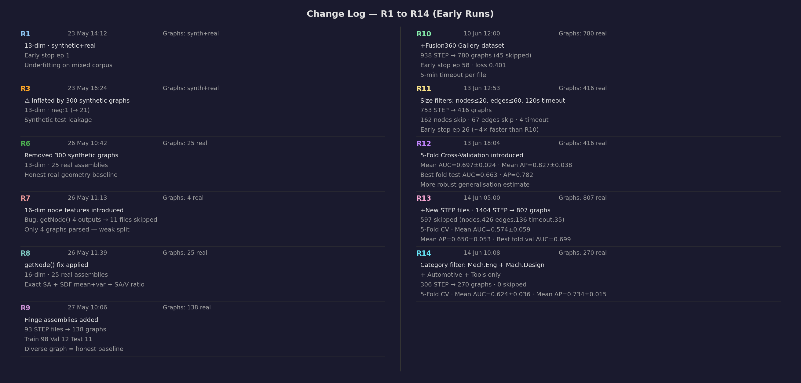
TRAINING HISTORY — ERA 1
R1 → R14: Foundation & Data Pipeline
13-dim synthetic-mixed baseline → real-geometry-only → 16-dim trimesh/SDF features → 5-fold cross-validation introduced at R12.
AI-Assisted 3D Assembly Design — End-Semester Review · source: docs/training_changelog_a.png
10

Slide 11
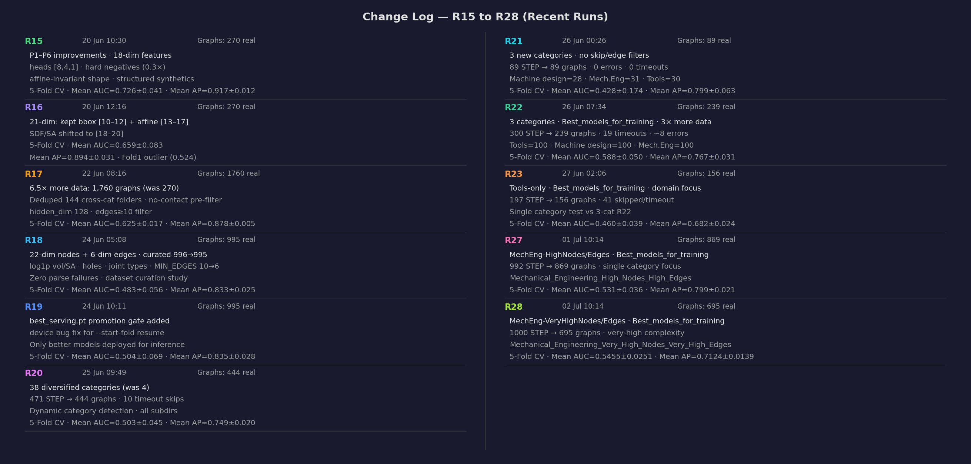
TRAINING HISTORY — ERA 2
R15 → R28: Feature Engineering & Category Sweeps
P1–P6 improvements land the 22+6-dim schema (R18) · a promotion gate (R19) starts protecting the serving model · systematic category ablations through R28.
AI-Assisted 3D Assembly Design — End-Semester Review · source: docs/training_changelog_b.png
11

Slide 12
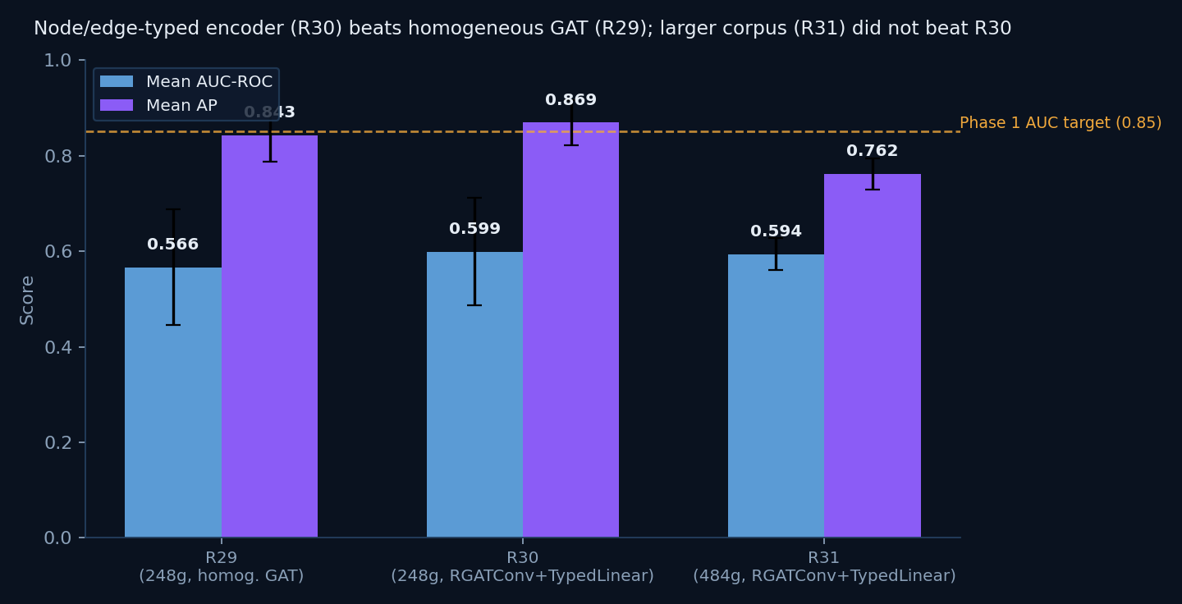
TRAINING HISTORY — ERA 3
R29 → R34: Heterogeneous Architecture
Run | Date | Key Change | Mean AUC | Result
R29 | 19 Jul | New 8-category corpus (248g) · homogeneous GAT | 0.566 | Promoted
R30 ★ | 19 Jul | RGATConv + TypedLinear · 602K→2.44M params | 0.599 | Promoted
R31 | 21 Jul | Corpus → 484 graphs · MPS OOM fixed | 0.594 | Not promoted
R32 | 01 Aug | Corpus → 193 folders / 7 categories | 0.507 | Not promoted
R33 | 06 Aug | 8-class taxonomy migration (multi-signal voting) | 0.531 | Manual promote
R34 ★ | 09 Aug | Classifier absolute-size blind-spot fixed | 0.556 | Promoted
KEY FINDING
A relation-aware architecture (R30) beats scale alone: R31's +236 graphs and R32's +73 more both underperformed R30's smaller-but-typed corpus — confirming the encoder change, not corpus size, was the real lever.
AI-Assisted 3D Assembly Design — End-Semester Review
12

Slide 13
TRAINING HISTORY — ERA 4
R35 → R38: Precision Engineering Sprint
Run | Date | What Landed | Mean AUC | Result
R35 | 10 Aug | Real joint-type & hole-count features finally populated (were always 0.0 — sourced from a file that never existed in the corpus) | 0.539 | Not promoted
R36 ★ | 10 Aug | Spatial link-prediction signal + real contact-area edge weight | 0.628 | Promoted (+0.072)
R37 ★ | 11 Aug | neg_ratio 0.5→1.0 fix · seeded reproducibility · promotion-gate bug fixed | 0.677 | Promoted (+0.049)
R38 ★ | 12 Aug | Encoder benchmark (RGAT stays) + capacity ablation (dropout=0.3) + part-bank quality gate | 0.6875 | Promoted (+0.011)
KEY FINDING
R35 fixed features that had been silently dead since the project began — hole count and joint type were always zero, every single run through R34. Once real, R36's spatial signal jumped Mean AUC +0.072 in one run: the biggest single-run gain of the whole project, and it came from fixing broken plumbing, not tuning.
AI-Assisted 3D Assembly Design — End-Semester Review
13

Slide 14
THE FINAL RUN — AUG 16–17, 2026
One Full End-to-End Retrain, Ahead of Today
"One full end-to-end, all training included" — run per explicit request, ahead of the 2026-08-21 deadline. That deadline is today.
Phase 1
Phase 2
Phase 3
Mean AUC
Hit@1
IoU / Chamfer
0.8235
0.4267
0.6277 / 0.0356
±0.0219 · up from 0.6875 (+0.136)
beats majority baseline 0.4133
best on both axes at once
target 0.85
first genuine win, not a tie
target ≥0.35 / ≤0.08 — cleared
Corpus expanded 193 → 238 models (233 usable graphs after 5 parse failures) · Part bank rebuilt: 5,363 parts / 237 assemblies · Two mid-run crashes auto-recovered by a new watchdog script
AI-Assisted 3D Assembly Design — End-Semester Review
14

Slide 15
RESULTS
Deliverables vs. Targets
Phase | Deliverable | Target | Achieved | Status
Phase 1 | Missing-component detection (link prediction) | AUC ≥ 0.85 · AP ≥ 0.82 | AUC 0.8235 · AP ≥0.82 met in earlier runs (e.g. R15: 0.917) | Near target
Phase 2 | Next-component ranking (NodeRanker) | Hit@5 ≥ 0.70 · MRR ≥ 0.64 | Hit@5 0.896 (met) · Hit@1 0.4267 > baseline · MRR improving | Partially met
Phase 3 | Missing-shape generation | IoU ≥ 0.35 · Chamfer ≤ 0.08 | IoU 0.6277 · Chamfer 0.0356 | Target cleared
Final | Live demo, thesis, open-source repo | STEP upload → 3D view → prediction → AI explanation | Demo live, MIT-licensed, run end-to-end today | Delivered
AI-Assisted 3D Assembly Design — End-Semester Review
15

Slide 16
ENGINEERING RIGOR
Challenges Overcome
MPS Memory Leaks
Silent Swap-Pressure Kills
⚙
Apple-Silicon GPU cache grew unchecked, RSS ran to 19–51GB and thrashed swap. Fixed with periodic gc.collect() / torch.mps.empty_cache().
↻
Training processes died silently mid-fold under memory pressure. Built auto-resume watchdog scripts that detect the crash and relaunch from the right fold.
STEP Parse Timeouts
Promotion-Gate Bug
⏱
SIGKILL doesn't guarantee instant death for a stuck OpenCASCADE call on macOS. Bounded polling loops + a single retry at 2× budget.
⚖
A lexicographic tuple comparison silently ignored AP whenever AUC tied. Fixed to require both metrics improve before a model reaches production.
Fastener Orientation Bug
Per-Hole Detection Redesign
↗
Bolts aligned their short axis onto a joint instead of the long shaft axis. Fixed by using the middle extent to tell rods from disks.
●
A whole-body region guess collapsed 12 real bolt holes into 1 ghost part. Replaced with per-hole cylindrical-face detection — 12/12 now correctly filled.
AI-Assisted 3D Assembly Design — End-Semester Review
16

Slide 17
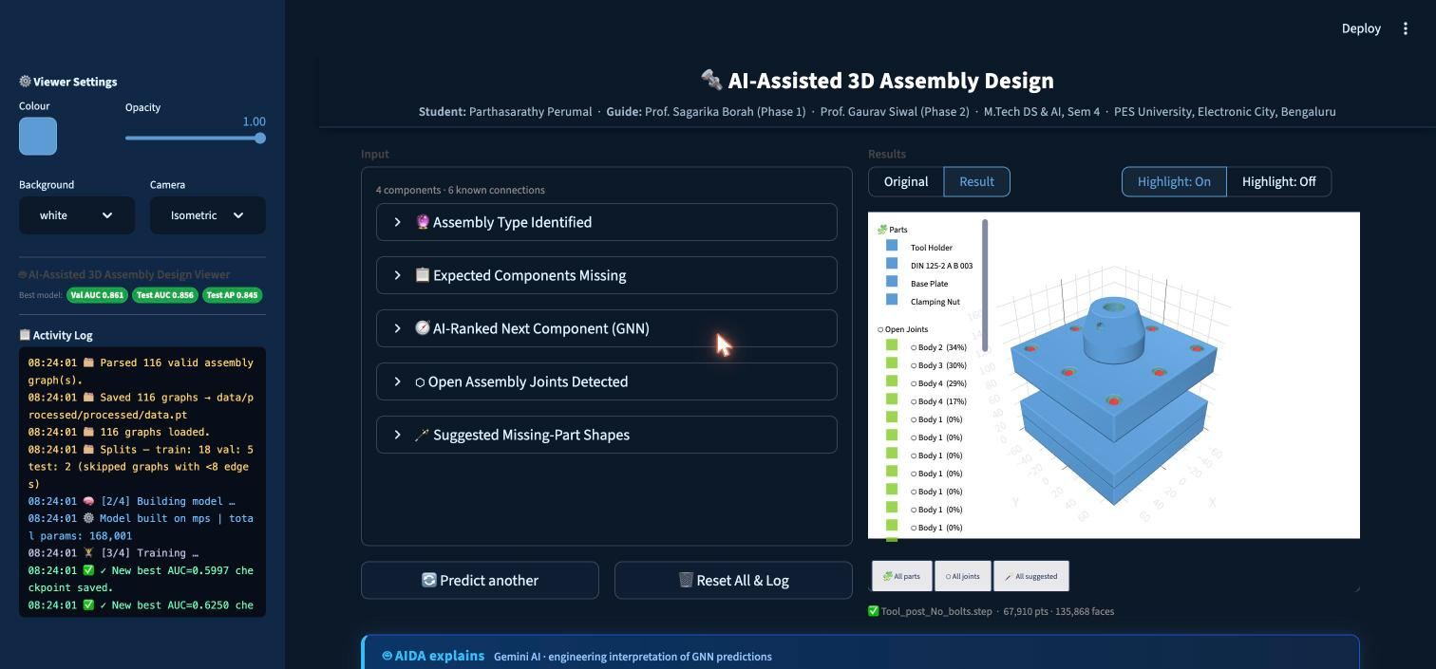
LIVE DEMO — RUN TODAY
Tool_post_No_bolts.step
4 components · 6 known connections
GNN predicts Clamping Nut ↔ Base Plate missing at 94.8% confidence
3 open joints detected — Body 2 (34%), Body 3 (30%), Body 4 (29%) open surface
Part bank suggests: 1 Nut (100% fit) + 2 Bolts (100% / 87% fit)
AIDA: “incomplete fastening operation” — recommends completing the clamping-nut mate and constraining the 3 open bodies
End-to-end: STEP upload → mesh → GNN inference → AI explanation in ~24 seconds
Streamlit 3D viewer — live inference on a real STEP file, uploaded during this session
AI-Assisted 3D Assembly Design — End-Semester Review
17

Slide 18
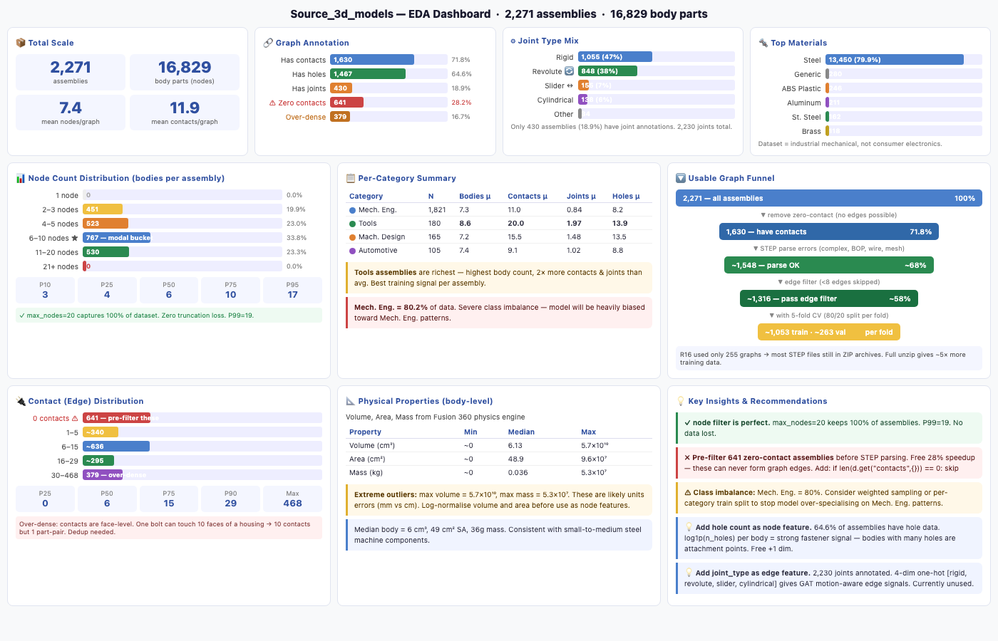
DATA
Source Corpus — Exploratory Analysis
Raw scan of Source_3d_models/ before curation & filtering down to the training corpus
AI-Assisted 3D Assembly Design — End-Semester Review · 2,271 assemblies · 16,829 body parts
18

Slide 19
CONCLUSION
What This Project Delivers
✓
Full 3-phase pipeline — detect, rank, generate — working end-to-end on real CAD geometry
✓
38+ tracked training runs across 185 commits, with systematic ablations and honest reporting of regressions
✓
A novel Octree open-surface detector and a hybrid retrieval + VAE shape generator
✓
A live Gemini-powered explanation agent (AIDA) reasoning in engineering language
✓
Phase 3 targets comfortably exceeded — IoU 0.63 vs. a 0.35 target
✓
Interactive Streamlit demo, fully open-source (MIT), zero proprietary CAD-API dependency
AI-Assisted 3D Assembly Design — End-Semester Review
19

Slide 20
LOOKING AHEAD
Limitations & Future Work
LIMITATIONS
FUTURE WORK
Phase 1 Mean AUC 0.8235 — close to, but just under, the 0.85 target
NodeRanker still over-predicts the 'body' class (64.7% predicted vs. 41.3% true) — Hit@1 beats baseline but isn't yet a solved ranking problem
~39.5% of bodies are flagged ambiguous by the classifier's voting rules — reported honestly, not hidden
GNNExplainer interpretability layer is planned but not yet integrated
Phase 3 shape generation is currently scoped to fasteners (bolt/washer/nut) only
Integrate GNNExplainer for per-prediction interpretability
Grow the corpus further — the learning-curve check (R38) still shows no plateau at 233 graphs
Resolve NodeRanker's majority-class collapse with class-balanced sampling or loss reweighting
Broaden Phase 3 shape generation beyond fasteners to plates and shafts
Push Phase 1 AUC past 0.85 with the expanded 238-model corpus as the new baseline
AI-Assisted 3D Assembly Design — End-Semester Review
20

Slide 21
Thank You
Questions & Discussion
Parthasarathy Perumal · SRN PES2PGE24DS193
Guide (Phase 1): Prof. Sagarika Borah · Guide (Phase 2): Prof. Gaurav Siwal
M.Tech Data Science & AI · PES University, Electronic City, Bengaluru
Repository: MIT-licensed, open-source

