Slide 1
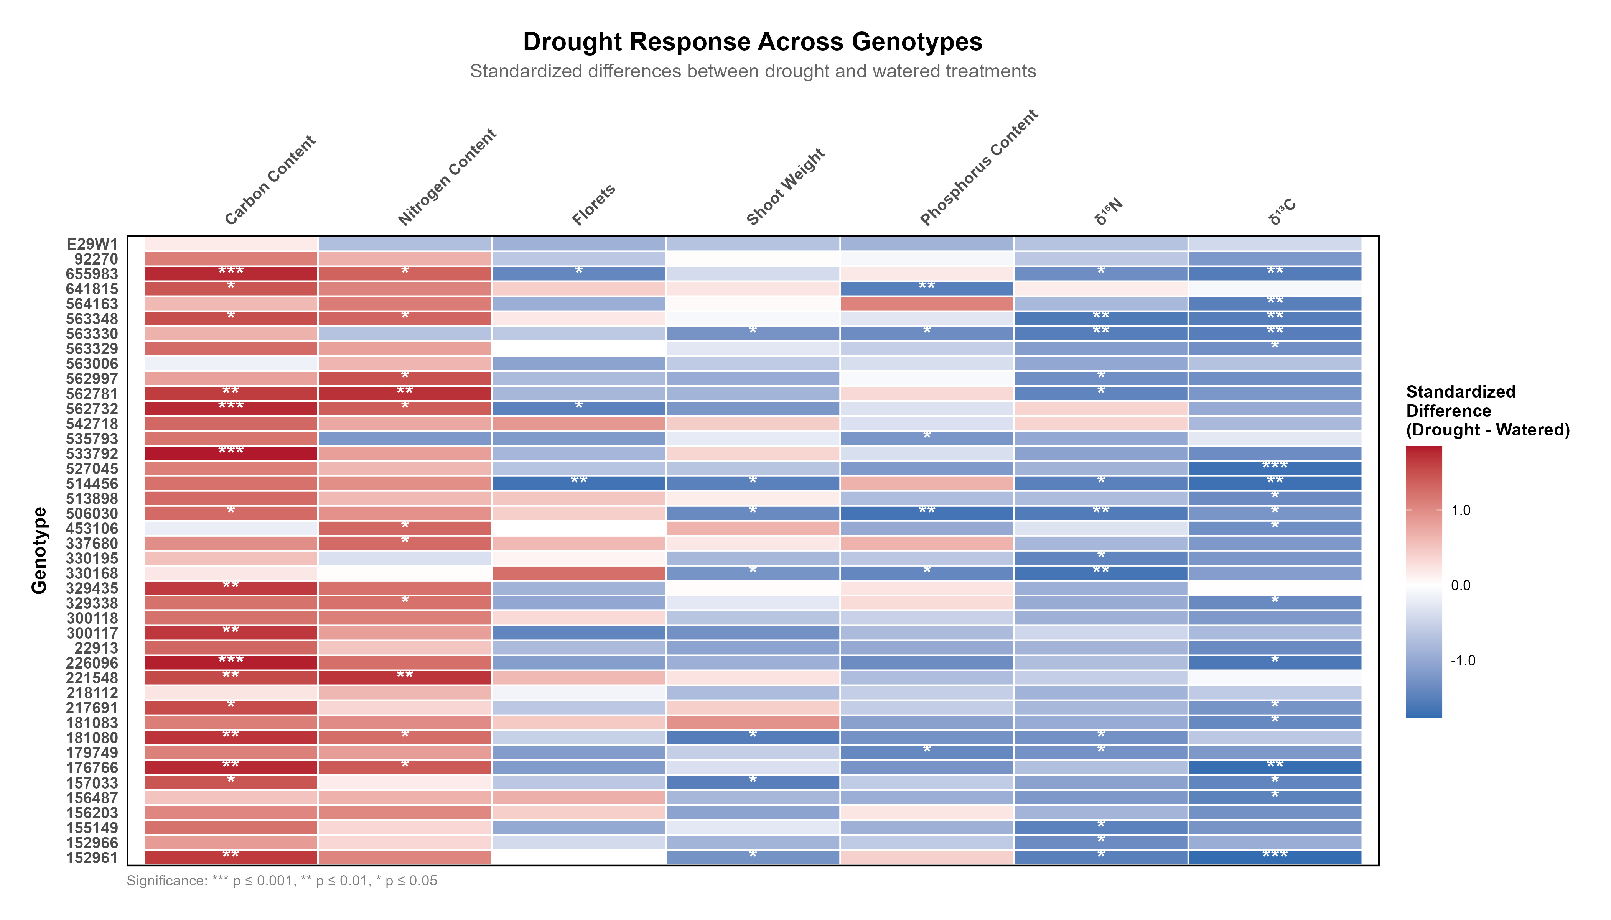
Blue = lower under drought

Slide 2
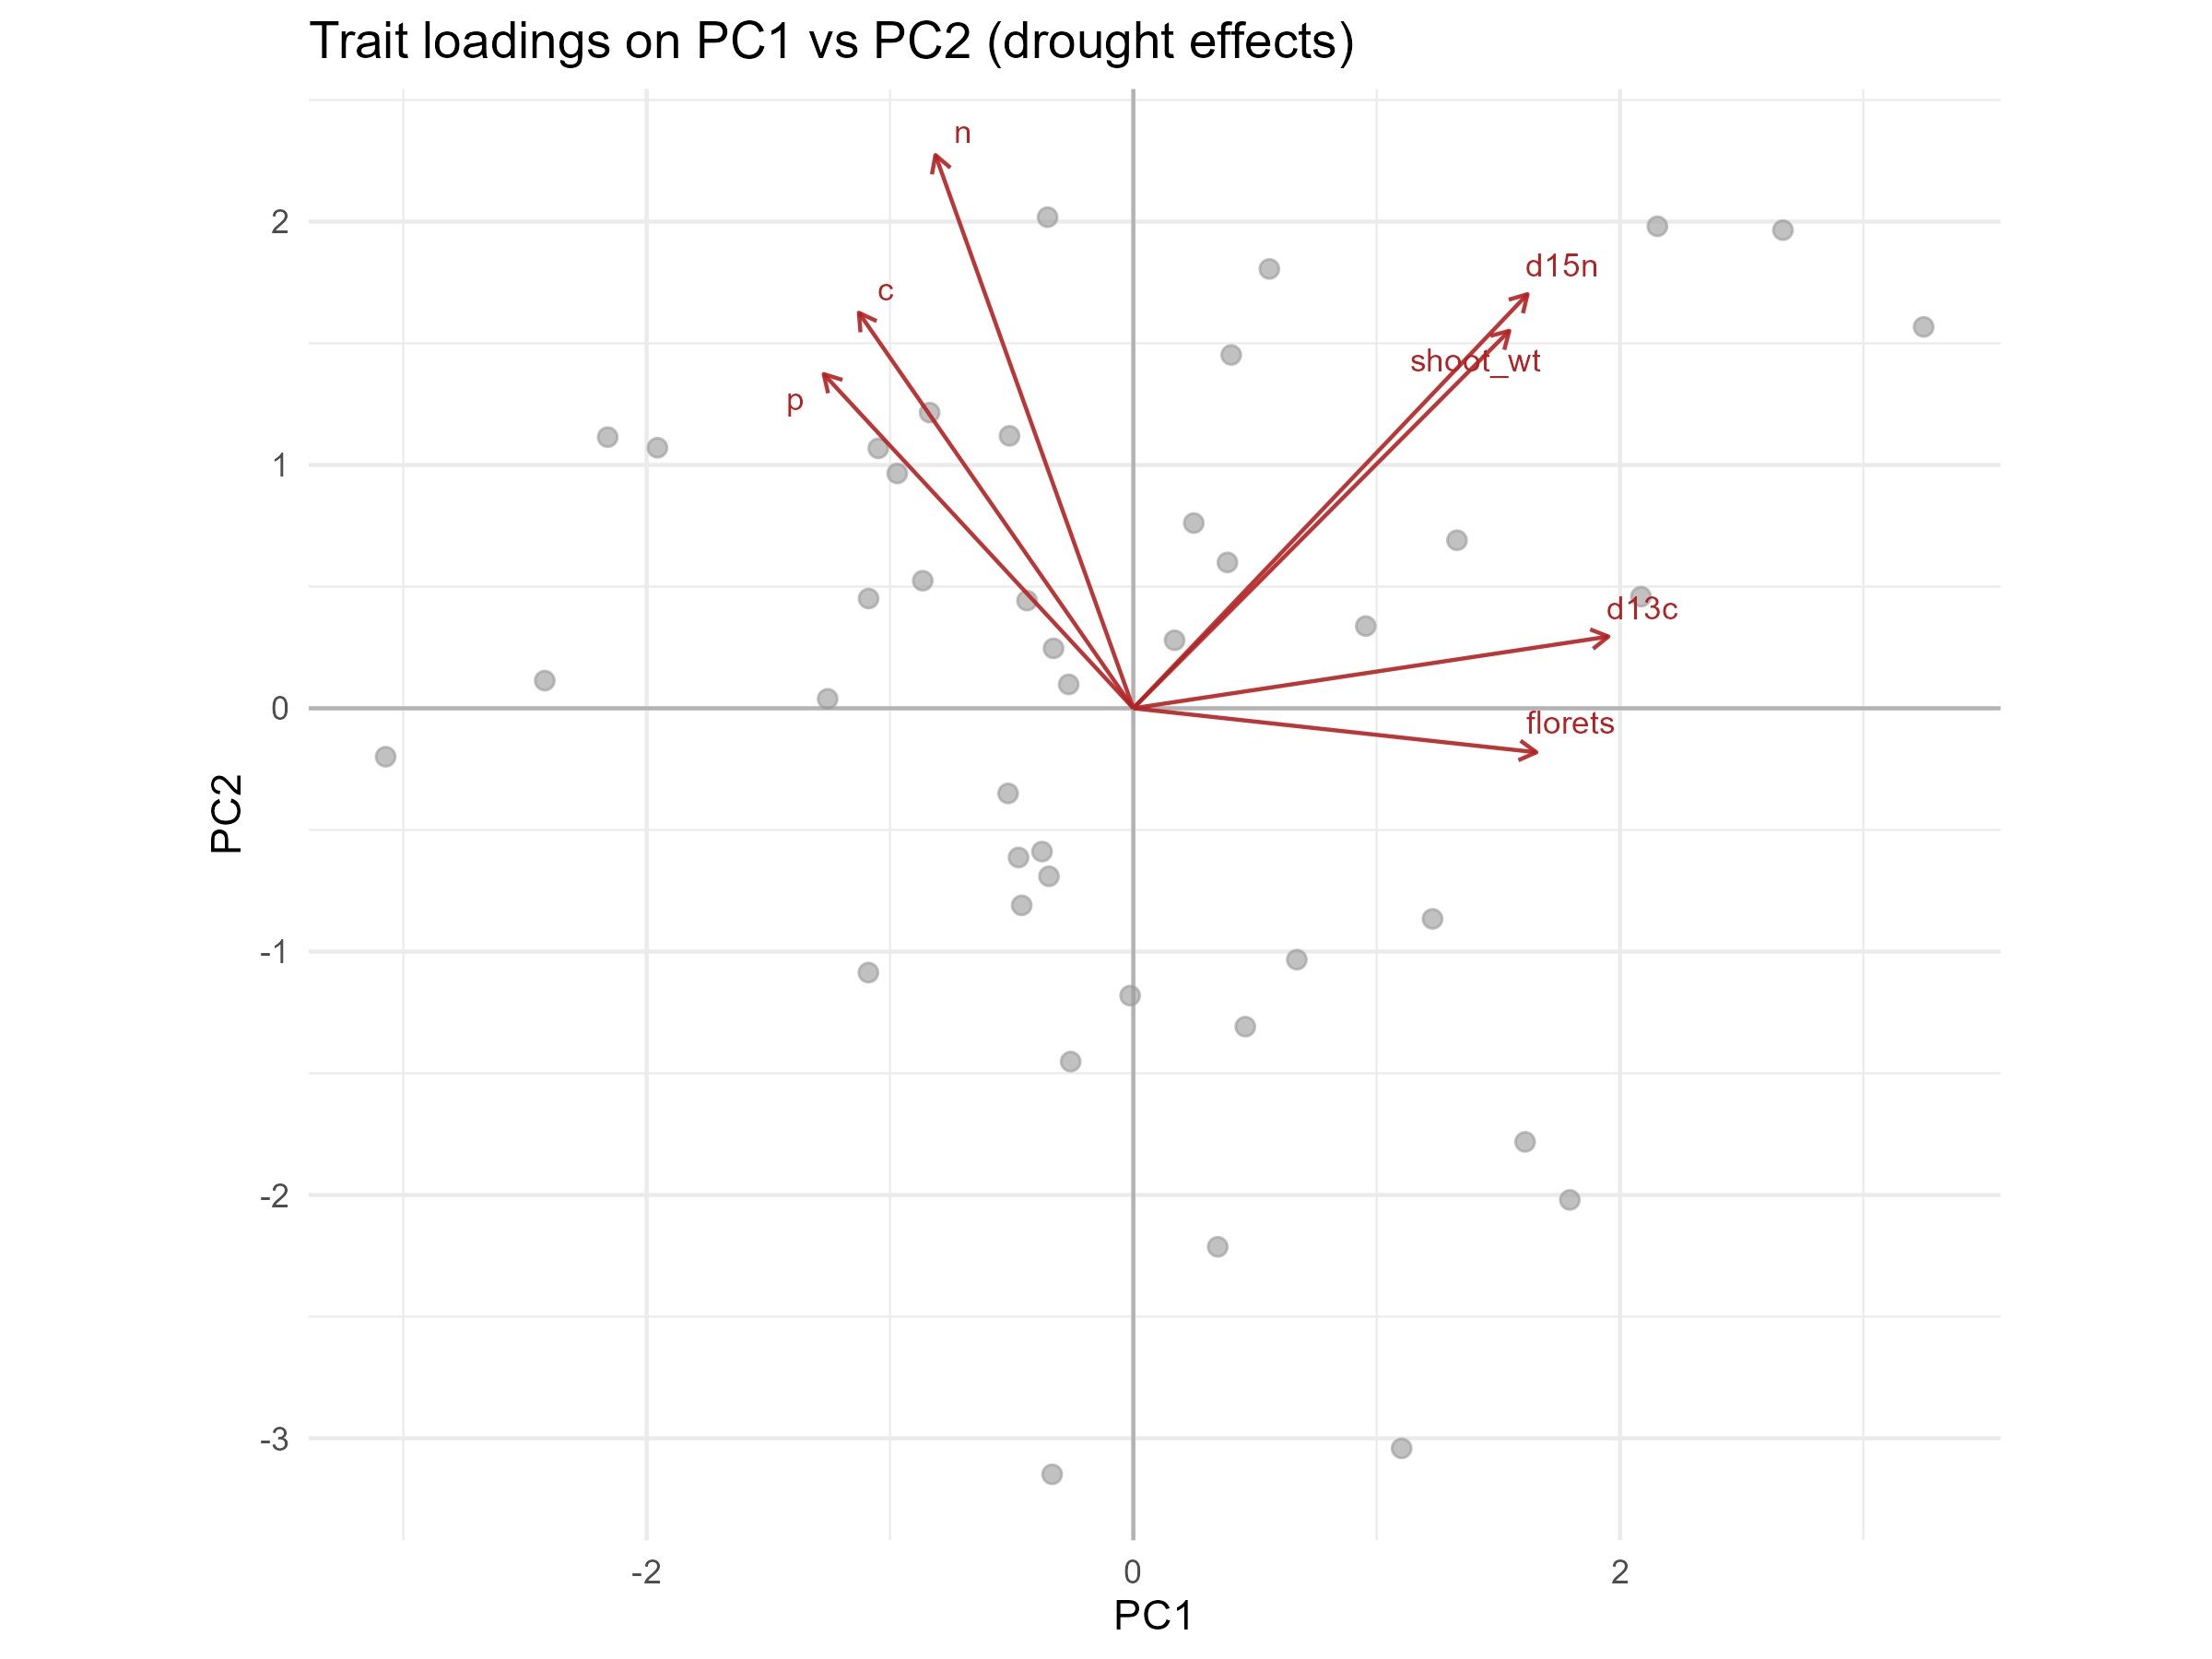
PC1: Nutrients vs. biomass

Slide 3
PC1: Nutrients vs. biomass

Slide 4
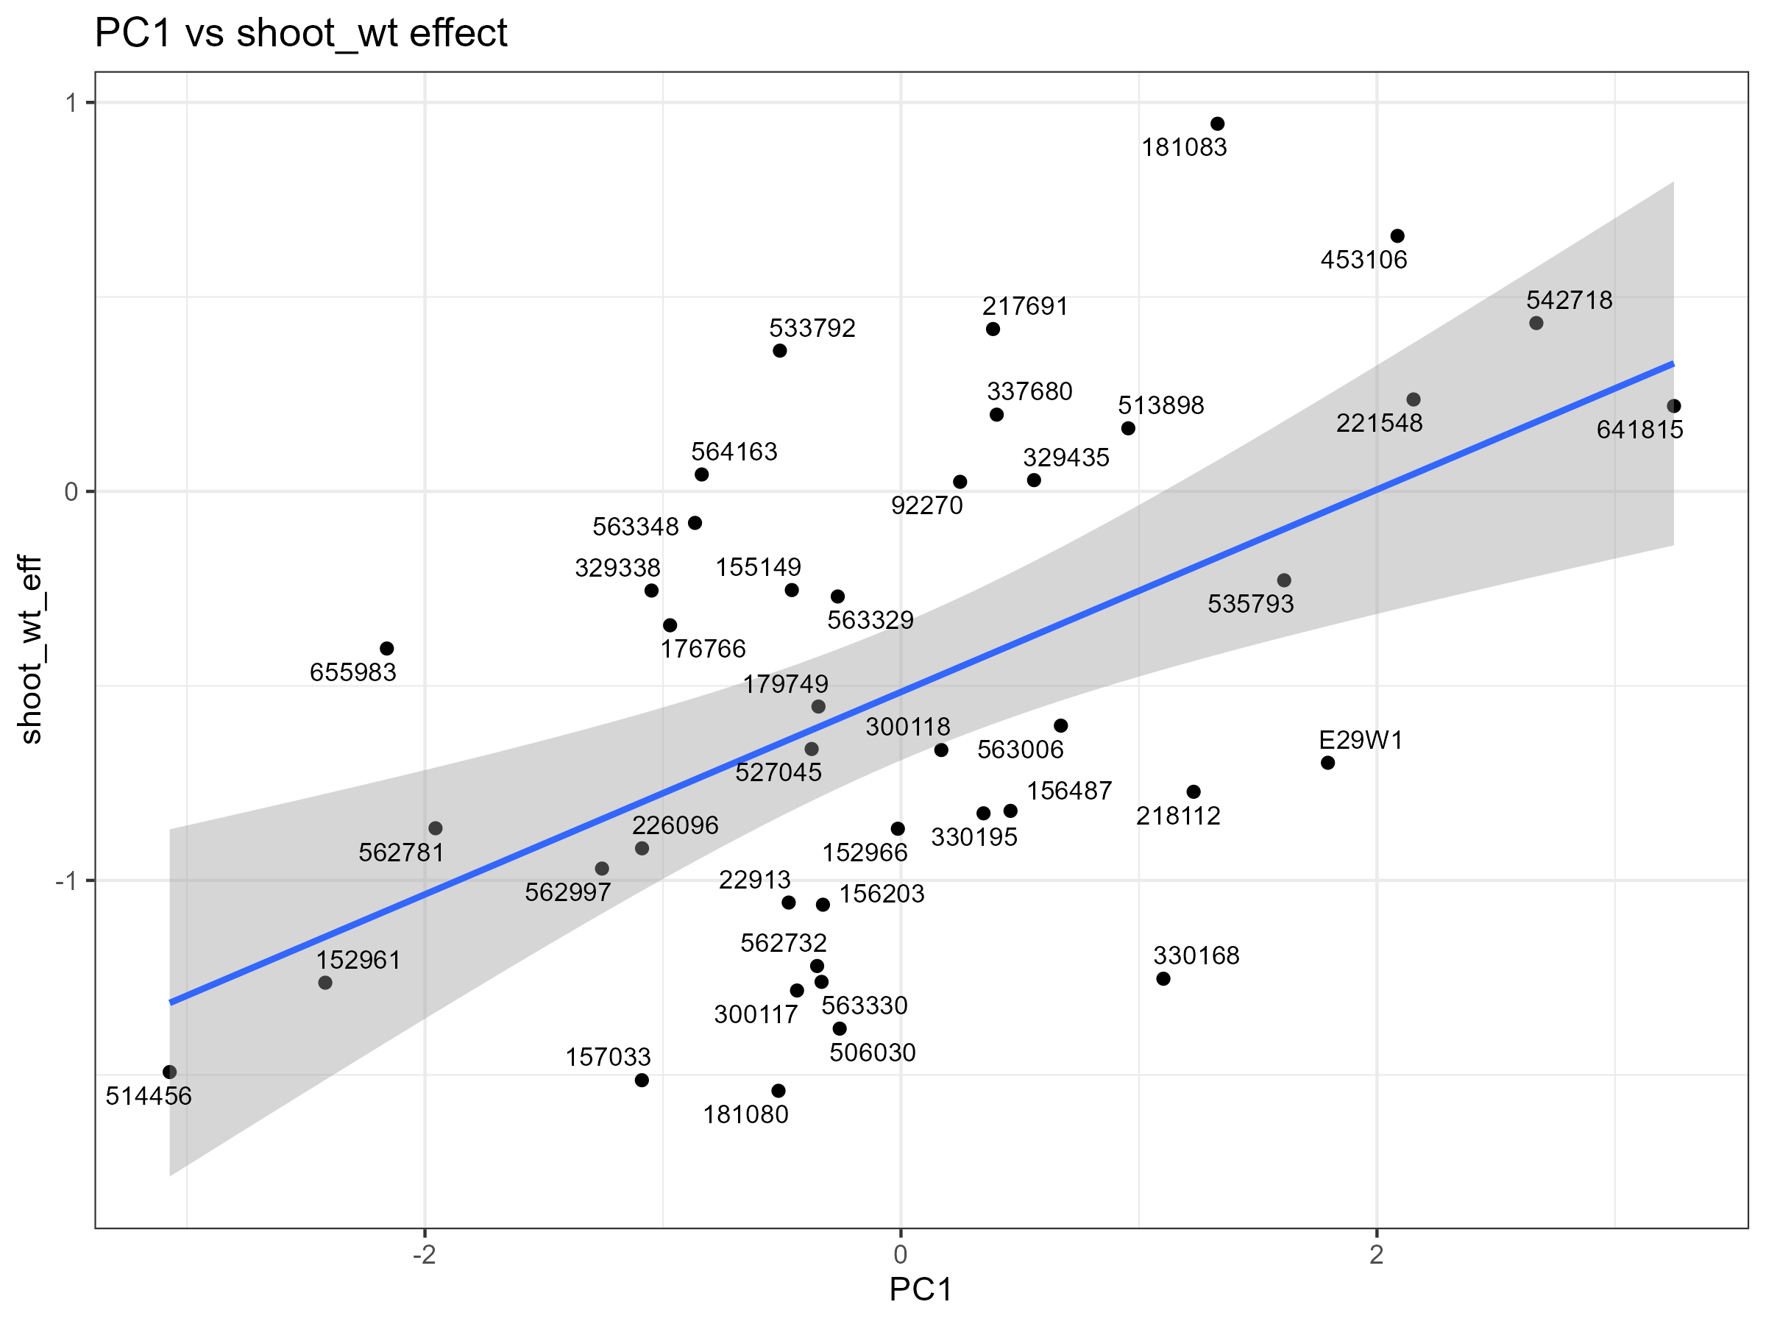

Slide 5
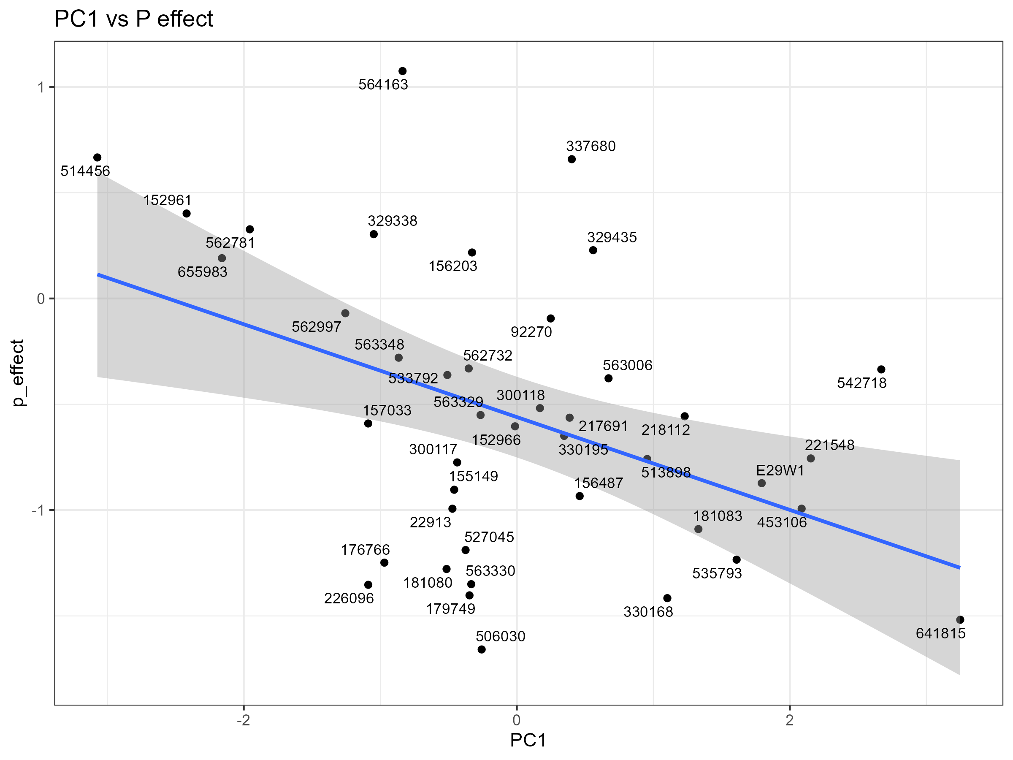

Slide 6
PC1: Nutrients vs. biomass

Slide 7
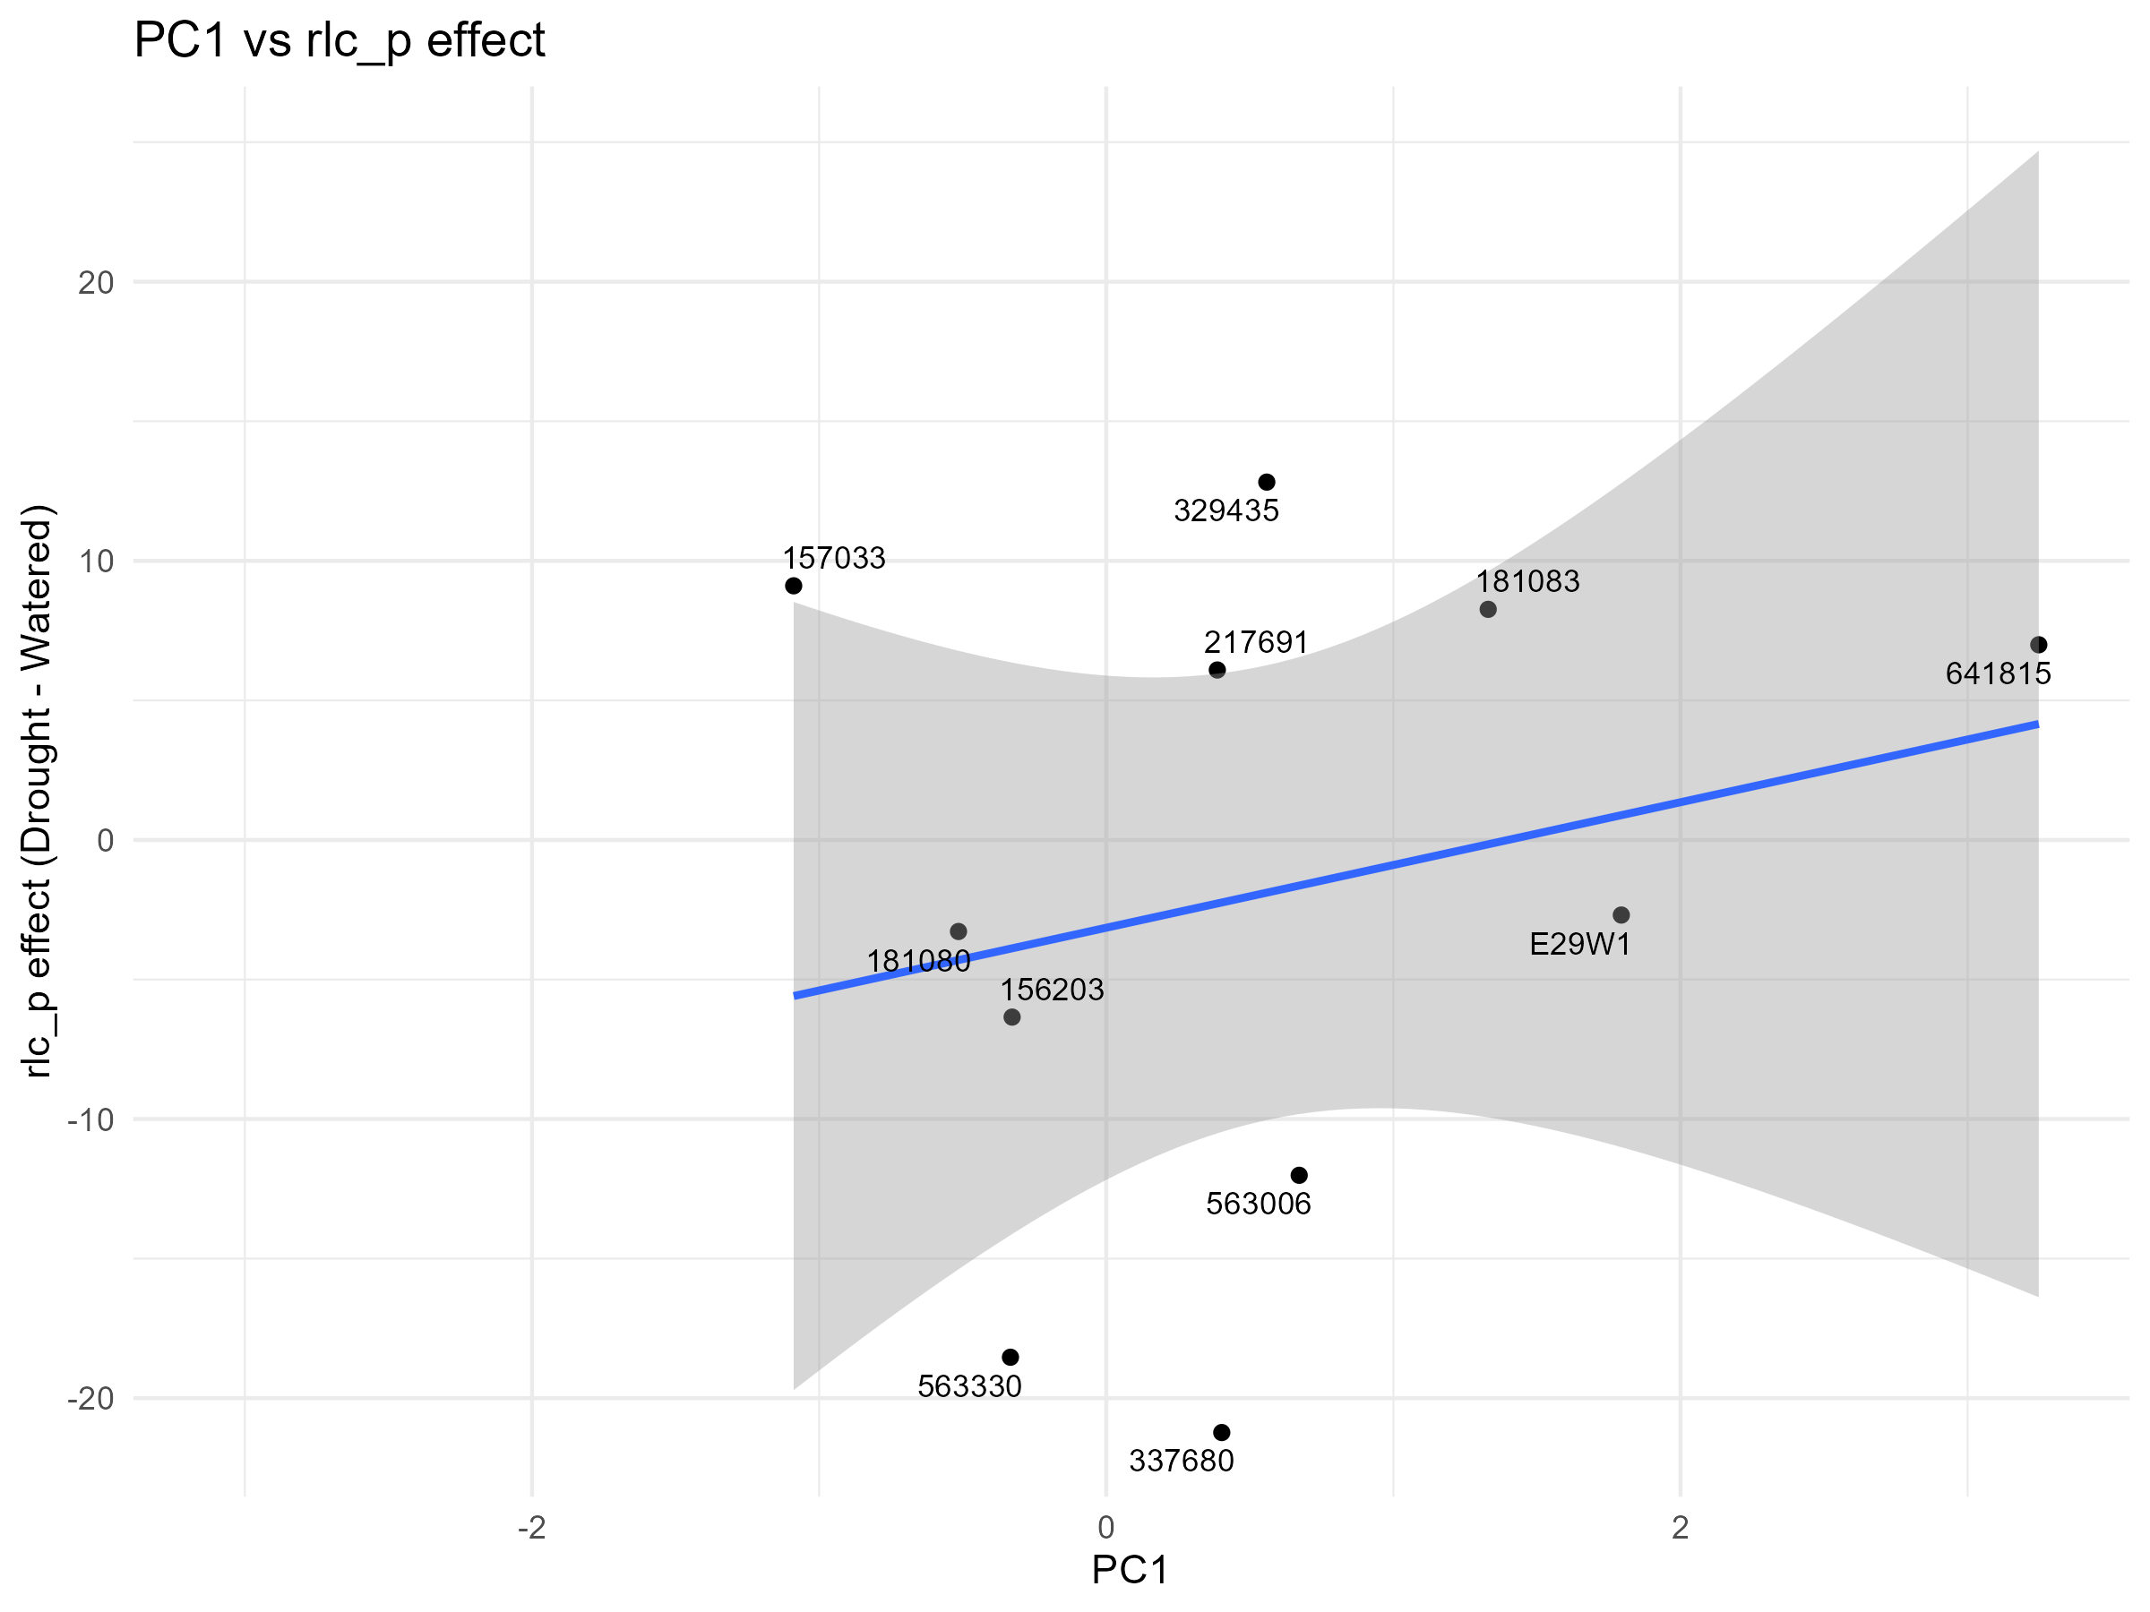

Slide 9
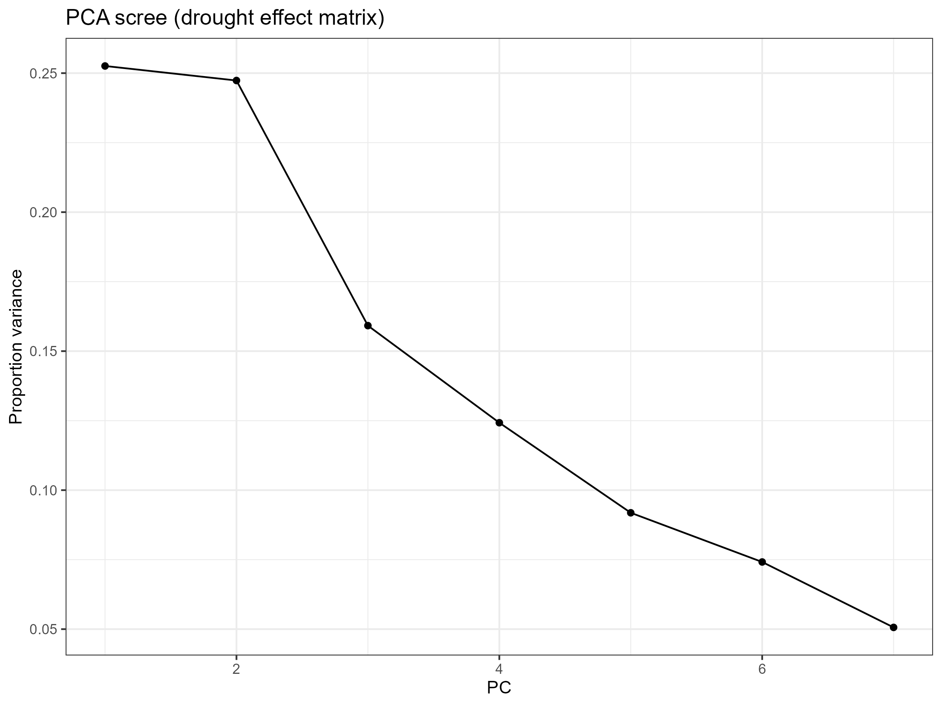
PC1 and PC2 are the biggest explainers of variance (~50%)

