Slide 1
“ProGestureCursor”

Slide 2




P.G.C.

Slide 3
ProGestureCursor – It stands for “Projector, Gesture and Cursor”
With the need of employing natural communication between humans and machines there has been a great emphasis on Human-Computer-Interaction (HCI) lately.
Hand being the most elective general-purpose tool because of its dexterity, adopting hand gesture as an interface in HCI has become very common.
P.G.C.

Slide 4
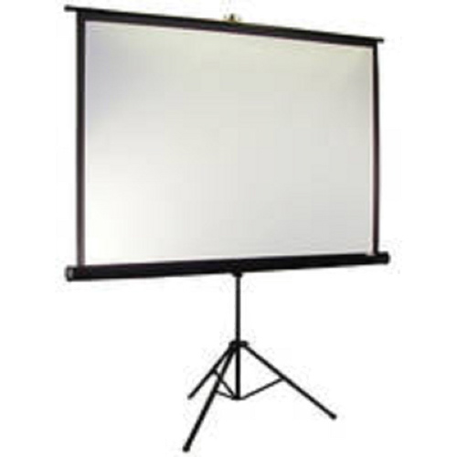
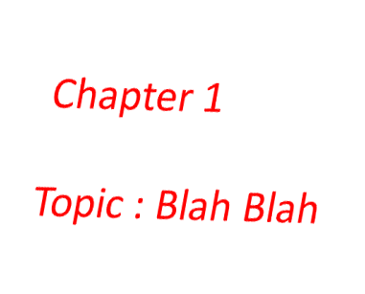

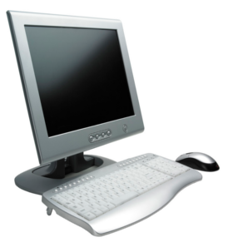
P.G.C.

Slide 5
Their have many existing technologies similar to our project, which have their own prone and cons.
Some cons of these projects are:
  Costlier camera
  Sophisticated embedded system
  Extra hardware device management
  many more…
Let’s see some devices…
P.G.C.

Slide 6
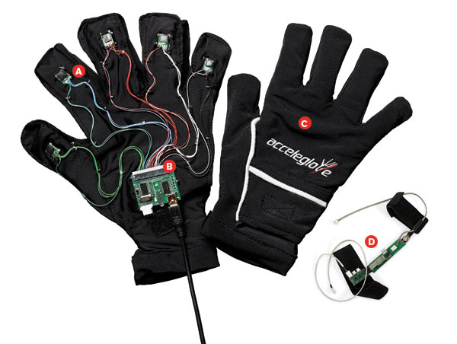
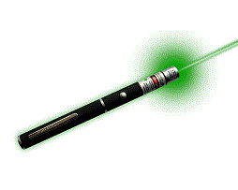
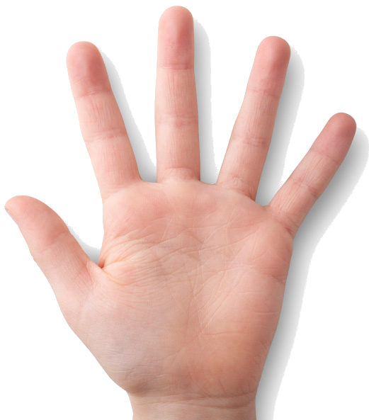
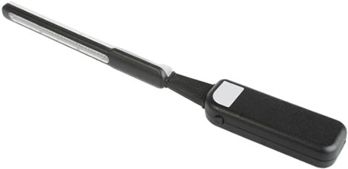
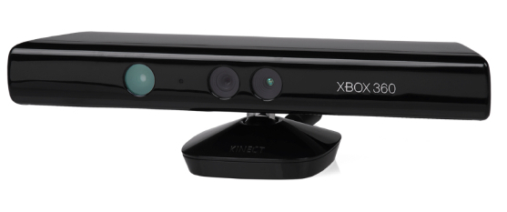
P.G.C.

Slide 7


The Skeleton
Core of the Project
Setup
P.G.C.

Slide 8
Setup
Screen
Projector
Web Camera
Projection
P.G.C.

Slide 9

Setup
Real time capturing of the projected image and the user .
Projected Image
User
P.G.C.

Slide 10

The Muscles
Functionality of the Project
Preprocessing
Hand Processing
Gesture Processing
API calls
P.G.C.

Slide 11

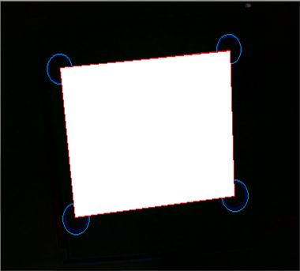

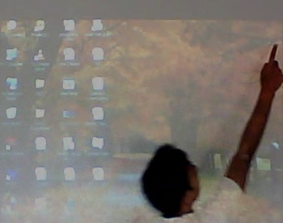
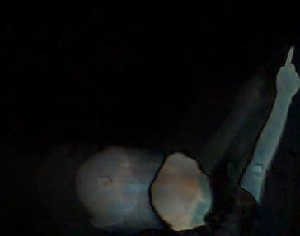

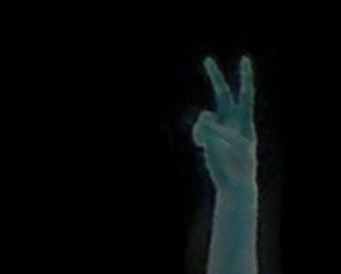
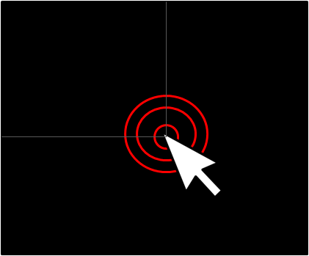

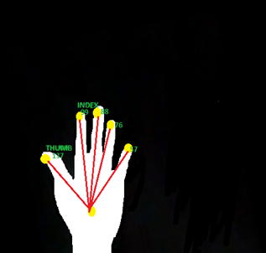
Hand Processing
API Calls
Pre-processing
Gesture Recognition
3. Screen Transformation
1. Screen Capture
2. Screen Detection
4. Motion Detection
5. Motion Capture
6. Motion Filtering
7. Hand Detection
8. Finger Detection
9. Gesture Recognition
10. Location Mapping
and API calls
P.G.C.

Slide 12

The Apparel
GUI of the Project
Intuitive
Appealing
Helpful
Standardized
P.G.C.

Slide 13
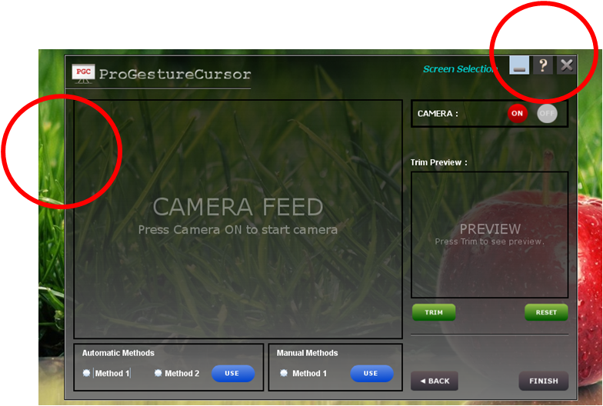
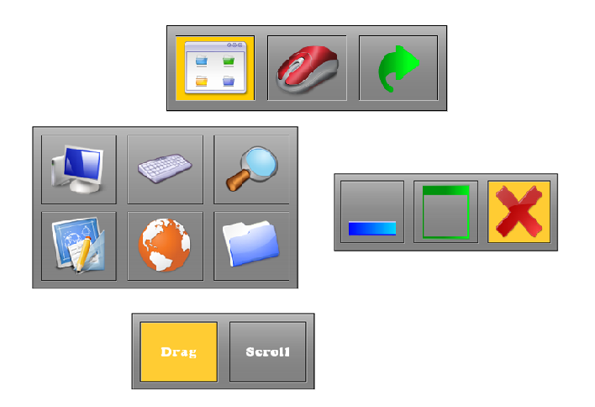
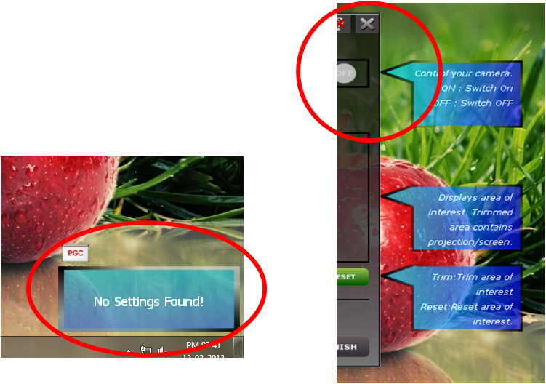
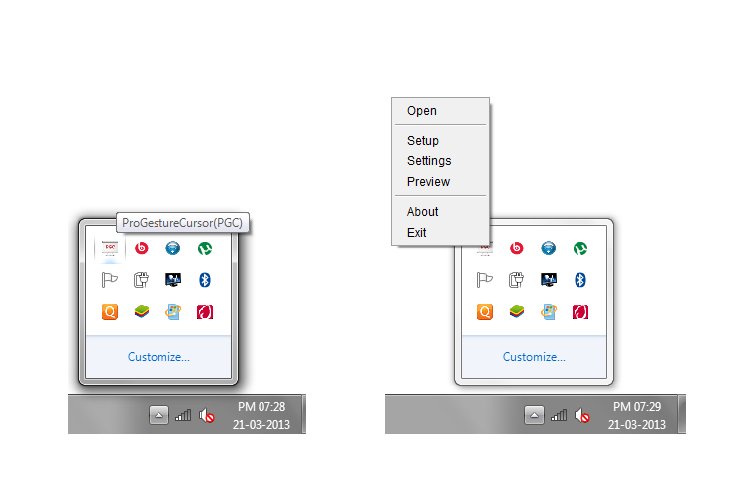
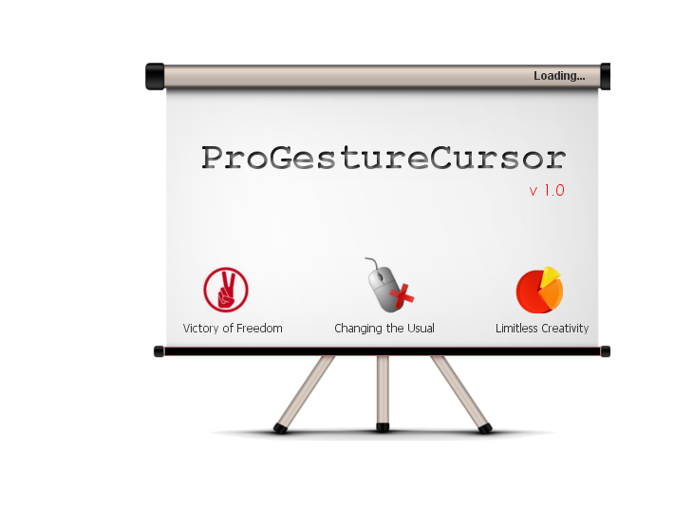
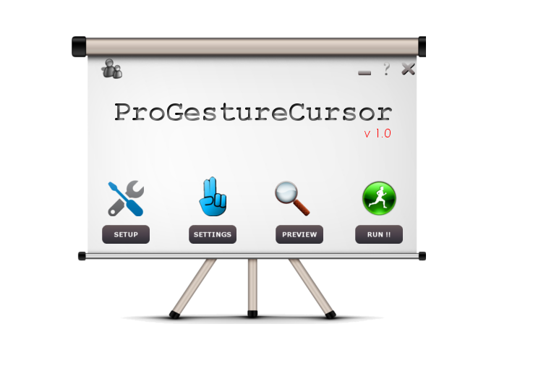

Appealing
Helpful
Standardized
Intuitive
P.G.C.

Slide 14
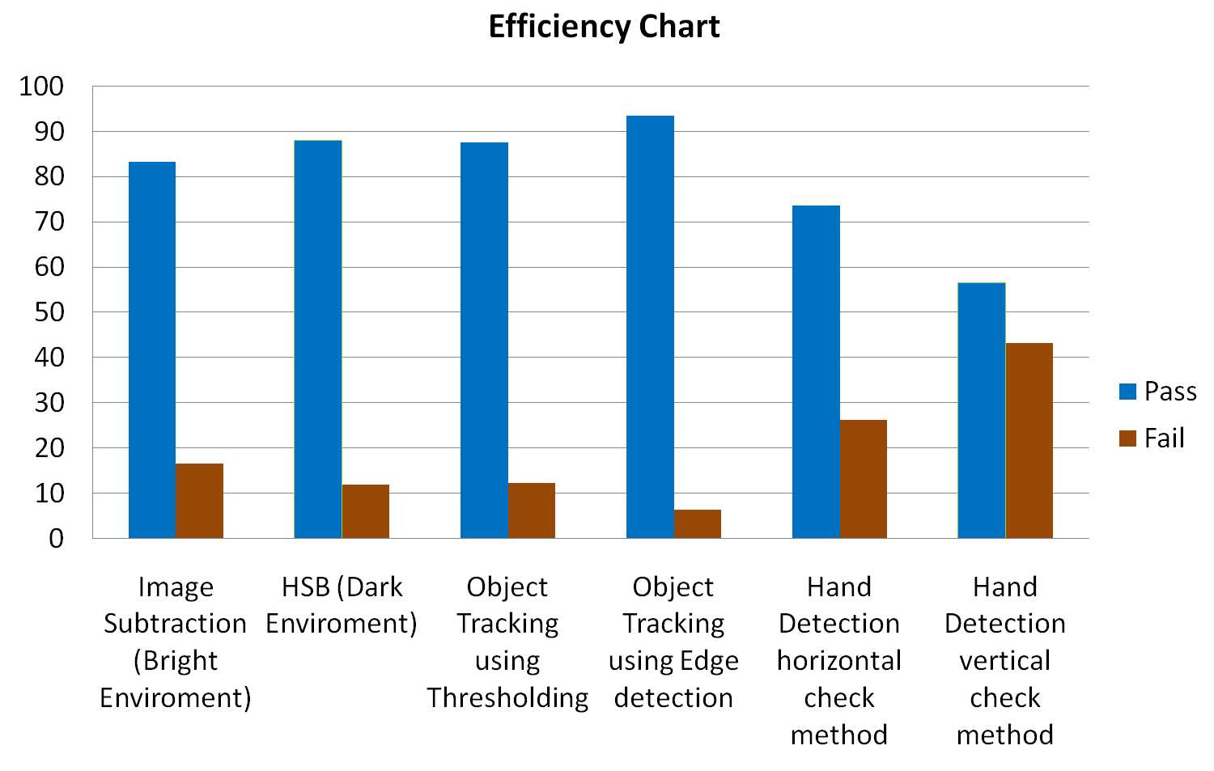
P.G.C.

Slide 15

THANK YOU
Any Questions? Lets Discuss!
P.G.C.

