Slide 1

CAPSTONE
WARM UP

Slide 2
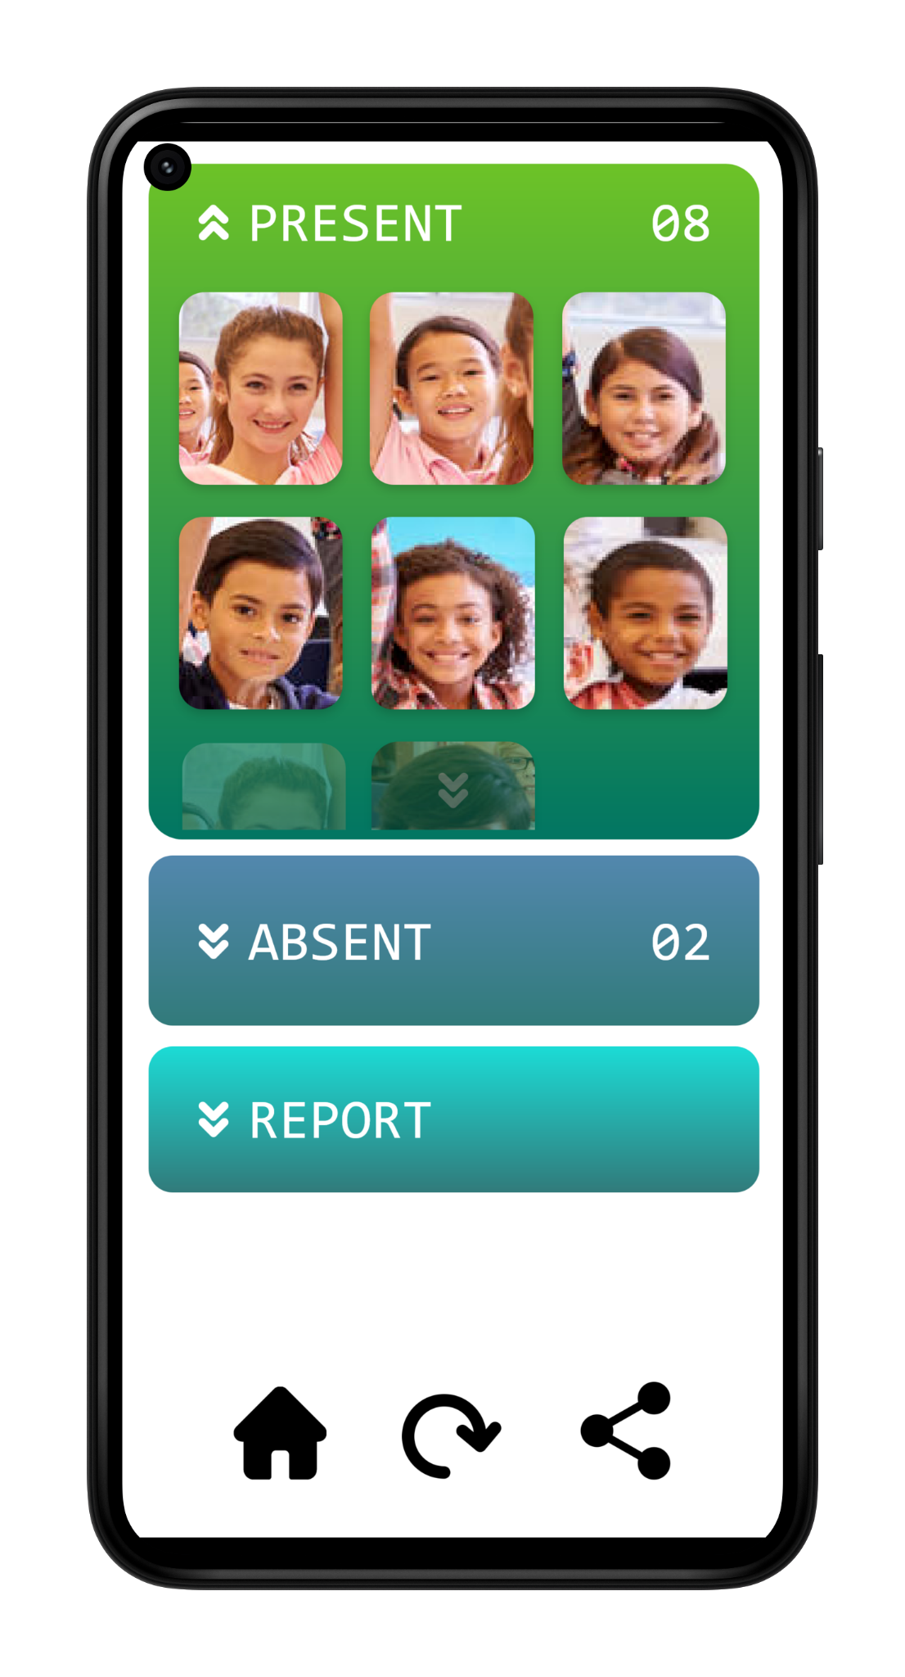
FAST
ACCURATE
DEPENDABLE
FACESHOT

Slide 3
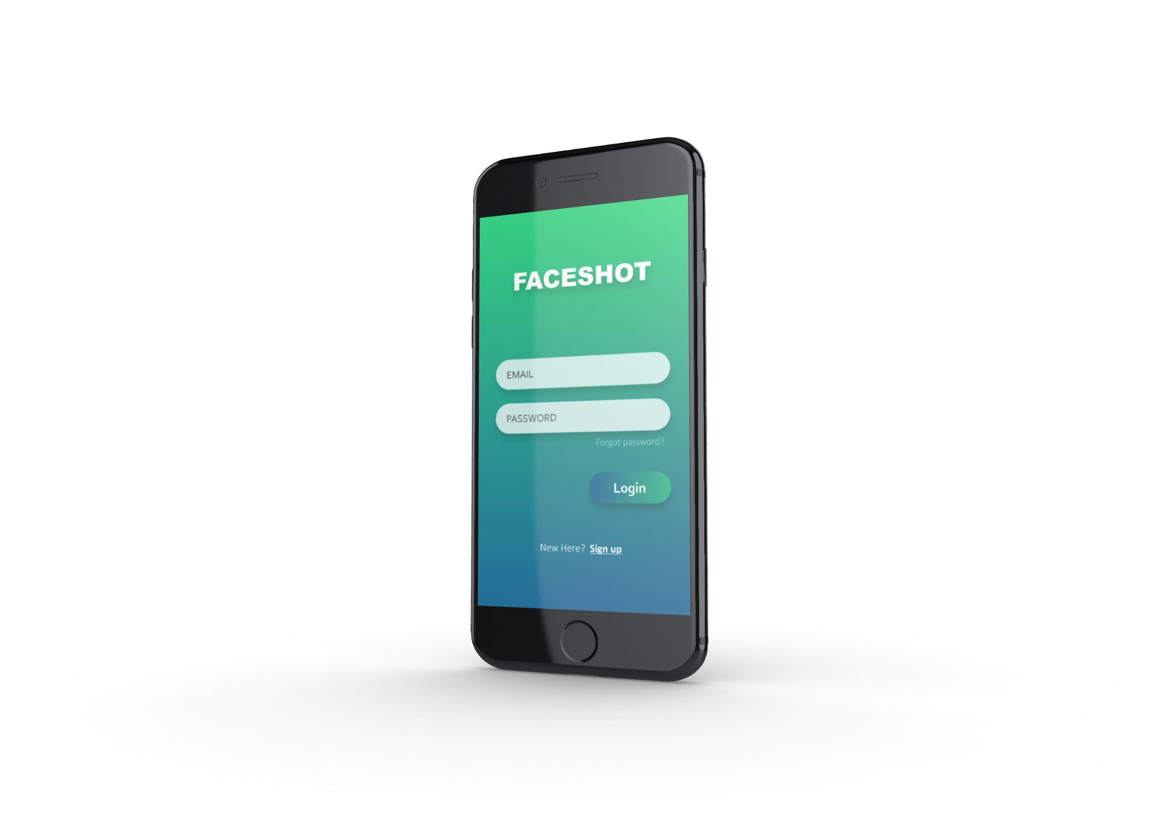
SCOPE
The scope of this project is to develop a mobile
application that uses face recognition
to mark the attendance of a class
with a single photograph.

Slide 4
PREVIOUSLY
ON

Slide 5
UPGRADES
Update the Teacher’s Application
Improved AI model
Azure Backend
Case study on the accuracy difference between Attendance from “Friends” cast and Real time students

Slide 6
Improved AI
Improved facial detection
More number of identities
Re training the model on more data to improve accuracy

Slide 7
Azure cloud hosting
Previously the backend server was hosted in Google Cloud Platform.
The updated application and the new models will be hosted in Azure Cloud Services and predictions and model retraining can be done in real time.

Slide 8

FLOW
DIAGRAM

Slide 9
Server
Image is compressed and sent to the server.
Images are received and pre-processed.
Face Detection Module detects faces
Face recognition modules identifies faces.
Teacher clicks a photo using our app.
Confidences are thresholded and a final list is compiled and saved.
Students receive push notifications.
Attendance information is updated on the teacher’s phone

Slide 10

TECH STACK

Slide 11



Front End (Mobile app + Web page)
Framework: Flutter
Language: Dart (Mobile App)
Web App

Slide 12


Communication
Framework: Flask
Language: Python

Slide 13


Computer
Vision
Framework: Tensorflow
Language: Python
Framework: OpenCV

Slide 14


Database, Auth, Cloud
Framework: Firebase
Platform: Azure

Slide 15

Version Control

Slide 16
THANK YOU
Praharsh Bhatt
Ram Raghu Sankar
Jerin Mathew

