Slide 2

OUR SOLUTION
Using face recognition to mark attendance using a single photograph.

Slide 3

FLOW
DIAGRAM

Slide 4
Server
Image is compressed and sent to the server.
Images are received and pre-processed.
Face Detection Module detects faces
Face recognition modules identifies faces.
Teacher clicks a photo using our app.
Confidences are thresholded and a final list is compiled and saved.
Students receive push notifications.
Attendance information is updated on the teacher’s phone

Slide 5
MINIMUM FEATURES
1. Teacher’s app: Captures pictures.
2. Transfer images to the Server.
3. Face Detection and Recognition.
4. Return list of identities. 5. Display information on the app.
6. Database updation.
Notes:
MVP: 1. Teacher’s app:
i. Click Picture.
Ii.
2. Send to Server
3. Prediction on Server
4. Return to Phone. 5.Display results on phone + headcount
6. Database updation.
MMP:
1. Teacher’s app: i.. Multiple pictures/ panorama
2. Push notifications - Student Module
3.
Final:
i. CRUD module in the app.
*iii. Face detection on the viewfinder.

Slide 6
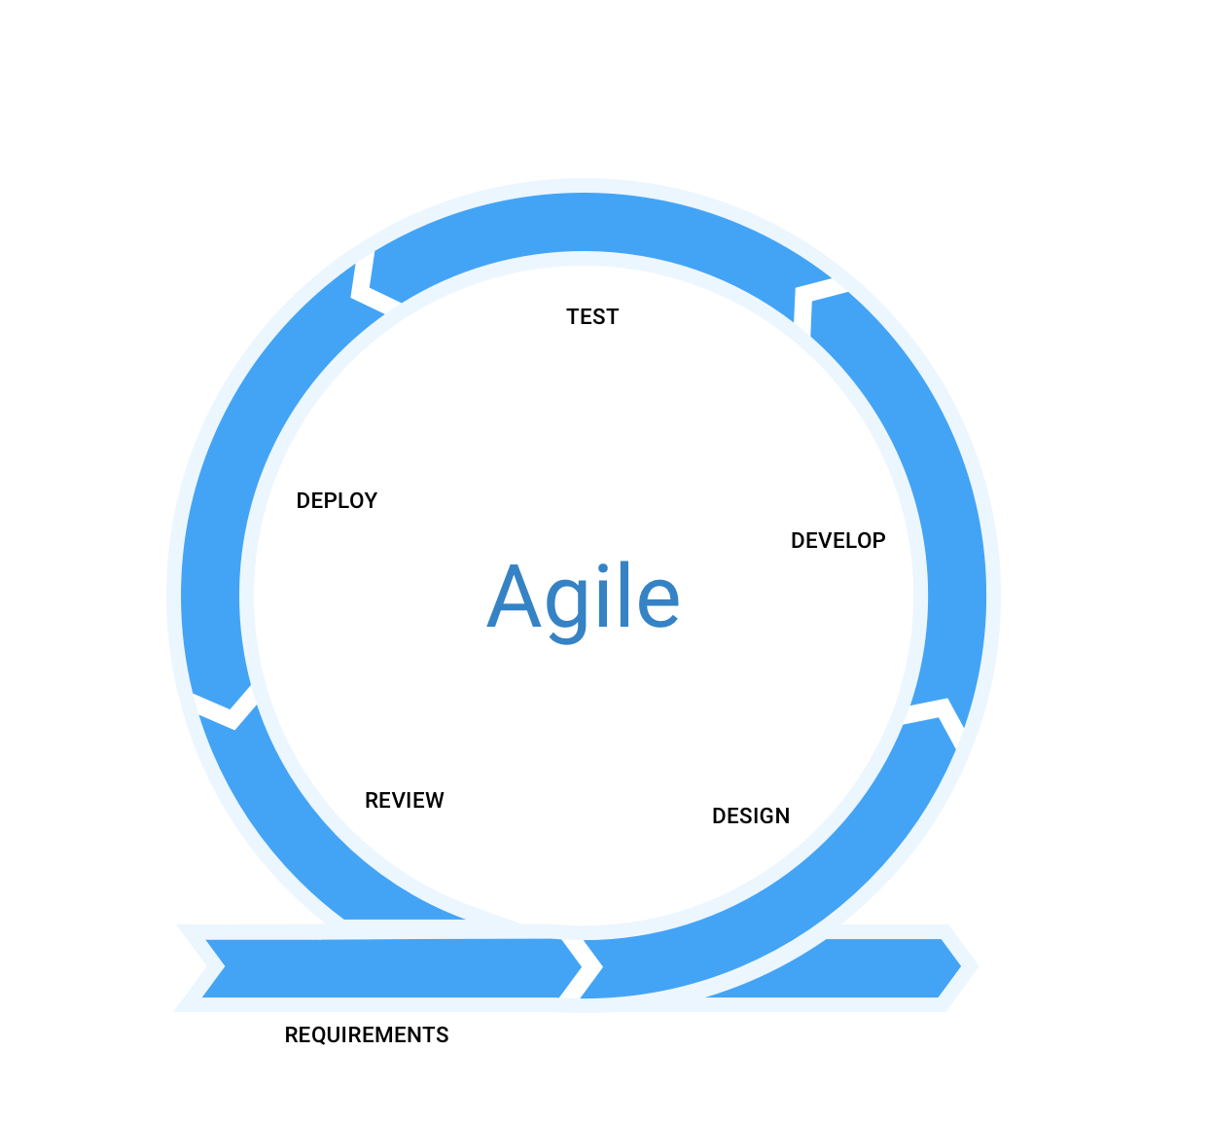
DEVELOPMENT LIFE CYCLE

Slide 7

TECH STACK

Slide 8


Front End (Mobile app)
Framework: Flutter
Language: Dart

Slide 9


Communication
Framework: Flask
Language: Python

Slide 10


Computer
Vision
Framework: Tensorflow
Language: Python
Framework: OpenCV

Slide 11

Database, Auth, Notifications
Framework: Firebase

Slide 12

Version Control

Slide 13

THANK YOU
Abhishek Joshi
Jerin Mathew
Praharsh Bhatt
Pruthviben Patel
Ram Raghu Sankar

