Slide 1



COMP6991031 | 2 SKS
NETWORKING & WEB SERVICE
HTTP, DNS, Reverse Proxy, TLS
PERTEMUAN 3 | 100 MENIT
Budi Juarto, S.T., M.Kom.
Departemen Informatika - BINUS @Bandung

Slide 2





Recap Pertemuan 2 & Agenda Hari Ini
Dari OS ke Jaringan
DI PERTEMUAN 2, KITA SUDAH:
Linux Fundamentals
HARI INI, KITA AKAN:
Networking + Web
Filesystem & navigation (FHS, cd/ls/pwd)
1. Networking foundations (TCP/IP, IP+port)
2. HTTP/HTTPS protocol (methods, status, headers)
3. DNS resolution (record types, dig)
4. Web server & reverse proxy (Nginx)
5. TLS & HTTPS (Let's Encrypt, certbot)
6. SSH tunneling (port forwarding)
Pipes & redirects (grep, find, xargs)
Permission rwx + chmod numeric (755, 600)
Package management (apt, dnf) + systemd
SSH key authentication ke server cloud
Praktikum 3: repo Docker dapat dijalankan di Codespaces atau Docker lokal.
BINUS UNIVERSITY | Cloud Services | Pertemuan 3
2

Slide 3




Learning Outcomes - Pertemuan 3
Capaian Sesi Hari Ini
1
2
3
4
Menjelaskan
Mengkonfigurasi
Mengsetup
Mendiagnosis
alur HTTP request/response, methods, dan status codes dengan benar.
DNS record (A, CNAME, MX, TXT) untuk domain custom.
Nginx sebagai reverse proxy + HTTPS dengan Let's Encrypt.
masalah jaringan pakai curl, dig, ss, dan ssh tunneling.
Sesi ini mendukung: LO2 (Apply – networking fondasi untuk deploy aplikasi) + LO1 (Analyze – pilih method, status code, record type)
BINUS UNIVERSITY | Cloud Services | Pertemuan 3
3

Slide 4
BAGIAN 01
Networking
Foundations
TCP/IP, port, dan model client-server - fondasi semua kerja di internet.

Slide 5
TCP/IP - 4 Layer Stack
Bagaimana data perjalanan dari laptop Anda ke server cloud
Layer 4
Format data yang dipahami aplikasi
Contoh:
Application
HTTP, HTTPS, SSH, DNS, SMTP, FTP
Browser kirim GET /home
Layer 3
Reliability + multiplexing via ports
Contoh:
Transport
TCP (reliable), UDP (fast)
TCP handshake + port 443
Layer 2
Routing antar jaringan via IP address
Contoh:
Internet
IP, ICMP, routing
Packet routed ke 13.250.1.2
Layer 1
Physical transmission (kabel, WiFi)
Contoh:
Link
Ethernet, WiFi, MAC address
Frame via WiFi router
Mnemonic: Saat akses github.com: Application (HTTP) → Transport (TCP port 443) → Internet (IP routing) → Link (WiFi/Ethernet).
BINUS UNIVERSITY | Cloud Services | Pertemuan 3
5

Slide 6
IP Address + Port
Alamat building + nomor pintu apartemen
IP ADDRESS - Alamat Mesin
PORT - Nomor Layanan
IPv4: 192.168.1.10 (32-bit, ~4.3 miliar alamat)
IPv6: 2001:db8::8a2e:370:7334 (128-bit, masa depan)
16-bit angka: 0 - 65535
Identifikasi service mana di sebuah mesin.
Private: 10.0.0.0/8, 172.16.0.0/12, 192.168.0.0/16
Public: alamat unik di internet (alokasi ISP / cloud provider)
Well-known: 0-1023 (butuh root)
Registered: 1024-49151 (user app)
Dynamic: 49152-65535 (ephemeral)
Port yang Wajib Hafal
22
SSH
53
DNS
80
HTTP
443
HTTPS
3000
Dev
Remote shell
Domain lookup
Web (plain)
Web (TLS)
Node.js, React
3306
MySQL
5432
Postgres
6379
Redis
8000
Django
8080
Alt HTTP
Database
Database
Cache/KV
Python dev
Proxy/dev
BINUS UNIVERSITY | Cloud Services | Pertemuan 3
6

Slide 7


Client-Server Model
Pola komunikasi paling umum di internet
1. REQUEST (GET /home)
2. RESPONSE (200 OK + HTML)
CLIENT
SERVER
Browser, mobile app, CLI
Nginx, Node.js, API backend
Contoh: Buka github.com
1
Browser resolve
'github.com'
ke IP (DNS)
2
Buka koneksi TCP
ke IP:443
(HTTPS)
3
TLS handshake
(certificate
verification)
4
Kirim HTTP
GET / + headers
5
Server proses
+ kirim response
(HTML/JSON)
BINUS UNIVERSITY | Cloud Services | Pertemuan 3
7

Slide 8
BAGIAN 02
HTTP/HTTPS
Protocol
Bahasa utama web - request, response, methods, dan status codes.

Slide 9
HTTP Request & Response Anatomy
Struktur pesan HTTP yang dipertukarkan
REQUEST (client -> server)
RESPONSE (server -> client)
HTTP/1.1 request
HTTP/1.1 response
POST /api/users HTTP/1.1
Host: api.example.com
Content-Type: application/json
Authorization: Bearer eyJhbGc...
User-Agent: curl/8.4.0
Content-Length: 47
{
"name": "Budi",
"email": "budi@bdg.id"
}
# Struktur:
# 1. Start line (method + path + ver)
# 2. Headers
# 3. Empty line
# 4. Body (JSON / form / file)
HTTP/1.1 201 Created
Content-Type: application/json
Content-Length: 89
Date: Wed, 15 May 2026 09:14:23 GMT
Cache-Control: no-cache
Location: /api/users/42
{
"id": 42,
"name": "Budi",
"created": "2026-05-15T09:14:23Z"
}
# Struktur:
# 1. Status line (ver + code + reason)
# 2. Headers
# 3. Empty line
# 4. Body (JSON / HTML / file)
BINUS UNIVERSITY | Cloud Services | Pertemuan 3
9

Slide 10

HTTP Methods
6 verb yang menyatakan niat request
GET
Safe + Idempotent
POST
Not idempotent
PUT
Idempotent
Tujuan: Ambil resource
Body: No body
Tujuan: Buat resource baru
Body: Body wajib
Tujuan: Replace seluruh resource
Body: Body wajib
GET /api/users/42
POST /api/users + JSON
PUT /api/users/42 + JSON
PATCH
Not idempotent
DELETE
Idempotent
HEAD
Safe + Idempotent
Tujuan: Update sebagian
Body: Body wajib
Tujuan: Hapus resource
Body: No body
Tujuan: GET tanpa body (cek meta)
Body: No body
PATCH /api/users/42 + diff
DELETE /api/users/42
HEAD /file.zip (cek size)
Idempotent: kirim 1x atau 5x hasilnya sama. GET/PUT/DELETE idempotent. POST tidak.
BINUS UNIVERSITY | Cloud Services | Pertemuan 3
10

Slide 11
HTTP Status Codes
Angka 3-digit yang ngasih tahu hasil request
1xx
2xx
3xx
4xx
5xx
Informational
Success
Redirect
Client Error
Server Error
Request diterima, masih diproses. Jarang dilihat langsung.
Request berhasil. Yang paling sering Anda lihat.
Resource pindah - client harus follow.
Kesalahan dari sisi client - request salah.
Server bermasalah - bukan salah client.
Contoh:
Contoh:
Contoh:
Contoh:
Contoh:
100 Continue
101 Switching Protocols
103 Early Hints
200 OK
201 Created
204 No Content
301 Moved Permanently
302 Found
304 Not Modified
400 Bad Request
401 Unauthorized
403 Forbidden
404 Not Found
429 Too Many Req
500 Internal Server
502 Bad Gateway
503 Service Unavail
504 Gateway Timeout
Wajib hafal: 200, 201, 301, 401, 403, 404, 500, 502, 504 - yang muncul di production sehari-hari.
BINUS UNIVERSITY | Cloud Services | Pertemuan 3
11

Slide 12
HTTP Headers yang Penting
Metadata yang menyertai request/response
REQUEST HEADERS
RESPONSE HEADERS
Host
domain target (wajib di HTTP/1.1)
Content-Type
format body response (application/json)
User-Agent
info client (browser / library)
Cache-Control
policy caching (no-cache, max-age=3600)
Accept
format yg bisa diterima (application/json)
Set-Cookie
server set cookie ke browser
Authorization
auth token (Bearer xxx, Basic xxx)
Location
URL redirect (untuk 3xx)
Content-Type
format body yang dikirim
Access-Control-*
CORS - domain mana yang boleh akses
Cookie
session info dari browser
X-RateLimit-*
info rate limiting (sisa quota)
Tip debugging: headers sering jadi sumber bug - cek dulu sebelum cek body. Open DevTools -> Network tab.
BINUS UNIVERSITY | Cloud Services | Pertemuan 3
12

Slide 13
curl - Swiss Army Knife untuk HTTP
Wajib bisa untuk test API dari CLI
Flag yang Wajib Tahu
curl in action
# Simple GET
$ curl https://api.github.com/users/torvalds
# POST JSON dengan auth
$ curl -X POST https://api.example.com/users \
-H 'Content-Type: application/json' \
-H 'Authorization: Bearer xxx' \
-d '{"name":"Budi"}'
# Verbose - lihat headers
$ curl -v https://example.com
> GET / HTTP/2
> Host: example.com
< HTTP/2 200
< content-type: text/html
# Test API dengan jq
$ curl -s api.example.com | jq '.users[].name'
-X METHOD
Pilih method (GET default)
-H 'K: V'
Tambah header
-d 'data'
Kirim body (auto-POST)
-i
Include response headers
-v
Verbose - tampilkan request
-L
Follow redirect
-o file
Save output ke file
-s
Silent (no progress bar)
BINUS UNIVERSITY | Cloud Services | Pertemuan 3
13

Slide 14
HTTP/1.1 vs HTTP/2 vs HTTP/3
Evolusi protokol untuk web yang lebih cepat
HTTP/1.1
1997
HTTP/2
2015
HTTP/3
2022
TCP + plaintext
TCP + TLS + binary
QUIC (atas UDP)
Karakteristik:
Karakteristik:
Karakteristik:
Text-based protocol
Persistent connection
1 req/koneksi (head-of-line blocking)
No native compression
Binary framing
Multiplexing (req paralel)
Header compression (HPACK)
Server push (jarang dipakai)
Pakai UDP + QUIC, bukan TCP
No TCP head-of-line blocking
0-RTT connection setup
Better di mobile / lossy network
Pakai untuk: Legacy systems
Pakai untuk: Production web modern
Pakai untuk: Cloudflare, YouTube, Google
Real-world: Vercel, Cloudflare, dan kebanyakan cloud serve HTTP/2 + HTTP/3 by default. Browser nego otomatis lewat ALPN saat TLS handshake.
BINUS UNIVERSITY | Cloud Services | Pertemuan 3
14

Slide 15
BAGIAN 03
Domain Name
System (DNS)
Bagaimana 'github.com' diterjemahkan jadi alamat IP server.

Slide 16
DNS Resolution Flow
Dari typing URL ke IP - 6 langkah
1
Browser
Cek cache lokal (recent lookups)
2
OS Resolver
Cek /etc/hosts + OS cache
3
Recursive Resolver
DNS server ISP / 1.1.1.1 / 8.8.8.8
4
Root Server
Tanya: 'siapa yang punya .com?'
5
TLD Server
Tanya: 'siapa authoritative untuk github.com?'
6
Authoritative NS
Jawab: alamat A/AAAA github.com dapat berubah
Waktu lookup bergantung resolver dan jaringan; hasil dapat tersimpan di cache. TTL (Time To Live) menentukan lama cache; nilainya bergantung konfigurasi record.
BINUS UNIVERSITY | Cloud Services | Pertemuan 3
16
Notes:
DNS tidak memiliki satu TTL atau waktu lookup baku. Bandingkan dig web A, dig web AAAA, dan hasil resolver container. Rujukan: https://developers.cloudflare.com/learning-paths/cybersafe/concepts/what-is-dns/ .

Slide 17
DNS Record Types
Macam-macam info yang bisa disimpan di DNS
A
IPv4 address
AAAA
IPv6 address
CNAME
Alias domain
Contoh:
Contoh:
Contoh:
github.com -> 140.82.114.4
github.com -> 2606:50c0:8000::153
www -> github.com
Pakai untuk:
Pakai untuk:
Pakai untuk:
Domain ke server (paling umum)
Domain ke server IPv6
Sub-domain pointing ke domain lain
MX
Mail server
TXT
Text arbitrary
NS
Name server
Contoh:
Contoh:
Contoh:
github.com -> aspmx.l.google.com
v=spf1 include:_spf.google.com
github.com -> ns-421.awsdns-52.com
Pakai untuk:
Pakai untuk:
Pakai untuk:
Email routing (Gmail, custom domain)
Verifikasi domain, SPF, DKIM
Delegasi ke authoritative NS
Essential untuk Anda: A (point ke server), CNAME (Vercel/Netlify deploy biasa pakai ini), TXT (verifikasi ownership Google Search Console, Cloudflare).
BINUS UNIVERSITY | Cloud Services | Pertemuan 3
17

Slide 18
dig & nslookup - DNS Debugging
Tool wajib saat domain bermasalah
dig - the modern way
dig in action
Tampilkan info DNS lengkap. Default pakai resolver sistem.
$ dig github.com +short
140.82.114.4
$ dig github.com
;; ANSWER SECTION:
github.com. 60 IN A 140.82.114.4
;; AUTHORITY SECTION:
github.com. 86400 IN NS ns-421.awsdns-52.com.
;; Query time: 28 msec
;; SERVER: 192.168.1.1#53
# Lookup MX record (mail server)
$ dig gmail.com MX +short
10 alt2.gmail-smtp-in.l.google.com.
20 alt3.gmail-smtp-in.l.google.com.
5 gmail-smtp-in.l.google.com.
dig github.com
Lookup A record (default)
dig github.com AAAA
Lookup IPv6 (AAAA)
dig github.com MX
Cari mail server
dig +short github.com
Output ringkas, IP saja
dig +trace github.com
Trace dari root - debug
dig @1.1.1.1 example.com
Pakai resolver Cloudflare
BINUS UNIVERSITY | Cloud Services | Pertemuan 3
18

Slide 19
BAGIAN 04
Web Server &
Reverse Proxy
Nginx, Apache, dan kenapa reverse proxy jadi standar production.

Slide 20

Apa itu Web Server?
Software yang serve HTTP request - bisa static file atau dynamic
Web server = process yang listen di port 80/443 dan respond HTTP request.
Tugas: terima request, baca file dari disk (static) atau forward ke app server (dynamic), kembalikan response.
Web Server Populer
Nginx
Apache
Caddy
Cloudflare
Reverse proxy
Web server
HTTPS otomatis
Share: Edge
Event-driven, performa tinggi. Standar reverse proxy modern.
Veteran sejak 1995. .htaccess + module-based. PHP friendly.
HTTPS otomatis dari Let's Encrypt. Config simple (Caddyfile).
Bukan self-hosted - CDN + edge worker. Banyak situs di belakang ini.
Pangsa pasar berubah; fokus fungsi tiap layanan. Praktikum kita: Nginx (paling banyak dipakai untuk reverse proxy + serve static asset).
BINUS UNIVERSITY | Cloud Services | Pertemuan 3
20
Notes:
Label pangsa pasar draft lama dihapus karena metode survei berubah dan tidak diperlukan untuk Lab 03. Fokus peran Nginx sebagai reverse proxy dan web server.

Slide 21



Reverse Proxy
Nginx di depan app server - pattern paling umum production
Next.js app
:3000
API backend
NGINX
:8000
INTERNET
:80, :443
Static files
/var/www
Kenapa Pakai Reverse Proxy?
TLS Termination
Load Balancing
Security Layer
Caching + Compression
Handle HTTPS di Nginx, backend cukup HTTP biasa.
Distribusi traffic ke banyak backend instance.
Rate limit, IP blocking, WAF di depan app.
Gzip + static cache - kurangi load backend.
BINUS UNIVERSITY | Cloud Services | Pertemuan 3
21

Slide 22
Nginx Config Example
Reverse proxy + HTTPS untuk Next.js
Struktur Config Nginx
/etc/nginx/sites-available/myapp.conf
server {
listen 80;
server_name myapp.com www.myapp.com;
return 301 https://$host$request_uri;
}
server {
listen 443 ssl http2;
server_name myapp.com;
# TLS dari Let's Encrypt
ssl_certificate /etc/letsencrypt/live/myapp.com/fullchain.pem;
ssl_certificate_key /etc/letsencrypt/live/myapp.com/privkey.pem;
location / {
proxy_pass http://localhost:3000;
proxy_set_header Host $host;
proxy_set_header X-Real-IP $remote_addr;
proxy_set_header X-Forwarded-Proto $scheme;
}
}
/etc/nginx/nginx.conf
Main config (global directives)
/etc/nginx/sites-available/
Server config (per-domain)
/etc/nginx/sites-enabled/
Active config (symlink)
/var/log/nginx/access.log
Akses log (request masuk)
/var/log/nginx/error.log
Error log (debug di sini)
test + reload
$ sudo nginx -t && sudo systemctl reload nginx
BINUS UNIVERSITY | Cloud Services | Pertemuan 3
22

Slide 23
BAGIAN 05
TLS & HTTPS
Enkripsi end-to-end + identitas server - kenapa HTTPS wajib.

Slide 24


Kenapa HTTPS Wajib
Bukan optional lagi - browser udah tandai HTTP sebagai 'Not Secure'
HTTPS
Halaman di Chrome
umumnya memakai HTTPS
(Google Transparency Report; metrik berbeda per platform)
3 Alasan Wajib HTTPS
Confidentiality
Integrity
Authenticity
Data antara client dan server di-enkripsi. WiFi publik / ISP tidak bisa baca password Anda.
TLS memeriksa integritas agar perubahan data saat transit terdeteksi.
Server dibuktikan identitasnya lewat certificate. Membantu memeriksa identitas server pada domain tujuan.
BINUS UNIVERSITY | Cloud Services | Pertemuan 3
24
Notes:
Google Transparency Report menunjukkan adopsi HTTPS pada Chrome, tetapi persentase berbeda menurut platform dan negara; karena itu tidak ditulis sebagai satu angka universal. Sumber: https://transparencyreport.google.com/https/overview?hl=en . Sertifikat TLS membuktikan kontrol atas domain yang diminta, bukan bahwa isi situs bebas phishing.

Slide 25
TLS Handshake (TLS 1.3)
Bagaimana koneksi aman terbentuk - 5 langkah
1
Client Hello
->
Browser kirim: 'aku support TLS 1.3 + cipher AES, ECDHE'
2
Server Hello + Certificate
<-
Server pilih cipher + kirim certificate (signed by CA)
3
Verify Certificate
->
Browser cek: CA terpercaya? Tidak expired? Domain cocok?
4
Key Exchange (ECDHE)
<->
Kedua pihak generate session key bersama (forward secrecy)
5
Encrypted Tunnel Ready
<->
Semua HTTP traffic setelahnya di-enkripsi pakai session key
-> client to server <- server to client <-> both | TLS 1.3 = 1-RTT handshake, jauh lebih cepat dari TLS 1.2 (2-RTT).
BINUS UNIVERSITY | Cloud Services | Pertemuan 3
25

Slide 26


Let's Encrypt + Certbot
Sertifikat gratis untuk domain tervalidasi
Let's Encrypt
certbot workflow
# 1. Install certbot (Ubuntu)
$ sudo apt install -y certbot python3-certbot-nginx
# 2. Generate cert + configure Nginx otomatis
$ sudo certbot --nginx -d myapp.com -d www.myapp.com
Certbot membuat:
/etc/letsencrypt/live/myapp.com/fullchain.pem
/etc/letsencrypt/live/myapp.com/privkey.pem
Updated nginx config dengan ssl_certificate
# 3. Test renew (dry run)
$ sudo certbot renew --dry-run
Congratulations, all renewals succeeded
# 4. Auto-renew via systemd timer
$ systemctl status certbot.timer
active (waiting) since Mon 14:00:00
Certificate Authority (CA) non-profit yang issue certificate TLS gratis.
Gratis selamanya - tidak ada biaya
Auto-renew via timer/cron sesuai instalasi
Otomatisasi penuh dengan ACME protocol
Dipercaya browser utama
Dipakai luas untuk sertifikat TLS web
Rate limit berlaku; cek dokumentasi resmi
BINUS UNIVERSITY | Cloud Services | Pertemuan 3
26
Notes:
Let's Encrypt memerlukan kontrol domain/validasi ACME. Lab 03 lokal memakai sertifikat self-signed yang dibuat dengan scripts/make-cert.sh, sehingga tidak perlu domain publik. Rate limit dan masa berlaku berubah; cek https://letsencrypt.org/docs/rate-limits/ dan https://eff-certbot.readthedocs.io/en/stable/using.html (diakses 8 Oktober 2026).

Slide 27
BAGIAN 06
SSH Tunneling
& Port Forwarding
Akses service di server cloud lewat tunnel - tanpa expose port public.

Slide 28
SSH Port Forwarding
3 mode tunneling untuk akses service di belakang firewall
-L
Akses port di REMOTE server lewat port di LOCAL machine.
Use case: Akses Postgres di server cloud dari laptop
$ ssh -L 5432:localhost:5432 budi@vm
LOCAL
Cara kerja: Buka port 5432 di laptop, forward ke localhost:5432 di vm
-R
Expose port di LOCAL machine lewat port di REMOTE server.
Use case: Share dev server lokal ke teman / public
$ ssh -R 8080:localhost:3000 budi@vm
REMOTE
Cara kerja: Buka port 8080 di vm, forward ke localhost:3000 di laptop
-D
Bikin SOCKS proxy lokal yang route lewat SSH tunnel.
Use case: VPN-like browsing via server
$ ssh -D 1080 budi@vm
DYNAMIC (SOCKS)
Cara kerja: Buka SOCKS proxy di laptop port 1080, route via vm
BINUS UNIVERSITY | Cloud Services | Pertemuan 3
28

Slide 29
Praktis: Akses Postgres di VM via SSH Tunnel
Use case sehari-hari untuk dev work
SSH :22
localhost
LAPTOP
VM CLOUD
POSTGRES
localhost:5432
ssh server
:5432 (private)
ssh tunnel workflow
# 1. Buka tunnel di terminal pertama (biarkan jalan)
$ ssh -L 5432:localhost:5432 budi@cloud-vm
# 2. Di terminal kedua / GUI (DBeaver, psql), connect ke:
$ psql -h localhost -p 5432 -U postgres
psql (15.5)
Type "help" for help.
postgres=# SELECT version();
# Background mode (-f -N -T)
$ ssh -fNT -L 5432:localhost:5432 budi@cloud-vm
BINUS UNIVERSITY | Cloud Services | Pertemuan 3
29

Slide 30
Cheat Sheet - Networking & Web
Print, tempel di samping laptop
Diagnose
HTTP
DNS
Nginx
ping -c 3 host
traceroute host
ss -tulpn
curl -I url
netstat -an
dig host
GET /path
POST + body
Status 2xx OK
Status 4xx client
Status 5xx server
Content-Type
dig host
dig host +short
dig host MX
dig +trace host
A = IPv4
CNAME = alias
nginx -t
systemctl reload nginx
/etc/nginx/sites-*
proxy_pass http://...
listen 443 ssl
/var/log/nginx/
TLS
SSH Tunnel
Ports
Test API
certbot --nginx -d
certbot renew
openssl s_client
TLS 1.3 1-RTT
ECDHE forward secret
Let's Encrypt free
ssh -L local
ssh -R remote
ssh -D 1080 SOCKS
ssh -fNT bg
~/.ssh/config
ssh-copy-id
22 SSH
53 DNS
80 HTTP
443 HTTPS
5432 Postgres
3000 Dev
curl -X POST
-H 'auth: ...'
-d 'body'
-v verbose
| jq parse JSON
-o save file
BINUS UNIVERSITY | Cloud Services | Pertemuan 3
30

Slide 31



Wrap-Up & Persiapan Pertemuan 4
Virtualisasi & Containerization minggu depan
Key Takeaways Hari Ini
PRAKTIKUM 3 - LATIHAN SESI INI
1
TCP/IP 4-layer + port = fondasi semua komunikasi
Diagnostik DNS, HTTP, port, dan TLS
2
HTTP: methods (GET/POST/PUT/DELETE) + status (200, 404, 500)
Jalankan stack lab jaringan di Codespaces atau Docker lokal
Bandingkan dig/nslookup dan ping/traceroute
Uji GET/POST, status, header via curl/wget
Uji port lokal via nc/nmap; cek sertifikat TLS
3
DNS: A, CNAME, MX, TXT - terjemahkan domain ke IP
4
Reverse proxy (Nginx) = standar production
5
HTTPS wajib - Let's Encrypt + Certbot bikinnya 1 perintah
PERTEMUAN 4
SSH tunneling akses service di-private tanpa expose port
Virtualisasi & Containerization
6
VM vs container, hypervisor (Type 1 vs 2), Linux namespace + cgroup, intro Docker.
Pertanyaan?
Diskusi sebelum lanjut ke Container
Sesi ini mendukung: LO2 (Apply) + LO1 (Analyze)
BINUS UNIVERSITY | Cloud Services | Pertemuan 3
31

Slide 32
BINUS UNIVERSITY | Cloud Services | Pertemuan 3
Diagnostik jaringan untuk aplikasi cloud
Hubungkan konsep OSI/TCP-IP dengan hasil perintah
• Alamat IPv4/IPv6 dan DNS menentukan tujuan koneksi; port menentukan layanan.
• REST memakai resource, method, status, dan header HTTP(S).
• CDN menyajikan konten dekat pengguna; TLS memverifikasi identitas server.
• Bandingkan dig, ping, curl, nmap lokal, dan openssl di labs/03.
• Catat host, port, status, sertifikat, serta penyebab tiap kegagalan.
Materi praktik: SeedFlora/meet3CloudService | Sumber: RPS COMP6991031
Notes:
Sumber: RPS PDF, sesi 3. Perintah nmap di lab dibatasi ke stack lokal milik mahasiswa.

Slide 33
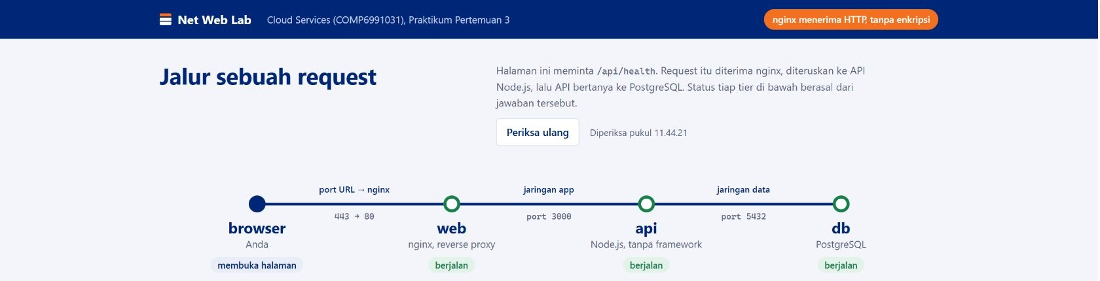
BINUS UNIVERSITY | Cloud Services | Pertemuan 3
Aplikasi tiga tier dalam Codespaces
Browser, reverse proxy nginx, API Node.js, dan PostgreSQL
Klik: Ports > 8080 > Open in Browser; lalu Periksa ulang.
Tujuan: amati web, API, dan database. Cara kerja: nginx meneruskan /api/health ke Node.js.
Baca hasil: web, api, db berjalan; akses luar Codespaces memakai HTTPS menuju nginx port 80.
Repo praktikum: github.com/SeedFlora/meet3CloudService
33
Notes:
Bukti visual dari GitHub dan Codespaces pada 1 Oktober 2026. Berkas: lab03_codespaces_web_live.jpg. Gambar dipotong agar langkah dan keluaran terbaca. Repo: https://github.com/SeedFlora/meet3CloudService. URL Codespaces dipotong dari gambar. Pada akses luar Codespaces, browser menggunakan HTTPS dan port URL diteruskan ke nginx port 80.

Slide 34
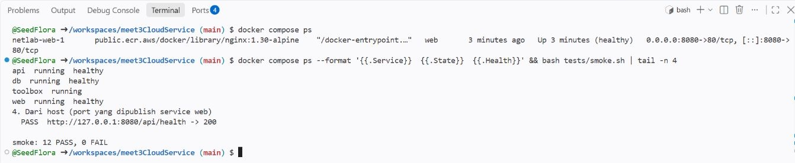
BINUS UNIVERSITY | Cloud Services | Pertemuan 3
Bukti layanan dan konektivitas
Status Compose dan smoke test dari Codespaces
Perintah gambar: docker compose ps --format "{{.Service}} {{.State}} {{.Health}}" && bash tests/smoke.sh | tail -n 4
Tujuan/cara: status empat service dibaca dahulu; && lanjut bila sukses, tail -n 4 meringkas smoke.
Baca hasil: web/api/db healthy, toolbox running, dan smoke 12 PASS, 0 FAIL.
Repo praktikum: github.com/SeedFlora/meet3CloudService
34
Notes:
Bukti visual dari GitHub dan Codespaces pada 1 Oktober 2026. Berkas: lab03_codespaces_docker_live.jpg. Gambar dipotong agar langkah dan keluaran terbaca. Repo: https://github.com/SeedFlora/meet3CloudService. Perintah screenshot: docker compose ps; docker compose ps --format "{{.Service}} {{.State}} {{.Health}}" && bash tests/smoke.sh | tail -n 4. Status pada screenshot adalah contoh hasil konfigurasi akhir.

Slide 35
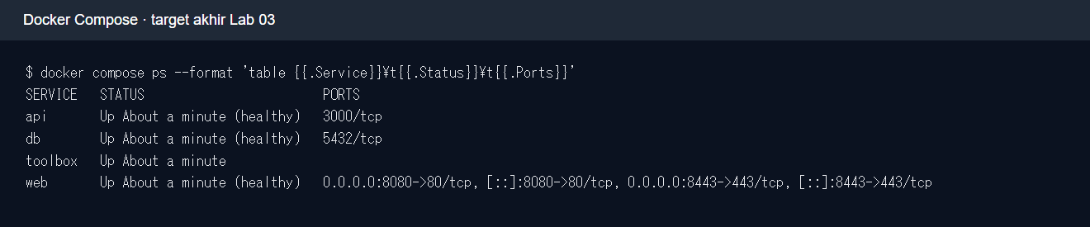
BINUS UNIVERSITY | Cloud Services | Pertemuan 3
Segmentasi port pada target akhir
API dan database tetap sehat di jaringan internal
Perintah: docker compose ps --format 'table {{.Service}}\t{{.Status}}\t{{.Ports}}'
Tujuan/cara: baca mapping host dari Compose dan bedakan dengan port internal service.
Baca hasil: hanya web pada 8080/8443; API dan DB masih healthy tanpa port host.
Repo praktikum: github.com/SeedFlora/meet3CloudService
35
Notes:
Bukti visual dari GitHub dan Codespaces pada 1 Oktober 2026. Berkas: lab03_docker_target.png. Gambar dipotong agar langkah dan keluaran terbaca. Repo: https://github.com/SeedFlora/meet3CloudService. Target dari salinan uji lokal setelah penyelesaian lab.

Slide 36
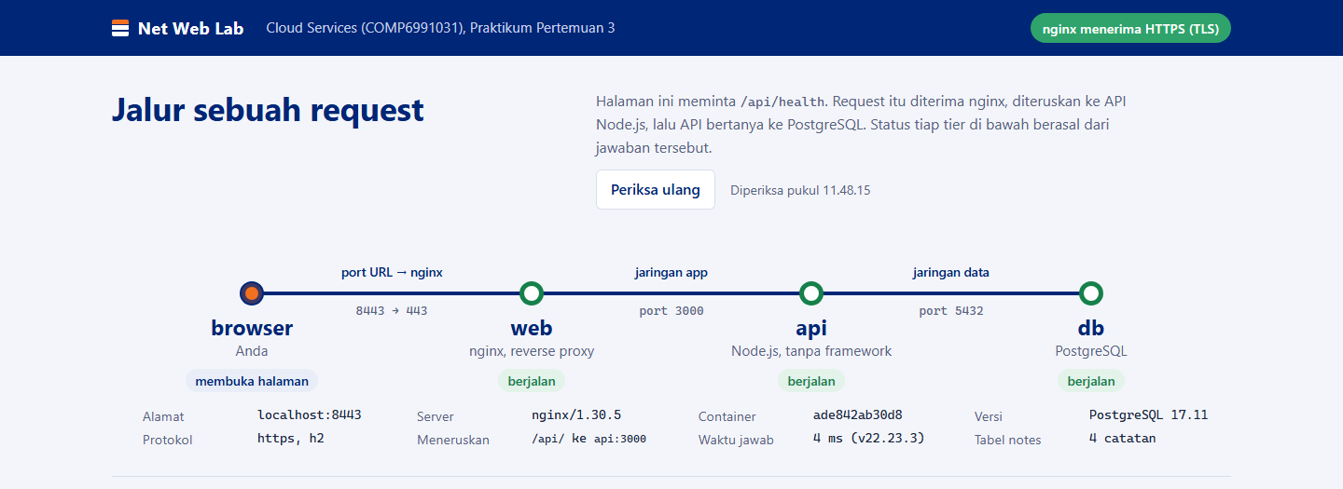
BINUS UNIVERSITY | Cloud Services | Pertemuan 3
HTTPS pada aplikasi tiga tier
Sertifikat lab, reverse proxy, dan status layanan
Perintah: docker compose exec toolbox curl --cacert /lab/web/certs/lab.crt https://web/api/health
Tujuan/cara: curl memverifikasi sertifikat self-signed sebelum meminta /api/health dari nginx.
Baca hasil: HTTP 200 dan badge HTTPS; 8443 diteruskan ke nginx 443.
Repo praktikum: github.com/SeedFlora/meet3CloudService
36
Notes:
Bukti visual dari GitHub dan Codespaces pada 1 Oktober 2026. Berkas: lab03_web_https_target_top.png. Gambar dipotong agar langkah dan keluaran terbaca. Repo: https://github.com/SeedFlora/meet3CloudService. Browser mungkin memperingatkan sertifikat self-signed. Gambar target dari salinan uji lokal.
Lab resmi: https://github.com/SeedFlora/meet3CloudService

Slide 37
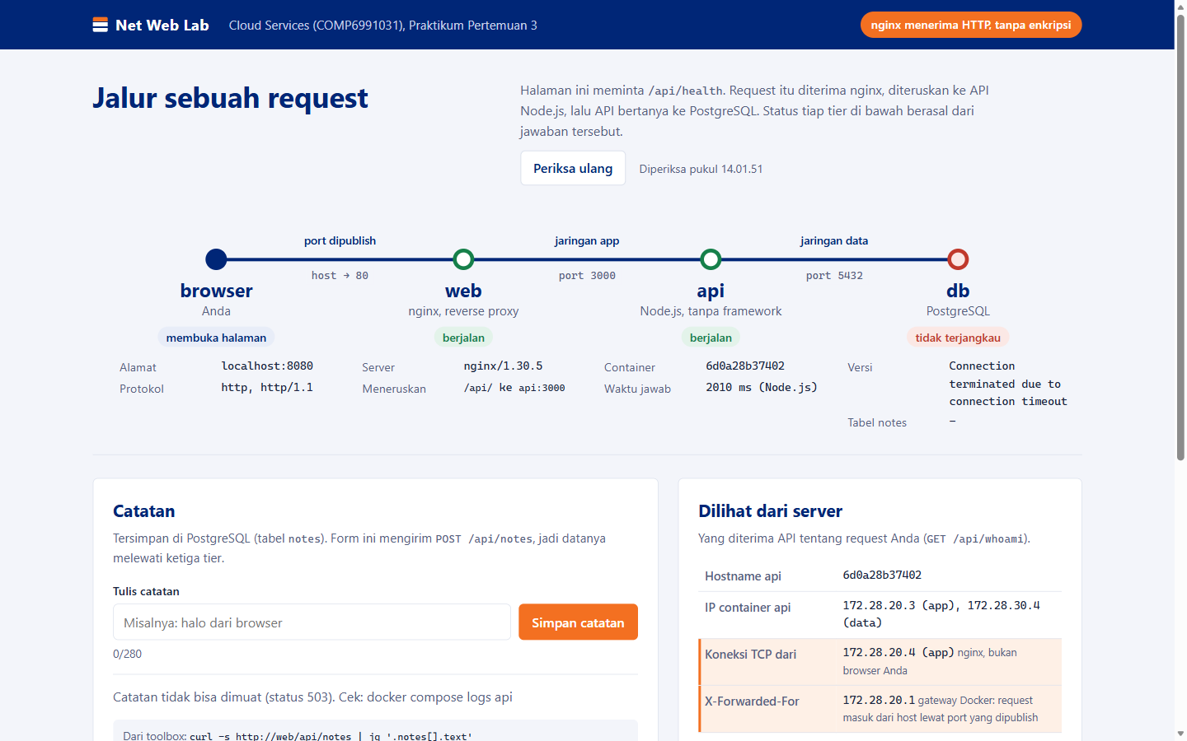
BINUS UNIVERSITY | Cloud Services | Pertemuan 3
HTTP 503 memerlukan diagnosis per lapisan
Kasus kerja: halaman terbuka, namun data gagal dimuat saat database terputus.
LAB 03
1. DNS menemukan alamat service. TCP menghubungkan host dan port. HTTP menyatakan hasil request.
2. TLS melindungi koneksi sebelum HTTP dikirim. Reverse proxy meneruskan request ke API.
3. Di Lab 03, dig, curl, nc, dan openssl menunjukkan lapisan yang berhasil atau gagal.
Perintah pertama yang akan dicoba
curl -i http://web/api/health
Lab 03: web dan API hidup, tetapi database tidak terjangkau sehingga catatan memberi 503.
COMP6991031 | Cloud Services
37
Notes:
Gunakan kasus 503 pada screenshot untuk menelusuri urutan DNS → IP → TCP/port → TLS bila HTTPS → HTTP → reverse proxy → API → database. Perhatikan 503 dapat berasal dari API saat database gagal; jangan menyimpulkan dari satu status saja. Di praktik pakai dig/nslookup, nc/nmap hanya pada target lab, curl/wget, dan openssl. Sumber Cloudflare DNS dan curl dibuka 8 Oktober 2026. Penjelasan TLS: https://www.cloudflare.com/learning/ssl/how-does-ssl-work/ ; video TLS tambahan: https://developers.cloudflare.com/videos/strict-ssl-concepts/ .
Screenshot: D:\cloud services\P3\screenshots\lab-db-mati-503.png
Repo: https://github.com/SeedFlora/meet3CloudService

Slide 38
BINUS UNIVERSITY | Cloud Services | Pertemuan 3
Sebelum Lab 03: telusuri satu request
Jika halaman tampil tetapi data 503, lapisan mana yang perlu diperiksa dulu?
TONTON
COBA 5 MENIT
Cloudflare: The Online Address Book (video DNS)
docker compose up -d --build --wait
docker compose exec toolbox bash
dig web; curl -i http://web/api/health
Catat kapan nama host menjadi alamat IP; uji hasilnya dengan dig dan curl.
BACA
Cloudflare: What is DNS? (artikel)
Nyalakan stack; dari toolbox cek DNS, HTTP, port, dan sertifikat TLS.
curl: HTTP scripting dan inspeksi respons
Cloudflare: cara kerja TLS/SSL
MODUL DAN KODE LAB
github.com/SeedFlora/meet3CloudService
COMP6991031 | Cloud Services
38
Notes:
Gunakan kasus 503 pada screenshot untuk menelusuri urutan DNS → IP → TCP/port → TLS bila HTTPS → HTTP → reverse proxy → API → database. Perhatikan 503 dapat berasal dari API saat database gagal; jangan menyimpulkan dari satu status saja. Di praktik pakai dig/nslookup, nc/nmap hanya pada target lab, curl/wget, dan openssl. Sumber Cloudflare DNS dan curl dibuka 8 Oktober 2026. Penjelasan TLS: https://www.cloudflare.com/learning/ssl/how-does-ssl-work/ ; video TLS tambahan: https://developers.cloudflare.com/videos/strict-ssl-concepts/ .
Video: https://developers.cloudflare.com/videos/the-online-address-book/
Artikel: https://developers.cloudflare.com/learning-paths/cybersafe/concepts/what-is-dns/
Rujukan tambahan: https://curl.se/docs/httpscripting.html
Rilis terkini: https://www.cloudflare.com/learning/ssl/how-does-ssl-work/
Repo lab: https://github.com/SeedFlora/meet3CloudService

