Slide 1

Mobile communication system
3G
Mariam Elseedawy 201901281
Mariam Tawfik 201900720
Rodina Kamal 201900642

Slide 2
TABLE OF CONTENTS
What is 3G?
QPSK
Basic parameters
Labview and USRP
MATLAB Results
Resources
01
02
03
04
05
06

Slide 3
What is 3G?
01

Slide 4
Third generation mobile communication technology, referred to as 3G refers to the cellular network mobile phone technology that supports high-speed data transmission.
3G service can simultaneously transmit voice (call) and information (email, instant communication, etc.).
The representative feature of 3G is to provide high-speed data.
It is mainly built by QPSK.

Slide 5
QPSK
02

Slide 6
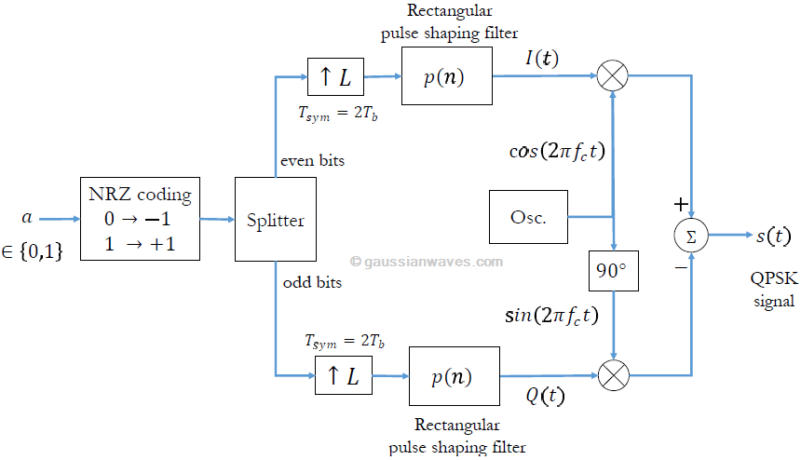
Modulation

Slide 7
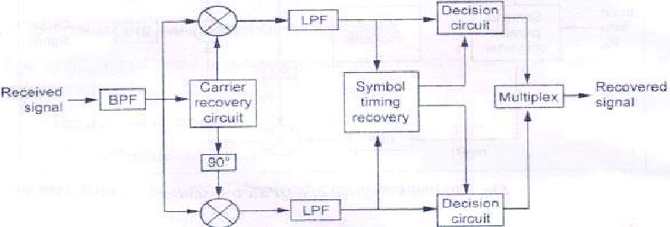
Demodulation

Slide 8
Basic parameters
03

Slide 9
Pulse shape of base-band pulse : The transmit pulse-shaping filter is a root-raised cosine (RRC) with roll-off α =0.22
Bit rate: up to 2 M bit/s
Channel BW: 5 MHz
Frequency band:
1920- 1980 MHz (uplink)
2110-2170 MHz (downlink)

Slide 10
Labview and USRP
04

Slide 11
Labview part
b.

Slide 12
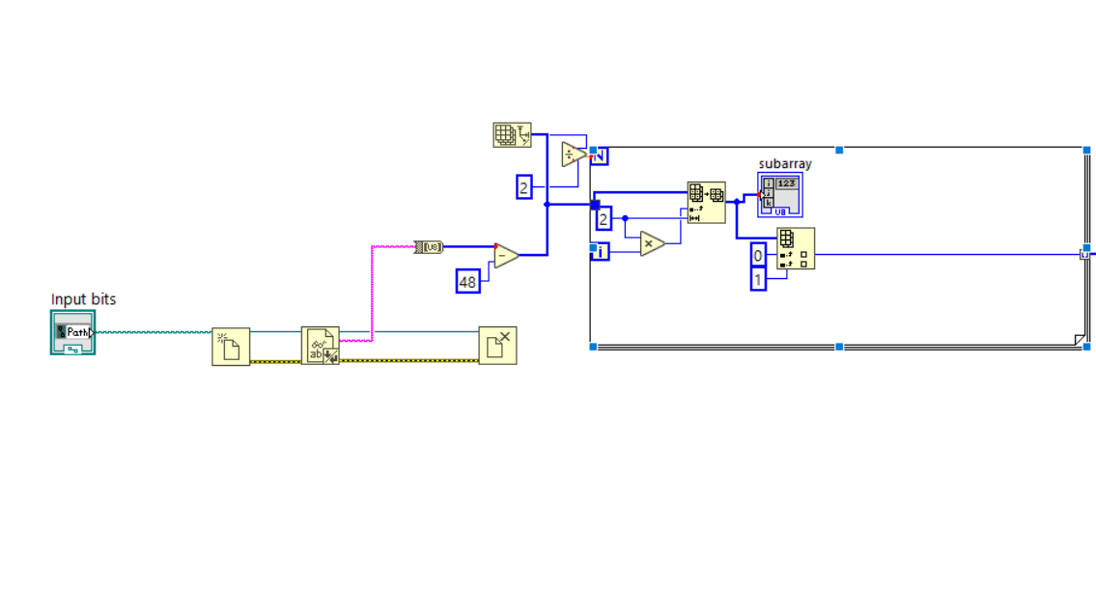
Reading Image:

Slide 13
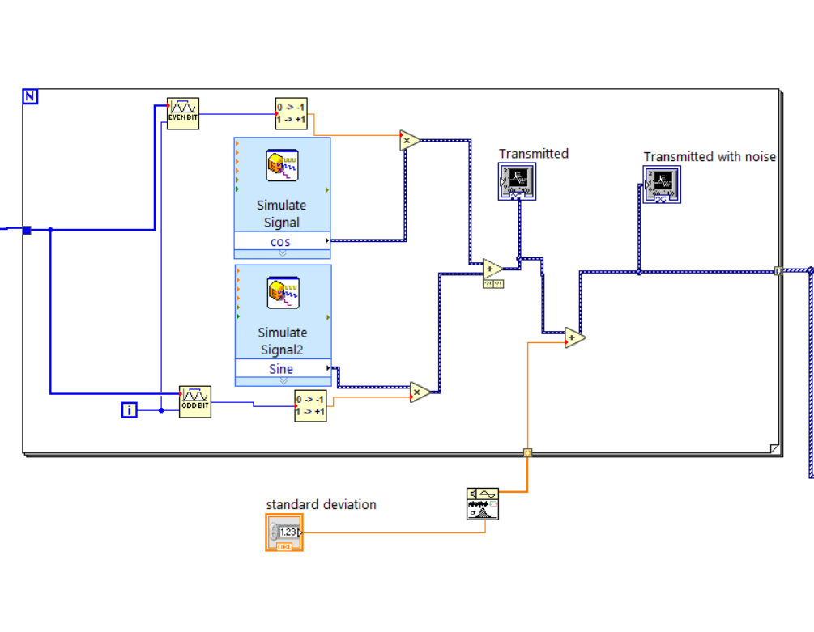
Modulation:

Slide 14
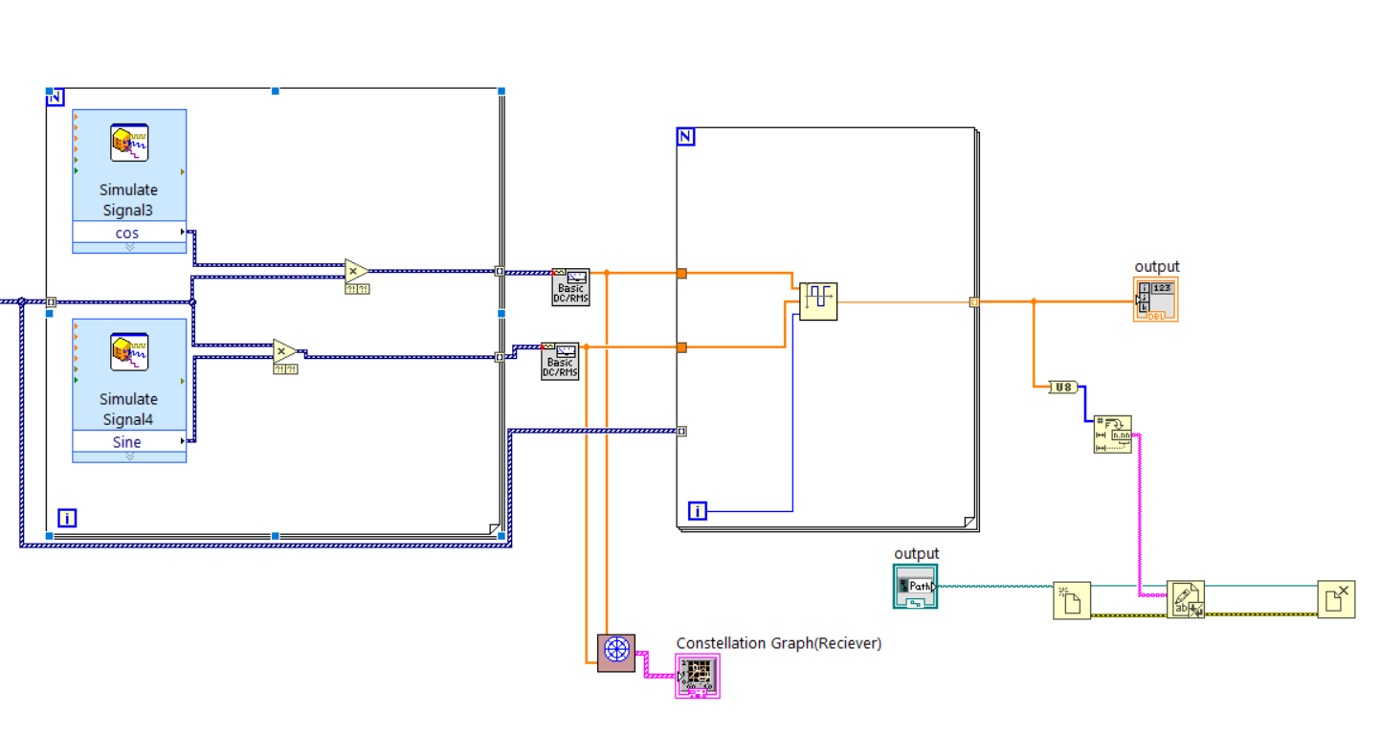
Demodulation and writing in file:

Slide 15
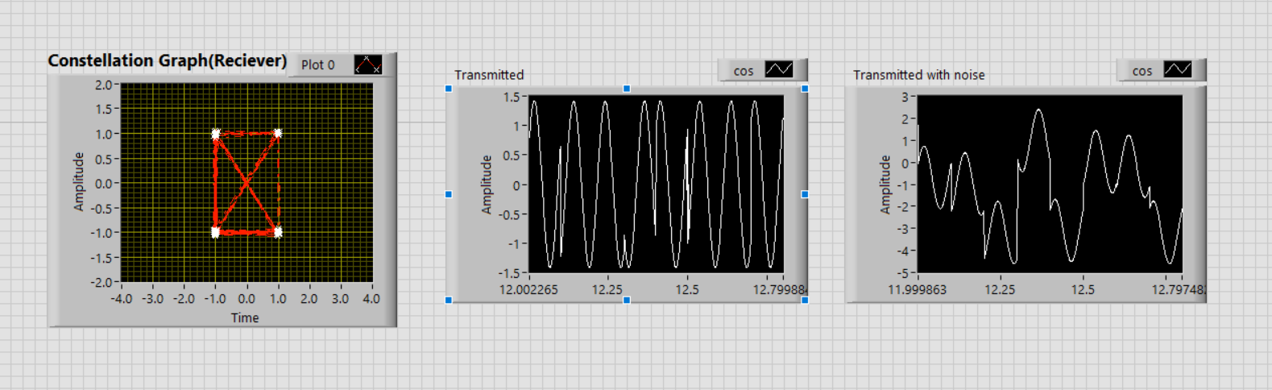
Results

Slide 16
USRP part
b.

Slide 17
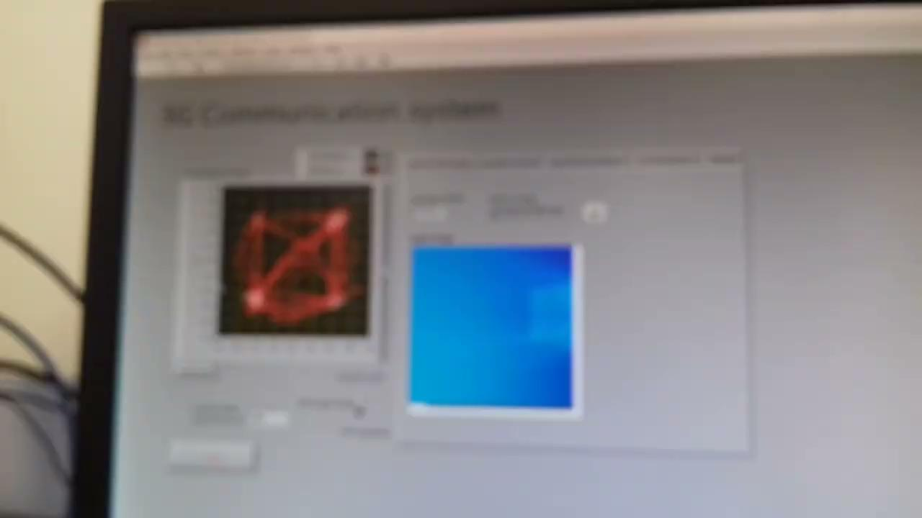
Video

Slide 18
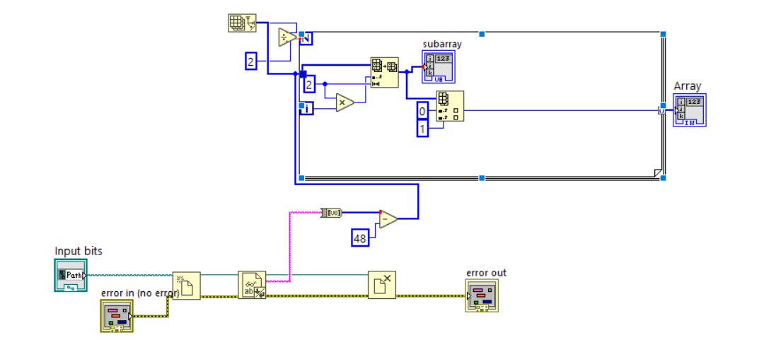
Our Source:

Slide 19
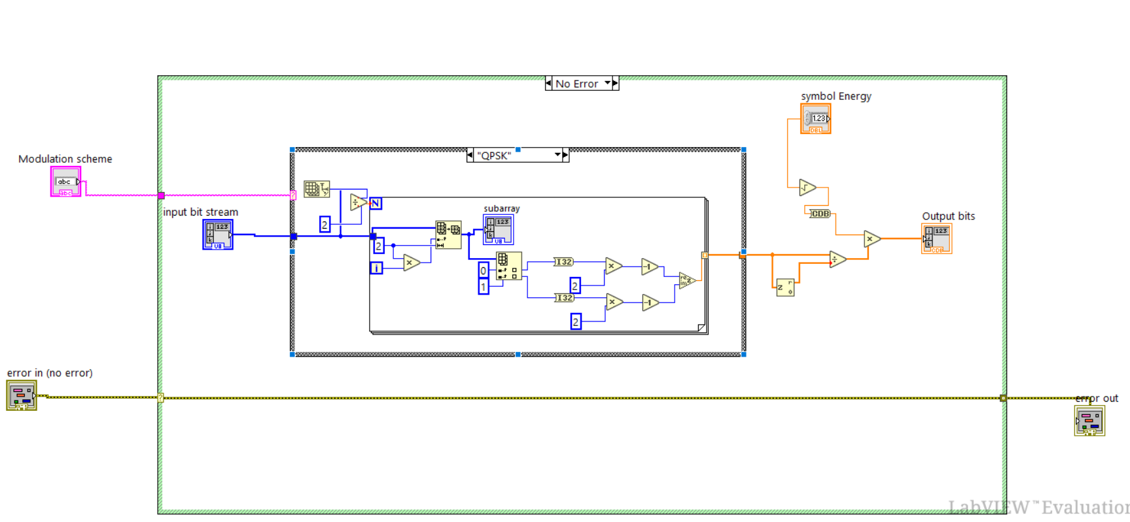
Modulation:

Slide 20
MATLAB Results
05

Slide 21
Let’s see them in MATLAB!

Slide 22
RESOURCES
06
https://www.techtarget.com/searchnetworking/definition/3G-third-generation-of-mobile-telephony
https://hutch.lk/difference-2g-3g/
http://www.emagtech.com/wiki/index.php/System-Level_Tutorial_Lesson_3:_Analyzing_a_Communications_System_Using_Virtual_Blocks
https://www.google.com/url?sa=i&url=https%3A%2F%2Fwww.researchgate.net%2Ffigure%2FBlock-diagram-showing-steps-of-JPEG-image-compression-and-decompression_fig1_275641616&psig=AOvVaw3YlJJWwVvQkw1NalyQvhYK&ust=1673103187646000&source=images&cd=vfe&ved=0CBEQjhxqFwoTCNierZuZs_wCFQAAAAAdAAAAABAE

Slide 23
Thank you!

