Slide 1
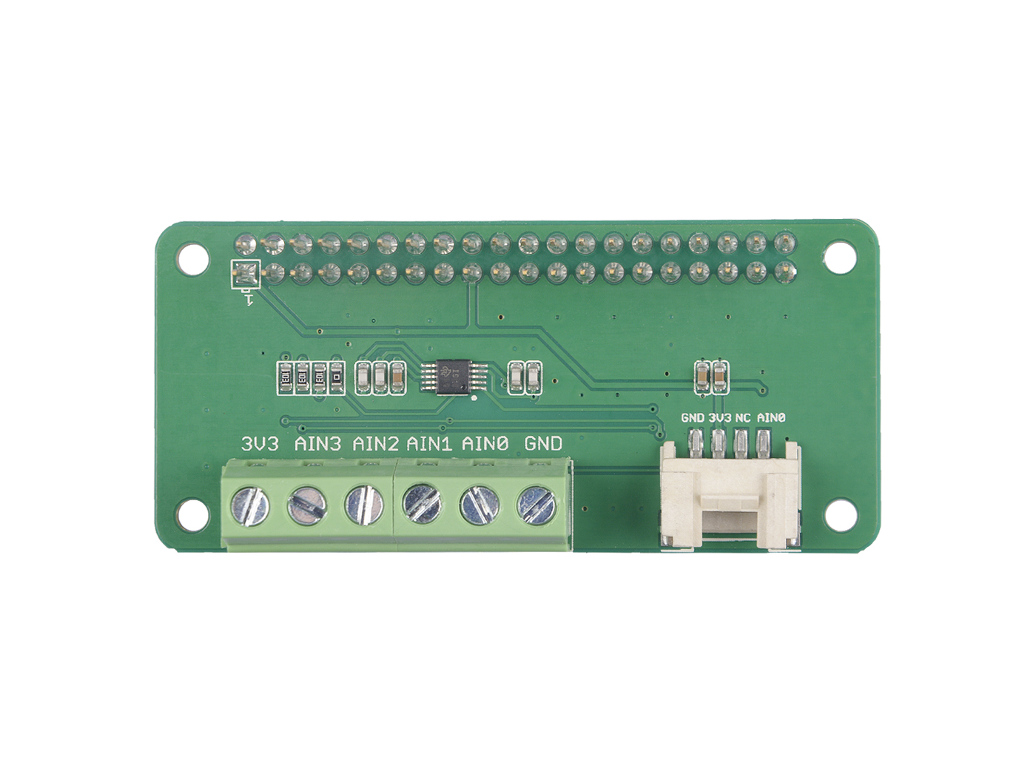










GND: Power pin, GND output
3V3: Power output, out put 3.3V
NC: Not connected
AIN0: Analog pin 0
GND: the same as pin 4.
AIN0: Analog pin 0
AIN1: Analog pin 1
AIN2: Analog pin 2
AIN3: Analog pin 3
3V3: Power output, out put 3.3V

Slide 2
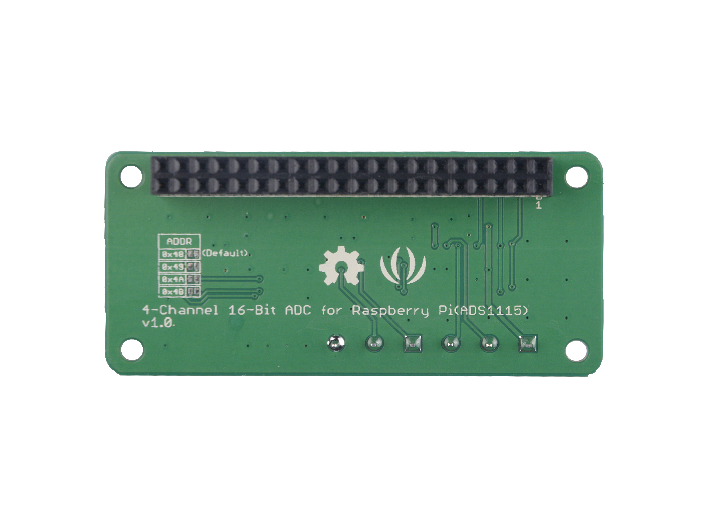
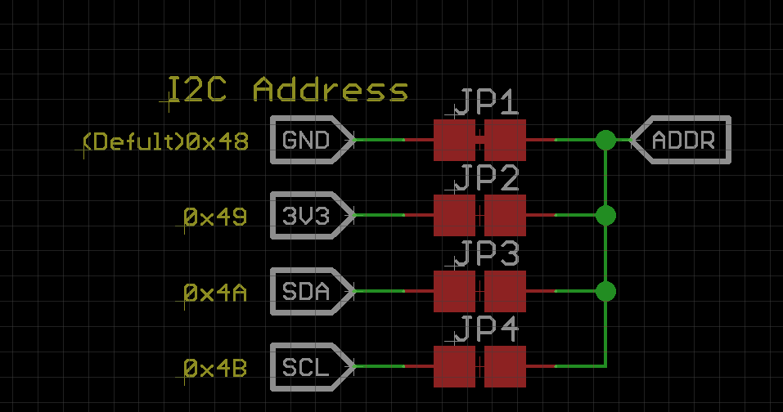
Default
0x48
0x49
0x4A
0x4B

