Slide 1
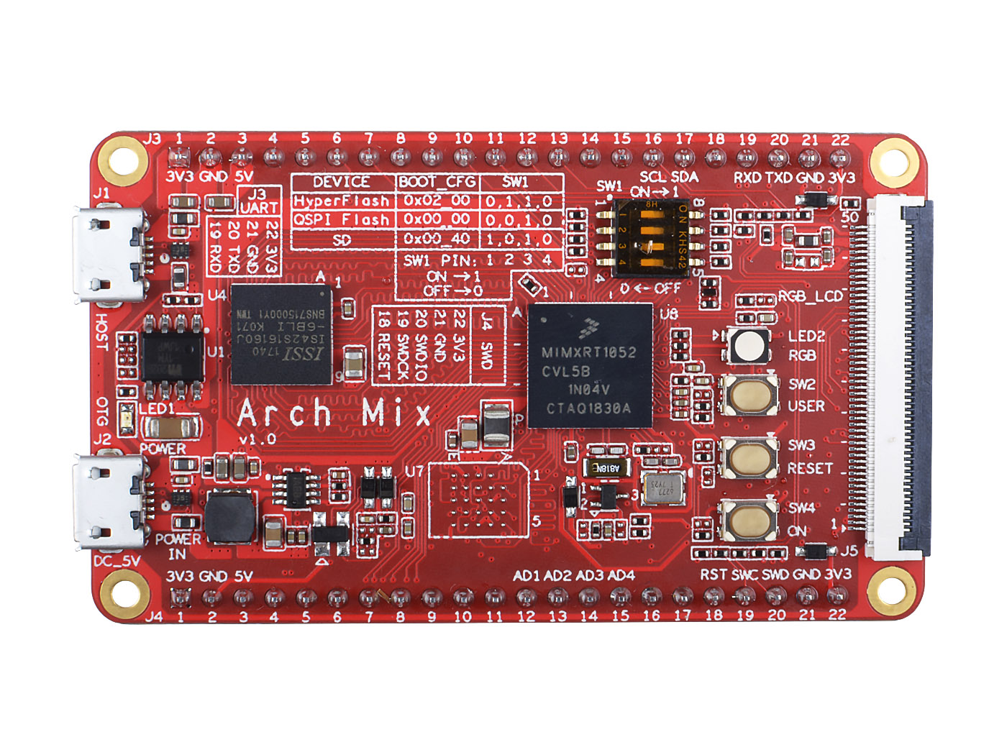
3
6
11
1
7
0
8
9
2
4
5
10
0- LED1, Power LED
1- J1, USB Host*⁰
2- J2, USB OTG and DC Power In*⁰
3- U4, 32MB SDRAM
4- U7, 64MB HyperFlash*¹
5- U8, CPU RT1052
6- SW1, Boot Configuration DIP Swith
7- LED2, RGB
8- SW2, User Button
9- SW3, Reset Button
10- SW4, Power ON/OFF Button*²
11- J5, RGB LCD Interface

Slide 2
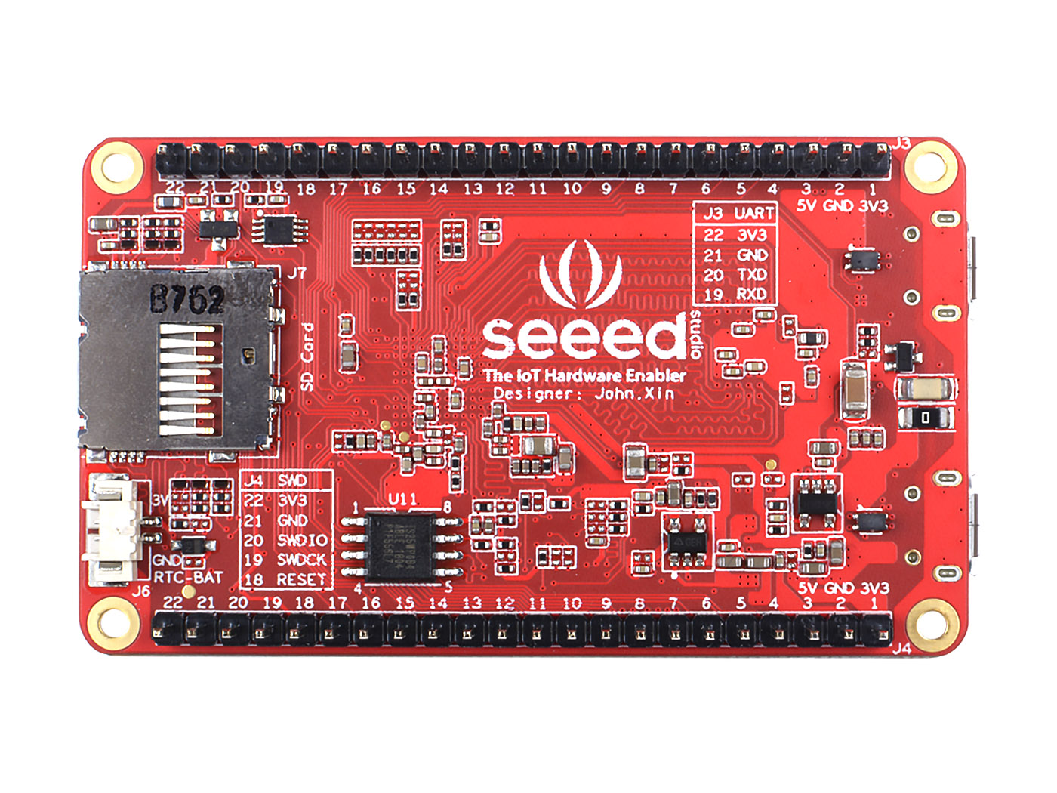
12
13
14
15
12
12- J3 J4 , 1x22Pin Expansion PIN Header
13- J7, Micro SD Card
14- J6, RTC CR2032 BAT Connector*³
15- U11, 8MB QSPI Flash*¹

