Slide 1
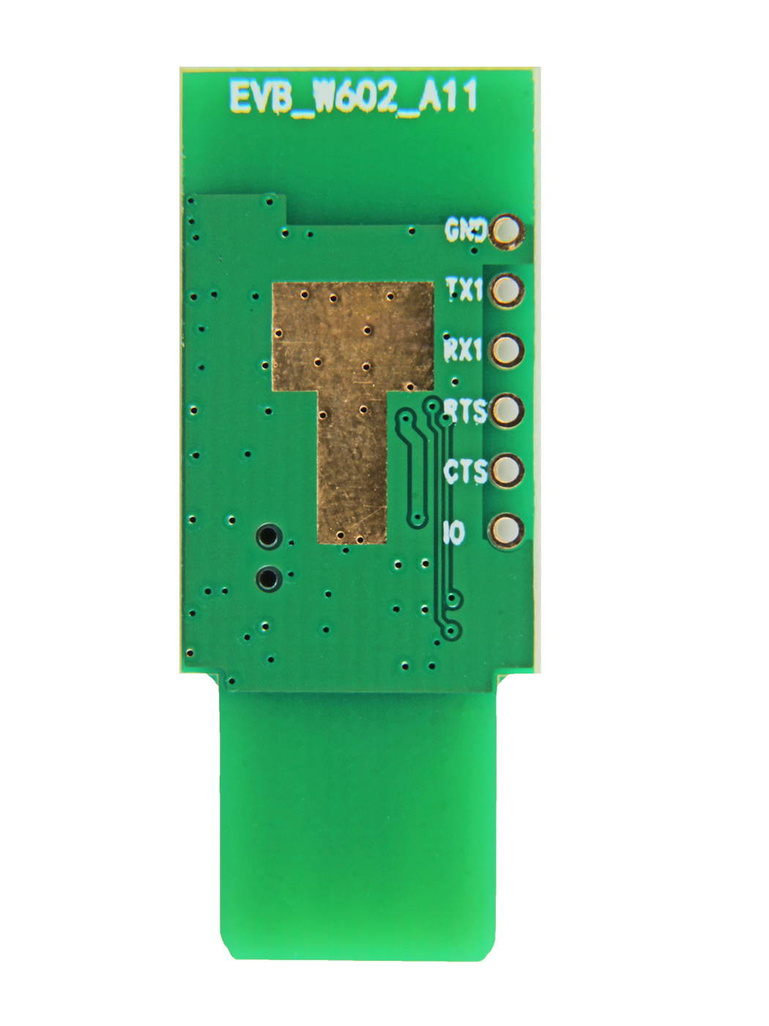






GND: the system GND
TX1: UART1_TX | also can work as SPI, H_SPI_DO
RX1: UART1_RX | also can work as SPI, H_SPI_DI
RTS: UART1_RTS | also can work as SPI, H_SPI_CSCTS
CTS: UART1_CTS | also can work as SPI, H_SPI_INT
IO: GPIO PB_8 | also can work as SPI, H_SPI_CK

