Slide 1
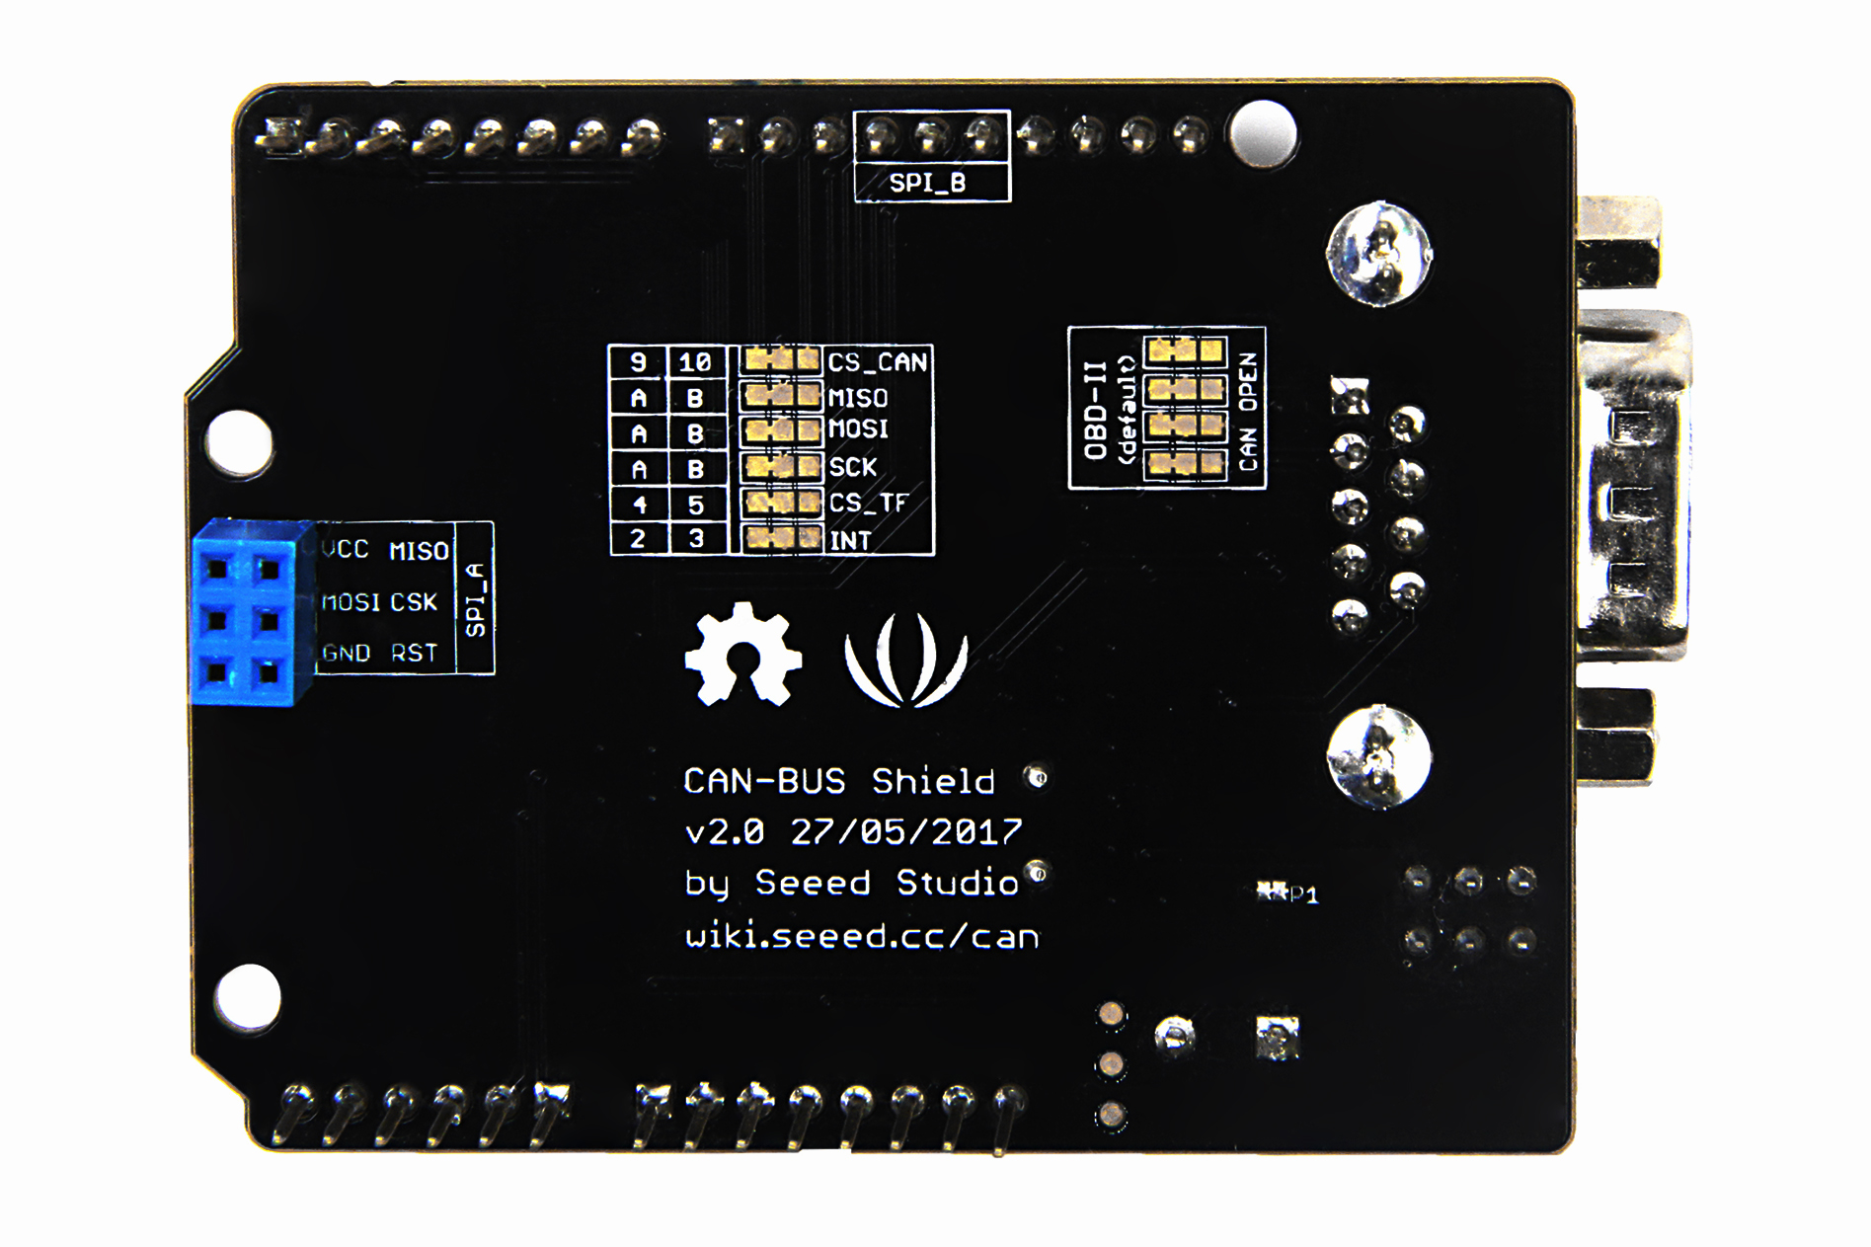
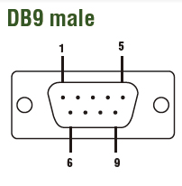
OBD–II by Default
Signal | DB9
GND | PIN2
CAN_H | PIN3
CAN_L | PIN5
GND | PIN1
OBD–II Right PAD
Signal | DB9
GND | PIN3
CAN_H | PIN7
CAN_L | PIN2
GND | PIN1

