Slide 1
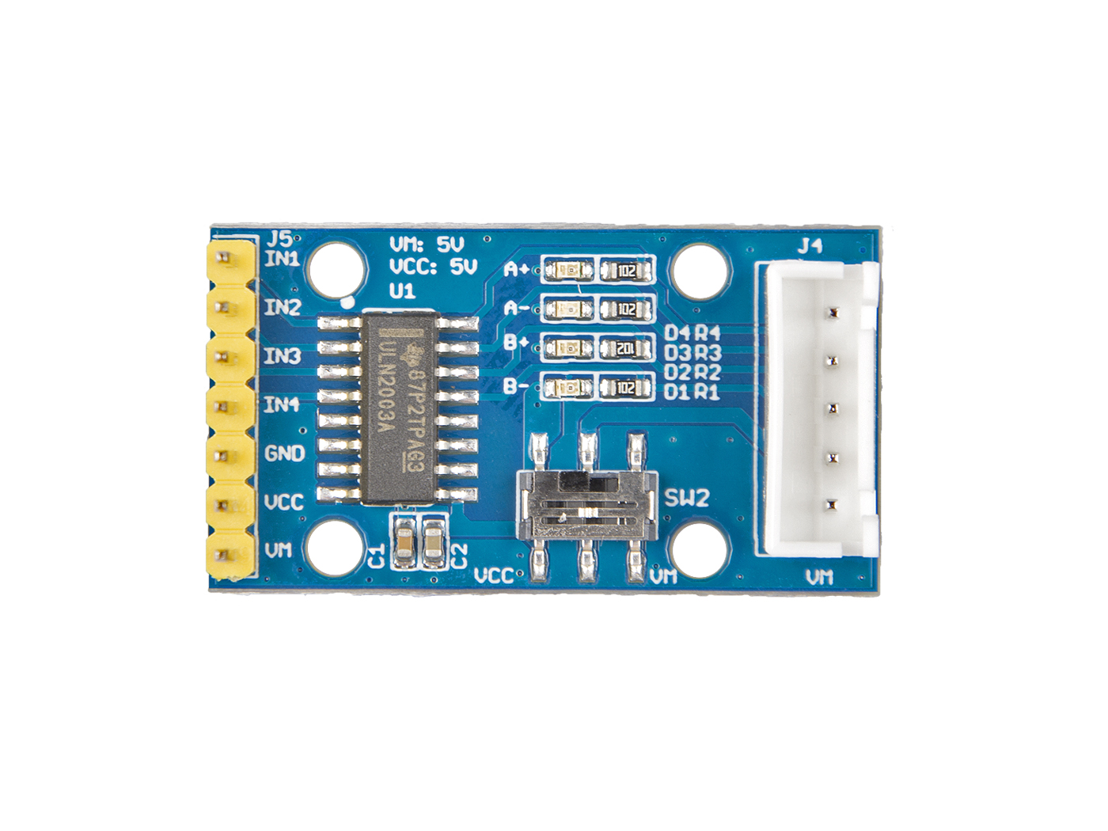







A
B
C
D
E
Motor Power Switch
IN1: input 1 connect to phrase 1
IN2: input 2 connect to phrase 2
IN3: input 3 connect to phrase 3
IN4: input 4 connect to phrase 4
GND: connect this module to the system GND
VCC: we use 5v for this module
VM: optional power for Motor
A
connect D4 to Blue coil
connect D3 to Pink coil
connect D2 to Yellow coil
connect D1 to Orange coil
Connect Power switch pin to Red coil
B
C
D
E

Slide 2

Blue
Yellow
Red
Orange
Pink

