Slide 1
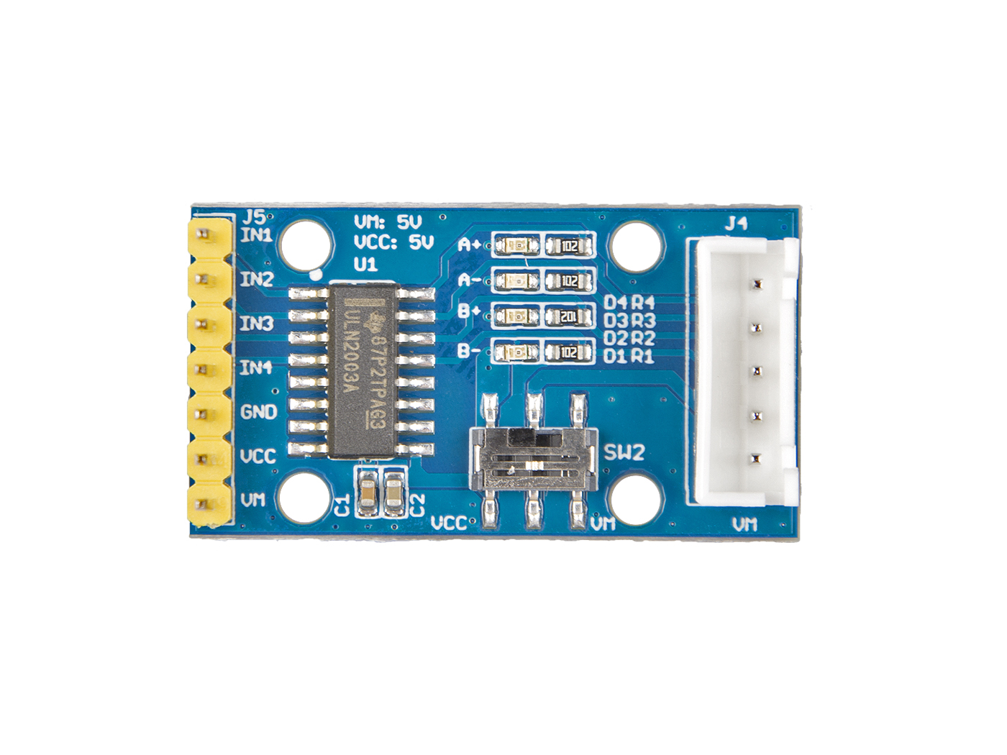







A
B
C
D
E
INT1: connect this module to the system GND
INT2: you can use 5V or 3.3V for this module
INT3: I²C serial data
INT4: I²C serial clock
GND: connect this module to the system GND
VCC: we use 5v for this module
VM: select power for Motor
A
B
C
D
E

