Slide 1
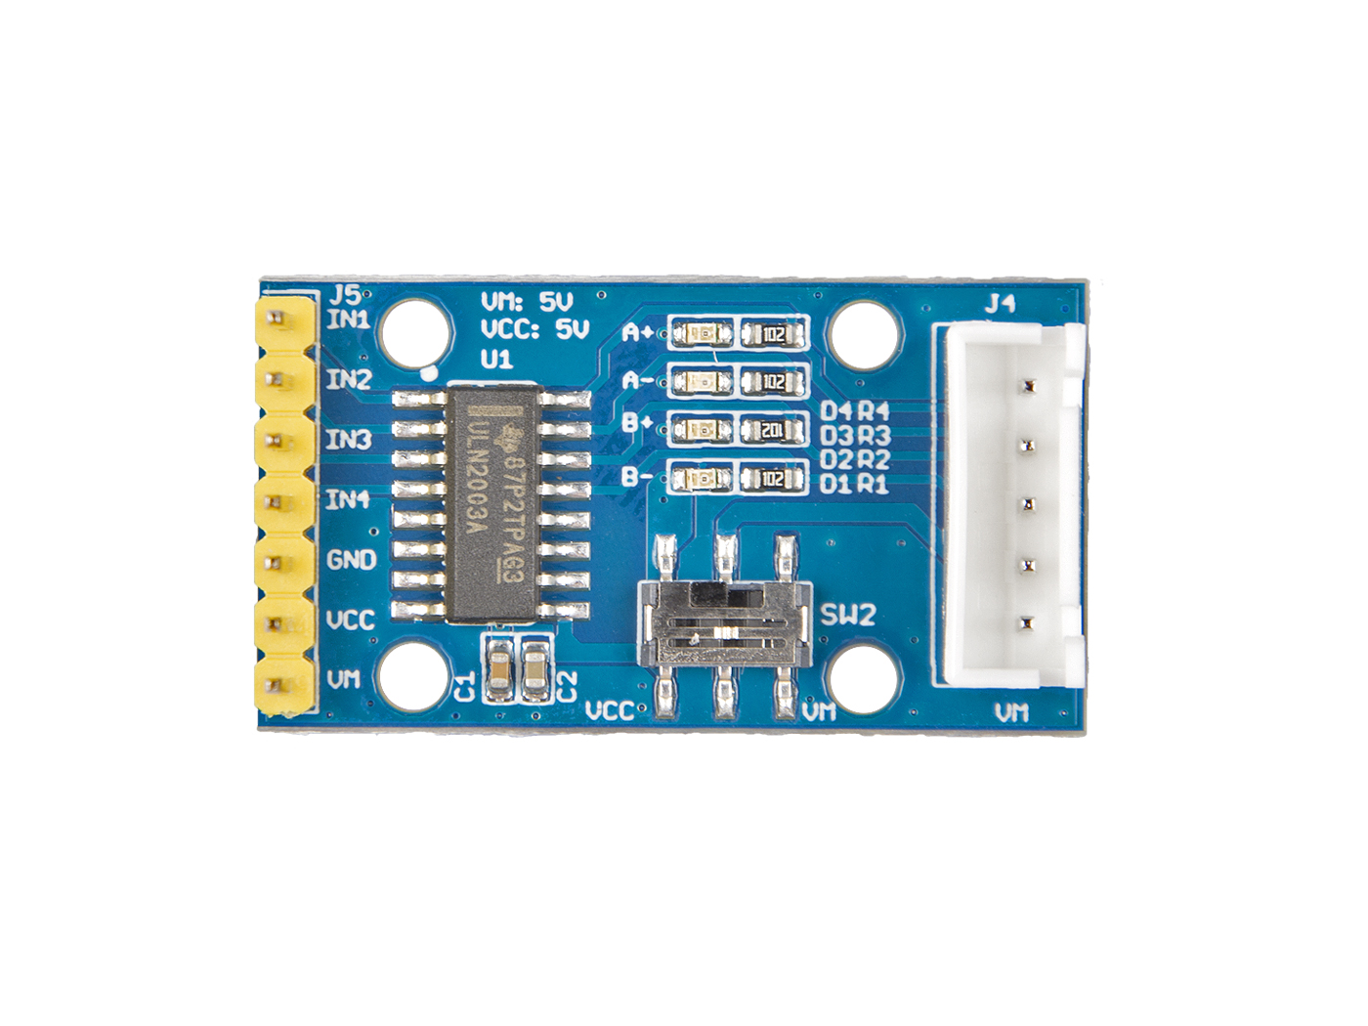







A
B
C
D
E
Motor Power Switch
INT1: connect to phrase 1
INT2: connect to phrase 2
INT3: connect to phrase 3
INT4: connect to phrase 4
GND: connect this module to the system GND
VCC: we use 5v for this module
VM: optional power for Motor
A
connect to Blue coil
connect to Pink coil
connect to Yellow coil
connect to Orange coil
Connect to Red coil
B
C
D
E

